Slide 1

Welcome!
Learning React
by creating an App!

Slide 2
Helpful But not Required
Prior Knowledge of:
HTML
JavaScript
ECMAScript 6 or 2015

Slide 3
What is React?
It is a JavaScript library for building user interfaces, from simple to complex, just by using isolated pieces called components.
In technical terms such as MVC – Model-View-Controller, React is the View.
Analogy – A house, React is the yard, paint, couches, beds, TVs, decorations, etc.

Slide 4
Why use React?
Easier builds with complex user interfaces.
Uses the fast Virtual DOM (Document Object Model).
Reusable components/parts.
Supported by a large community and Facebook.
Other: JSX, React Native, Redux.

Slide 5
Documentation from W3.org
The Document Object Model (DOM) is a programming API for HTML and XML documents. It defines the logical structure of documents and the way a document is accessed and manipulated. In the DOM specification, the term "document" is used in the broad sense - increasingly, XML is being used as a way of representing many different kinds of information that may be stored in diverse systems, and much of this would traditionally be seen as data rather than as documents. Nevertheless, XML presents this data as documents, and the DOM may be used to manage this data.

Slide 6
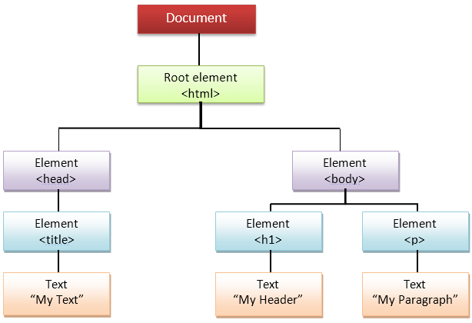
Document Object Model – aka: “the Dom”
Image from guru99.com showing the DOM.

Slide 7
Build Time
Let make an application!

Slide 8
Set Up Environment
Go into command line or CLI.
Check for which version of NodeJS, type: node --version
Type: “npm install -g update node” or download: https://nodejs.org/en/
Now to add React, type: “npm install –g create-react-app”
Next, type: create-react-app my-app
Finally, type: react start my-app

