Slide 1
🧬
Protein Function Rescue
Structure-based rediscovery of hypothetical proteins from the AlphaFold Database
A transparent, laptop-scale pipeline — no GPU, no HPC, fully reproducible
[Student Name] · Methods / proof-of-concept
Notes:
Protein Function Rescue: a laptop-scale, transparent pipeline that turns AlphaFold structures into ranked, evidence-linked functional hypotheses for proteins that sequence methods leave unannotated.

Slide 2
The dark proteome
A quarter to a half of every proteome has no assigned function
●
"Hypothetical", "uncharacterized", DUF Sequence matched nothing known — no function assigned.
200M+
25–50%
●
Sequence homology fails first Below ~20–25% identity, function transfer by sequence breaks down.
predicted structures in the AlphaFold DB
of a typical proteome is unannotated
●
These proteins matter Enzymes, transporters, and untapped drug/vaccine targets in pathogens.
Notes:
The gap between known sequences and known functions keeps widening. AlphaFold gives us 200M+ structures to attack it with.

Slide 3
Structure outlives sequence
The biological basis for the whole approach
Structure is empirically 3–10× more conserved than sequence.
So a protein can be a near-perfect
3D match to a well-studied enzyme while looking like noise at the sequence level. Comparing shape, not sequence, recovers those hidden relationships.
3–10×
structure conserved longer than sequence
(Illergård et al., 2009)
Notes:
This is the entire biological motivation: fold outlasts sequence, so structural search reaches into the sequence 'twilight zone'.

Slide 4
Why this pipeline exists
The novelty is accessibility, transparency, and reproducibility
Published structure-based annotation workflows typically depend on:
High-performance computing
GPUs
Large pre-indexed databases
Complex software environments
Our question: Can a transparent, dependency-light workflow achieve meaningful annotation performance on commodity hardware while remaining fully reproducible?
Interpretable — unlike learned predictors (DeepFRI)
Accessible — unlike speed-first search (Foldseek)
Notes:
Existing work proves structure-based annotation works, but on heavy infrastructure. We ask whether it can be done transparently on a laptop — complementary to DeepFRI (interpretable) and Foldseek (accessible).

Slide 5
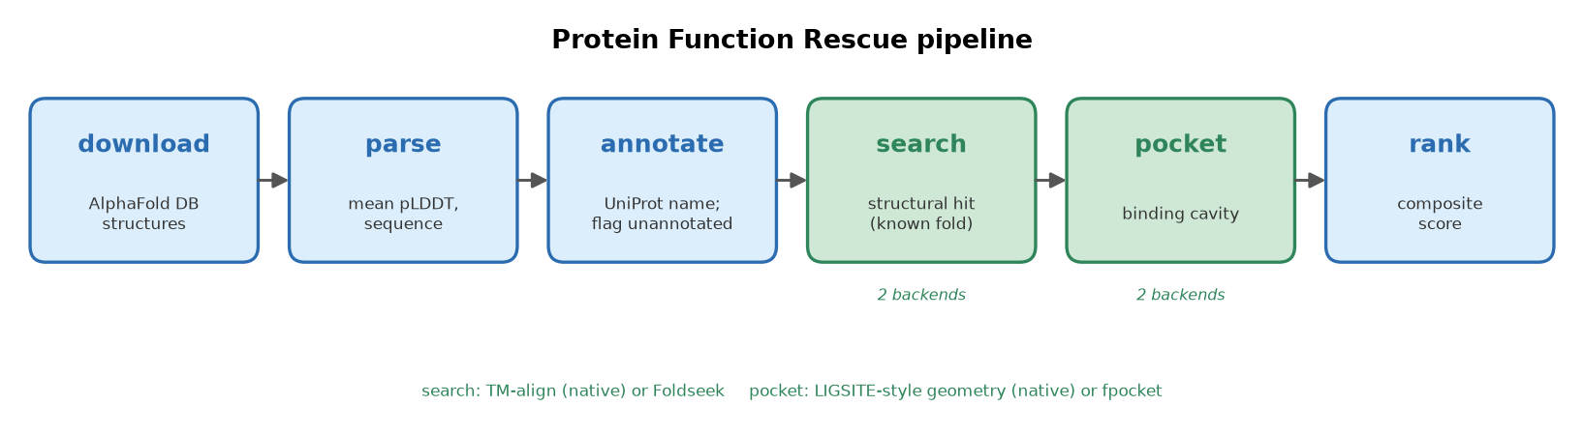
The pipeline
Six cached stages — consumes AlphaFold DB, no GPU, no compiled binaries
download → parse → annotate → search → pocket → rank. Each stage caches to disk and is independently re-runnable.
Notes:
The pipeline consumes pre-computed AlphaFold models. The two compute-heavy stages — search and pocket — have native, dependency-free implementations.

Slide 6
Two interchangeable backends
The same workflow runs on a laptop — or scales on a Linux server
Stage
Native (default, any OS)
High-performance (Linux/macOS)
search
TM-align (tmtools, pure Python)
Foldseek
pocket
LIGSITE-style geometry (NumPy/SciPy)
fpocket
Switch with one line in config.yaml. TM-align is the gold-standard aligner that defines the TM-score Foldseek reports.
Notes:
Native backends need no external binaries. Foldseek/fpocket are optional for speed and scale.

Slide 7
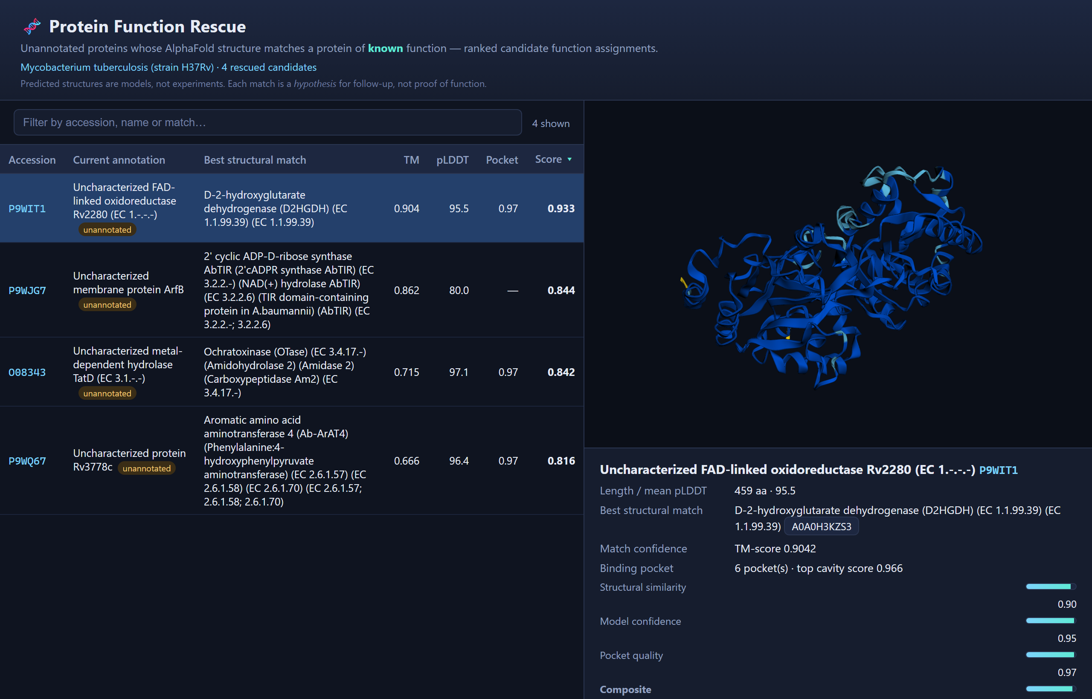
Pilot: Mycobacterium tuberculosis
Ranked candidates, each explorable in 3D
Top hit — P9WIT1 "Uncharacterized FAD-linked oxidoreductase" matches D-2-hydroxyglutarate dehydrogenase at TM-score 0.90 — both are oxidoreductases (EC 1.x).
Notes:
The viewer colours each structure by pLDDT confidence and links every candidate to its structural match, pocket, and per-component scores.

Slide 8
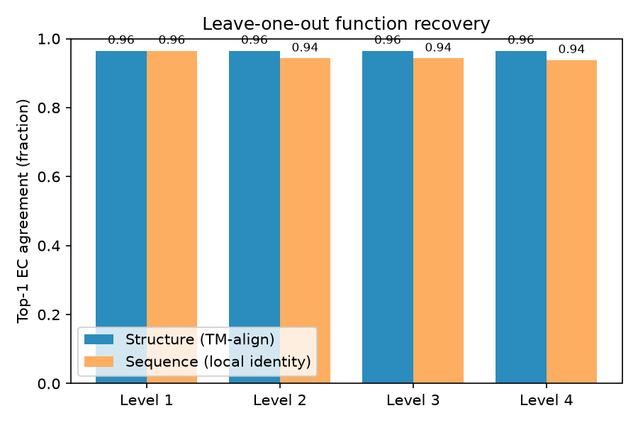
Does it get the right answer?
Leave-one-out benchmark: 227 enzymes, 29 families, 6 classes
96.5%
93.8%
exact-EC recovery (structure)
sequence-identity baseline
Structure ties at the class level and is better at pinpointing the exact reaction. We claim complementarity, not dominance.
Notes:
Structure recovers the exact 4-level EC number for 96.5% vs a pairwise sequence baseline at 93.8% (tied at class level).

Slide 9
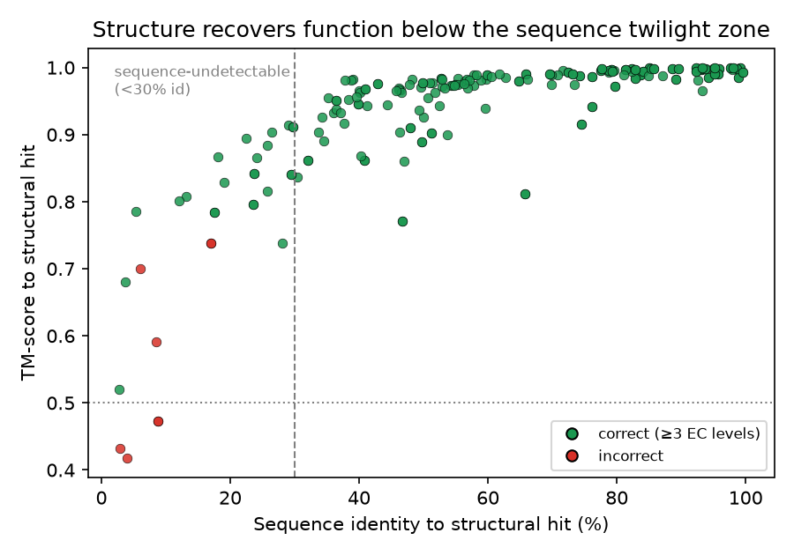
Where structure wins
Recovering function in the sequence "twilight zone"
24 / 219
correct recoveries below 30% identity
2.8%
identity — a lipase, still recovered correctly
5 vs 0
cases where structure beat sequence (never the reverse)
Notes:
Below 30% identity sequence homology is unreliable; structure still recovers correct function — including a lipase matched at under 3% identity.

Slide 10
Beyond fold: catalytic residues
Verifying the active site, not just the shape
For each match we superpose the candidate onto its reference and check whether the reference's annotated catalytic, metal- and ligand-binding residues are structurally conserved.
O08343 — strong support matched to a Zn amidohydrolase 8 / 8 functional residues position-conserved Zn-His111, Zn-His113, catalytic Asp378
conserved in identity
P9WJG7 — self-flagged a 50-residue protein 0 / 6 functional residues conserved reference active-site residues 36–55 Å away
after superposition
The method down-weights its own weak call.
Notes:
Residue-level verification strengthens confident assignments (conserved zinc-binding histidines) and automatically flags spurious ones.

Slide 11
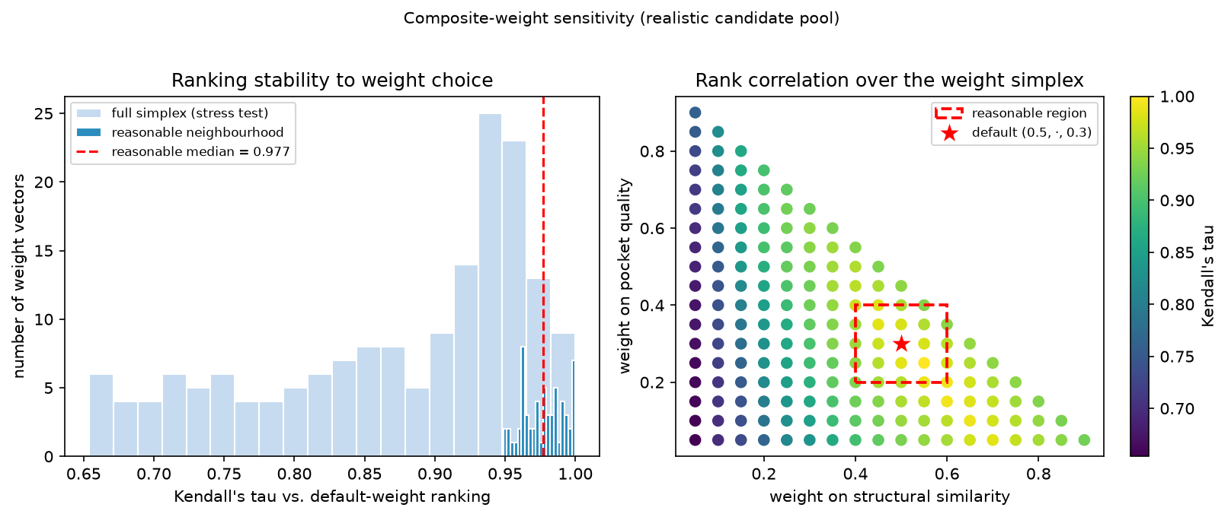
Robust and calibrated
The ranking does not hinge on the score weights
Kendall τ ≈ 0.98 across all reasonable weightings (top-10 unchanged) Precision 0.982 at the default TM ≥ 0.5 cutoff
(1.00 at TM ≥ 0.75)
Weights tune emphasis, not outcome — and the confidence threshold keeps precision high while abstaining on ambiguous folds.
Notes:
Across the reasonable weight neighbourhood the ranking is essentially unchanged (median Kendall tau 0.98); precision at the default threshold is 0.982.

Slide 12
Using it yourself
Three commands on a laptop — no GPU, no admin rights
1
Install
python -m pip install -r requirements.txt
2
Run the pipeline
python -m pipeline.run all
3
Explore results
open web/index.html (double-click)
Swap organism: edit the organism block in config.yaml · Faster/at scale: set backend: foldseek / fpocket
Notes:
Install deps, run one command, open the viewer. Organism and backends are single config edits.

Slide 13
Honest limitations
What the method does — and does not — show
▸
Predictions are hypotheses — Structural matches suggest function; they are not experimental proof. None validated in the wet lab.
▸
Curated benchmark — 227 well-behaved enzymes — an optimistic estimate vs. the messier real dark proteome.
▸
EC-recovery is a proxy — Captures enzyme function, not non-enzymatic roles, multi-domain or moonlighting proteins.
▸
Simple sequence baseline — Compared to pairwise identity, not profile/HMM search — a stronger baseline would narrow the gap.
Notes:
The framing is deliberately careful: hypotheses not proof, curated benchmark, EC proxy, simple baseline.

Slide 14
A credible, accessible tool
Structure-based function annotation — transparent, validated, and reproducible on a laptop.
96.5%
227
0.982
0
exact-EC recovery
enzymes benchmarked
precision at TM ≥ 0.5
GPUs / HPC required
Interpretable, complementary to DeepFRI and Foldseek — every assignment traceable to a structural match and conserved catalytic residues.
Notes:
Takeaway: meaningful, interpretable, validated structure-based annotation on commodity hardware.

