Slide 1
The Pagerank citation ranking: Bringing order to the web
Page, Lawrence and Brin, Sergey and Motwani, Rajeev and Winograd, Terry (1999)

Slide 2
What’s PageRank?
PageRank is a link analysis algorithm which assigns numerical value to each element of a set, with the purpose of measuring their relative importance within the set (WWW).
Notes:
Put it simple: It’s a algorithm that calculate the relative importance of each webpage.

Slide 3
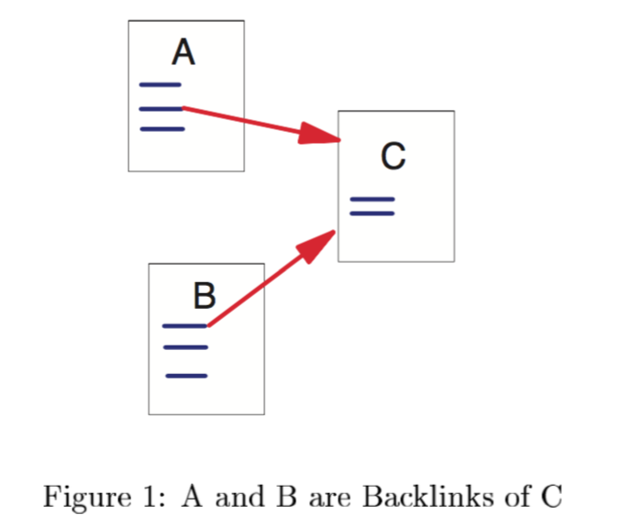
Link Structure of WWW
In 1999, the graph of www has about 150 million nodes (pages) and 1.7 billion edges (links)
Every page has some number of forward links (outedges) and backlinks (inedges)
Given a webpage, we may not know all its backlinks, but we can immediately find out its forward links.

Slide 4
Some Definition
Let u be a web page, define the following:
F_{u} be the set of all pages u points to.
B_{u} be the set of all pages that point to u.
N_{u} be the cardinality of F_{u} or equivalently N_{u} = |F_{u}|
Notes:
Cardinality of a set means the number of element in a set, or the size of the set.

Slide 5
Some Definition
In the right example,
F_{A} = {B, C}
B_{A} = {C}
N_{A} = 2
F_{C} = {A}
B_{C} = {A, B}
N_{C} = 1

Slide 6
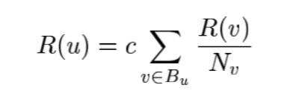
Simple Version of PageRank
We define the simple ranking R of a page u to be:
Note: this is a recursive definition. And c is just a factor to normalize the sum of all page rank
Notes:
To understand this definition, we first ignore the factor c. Then the ranking of a page u is a sum of many fractions.
These fractions come from the backward set of u. The ranking of a page u is dependent on the PageRank values for each page v in Bu divided by the
number of links from page v.

Slide 7
Simple Example
0.25
0.25
We first initialize ranking of all pages to be 0.25
In first iteration (c = 1):
R(A) = R(B) / 2 + R(C) / 1 +
R(D) / 3
= 0.125 + 0.25 + 0.083
= 0.458
A
D
B
C
0.25
0.25
Notes:
If the algorithm iterates to convergence, we can assign any value to the pages at the beginning.
But different choice of initialization results in different rate of convergence. For demonstration purpose,
we initialize them to be the same in the example.
We can also adjust the final sum of all page ranks by adjusting the factor c. In this case, we set the sum to
be 1, so what we finally get is a probability distribution.

Slide 8
Simple Example
0.25
0.458
0.25
0.25
Similarly:
R(B) = R(D) / 3 = 0.083
R(C) = R(B) /2 + R(D) / 3
= 0.125 + 0.083 = 0.208
R(D) = R(A) / 1 = 0.25
Note in the first iteration, we don’t use the new page rank to calculate.
A
D
B
C
0.25
0.083
0.25
0.208
Notes:
If the algorithm iterates to convergence, we can assign any value to the pages at the beginning.
But different choice of initialization results in different rate of convergence. For demonstration purpose,
we initialize them to be the same in the example.
We can also adjust the final sum of all page ranks by adjusting the factor c. In this case, we set the sum to
be 1, so what we finally get is a probability distribution.

Slide 9
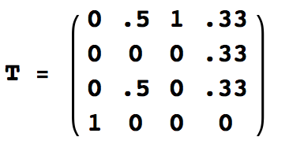
Simple Example
0.25
0.458
0.25
0.25
Another way to think:
Define Transition matrix:
where T_{ij} denotes the portion of rank flowing from page j to page i.
We can calculate new rank by:
R = cTR
where c is the normalize factor
A
D
B
C
0.25
0.083
0.25
0.208
Notes:
If the algorithm iterates to convergence, we can assign any value to the pages at the beginning.
But different choice of initialization results in different rate of convergence. For demonstration purpose,
we initialize them to be the same in the example.
We can also adjust the final sum of all page ranks by adjusting the factor c. In this case, we set the sum to
be 1, so what we finally get is a probability distribution.
Power Method.

Slide 10
Problem: Rank Sink
Consider several pages that form a loop and points to no other pages. Then the loop will accumulate the rank and never distribute any rank.
Call it rank sink
1
2
3

Slide 11
Solution: Rank Source
To overcome rank sink, introduce rank source, E(u). And formally define page rank R’ as
Where c is maximized and the sum of all rank is 1.

Slide 12
Rank Source
Rank source E: it’s a vector over the Web pages which is used to make up for rank sinks.
One can customize PageRank by choosing E.
For example, choose E to be uniform over all web page corresponds to a random surfer that may jump to random page.
Notes:
According to wiki.

Slide 13
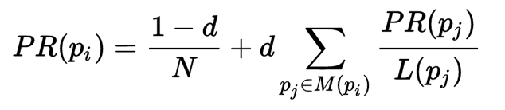
Damping Factor
Later version of PageRank algorithm use damping factor to avoid rank sink and adjust final sum. The formula is:
Where N is the total number of pages, d is the damping factor, a number between 0 and 1, L is the number of forward links in page p_{j}
Notes:
According to wiki.
The sum of all PageRank will also be 1 in this case.

Slide 14
Damping Factor – Random Surfer
PageRank is considered as a model of Random Surfer.
With probability d, the surfer may choose a random link from the current page to go to.
In addition, the surfer gets bored sometimes and jumps to a random page with probability 1 – d.
Notes:
Explain 1-d/N
The random surfer visits a web page with a certain probability which derives from the page's PageRank.
The probability that the random surfer clicks on one link is solely given by the number of links on that page.
This is why one page's PageRank is not completely passed on to a page it links to, but is divided by the number of links on the page.

Slide 15
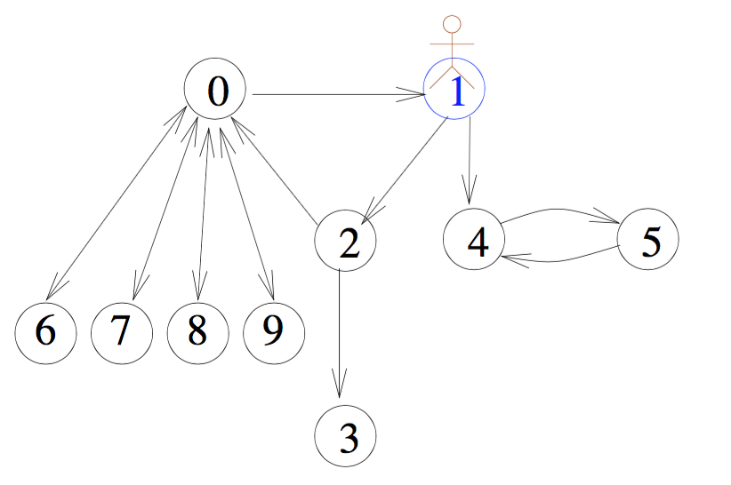
Damping Factor
For example, a surfer starts at page 1.

Slide 16
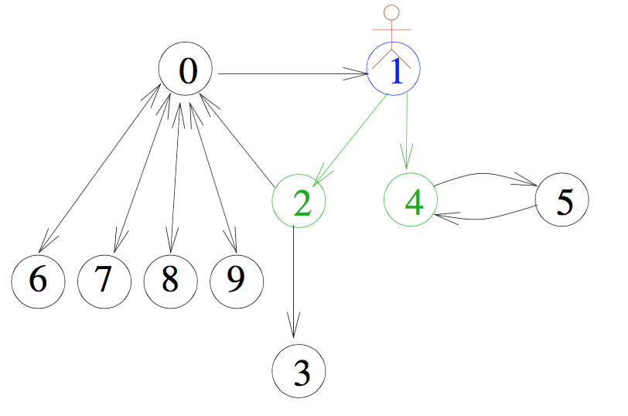
Damping Factor
At each step, with probability d, a server chooses next page by clicking a random link at the current page.
Notes:
According to wiki.

Slide 17
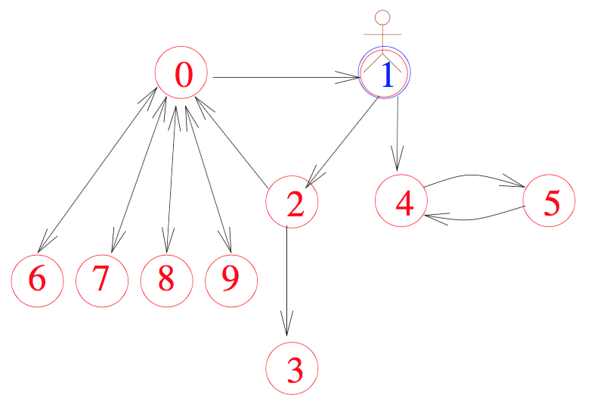
Damping Factor
Meanwhile, with probability 1 – d, (s)he jumps to a random page.
Notes:
According to wiki.

Slide 18
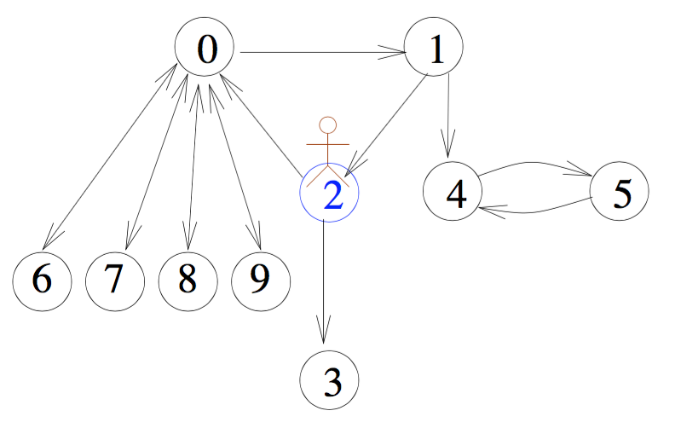
Damping Factor
Suppose (s)he goes to page 2.

Slide 19
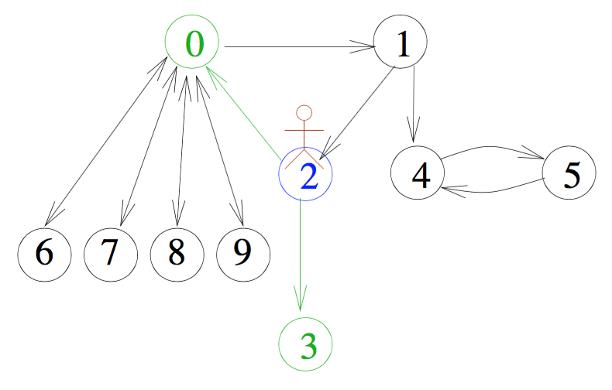
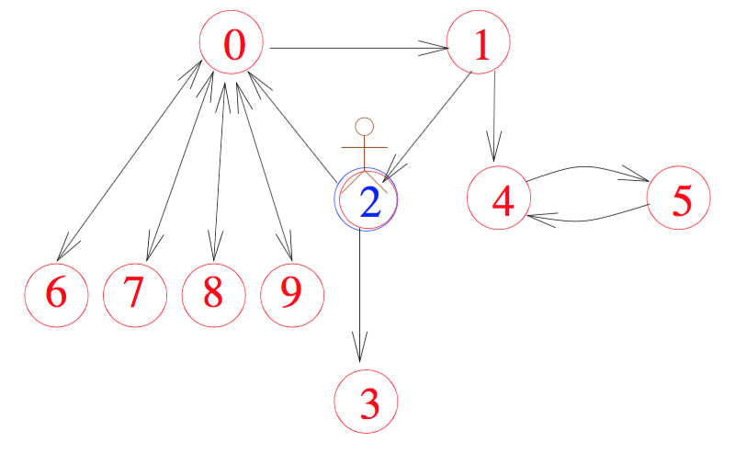
Damping Factor

Slide 20
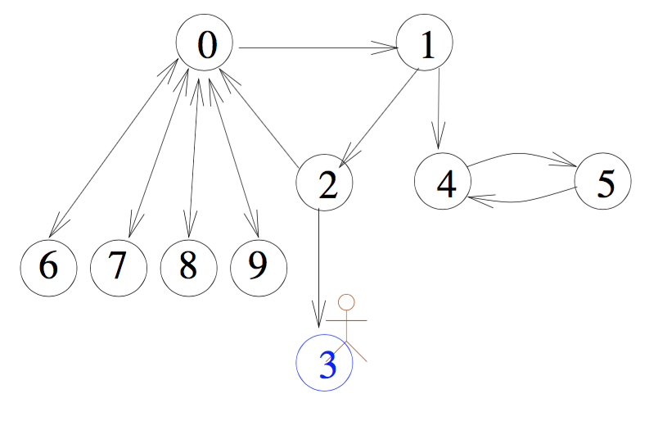
Damping Factor
What if (s)he goes to a page with no outgoing edges?

Slide 21
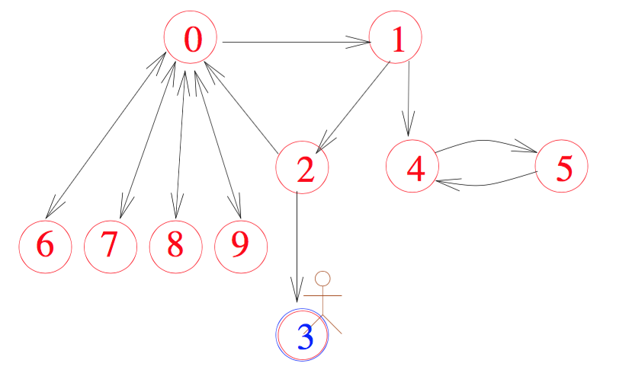
Damping Factor
In that case, it will jump to a random page with probability 1.

Slide 22
Damping Factor
One usually chooses d to be 0.85. Why ?
“Those smart guys at Google use 0.85”
It works pretty well with high rate of convergence. Moreover, when d is higher than 0.85, the numeric instability increases.

Slide 23
Term Frequency and Inverse Document Frequency
Another most popular method to find the rank of documents is tf-idf.
Term Frequency is the frequency of the word in the document.
tf(t, f) = # t in file f.

Slide 24
Term Frequency and Inverse Document Frequency
Inverse Document Frequency is the number of documents that contain the target word. (In reality it’s usually scaled using logarithm)’
idf(t, F) = log (# files in F / # files in F containing t)
Then the tf-idf of a file is tf * idf.

Slide 25
Term Frequency and Inverse Document Frequency
For example, given target word “Vanderbilt” and a bunch of files, F₁, … F_{N}
The tf and idf of file F_{i} are :
tf(“super bowl”, F_{i}) = #appearance of “Vanderbilt” in F_{i}
idf(“super bowl”, {F}) =
log (N / #files contain “Vanderbilt”)
Then tf-idf of F_{i} is the product of tf and idf of F_{i}

Slide 26
Combine PageRank with TF-IDF
TF-IDF doesn’t consider the link structure of the page, while PageRank ignore the content of the page.
People have also try the combination of these two methods, i.e. calculate the rank of a page by:
Ranking = Weight * PageRank + tf-idf

Slide 27
Application -- Searching
Google: it utilizes a number of factors to rank search results including standard IR measures, proximity, anchor text, and PageRank
PageRank is greatest for underspecified queries.
Notes:
For example, a query for Stanford may return any web mentioning Stanford,
but using PageRank, the university homepage is listed first.

Slide 28
Other Applications
Estimate Web Traffic: it’s interesting to study why some high usage pages have low PageRank, e.g. pornographic pages.
Backlink Predictor: e.g. citation counts.
User Navigation, PageRank Proxy: User can see the PageRank of a page before click on it.

Slide 29
Conclusion
PageRank is a link analysis algorithm to calculate relative importance of pages, defined as
Later version of PageRank prefers:
Random Surfer Model and Damping Factor
TF-IDF and PageRank

