Slide 1

5.2 Microsoft Excel

Slide 2
Microsoft Excel…
…Microsoft Excel is the spreadsheet component of the Microsoft Office Suite.
It is used primarily to enter, edit, format, sort, perform mathematical computations, save, retrieve and print numeric data.

Slide 3
Objectives
Identify the main parts of the Excel window.
Identify the purpose of the commands on the menu bar.
Work with the buttons on the toolbar.

Slide 4
Objectives
Explain the purpose of options available for printing a spreadsheet.
Enter and format text and numbers into cells.

Slide 5
Objectives
Successfully move from one cell to another containing formulas and text.
Copy, Cut and Paste text and formulas.
Understand cell references.

Slide 6
Objectives
Understand cell references.
Perform basic mathematical operations in a spreadsheet.
Copy, Cut and Paste text and formulas.

Slide 7
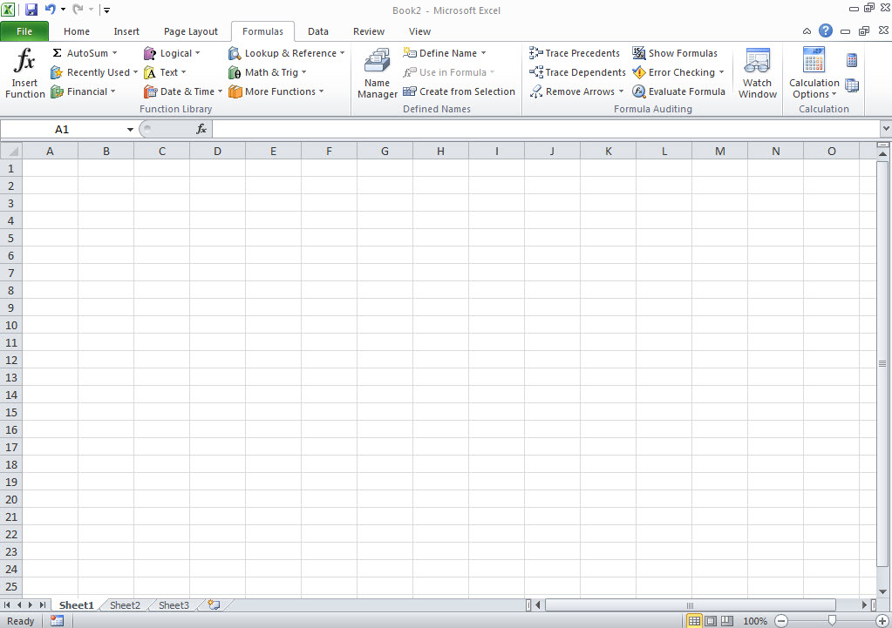
Screen Components
The opening screen for
Microsoft Excel 2010 looks like this…

Slide 8
Terminology
Terminology
While different versions have different appearances, they all have most of the same features. If you know what to call it, you should be able to find it in other versions.

Slide 9
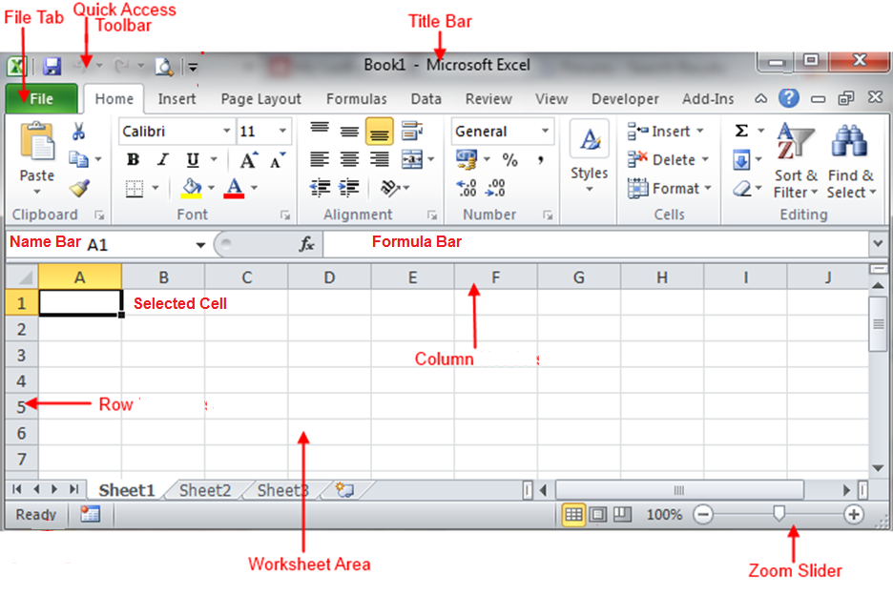
Diagram

Slide 10
Title Bar
The area outlined in red is called the
title bar.
It displays the names of the open program (in this case Microsoft Excel)
and the name of the current file.

Slide 11
Window Control
The area outlined in red contains the minimize, maximize/restore and close buttons for the program window.

Slide 12
Window Control Buttons
These three buttons are on almost every window that opens in a Windows based platform.
They are on Mac windows as well, but they are circles instead of squares.

Slide 13
Minimize
When you click the minimize button the program becomes a button on the Windows taskbar located at the bottom of the screen.

Slide 14
Task Bar
You can restore the document to its original shape and size by either:
Clicking on the button on the task bar one time to restore it to active mode,

Slide 15
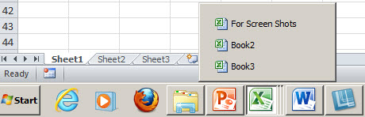
Multiple Files
If you have multiple files from the same program open you will need to select the one you want to restore to active mode.

Slide 16
Restore
When you click the maximize / restore button the program assumes the same shape and size it was before you minimized it.
Or
The program window will fill the screen.

Slide 17
Close
When you click the close button the program will ask you if you want to save the changes if you have made any changes. Once you have responded to this question the program will close.

Slide 18
Quick Access Toolbar
The area outlined in red is called the quick access toolbar.
It contains the most commonly used commands in Microsoft Word:
Save
Undo
Repeat

Slide 19
Ribbon Interface
Microsoft Office 2007 & 2010 use what is referred to as the “Ribbon” interface. The area outlined in red is the Ribbon.
The ribbons we are going to go over today are the default ribbons.

Slide 20
Ribbon Groups
You may customize the ribbon and or a group on the ribbon on your personal computer to have only the features you want to use.
In order to do this all you have to do is right mouse click on the ribbon or the group you want to customize.

Slide 21
Tab Menu
The words File, Home, Insert, etc… outlined in red are referred to as tabs. Each Tab has several Groups attached to it.

Slide 22
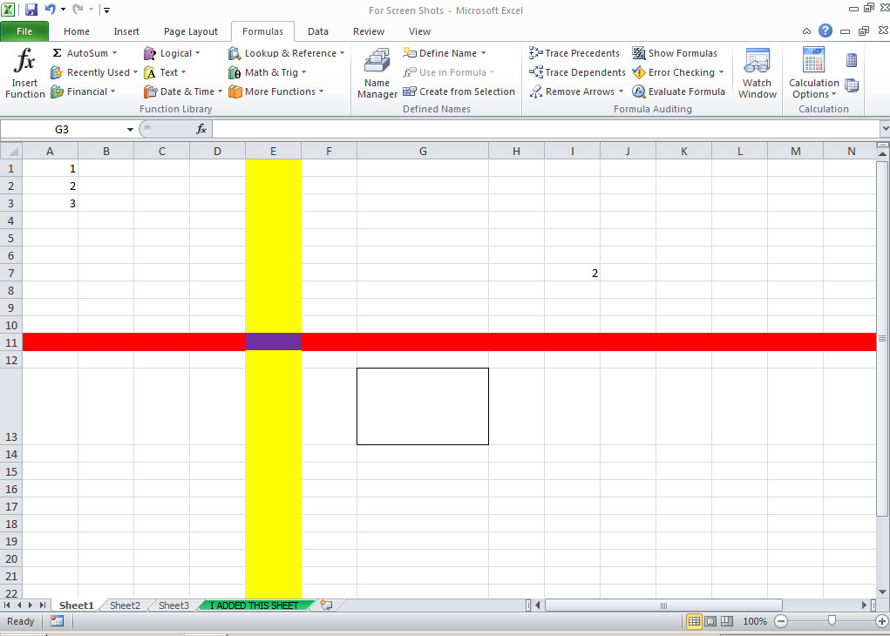
Worksheet
The area outlined in red is referred to as the worksheet and most of its components remain the same regardless of which tab you are currently using.

Slide 23
Columns and Rows
The name bar tells you the column and row of the cell that is selected.

Slide 24
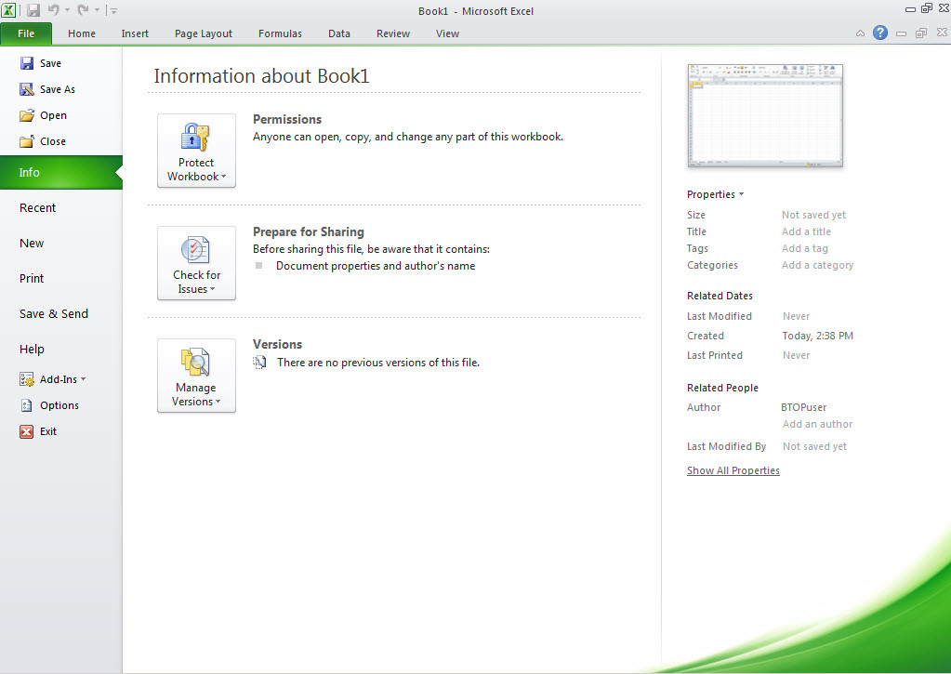
File Tab Menu
The File Tab menu contains the commands most commonly associated with the file.

Slide 25
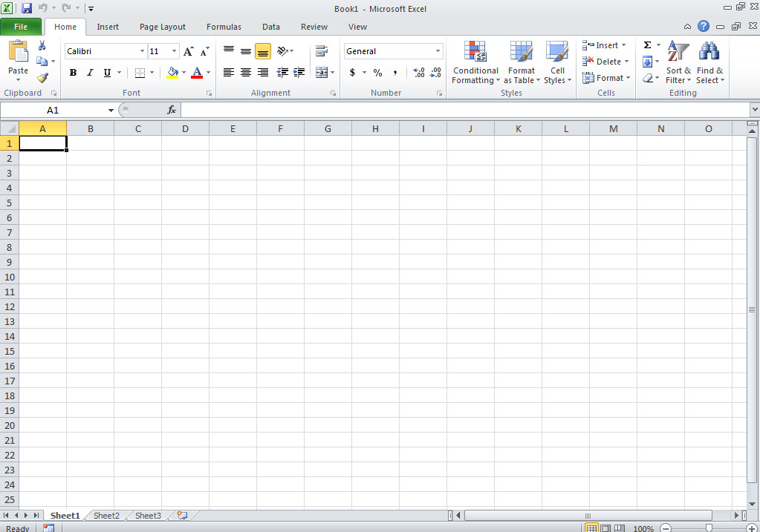
Home Tab
The Home Tab Groups contain the commands most commonly associated with the formatting and editing of cells and their contents.
Clipboard
Font
Alignment
Number
Styles
Cells
Editing

Slide 26
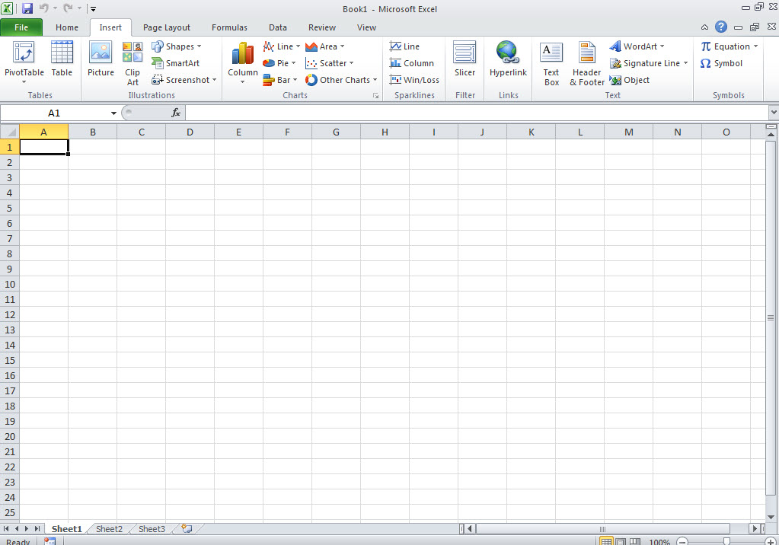
Insert Tab
The Insert Tab Groups contain the commands most commonly associated with adding something to the document.
Tables
Illustrations
Charts
Sparklines
Filter
Links
Text
Symbols

Slide 27
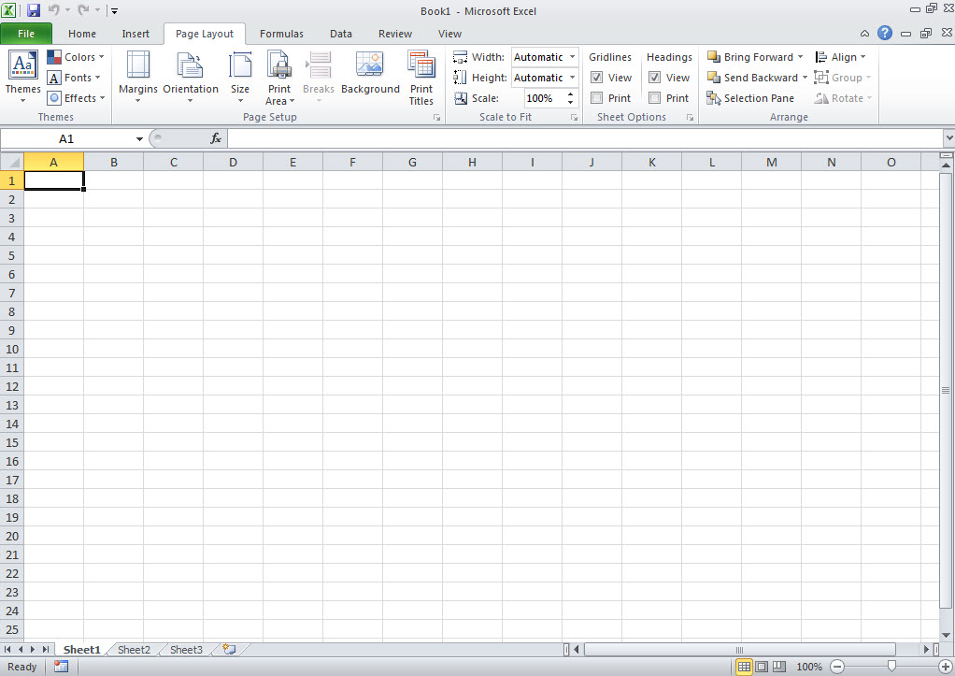
Page Layout Tab
The Page Layout Groups contain the commands most commonly associated with settings that would affect the entire page or worksheet.
Themes
Page
Setup
Page
Background
Paragraph
Arrange

Slide 28
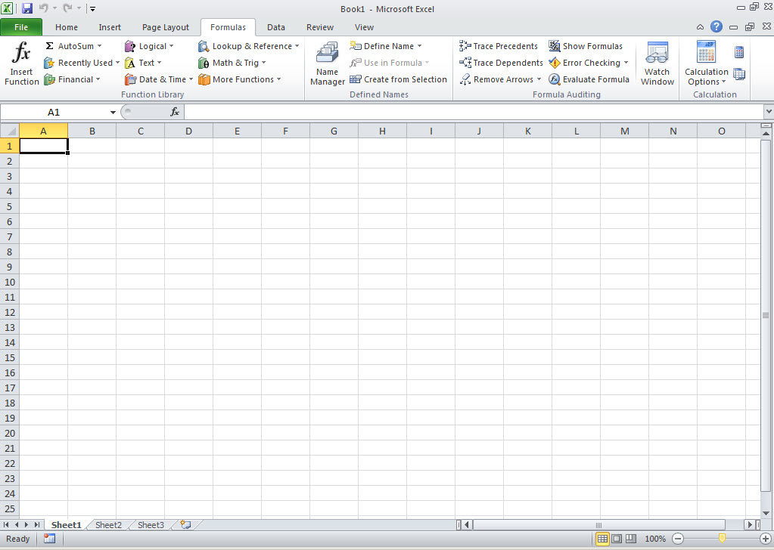
Formulas Group
The Formulas Groups contain the commands most commonly associated with Excel’s formulas and functions.
Defined
Names
Function
Library
Formula
Auditing
Calculation

Slide 29
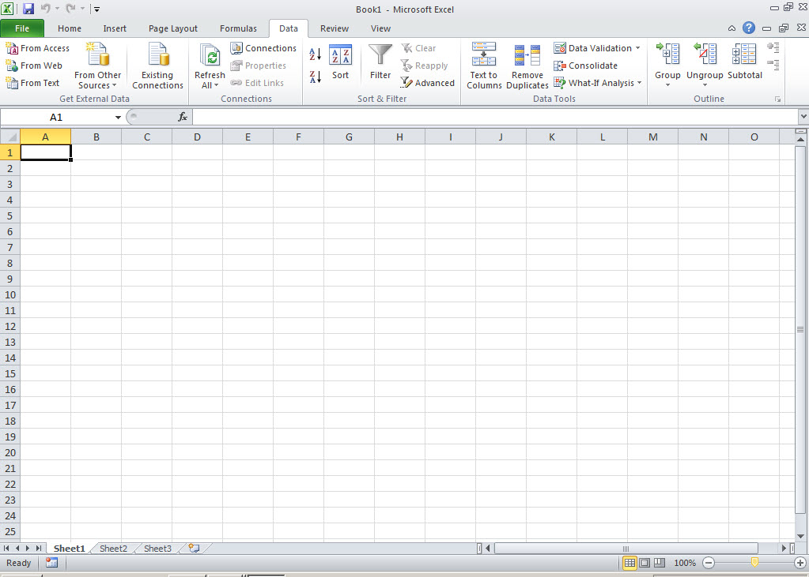
Data Tab
The Data Tab groups contain the commands most commonly associated with data from external sources, and evaluating or arranging data.
Get External
Data
Connections
Sort & Filter
Data Tools
Outline

Slide 30
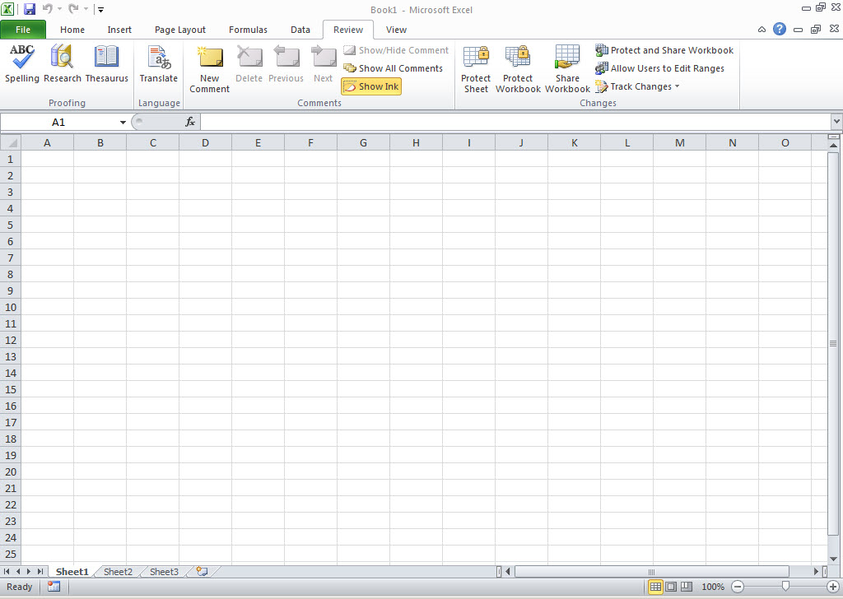
Reviews Tab
The Review Tabs groups contain the commands most commonly associated with the text portions of a spreadsheet and sharing changes.
Proofing
Language
Comments
Changes

Slide 31
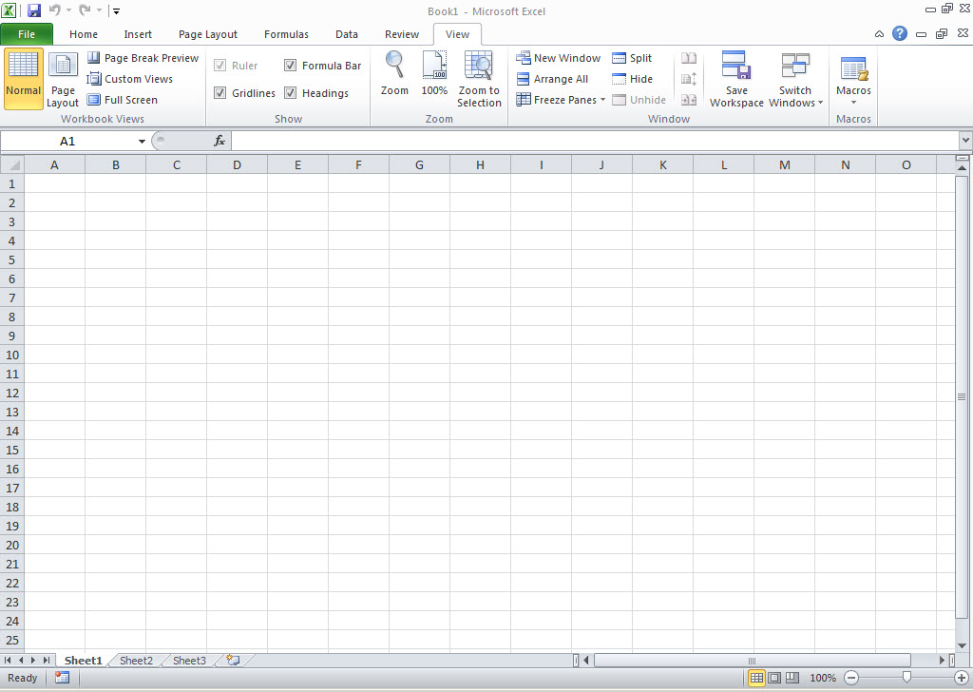
View Tab
The View Tab groups contain the commands most commonly associated with the variety of ways you can “look at” a worksheet or workbook.
Show
Workbook
Views
Zoom
Window
Macros

