Slide 1

Power supply

Slide 2
Introduction
Power supply convert alternating current to the direct (DC) current mainly convert 110-240v AC
Three types of power supply:
  Linear power supply
  Switched mode (SMPS
  Uninterrupted (UPS)
  power SMPS stands for Switch Mode Power Supply.
This receives 230V AC and translates it into different DC levels such as +5V, -5V, +12V, -12V.

Slide 3
Linear power supply
Linear power supply: transformer is used to convert voltage.
Transformer convert the line AC voltage to a smaller peak voltage
Rectifies AC signal produces large waveforms , capacitor filter is used filter the rectified wave which contain small pulses (ripple).

Slide 4
Linear power supply
Depend on requirements regulator adjust the output voltage
Good line and load regulation lower output voltage ripples.

Slide 5
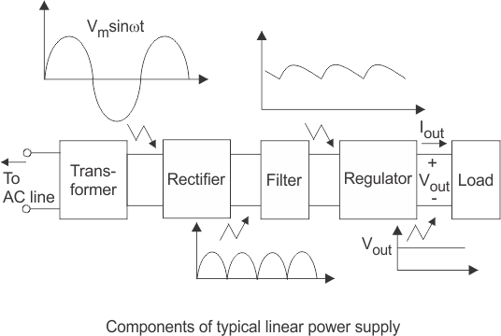
Linear power supply

Slide 6
Operation
The power supplies used in computers are switched mode power supplies.
The primary power received from AC mains is rectified and filtered as high-voltage DC.

Slide 7
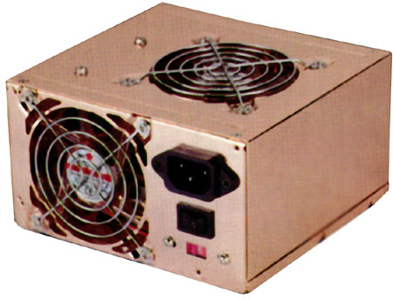
SMPS

Slide 8
SMPS
Switched mode : electronic power supply with switching regulator.
power SMPS stands for Switch Mode Power Supply.
  This receives 230V AC and translates it into different DC levels such as +5V, -5V, +12V, -12V.
it is switched to a high frequency approximately 10 to 100 KHz by a bipolar transistor and fed to the primary side (P) of a step-down transformer.
Uses feedback mechanism

Slide 9
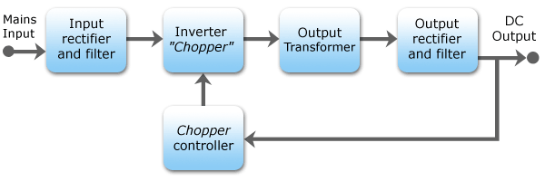
SMPS schematic diagram

Slide 10
SMPS working
Convert AC to DC voltage with rectifier
Which is unregulated DC voltage sent it to filter
Inverter convert DC to AC with help of power oscillator.
Output transformer inverts AC voltage up to down to the required output level.
Output rectifier and filter : AC output from transformer is rectified.
For lower voltage uses silicon/schottky diodes used and smoothing the rectified output by using filter.

Slide 11
SMPS working
This reduces the amount of the voltage passed through the transformer.
So the output voltage will be maintained normally.
Then it is sent to the output of the power supply.
A sample of this output is sent back as feedback signal for regulation.

Slide 12
AT and ATX power supply
PC using XT, AT,babyAT and LPX form factor uses switch to turn on the computer.
Newer versions of motherboard send signals through motherboard to power supply.
  AT
  ATX/NLX

Slide 13
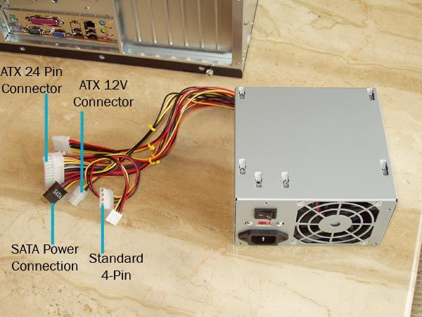
AT type SMPS
Front side power connector to SMPS
AT style SMPS provides DC output on two 6-pin connectors(carries DC power to motherboard) and two 4-pin connectors
Power good flag is set
output voltage stable

Slide 14
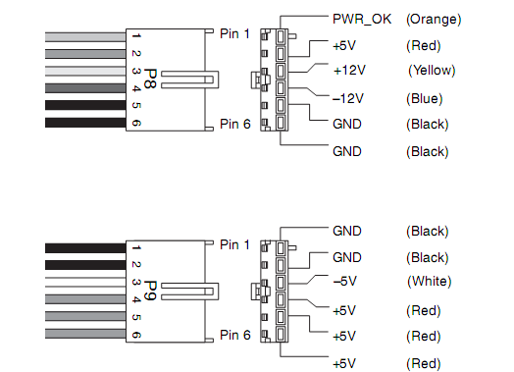
AT type SMPS

Slide 15
ATX/NLX type SMPS
Doesn't connect directly to power button
It uses five DC voltage ,20 pin connector.
  PS-ON: when it is low SMPS is ON or else OFF.
  5VSB:supplies power supply to circuits
  PW-OK:power good signal.
Front side power connector to SMPS
AT style SMPS provides DC output on two 6-pin connectors(carries DC power to motherboard) and two 4-pin connectors
  ATX/NLX
ftyrgfgggggggggg

Slide 16
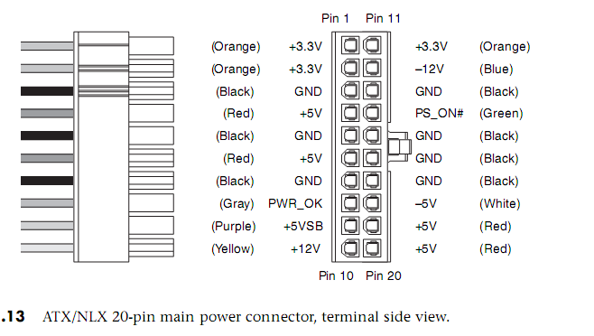
ATX/NLX type SMPS

Slide 17
Power Supply Characteristic
Wattage: The total, maximum output of the power supply in watts,Typical power ranges are from 200W to 500W.
Efficiency :
        Efficiency=Useful Power Output / Total Electrical Power Consume.
Regulation : The ability of a SMPS to maintain an output voltage within specified limits under varying of input voltage.

Slide 18
Power Supply Characteristic
Ripple : Also called AC Ripple or Periodic and Random Deviation(PARD) or simply Noise the Power Supply of course produces DC outputs from AC input.
Load Regulation: Sometimes called voltage load regulation. This specification refers to the ability of the power supply to control the output voltage level
Line Regulation: The complement of load regulation, this parameter describes the ability of the power supply to control its output levels

Slide 19
Power Supply problems
Blackouts: it is complete loss of electric power where voltage and current drop to 0,usually caused by physical interruption in the power line due to accidental damage by a person or act of nature, loss of AC will invariably shutdown the computer,loss of data, reduction productivity, corrupt file structure and damage files.

Slide 20
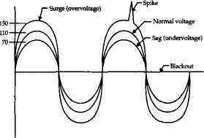
ATX/NLX type SMPS

Slide 21
Power Supply problems
Blackouts: it is complete loss of electric power where voltage and current drop to 0,usually caused by physical interruption in the power line due to accidental damage by a person or act of nature, loss of AC will invariably shutdown the computer,loss of data, reduction productivity, corrupt file structure and damage files.
Brownouts (Sag): The under voltage condition The high load items like air conditioners, welding machine, motor etc draw to much current that the AC voltage level drops.
power supply will fall out which resulting in intermittent system operation. file may be lost or corrupted on the hard drive.

Slide 22
Power Supply problems
Surge: small over voltage conditions that take place over relatively long periods and regulate power to a desired level excess energy must be switched (in SMPS).
Spikes: A spike is a large over voltage condition that occurs in the milliseconds. high energy switches can cause spikes on the AC line. Example equipment like drill machine, grinders, welding equipment etc. can produce power spikes.

Slide 23
Symptoms Supply problems
1. Flickering Lights, 2. Premature Component Failure, 3. Hard Drive Crashes, 4. The PC stalls, crashes, or reboots for no apparent reason.5. You suffer chronic or frequent hard drive failures or file access problems.
6. The CMOS RAM or modem NVRAM periodically looses its contents or
becomes corrupted.
7. The PC behaves erratically when other high-energy devices are turned on.
8. The modem regularly looses its connection, or fails data transfers.
9. The monitor display flickers or waves.

Slide 24
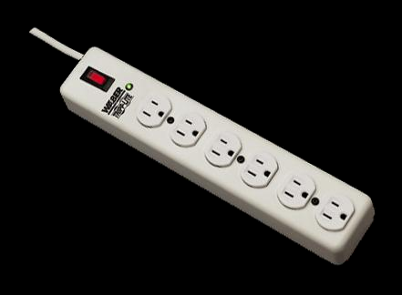
Protection Devices
To run a computer system properly requires a steady power supply with clean and noise free power.

Slide 25
Protection Devices
Surge Suppressor: simple and relatively inexpensive devices, designed to absorb high-voltage transients produced by lightning and other high-energy equipment.
Device inserted in AC to avoid spikes.
Avoids peak AC voltage.
Protection is accomplished by clamping (or shunting) voltages above a certain level (usually above 200 volts).
Metal oxide varistor, or MOV, diverts the extra voltage.
Circuit Breaker:Its purpose was to protect lighting circuit wiring from accidental short-circuits and overloads.

Slide 26
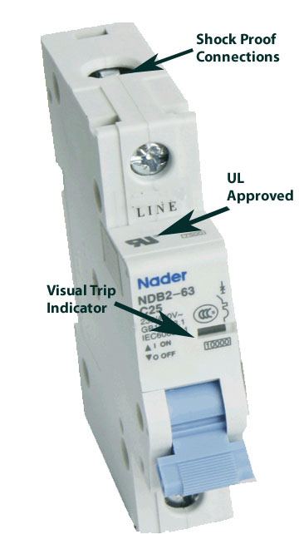
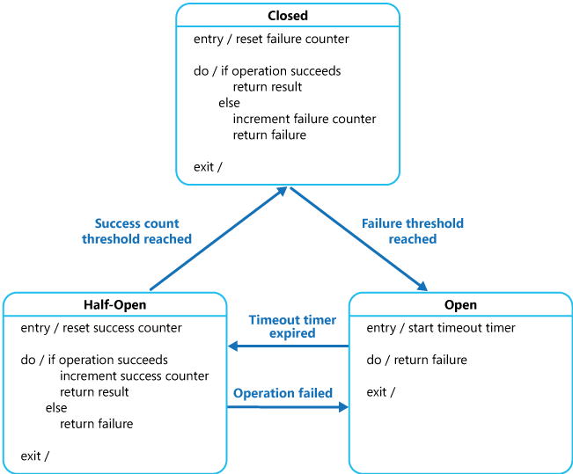
Protection Devices
Circuit Breaker:Its purpose was to protect lighting circuit wiring from accidental short-circuits and overloads.
CB can be reset to function normal.

Slide 27
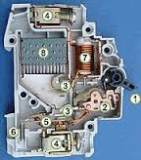
Protection Devices
Circuit Breaker:
1.actuator lever: trip/reset
2 actuator mechanism
3.Contacts:allow current
6 calibration screw:

Slide 28
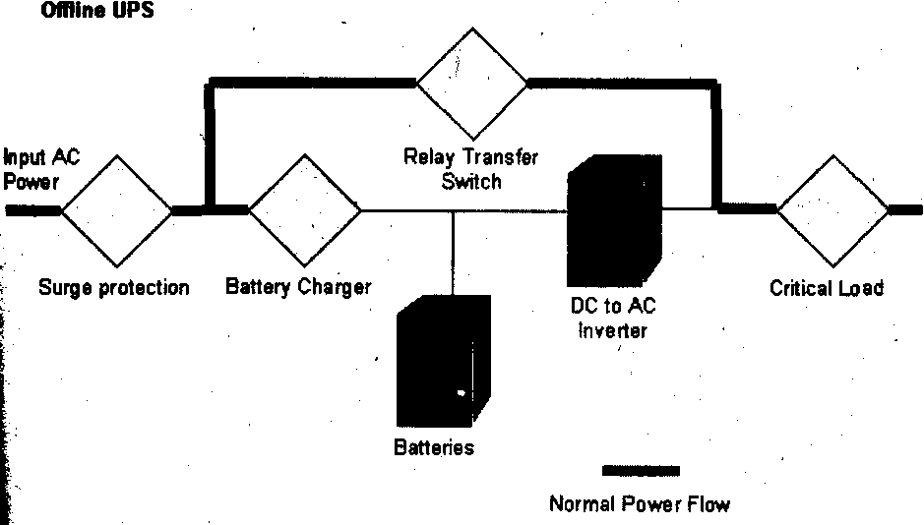
Uninterrupted Power Supply (UPS)
An UPS provides a back up power supply when there is a power failure from AC mains.

Slide 29
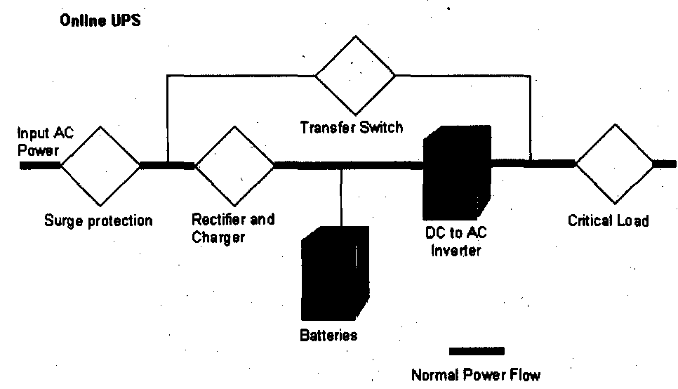
Uninterrupted Power Supply (UPS)
On-line UPS.

