Slide 1
BASIC COMPUTER CONCEPTS
Updated 8/27/04
Notes:
1
1

Slide 2
Hardware vs. Software
Hardware
  The computer equipment
  Includes printers, monitors, disk drives, etc.
Software
  Programs which tell the computer what to do
  Examples - word processing, gradebook, tutorials, games, etc.
Notes:
3
3

Slide 3

Notes:
4
4

Slide 4
History of Computers
Charles Babbage - father of computer
  1800’s planned analytical engine
ENIAC - developed at end of WW II
1951 - 1963 1st and 2nd generation
  very large, used unreliable vacuum tubes
1963 - present - 3rd and 4th generation
  smaller, faster - use transistors and integrated circuits

Slide 5
History - Microcomputers
Apple
  First sold in late 1970’s
  Developed by Jobs and Wozniak
IBM Personal Computers
  First sold in 1981
  Was quickly accepted by businesses
  IBM compatibles soon developed

Slide 6
Computer - Social Impact
Threat to privacy
Reduce personal interactions
Displace workers and change workplace
  Create two tiered society
Computer failures cause great damage
Artificial Intelligence
  Create a “new life form”
  Machines smarter than their creators

Slide 7
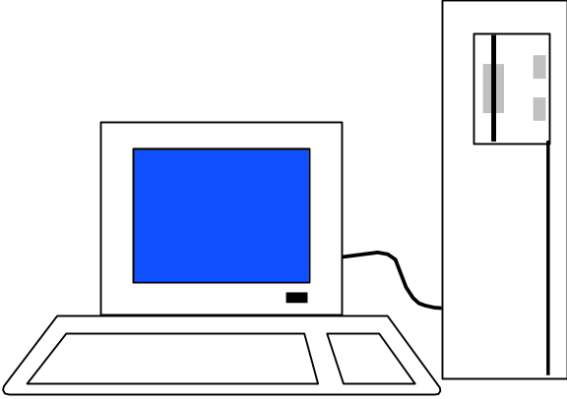
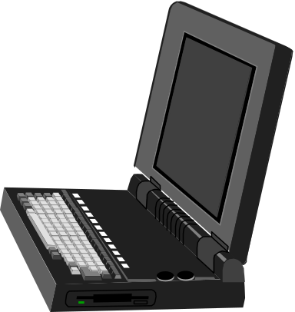
Types of Computers – Personal Computers (PC)
Also called Microcomputers
Available in desktop size, notebook size and handheld
Can be IBM, IBM Compatible or Apple
Notes:
8
8

Slide 8
Types of Computers - Minicomputers
Size of filing cabinet
Used by small and medium size companies and institutions
Operated by computer specialist
Terminals allow many people to use
Notes:
7
7

Slide 9
Types of Computers - Mainframes
Very powerful
Very fast
Used by large corporations and governmental agencies
Operated by computer specialist
Notes:
6
6

Slide 10
Types of Computers- Supercomputers
Most powerful
Fastest
Most expensive
  Several million dollars each
Used only by
  Governmental agencies
  Large international corporations
Notes:
5
5

Slide 11
Computer Operations
Input
Processing
Output
External Storage
Notes:
9
9

Slide 12
Input Devices - Keyboard
Most commonly used input device
Ergonomic - fit natural hand placement
Special keys
  Enter, Function, Ctrl, Alt, Num Lock, Esc
Notes:
10
10

Slide 13
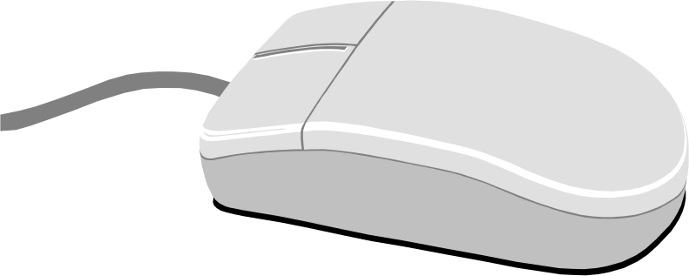
Input Devices - Mouse
Controls cursor on screen
May be mechanical or optical
Most models have a “wheel” for scrolling
Notes:
11
11

Slide 14
Input Devices - Other
Pointers (replaces mouse on notepads)
  Track point, track ball, touch pad
Scanner
Digital camera
Touch screen
Voice
Notes:
12
12

Slide 15
Output Devices
Monitor
Printer
Disk Drive
  Can also be input device
Modem
  Can also be input device
Notes:
24
24

Slide 16
Monitors
Made up of tiny elements called pixels
Each row of pixels is called a scan line
Picture is displayed by an electronic beam lighting up certain pixels
Notes:
25
25

Slide 17
Monitors - Resolution
Resolution is how sharp and clear the picture is
How many scan lines on the screen
    640 x 480 is low resolution
    1600 x 1200 is high resolution
Notes:
26
26

Slide 18
Monitors - Dot Pitch
Measures the distance between pixels
Commonly seen on monitors advertised
  .49 (not very good)
  .28 (much better)
  .26 or lower (excellent)
Notes:
28
28

Slide 19
Monitors - Sizes
Screen measured diagonally
  May also measure actual viewing area
14” or 15” on bargain systems
17” has become the standard
19 and 21” available but are more expensive.
Notes:
29
29

Slide 20
Monitors - LCD
Liquid Crystal Display
Similar to digital watch
Used for notebook computers
  Should be an Active Matrix Screen
Also used in flat screen monitors
  Much thinner than regular CRT monitor
  More expensive than regular CRT monitor

Slide 21
Monitors - Video Card
Processes info to send to monitor
Amount of video memory may speed up graphic intensive programs
  32 megs –general purpose
  128 or more megs – graphic intensive use
AGP port can speed up graphics
3D accelerator card improves graphics
Notes:
30
30

Slide 22
Monitor - Buying Hints
17” or larger
.28 dot pitch or better
32 or more megs of memory on video card
Notes:
31
31

Slide 23
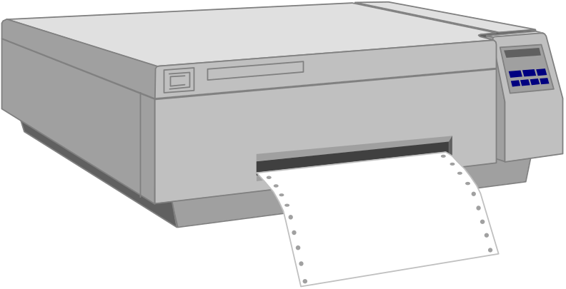
Printers
Laser
Ink Jet
Dot Matrix
Notes:
32
32

Slide 24
Printers - Laser
Works similar to a copy machine
  Color printers available but more expensive
Fast, quite, with excellent quality
More expensive to buy and operate
Some units scan, photocopy, and print
Notes:
35
35

Slide 25
Printers - Ink Jet
Squirts small jet of ink onto paper to form characters
Replaced dot matrix
Quiet
Does good job on color
Good quality and reliability
Notes:
34
34

Slide 26
Printers - Dot Matrix
Strikes pins against ribbon to print
Comes in 9 and 24 pin
Once very popular
Now replaced by ink jet and laser
Notes:
33
33

Slide 27
Printers - Speed
Measured in pages per minute (PPM)
Laser printers range from 20-45 ppm
  Color printing is slower

Slide 28
Printers - Quality of Print
One measure is dots per inch (DPI)
  300 dpi for general purpose uses
  600 dpi for higher quality
  1200 dpi for photo quality
May have different vertical and horizontal resolution
  600 x 300
Other factors can affect quality

Slide 29
Basic Processing Cycle
Central
Processing
Unit
Internal
Memory
Data Bus
Notes:
13
13

Slide 30
How Information Is Stored
Memory consist of switches which can be either on or off - Off=0 On=1
Each on/off switch is called a bit
Eight bits make up a byte
It takes one byte to store a character
  Character can be letter, space, punctuation, etc.
  ASCII code used
Notes:
20
20

Slide 31
Other Memory Terms
Byte is eight bits
Kilobyte (KB) is approx. 1,000 bytes
Megabyte (MB) is approx. 1million bytes
Gigabyte (GB) is approx. 1 billion bytes
Notes:
21
21

Slide 32
Central Processing Unit
Also called CPU, processor or microprocessor
Is the “brains” of the computer
Performs all computer operations
Notes:
14
14

Slide 33
CPU - IBM COMPATIBLES
Many made by company called Intel
Also made by AMD
Notes:
15
15

Slide 34
Pentium class processors
Needed to run most current software
Intel – Celeron or Pentium IV
AMD
Notes:
16
16

Slide 35
CPU - Clock Speed
Number of “cycles” per second computer can operate
Measured in megahertz (MHz)
One MHz = 1 million cycles per second
One gigahertz(GHz)=1 billion cycles
Current speeds 2-4 GHz
Notes:
17
17

Slide 36
CPU - Misc.
Performance also affected by speed of data bus
  400-800 MHz on most current systems
Cache can increase speed
  Stores data you will likely need next in an area that has faster access
  Both memory cache and disk cache used
  Should be 512 K or better
Notes:
18
18

Slide 37
CPU - Buying Hints
Minimum of Pentium IV or AMD Athlon
Minimum of 2 GHz clock speed
Minimum of 512K of cache
Notes:
19
19

Slide 38
Internal Memory - RAM
RAM - Random Access Memory
  CPU can access any location as quickly as any other
Can not only read current info but also write new info
Very important in determining capabilities of the computer system
Computer should have at least 256 megs - 512 preferred (can add to later)
Notes:
23
23

Slide 39
Internal Memory - ROM
ROM - Read Only Memory
  Can read info Stored in ROM
  Can not write new info into ROM
Used for “internal workings” of computer
Buyer is not very concerned with ROM
Notes:
22
22

Slide 40
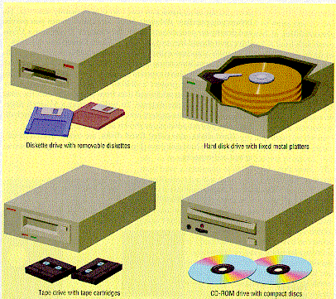
External Memory
Notes:
36
36

Slide 41
Floppy Drives
Comes in 5 1/4” and 3 1/2”
  All systems now only have 3 1/2”
HD - High density - comes on all current systems
  3 1/2” - 1.44 megs
Notes:
37
37

Slide 42
Hard Drives
Built into machine
Made up of stack of platters
Can store much more than floppy drives
  40 gigabytes should be minimum
Can access info much faster than floppy drive
Notes:
38
38

Slide 43
CD ROM
Same as music CDs
Are read only
Can store over 650 megs
All programs now only sold on CD
Make multimedia possible
Come in different speeds - 20x, - 50x
Notes:
39
39

Slide 44
DVD-ROM
Digital Video Disk
Can store up to 17 GB
Can store full-length movies
Can also read CD-ROM disk

Slide 45
CD-RW & DVD-RW DRIVES
Allows you to write to disk
Useful for
  Data backup
  Storage of large files
  Recording music and other multimedia files
DVD-RW
  Allows you to write to both CD and DVD disk
  Still somewhat expensive

Slide 46
Storage Devices - Other
USB drive
  Very popular – 64-512 MB
Tape drive
  Similar to cassette tape
  Used for backup
Zip drive
  100 MB to 2 GB capacity
  Everyday use and backup

Slide 47
Drives - Buying Advice
40 gigabyte hard drive
One 3 1/2” high density floppy drive
CD-RW drive
DVD not yet essential but useful
Notes:
41
40

Slide 48
Expansion Slots
Allows you to add capabilities
Example of cards you can add
  Network card
  Modem
Notes:
45
45

Slide 49
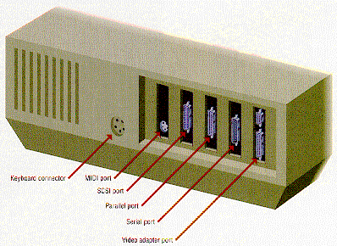
Ports
Connects computer to another device
Parallel port
  Used primarily by printers
Serial ports
  Modem, mouse, etc.
SCSI - chain devices
USB –may be needed for
  Digital Cameras
  Mp3 players
  Other devices
Notes:
46
44

Slide 50
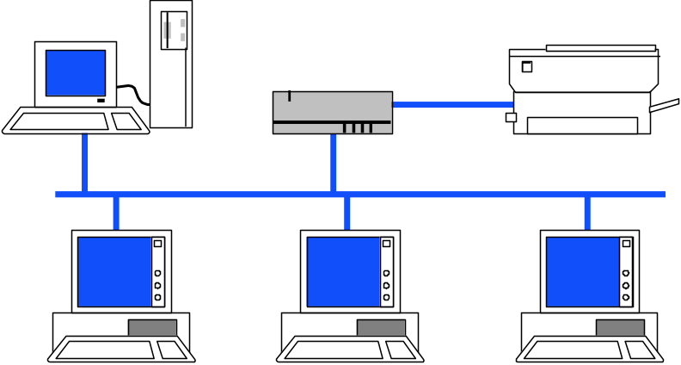
Networks
Connects computers
LAN - Local Area
WAN - Wide Area
Wireless
Allows sharing of programs, files, printers, etc.
Server is “main” computer
Notes:
44
43

Slide 51
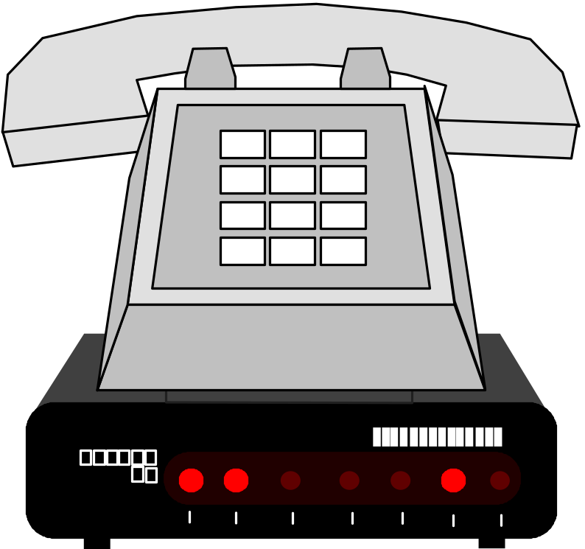
Modems - General
Allows 2 computers to communicate over phone lines
Can be internal or external
Can also have fax capabilities
Notes:
42
41

Slide 52
Modems
Bits per second(bps) indicates speed
  Old modems - 9,600, 14,400, 28,800, 33,600
  56,000 (56K) has becoming standard
Ways of connecting to the Internet
  Dial-up modem – used in most homes
  Cable modem – uses TV cable lines
  DSL – modified phone line
  T1 line – used by schools, businesses, etc.
Notes:
43
42

Slide 53
Buying Hints Summary - Min Hardware Requirements
2 GHz Pentium IV Class Processor
256 megabytes of RAM
17”, .28 dot pitch monitor with 32 meg card
40 gigabyte hard drive
CD-RW
56k modem
Ink jet or laser printer
Notes:
47
46

Slide 54
Buying Hints - Software Bundles
Many systems come with software included
Productivity
  Microsoft Works
  Microsoft Office, Lotus SmartSuite, etc
  Quicken, Money, or other financial software
Reference
  Microsoft Encarta or Compton’s encyclopedia
Games

Slide 55
Buying Hints - Service and Warranty
Toll-free 24 hr 7 day support (800 #)
1 year warranty on parts and labor
Optional extended warranty
30 day return policy

Slide 56
Buying Hints - Web Sites
On-line computer stores
  C-Net Hardware – reviews and prices from many vendors
  Dell - http://www.dell.com/
  Gateway - http://www.gateway.com/_x000b_

Slide 57

Notes:
48
47

Slide 58
Programs
Set of instructions to the computer
Programming languages
  Machine language
  Assembly language
  Procedural languages
    Basic, Fortran, Cobol
  Object oriented languages
    Visual Basic, C++, C#, Java

Slide 59
Systems Software
Run fundamental operations
  Loading and running programs
  Saving and retrieving data
  Communicating with printers, modems, etc.
Examples of systems software
  DOS
  Windows 3.1, 95, 98, Me, 2000, and XP
  Unix
  Linux
Notes:
49
48

Slide 60
Applications Software
Helps you to accomplish a certain task
Examples
  Word processing - memos, reports, etc.
  Spreadsheets - budgets, etc.
  Database - search, sort, select data
  Educational - simulations, practice
  Graphics - charts, diagrams
  Desktop publishing - pamphlets, etc.
Notes:
50
49

Slide 61
Software - Legal Issues
Commercial software
  Can only make backup copies for yourself
  Can only use on one machine at a time
    Site license - use on more that one machine
Shareware
  Can use - make copies and give to anyone
  Should pay if you continue to use
Freeware – can copy and use indefinitely
Notes:
51
50

Slide 62
Software Viruses
Illegal code added to a program
May spread to many computers
  Copy files from one computer to another
  Download files by modem
  E-mail attachments
Virus may be relatively harmless
  Writes “You’ve been stoned” on screen
Virus may also be very damaging
  Erases everything on hard drive
Virus may activate on a certain date
Notes:
52
51

Slide 63
Virus Protection
Be careful where you copy files from
Do not open e-mail attachments unless you are sure that it is safe
Use virus protection program
  Detects and removes illegal code
  Should be updated often
Notes:
53
52

Slide 64
BASIC COMPUTER CONCEPTS
End of Slide Show

