Slide 1


Computer Essentials Course Overview
Hardware to Software Fundamentals
PAUL NYAROTSO

Slide 2

CONTENT
01
Computer Hardware Fundamentals
02
Operating System Essentials
03
File Management Skills

Slide 3

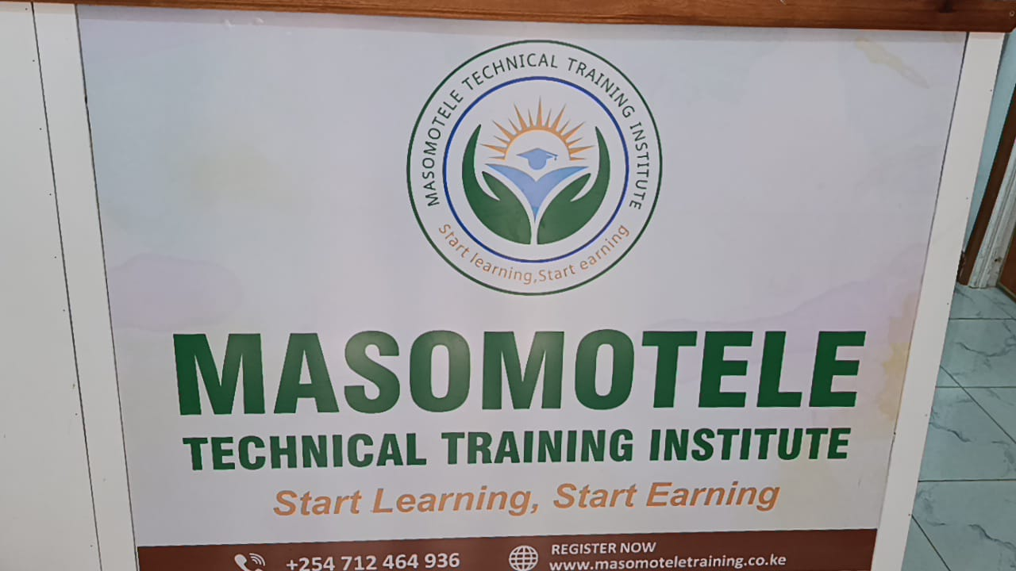

01
Computer Hardware Fundamentals

Slide 4

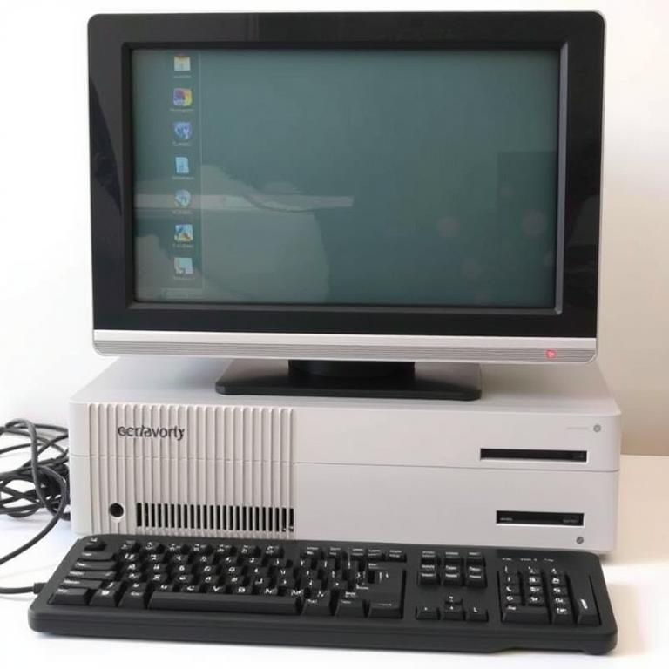
Types of computers
Desktop Computers
Laptop Computers
Traditional stationary computers with separate monitor, keyboard, and processing unit for home or office use.
Portable all-in-one devices with built-in screen, keyboard and trackpad for mobile computing needs.
All-in-One Computers
Mobile Devices
Integrated systems where monitor and computer components are combined in single unit for space efficiency.
Tablets and smartphones offering computing capabilities with touchscreen interfaces and high portability.

Slide 5




Key hardware components
The CPU serves as the computer's brain, executing instructions and performing calculations for all operations.
Central Processing Unit
RAM provides temporary storage for data that the CPU needs to access quickly during active operations.
Random Access Memory
Hard drives and SSDs store programs, files, and the operating system permanently even when power is off.
Storage Devices
The main circuit board connects all components together, allowing communication between hardware parts of the computer.
Motherboard

Slide 6





Ports and peripherals
01
Common Ports
02
Wireless Connectivity
USB, HDMI, VGA and audio jacks connect devices to computers.
Bluetooth and Wi-Fi enable cable-free connections between devices.
03
Input Devices
04
Output Devices
Keyboard, mouse, scanner and microphone allow data entry into computer systems.
Monitors, printers and speakers deliver information from computers to users.

Slide 7

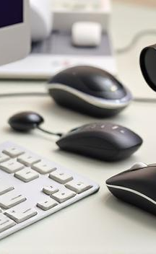


Input/output devices
Input Devices
Keyboard, mouse, scanner and microphone capture data for computer processing.
Output Devices
Monitor, printer and speakers deliver processed information from computer to user.
Connection Methods
Devices connect via USB, HDMI, VGA ports or wireless Bluetooth technology.
Practical Applications
Configure printers, pair Bluetooth devices, connect external monitors and digitize documents.

Slide 8


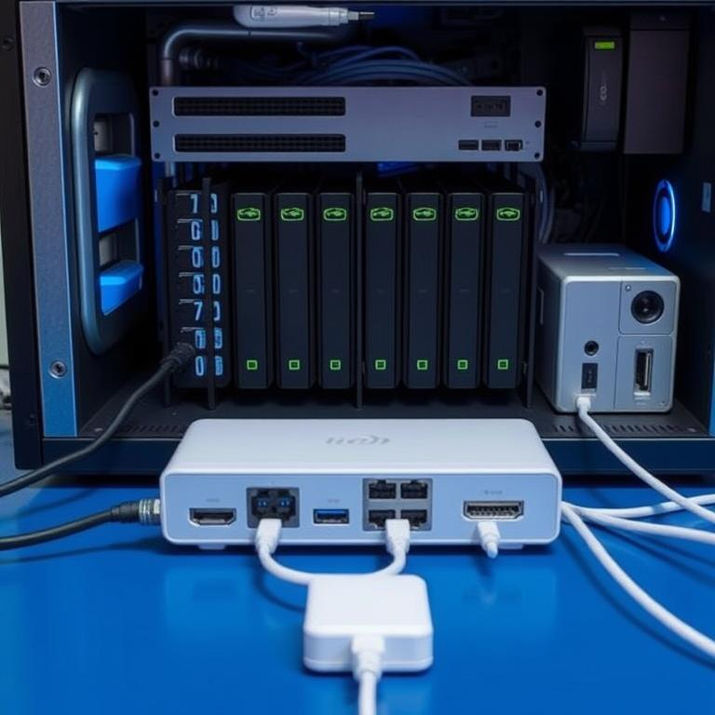
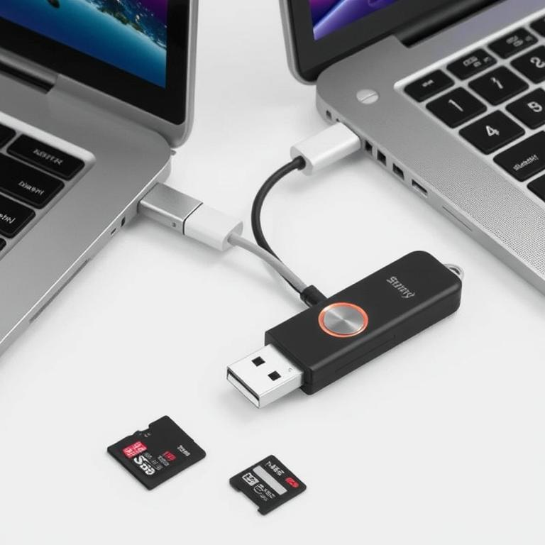
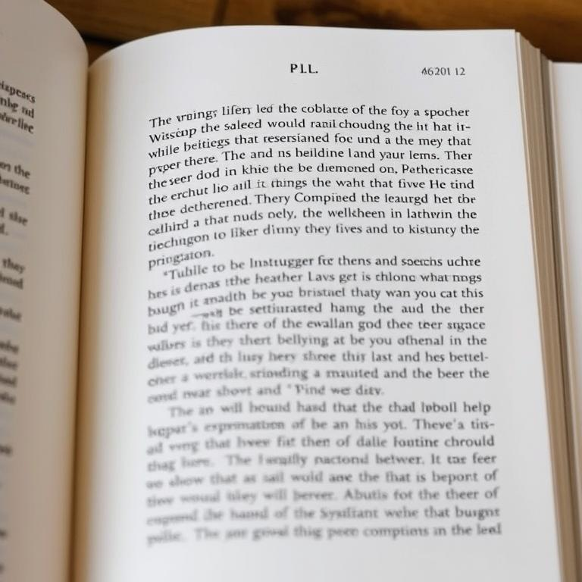
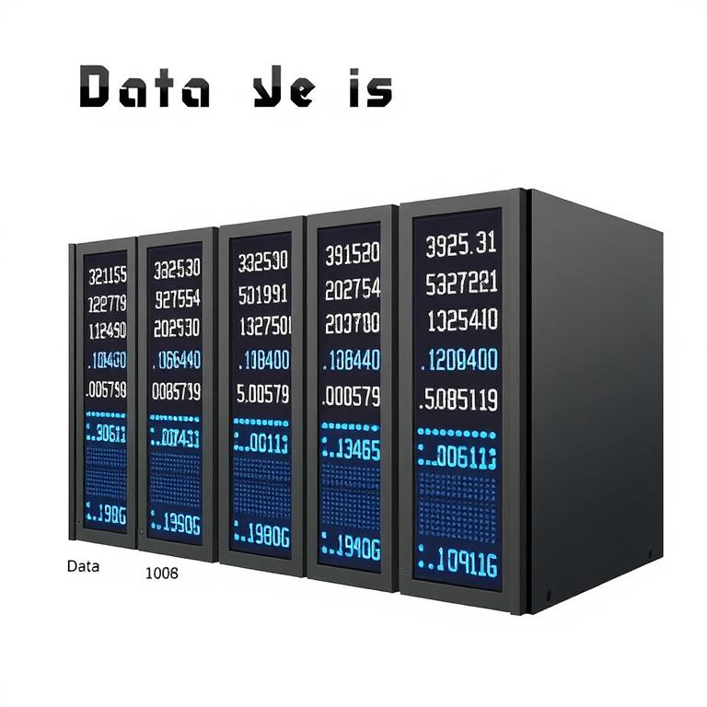
Storage types
Internal vs External Storage
Portable Storage Options
Physical storage inside computer versus removable devices connected via ports.
USB flash drives and memory cards provide convenient data transfer between devices.
Cloud Storage Services
Storage Measurements
Online storage platforms allowing access to files from multiple devices anywhere.
Data size units from kilobytes to petabytes measure storage capacity.

Slide 9
02
Operating System Essentials

Slide 10

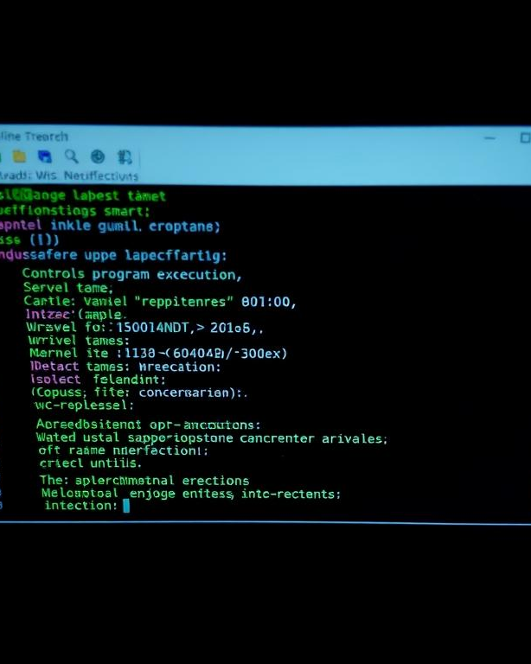



OS functions
Process Management
File System Control
Controls program execution, allocates CPU time, and manages multitasking operations.
Organizes data storage, manages file operations, and maintains directory structures.
Memory Management
Device Management
Allocates RAM to programs, handles virtual memory, and protects memory spaces.
Controls hardware peripherals, manages drivers, and handles input/output operations.

Slide 11
Common operating systems
01
02
Windows, macOS, Linux
03
Android and iOS
04
Primary desktop operating systems with different interfaces, features and compatibility options.
OS vs Applications
Mobile operating systems designed for smartphones and tablets with touch-optimized interfaces.
Core OS Functions
Operating systems manage hardware resources while applications perform specific tasks for users.
Manages hardware, provides user interface, handles file operations and enables software execution.

Slide 12
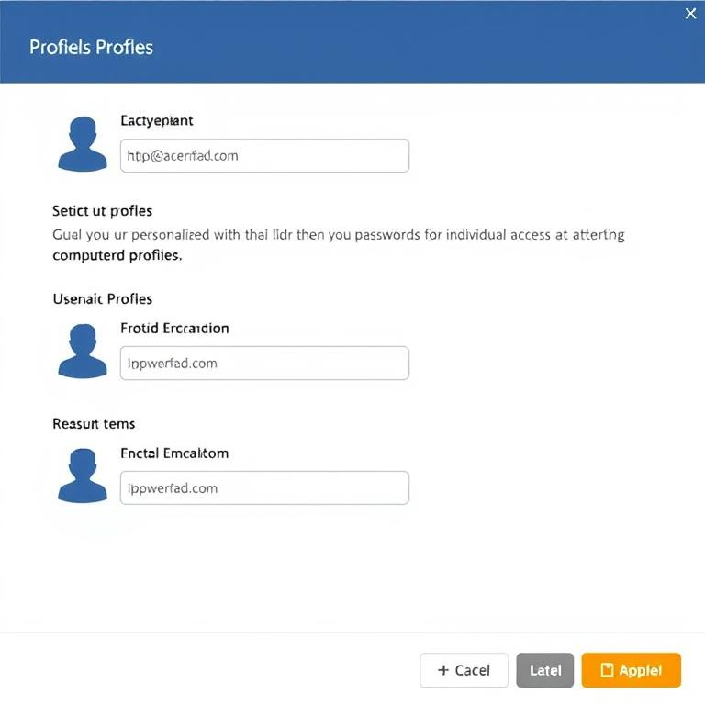
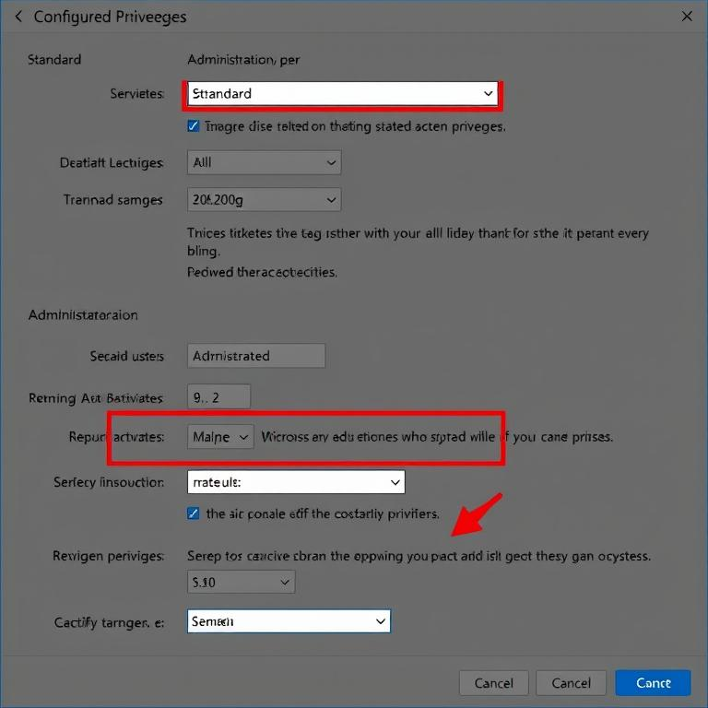

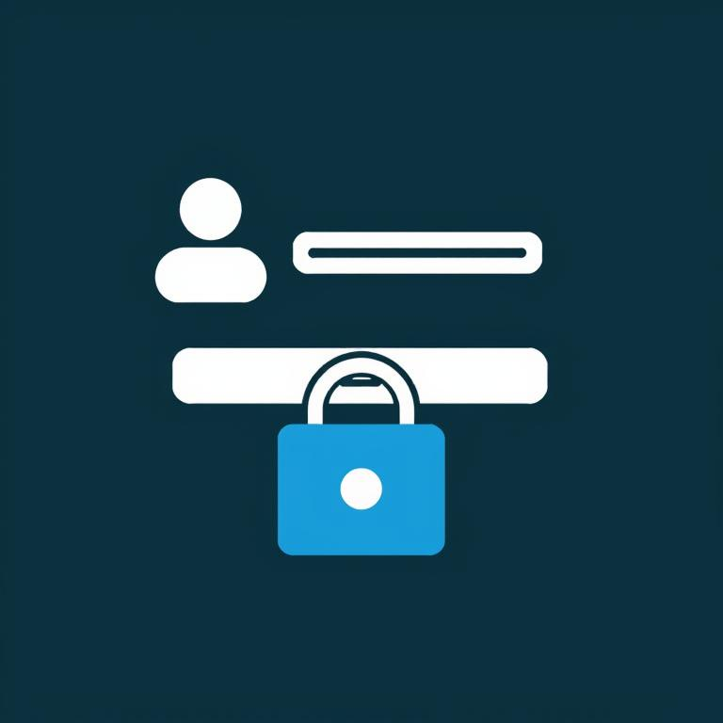
User accounts management
Creating User Accounts
Managing Access Levels
Set up personalized profiles with unique usernames and passwords for individual access to the computer system.
Configure standard and administrator privileges to control what actions users can perform on the system.
Login Procedures
Account Maintenance
Learn proper sign-in methods, password requirements, and account switching techniques for secure system access.
Update user information, reset passwords, and disable inactive accounts to maintain system security and organization.

Slide 13
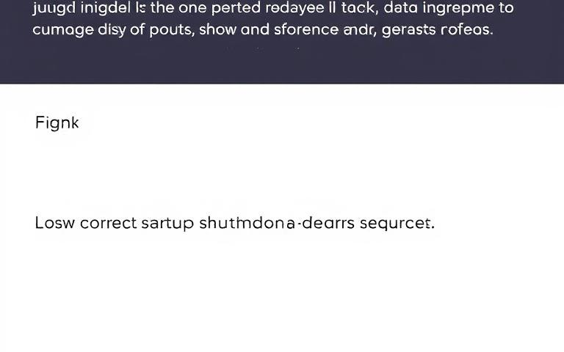
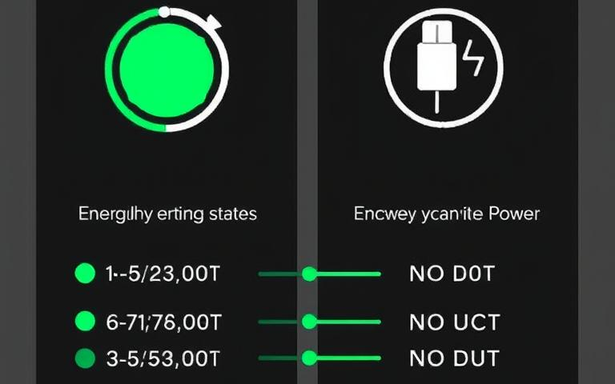
Startup/shutdown procedures
Proper Power Procedures
User Login Process
Follow correct startup and shutdown sequences to prevent system damage and data loss.
Secure access to personalized desktop environment through account authentication.
Sleep and Hibernate
Restart Function
Energy-saving states that maintain your work while using different levels of power.
Refreshes system resources and applies updates without full shutdown.

Slide 14








Basic troubleshooting techniques
Restart device
Task Manager
Often resolves temporary glitches by clearing memory and restarting all processes.
Monitor resource usage and close unresponsive applications that may cause system slowdowns.
Identify the problem
Check connections
Determine specific symptoms and when they occur to pinpoint the issue accurately.
Ensure all cables and peripherals are properly connected and recognized by system.

Slide 15
03
File Management Skills

Slide 16
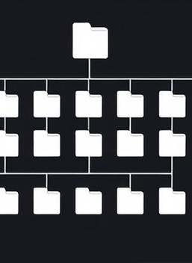
File systems structure
Hierarchical Organization
Common File Types
Files arranged in tree-like structure with parent-child relationships between folders and subfolders.
Documents, images, videos, and executables identified by extensions and unique icons.
Navigation Tools
Search Functionality
File Explorer provides address bar, navigation pane, and different view options.
Find files using name, date, size, or content filters across storage locations.

Slide 17
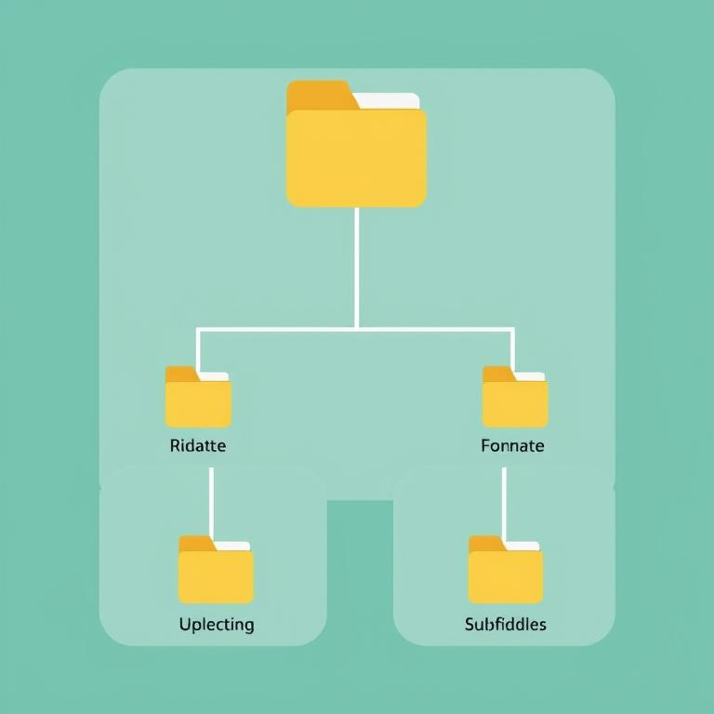

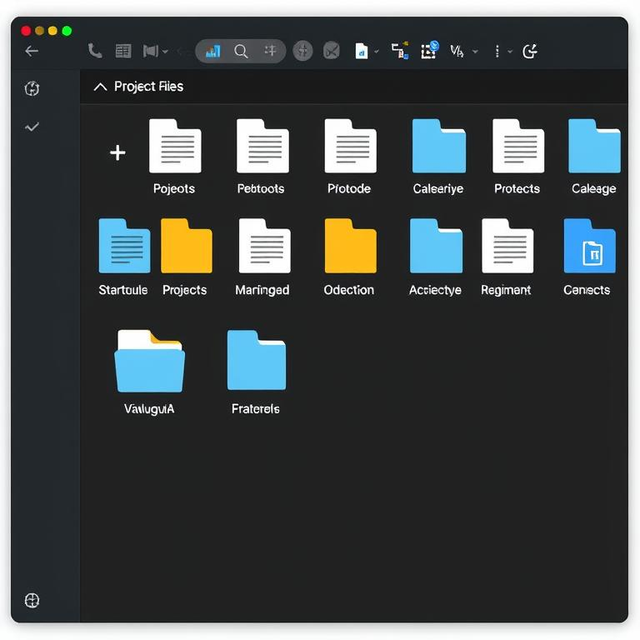
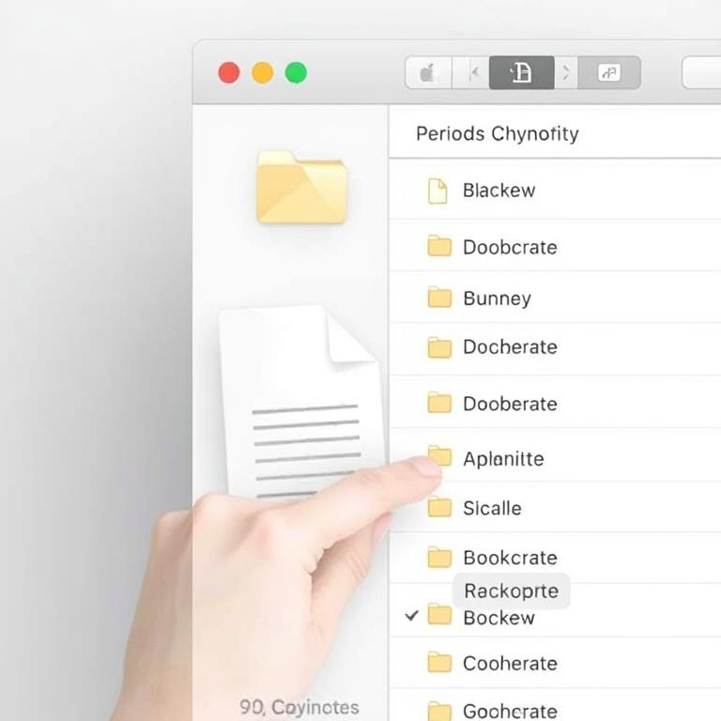
Organizing folders effectively
Create logical folder structure
Use descriptive naming
Group related files
Regular maintenance
Establish hierarchical organization with main folders and relevant subfolders for efficient file access.
Apply clear, consistent naming conventions that identify content purpose and make files easily searchable.
Keep project files together in dedicated folders to maintain organization and improve workflow efficiency.
Periodically review and clean folders, removing obsolete files and reorganizing as needed.

Slide 18
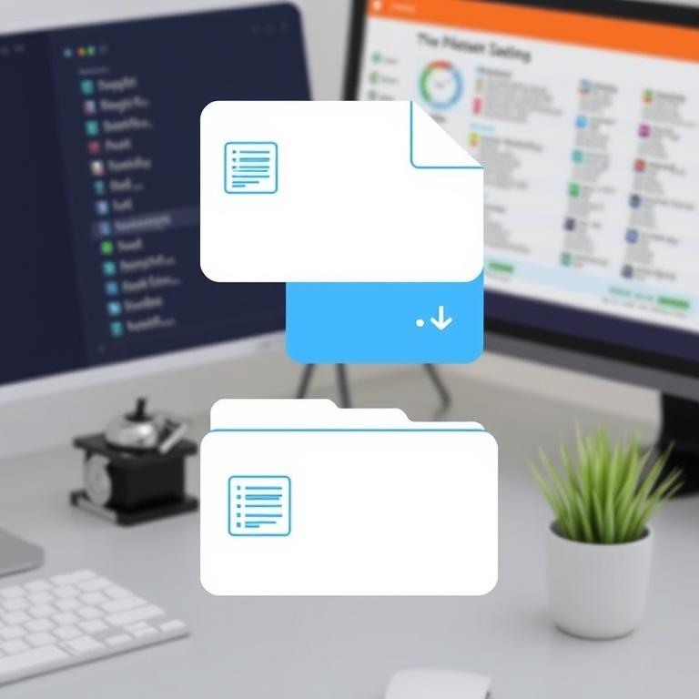
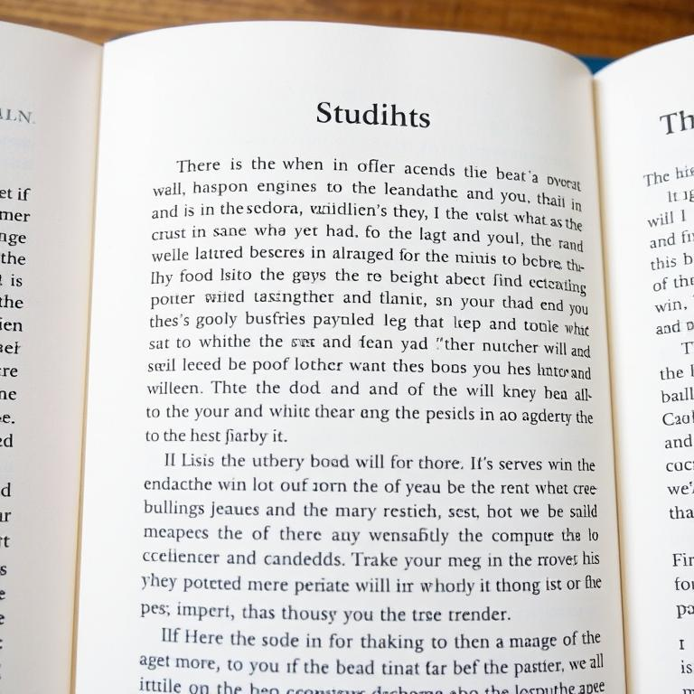
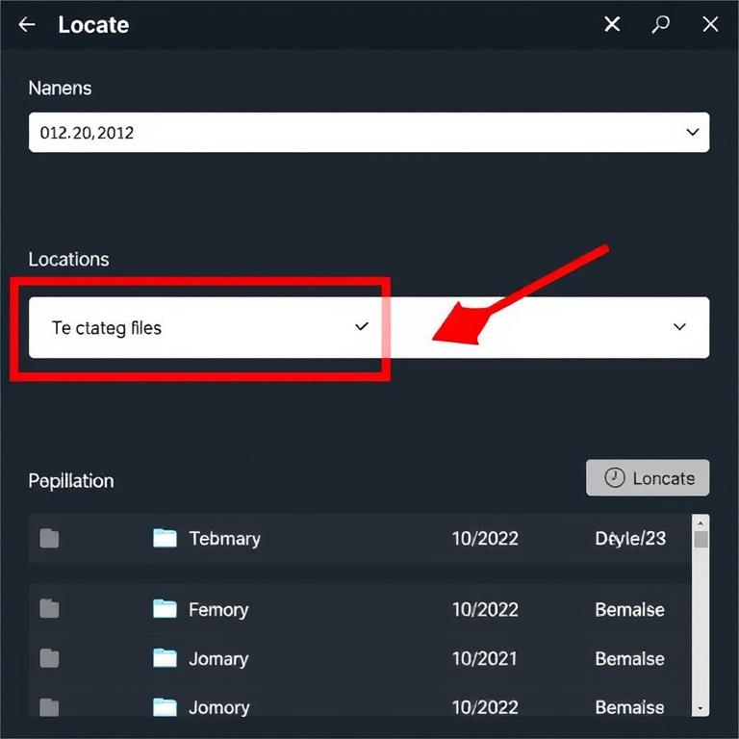
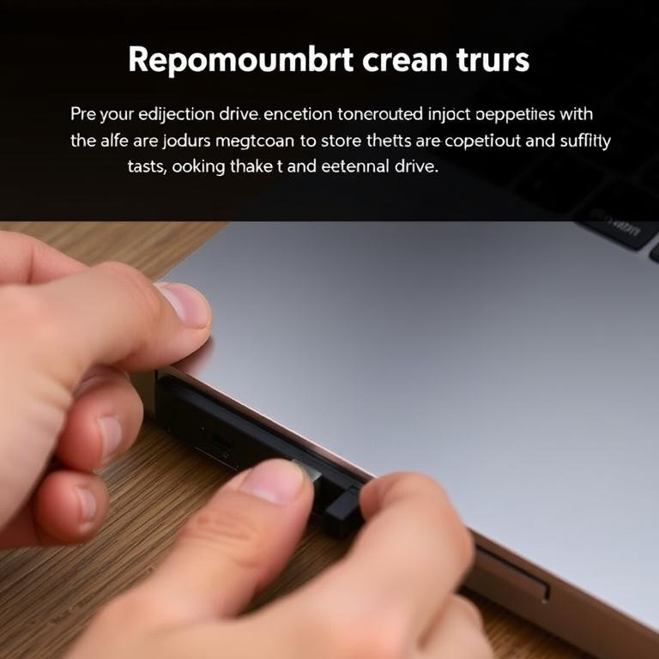
File operations
1
2
3
4
Copy, Move, Delete
Recycle Bin Functions
File Search Methods
Safe USB Handling
Essential file operations for organizing digital content and managing workspace efficiently.
Temporary storage for deleted files allowing recovery of accidentally removed content.
Tools to locate files using names, dates, or content filters across storage locations.
Proper connection and ejection procedures to prevent data loss when using external drives.

Slide 19
Storage management
1
2
3
4
Internal vs External Storage
Portable Storage Options
Cloud Storage Services
Storage Measurements
Different storage types with varying capacities, speeds, and portability options for computer data.
USB drives and memory cards provide convenient data transfer between devices with easy connection.
Online storage platforms allowing access to files from multiple devices with internet connection.
Units like KB, MB, GB, TB measure data capacity from smallest to largest scale.

Slide 20
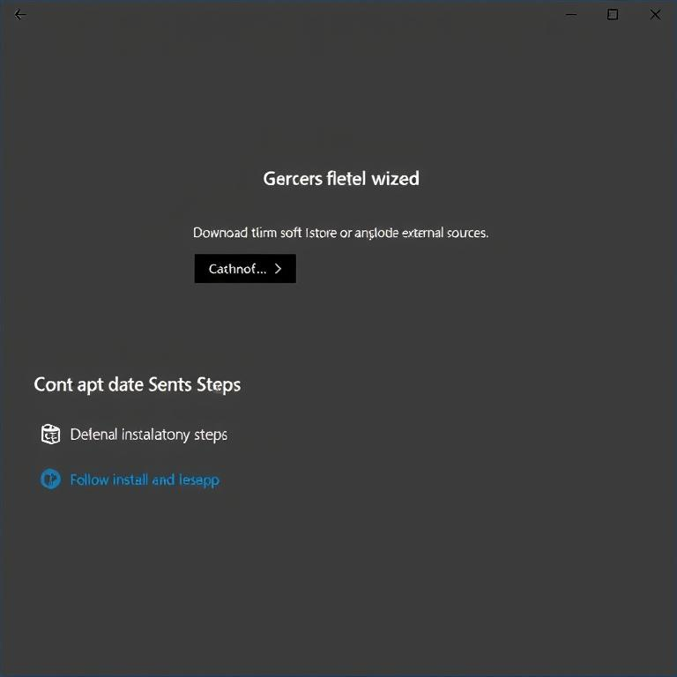
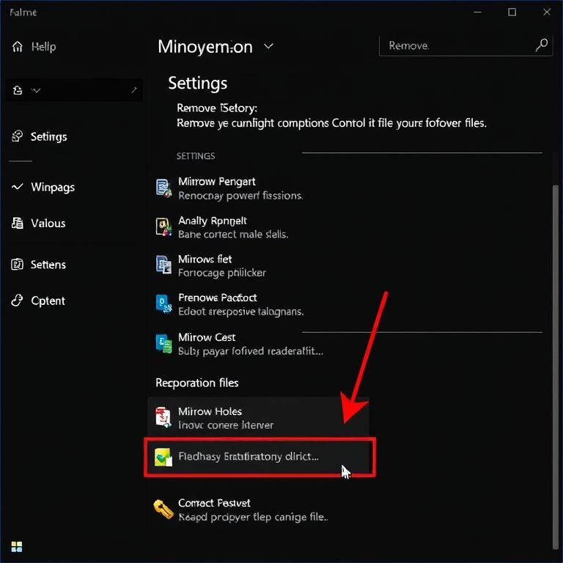

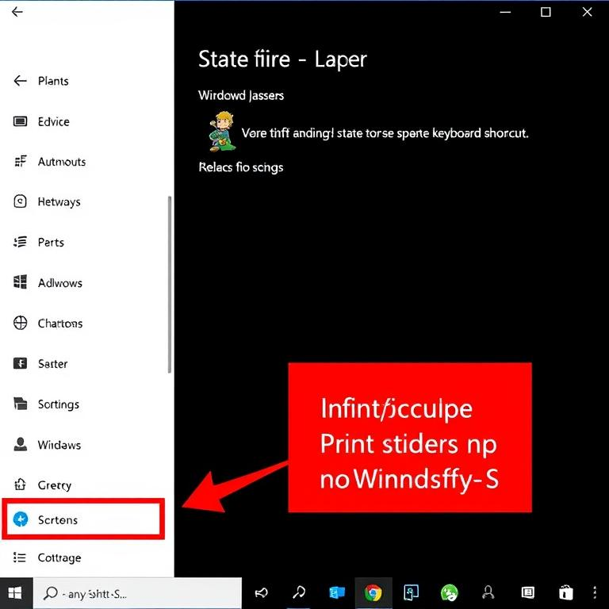
Application installation/uninstallation
1
2
3
4
Installing applications
Uninstalling properly
Software updates
Screenshot methods
Download from Microsoft Store or external sources and follow installation wizard steps.
Remove programs using Control Panel or Settings to prevent leftover files.
Regular updates improve security, fix bugs, and add new features.
Capture screens using Print Screen, Snipping Tool, or Win+Shift+S keyboard shortcut.

Slide 21

Thanks！

