Slide 1
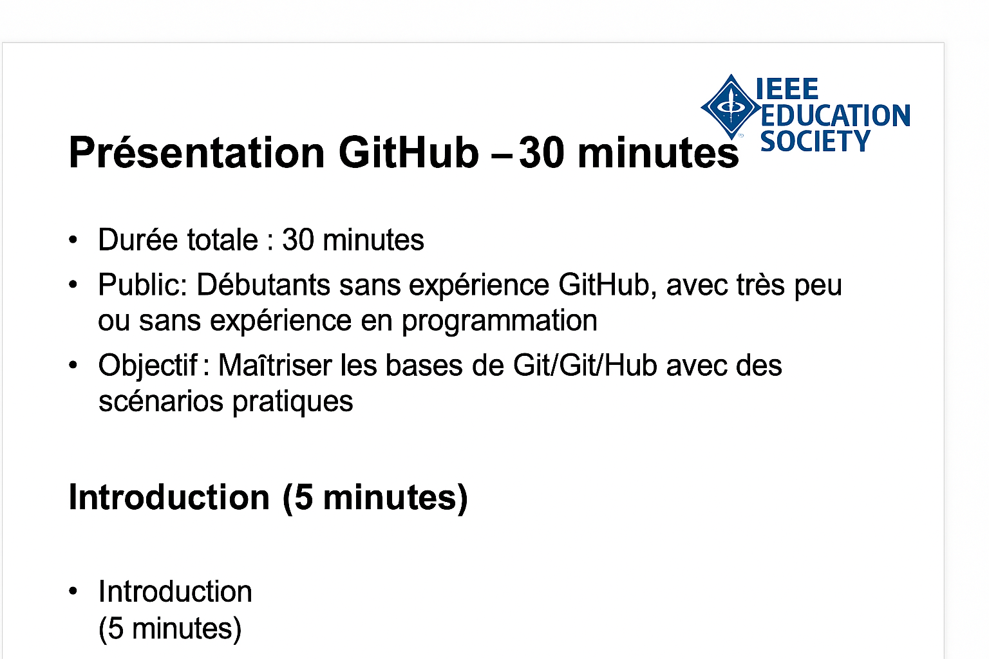
GitHub Presentation – 30 minutes
Total Duration: 30 minutes
Audience: Beginners with little or no GitHub experience
Goal: Master Git/GitHub basics through practical scenarios

Slide 2
Introduction (5 minutes)
Overview of objectives and agenda

Slide 3
Key Steps
1. Create a GitHub account
2. Initialize a repository
3. Commit and Push

Slide 4
Practical Scenarios
Example: Collaborating on an open-source project

Slide 5
Cheat Sheet
Essential Git commands:
- git init
- git add
- git commit
- git push

Slide 6
Exercises
Create a repository and make a commit

Slide 7
Questions & Support
Thank you for your attention!

