Slide 1
UI
Cartes
schedule
…
Timetable view
Csv parser
… parser
Controller
Route view
Data Importer
Map view
Route calculator
Transport Map
Geo Map
GPS calculator

Slide 2
Initially need to create:
walkGraph : Map< Node, Set<WalkSegment> >
Node :
StartPoint
MetroStation
EndPoint
Segment :
MetroSegment
WalkSegment

Slide 3


To calculate the track need to add segments of actual schedule (include possible repair works, delays due to accidents etc. – changings arrived from controller) to walkGraph
keep all the walkSegments, or replace those for which there is a better time (thanks to the metroSegments available)
repair works on red line
delay 30 minutes on
black line

Slide 4
Launch Dijkstra on this obtained (multi)graph
repair works on red line
delay 30 minutes on
black line

Slide 5
Add start and finish points
Calculate distances to nearest stations of obtained (multi)graph on some radius
Launch Dijkstra for this (multi)graph
repair works on red line
delay 30 minutes on
black line

Slide 6
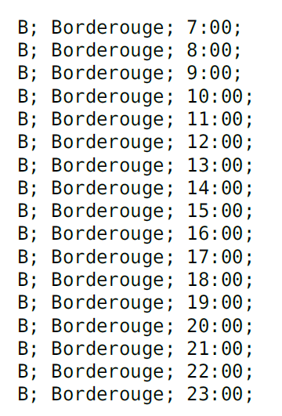
Dijkstra : how to apply according schedules ?
Initial schedule
We work only with copy + delays/annulations possibles
30;
30;
30;
30;
30;
30;
30;
30;
30;
30;
30;
30;
30;
30;
30;
but how to apply it to Dijkstra?

Slide 7
6:15 ( =22500s )
Dijkstra (details)
next train 7:00 ( =25200s )
Y
300s
500s
200s
450s
1000s
900s
250s
270s
300s
450s
300s
3050s
250s
X
330s
250s
7:00 ( =25200s)
7:20 ( =26400s)
7:30 ( =27000s)
7:40 ( =27600s )

Slide 8
Algo description
B
25200
B
26000
A
A
C
C
27000
Set initial weight for all vertex = ꚙ
Create structure of vertex (let’s call it ‘parens’), which size = nb of vertex
For each destination vertex we are setting weight as: Tw + Tt, where Tw – wait time for next train starting for current time at station, Tt – travel time in train to next station
Lest say we are starting from station A (start) at day time 25200 (seconds). We must set as weight to A value 25200.
Initialize all cases of ‘parents’ by vertex A
Then we need to estimate travel time to available neighbors, let’s say B & C
Nearest train to B start at 25400 and arrive to B at 26000, so Tw=200s, Tt=600, so weight of B will be 25200+200+600 = 26000. In ‘parent’ for B we check A.
The same way we must estimate weight of C, let’s say it will be 28000 (Tw=2000, Tt=800). ‘parent’ of C is A.
If there is no other destinations from A we mark it as visited
Then between C & B we must select vertex with smallest weight – B. From station B we start estimating other ways, there is only one to C, and this way gives weight of 27000, which is less than current value of 28000. Thus we must update weight of C to 27000. And also update his ‘parent’ by B.
From B there is no other ways – B is visited.
From C there is no other ways – C is visited.
All vertexes are visited, estimation is over.
To find the иуые path till whatever vertex, just use ‘parents’

Slide 9
Dijkstra (details)
6:15 ( =22500s )
repair works on red line
next train 7:00 ( =25200s )
300s
2950s
450s
1000s
900s
250s
270s
300s
450s
3050s
X + 1800s
330s
delay 30 minutes on black line

Slide 11
Future problems and solutions:
Time is counted from 00:00:00 (0 seconds) of one day and ends at
23:59:59 (86399 seconds) of the same day.
If the route involves the passage of midnight, then we need to subtract 86399,
convert to hh:mm:ss format and specify +1 day (arrival the next day at calculated time).

