Slide 1
[JAVA TRAINING] Basic
Providing basic knowledge of java

Slide 2
OUTLINE
Basic JAVA Programming
Hello world program
Variables
OOP
JAVA Conventions
JAVA Performance
This session assumes you have basic knowledge about programming

Slide 3
Hello World
Creating a file helloworld.java
public class HelloWorld {
public static void main( String[] args ) {
System.out.println(“Hello, World”);
}
}
Trying to compile it and launch it from command line
Notes:
1. Describe what happens if, in HelloWorld.java, you omit
public
static
void
args

Slide 4
variable
public class CoreMWEcimSWMTest {
public static final String resourcePath= “/home/cluster/incoming”;
public String UpgradeName = “ECIMTEST1”;
public clusterReboot(){
int retry = 5;
String result = null;
while( retry > 0){
result = sshlib.sendCommand(“cluster reboot –a –q”);
assertEqual(“1”, result);
}
}
CoreMWEcimSWMTest test1;
test1.clusterReboot();
System.out.println(“resourcePath = “ + CoreMWEcimSWMTest.resourcePath);
In Java, every variable has to stay in a class.
There are three kinds of variables
Instance variable - None-static variable
Class variable - Static variable
Local variable

Slide 5
OOP
Access Levels table in Java
Modifier | Class | Package | Subclass | World
public | Y | Y | Y | Y
protected | Y | Y | Y | N
no modifier | Y | Y | N | N
private | Y | N | N | N

Slide 6
OOP
Parent class object will be created before child class object
But the child object will be destroyed before its parent object
There is no “da thua ke trong java” but a class can implement for multiple interfaces

Slide 7
OOP
Polymorphism
Up-casting
Down-casting
Used to parameter input
Used to a member of class
Notes:
Person p;Employee e = new Employee(); p = (Person) e; p.setName(...); p.setSalary(...); // compile error
String teamInfo(Person p1, Person p2) {return "Leader: " + p1.getName() +"; member: " + p2.getName();}...Employee e1, e2; Manager m1, m2;…System.out.println(teamInfo(e1, e2));teamInfo(m1, m2); teamInfo(m1,e2);
class Manager extends Employee {Employee assistant;... public void setAssistant(Employee e) {assistant = e;}...}... Manager junior, senior;...senior.setAssistant(junior);
Case Team Leader →

Slide 8
JAVA CONVENTIONS
Class, Interface:
Class names should be nouns, in mixed case with the first letter of each internal word capitalized.
Method:
Methods should be verbs
In mixed case with the first letter lowercase, with the first letter of each internal word capitalized.
Example: run(), runFast(), getBackground().
Variable:
Lowercase first letter and internal words start with capital letters
Constant:
Uppercase with words separated by underscores (“_”).
Example: int MIN_WIDTH = 4; int MAX_WIDTH = 999; int GET_THE_CPU = 1;

Slide 9
Java conventions
Indentation:
Suggesting use the tab only (8/4 space tab)
{}
Wrapping lines:
Break before an operator
Comment:
/**
@ …..
…..
**/
Or
//
try {
//
//
} catch ( Exception e){
}

Slide 10
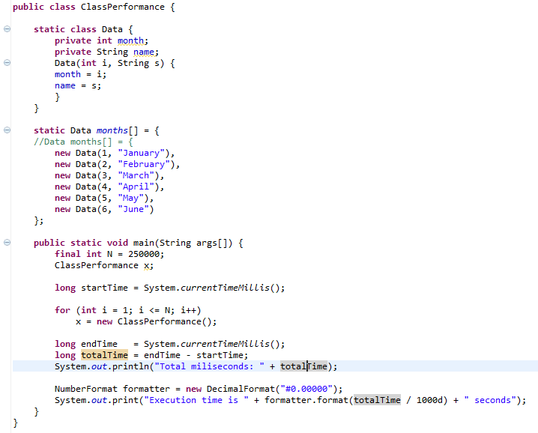
Improve Performance - Class
Instance Initialization
Static or not?
Static data: 27miliseconds
Non-static data: 278miliseconds

Slide 11
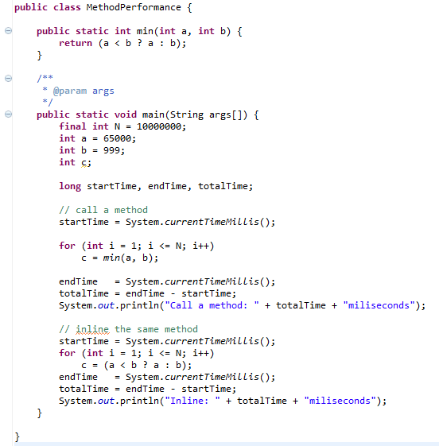
Improve Performance – Method (1)
Inline Method
Call a method: 416miliseconds
Inline: 204miliseconds
Inline method or not?

Slide 12
Improve Performance – String (1)
Remember: Java strings are Immutable
It meant, if you do like this:
it’ll be translated like this:
The two strings to be concatenated are copied to a temporary string buffer, then copied back.
String str = “testing”;
str += “abc”;
String str = "testing";
StringBuffer tmp = new StringBuffer(str);
tmp.append("abc");
str = tmp.toString();

Slide 13
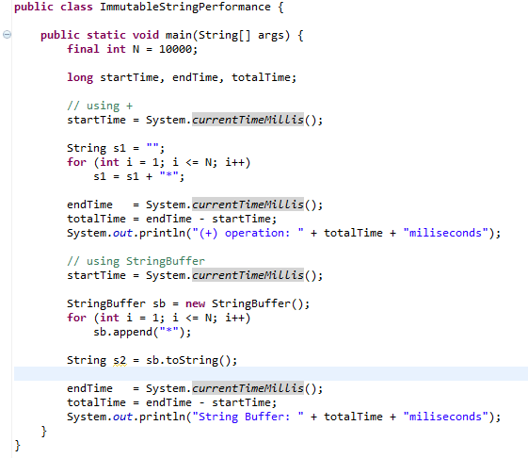
Improve Performance – String (2)
(+) operation vs. string buffer?
(+) operation: 163miliseconds
String Buffer: 4miliseconds

Slide 14
Improve Performance – String (3)
Some string functions are expensive: length(), charAt()
X Don’t
for (int i = 0; i < str.length(); i++)
int len = str.length();
for (int i = 0; i < len; i++)
X Don’t
for (int i = 0; i < len; i++)
if (s.charAt(i) == 'x')
char ss[] = s.toCharArray();
for (int i = 0; i < len; i++)
if (ss[i] == 'x')

