Slide 1

[ JAVA TRAINING ]
Providing Basic Knowledge of Java
By TrungHuynh

Slide 2
Outline
Basic Java Programming
Hello world program
Variables
OOP
Java Conventions
Java Performance
Mini Project

Slide 3
HELLO WORLD
Creating a file helloworld.java
Trying to complie it and launch it from command line
public class HelloWorld {
public static void main( String[] args ) {
System.out.println(“Hello, World”);
}
}

Slide 4
Variable
In Java, every variable has to stay in a class
There are three kinds of variables:
Instance variable – None static variable
Class variable – Static variable
Local variable
public class CoreMWEcimSWMTest {
public static final String resourcePath= “/home/cluster/incoming”;
public String UpgradeName = “ECIMTEST1”;
public clusterReboot(){
int retry = 5;
String result = null;
while( retry > 0){
result = sshlib.sendCommand(“cluster reboot –a –q”);
assertEqual(“1”, result);
}
}
CoreMWEcimSWMTest test1;
test1.clusterReboot();
System.out.println(“resourcePath = “ + CoreMWEcimSWMTest.resourcePath);

Slide 5
OOP – Object Oriented Programming
Access Levels table in Java
Modifier | Class | Package | Subclass | World
public | Y | Y | Y | Y
protected | Y | Y | Y | N
no modifier | Y | Y | N | N
private | Y | N | N | N

Slide 6
OOP – Object Oriented Programming
Parent class object will be created before child class object
But the child object will be destroyed before its parent object
Java does not support multiple inheritances but a class can implement for multiple interfaces
public class Engineer implements Employee, Person {}
public class Engineer extends Employee, Person {}
Button
Exit_Btn
LogIn_Btn

Slide 7
OOP – Object Oriented Programming
Polymorphism
Up-casting
Down-casting
Used to parameter input
Used to a member of class
Person p;
Employee e = new Employee();
p = (Person) e;
p.setName(...);
p.setSalary(...); // compile error
String teamInfo(Person p1, Person p2) {
return "Leader: " + p1.getName() +"; member: " + p2.getName();}...
Employee e1, e2; Manager m1, m2;…
System.out.println(teamInfo(e1, e2));
teamInfo(m1, m2); teamInfo(m1,e2);
class Manager extends Employee {
Employee assistant;...
public void setAssistant(Employee e) {
assistant = e;
}...
}...
Manager junior, senior;...
senior.setAssistant(junior);
Notes:
Person p;Employee e = new Employee(); p = (Person) e; p.setName(...); p.setSalary(...); // compile error
String teamInfo(Person p1, Person p2) {return "Leader: " + p1.getName() +"; member: " + p2.getName();}...Employee e1, e2; Manager m1, m2;…System.out.println(teamInfo(e1, e2));teamInfo(m1, m2); teamInfo(m1,e2);
class Manager extends Employee {Employee assistant;... public void setAssistant(Employee e) {assistant = e;}...}... Manager junior, senior;...senior.setAssistant(junior);

Slide 8
Java Conventions
Interface:
Class names should be nouns, in mixed case with the first letter of each internal word capitalized.
Method:
Methods should be verbs
In mixed case with the first letter lowercase, with the first letter of each internal word capitalized.
Example: run(), runFast(), getBackground().
Variable:
Lowercase first letter and internal words start with capital letters
Constant:
Uppercase with words separated by underscores (“_”).
Example: int MIN_WIDTH = 4; int MAX_WIDTH = 999; int GET_THE_CPU = 1;

Slide 9
Java Conventions
Indentation:
Suggesting use only the tab (8/4 space tab)
Wrapping lines:
Break before an operator
{}
try {
//
//
} catch ( Exception e){
}

Slide 10
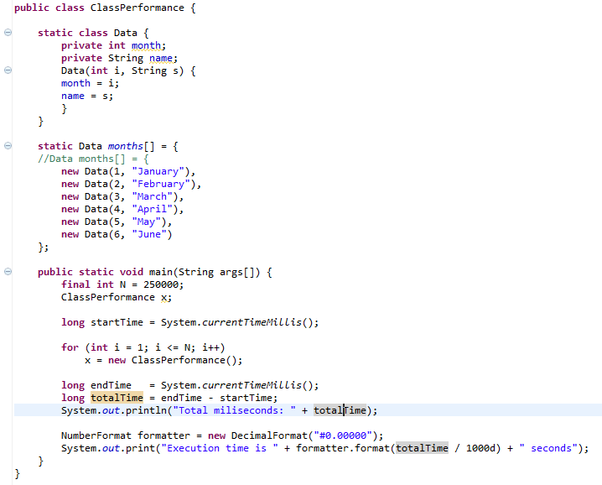
Improve Performance - Class
Instance Initialization
Static or not?
Static data: 27miliseconds
Non-static data: 278miliseconds

Slide 11
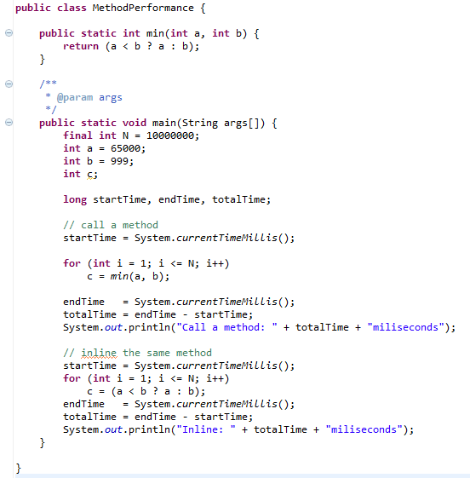
Improve Performance – Method (1)
Inline method or not?
Inline Method
Call a method: 416miliseconds
Inline: 204miliseconds

Slide 12
Improve Performance – String (1)
Remember: Java strings are Immutable
It meant, if you do like this:
it’ll be translated like this:
The two strings to be concatenated are copied to a temporary string buffer, then copied back.
String str = “testing”;
str += “abc”;
String str = "testing";
StringBuffer tmp = new StringBuffer(str);
tmp.append("abc");
str = tmp.toString();

Slide 13
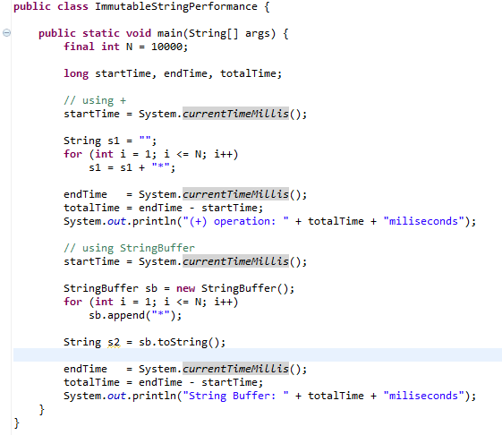
Improve Performance – String (2)
(+) operation: 163miliseconds
String Buffer: 4miliseconds

Slide 14
End
Thank for your listening
Questions ?
References:
http://introcs.cs.princeton.edu/
Think In Java
http://docs.oracle.com/javase/tutorial/java/javaOO/classdecl.html

