Slide 1
Programming Language Concepts
CSE 3302 / 5307 - Dr. Kenny Zhu
Tutorial 05
Wonjun Park

Slide 2
Homework 4

Slide 3

Problem 1 Description

Slide 4
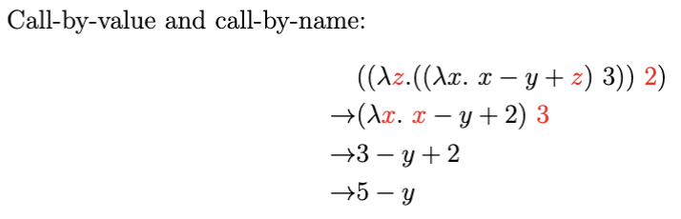
Problem 1 Solution

Slide 5

Problem 1 Description

Slide 6
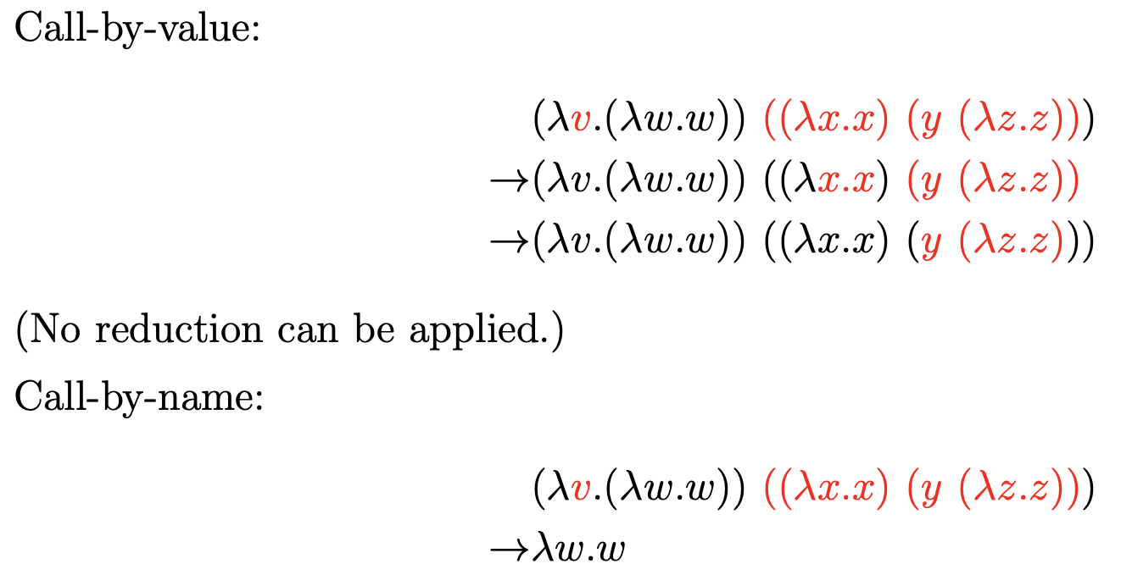
Problem 1 Solution

Slide 7

Problem 1 Description

Slide 8
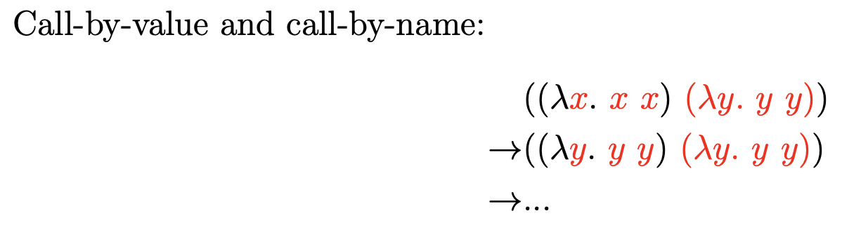
Problem 1 Solution

Slide 9

Problem 1 Description

Slide 10
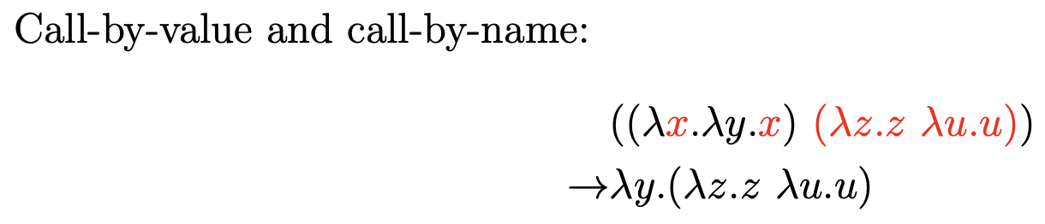
Problem 1 Solution

Slide 11
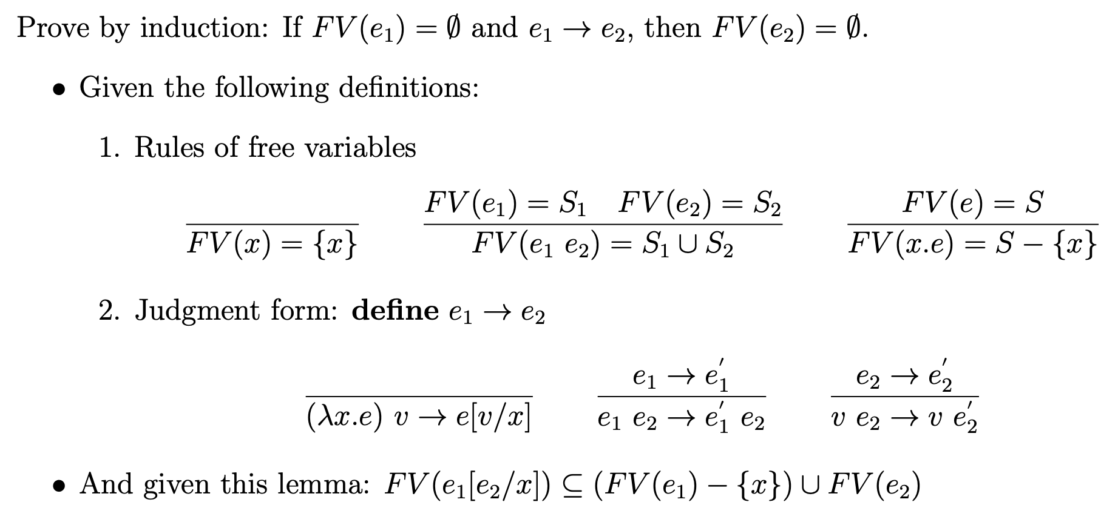
Problem 2 Description

Slide 12
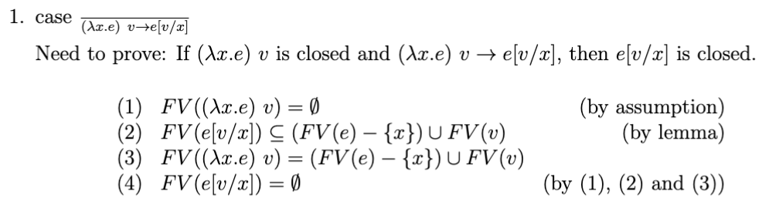
Problem 2 Solution

Slide 13
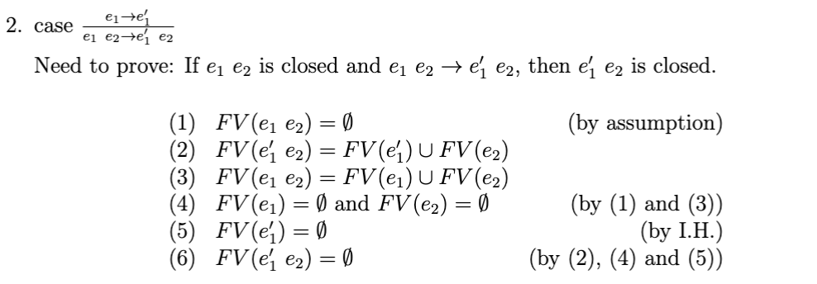
Problem 2 Solution

Slide 14
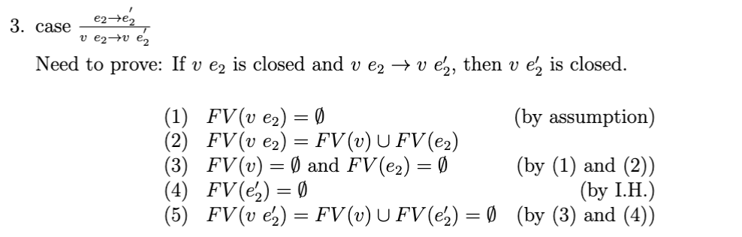
Problem 2 Solution

Slide 15
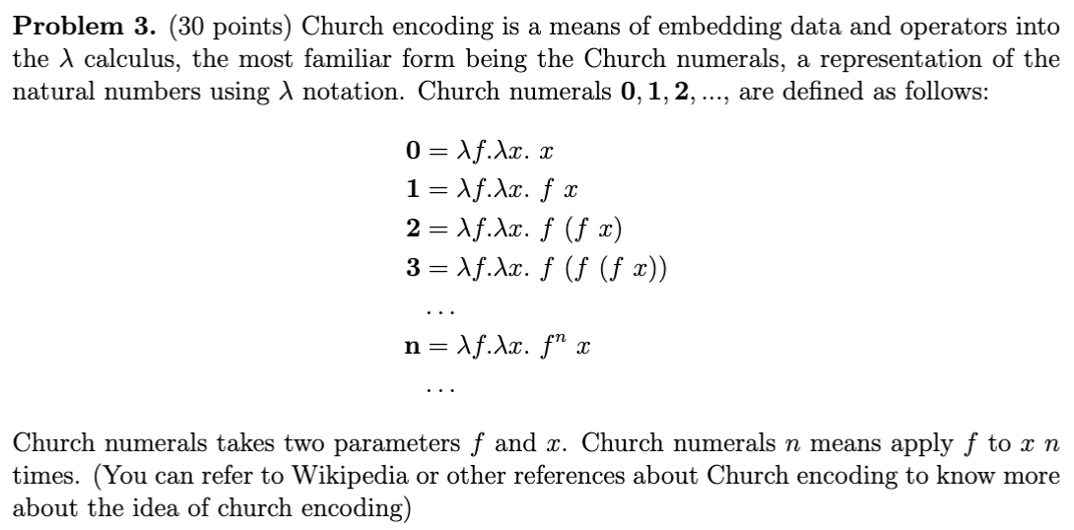
Problem 3 Description

Slide 16

Problem 3 Description

Slide 17

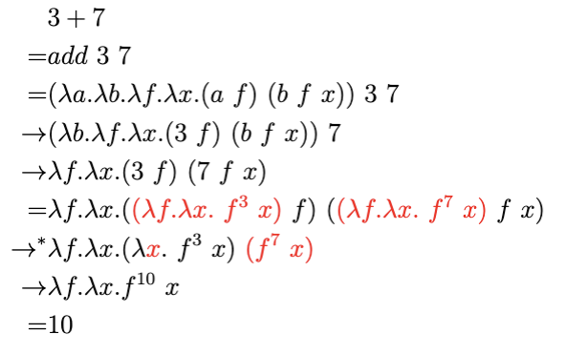
Problem 3 Solution

Slide 18

Problem 3 Description

Slide 19
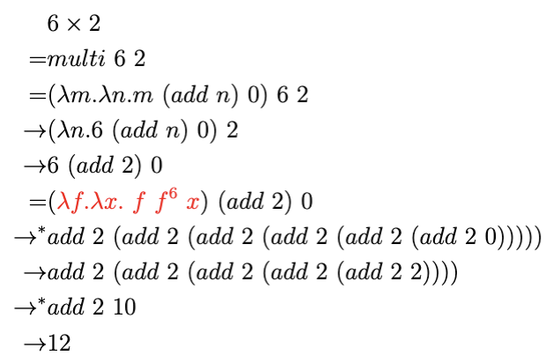

Problem 3 Solution

