Slide 1
CSE 3302 / 5307 Programming Language Concepts
Tutorial 03
Wonjun Park

Slide 2
Announcement
For 5307 students,
Please submit your homework through email,
until a further notice in the future.

Slide 3
Content
Quiz
Homework 2

Slide 4
Quiz

Slide 5
1. “succ(n) nat” is a judgement or judgement form ?
a. judgement
b. Judgement form

Slide 6
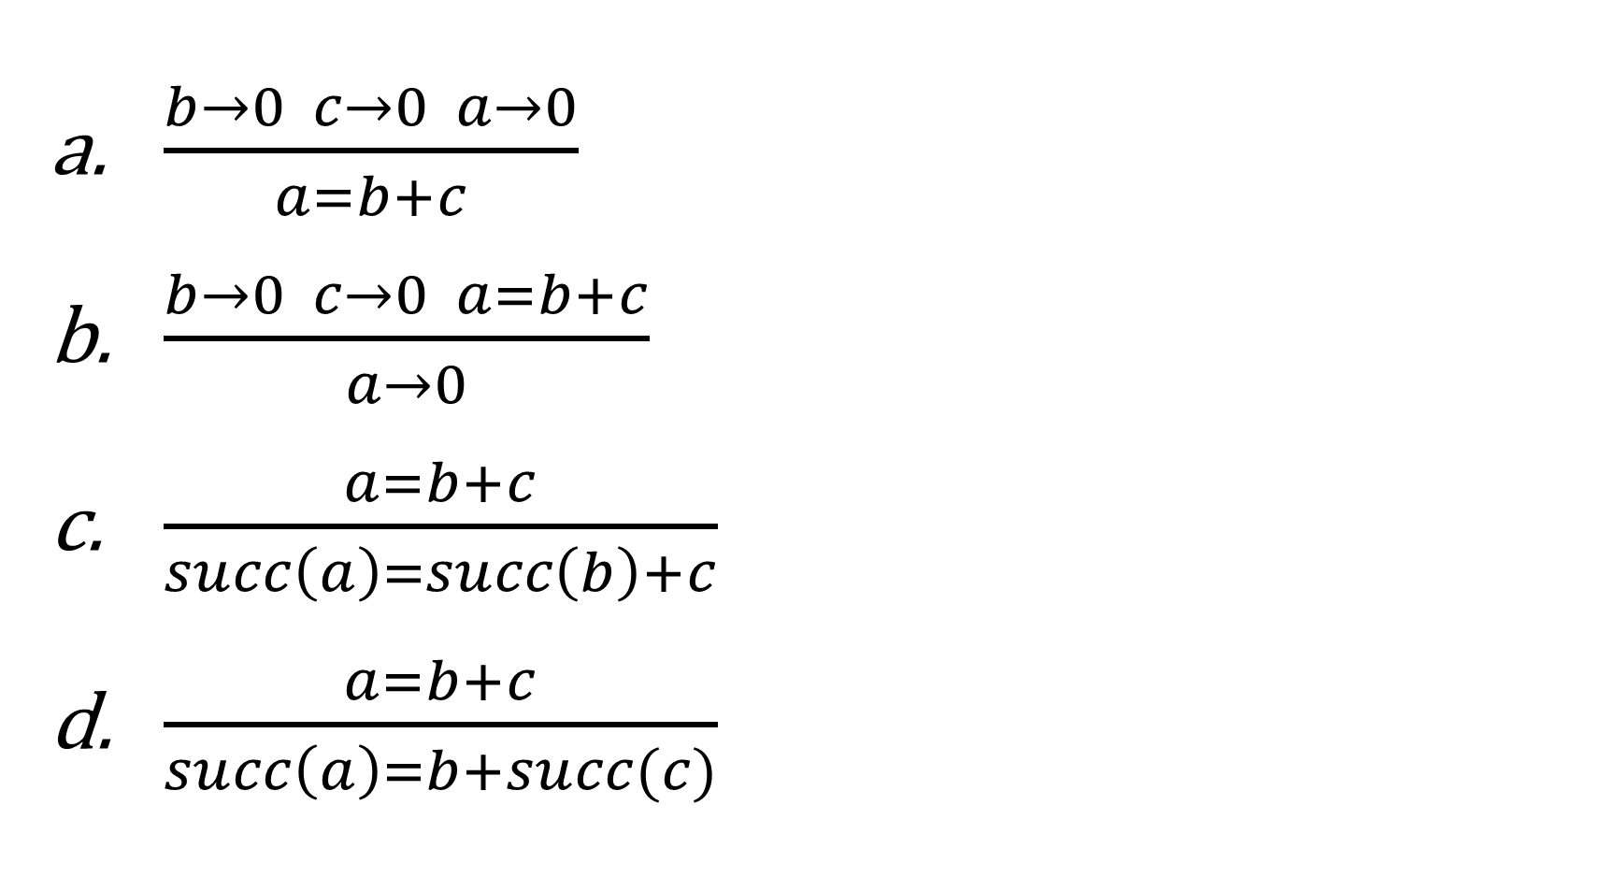
2. Which one of the following is NOT a rule of definition of judgement form a = b + c?

Slide 7
3. A bottom-up derivation of a judgement starts from ?
Proper rules
Axioms
Premises
Conclusion

Slide 8
4. Which one of the following is NOT a part of doing an inductive proof?
Clearly state the induction hypothesis.
Make a proper inductive definition.
Clearly state what you are doing induction on.
Show one case for each rule in the inductive definition.

Slide 9
5. If the structure of your induction hypothesis is “If X or Y then A”, which of the following things is proper for you to assume and prove?
Assume X or Y, prove A
Assume X and Y, prove A
Assume X prove A, or Assume Y prove A
Assume X prove A, and Assume Y prove A

Slide 10
6. If the structure of your induction hypothesis is “If X and Y then A”, which of the following things is proper for you to assume and prove?
Assume X or Y, prove A
Assume X and Y, prove A
Assume X prove A, or Assume Y prove A
Assume X prove A, and Assume Y prove A

Slide 11
Homework 2

Slide 12
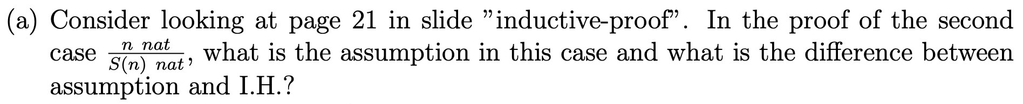
Problem 1 Description

Slide 13
Problem 1 Solution
Assumption is ”n nat”
Assumption is the judgement which are already given,
while I.H. means we can assume that a property P which we want to prove
holds for a particular instance

Slide 14
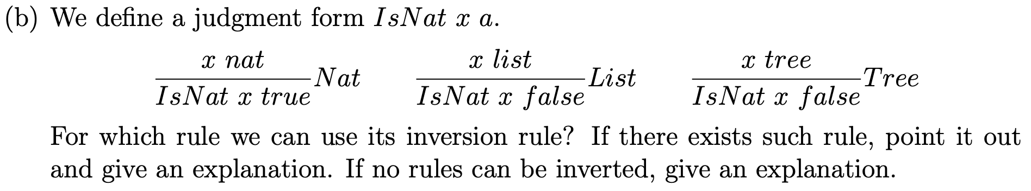
Problem 1 Description

Slide 15
Problem 1 Solution
We can use the inversion rule of Nat
<- “IsNat x false” is not guaranteed x is list or Tree

Slide 16
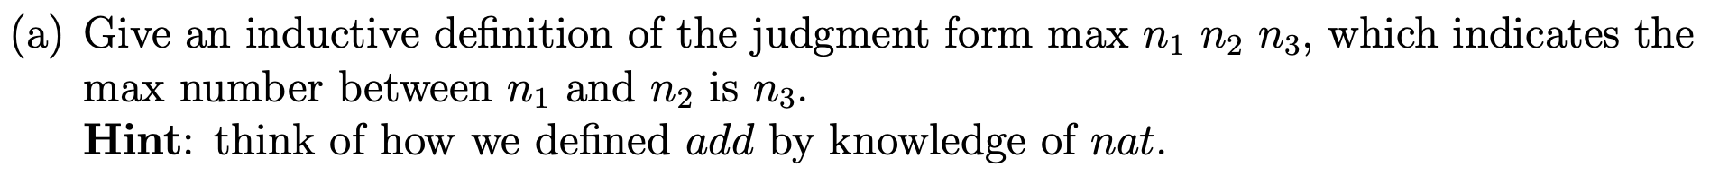
Problem 2 Description

Slide 17
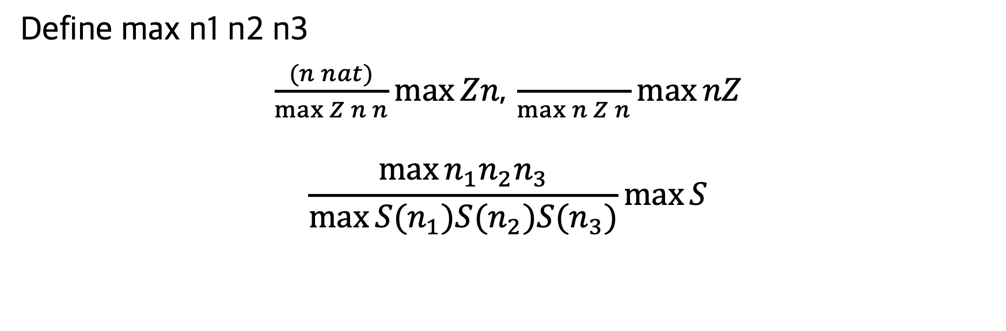
Problem 2 Solution
Define max n1 n2 n3
$\frac{(n nat)}{\max{Z n n}}\max{Zn}$, $\frac{}{\max{n Z n}}\max{nZ}$
$$\frac{\max{n_{1}n_{2}n_{3}}}{\max{{S(n}_{1}){S(n}_{2}){S(n}_{3})}}\max{S}$$

Slide 18
Problem 2 Description

Slide 19
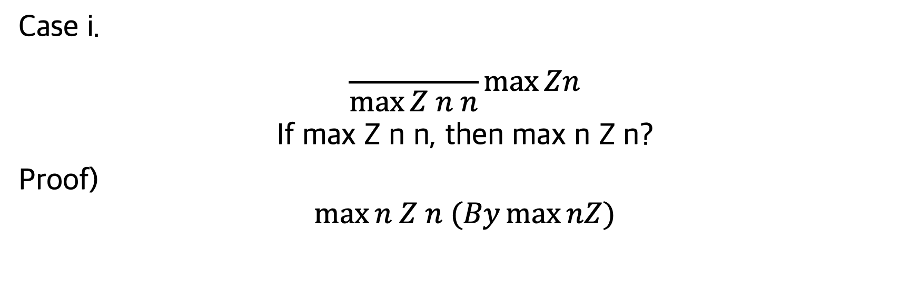
Problem 2 Solution
Case i.
$$\frac{}{\max{Z n n}}\max{Zn}$$
If max Z n n, then max n Z n?
Proof)
$$\max{n Z n (By\max{nZ)}}$$

Slide 20
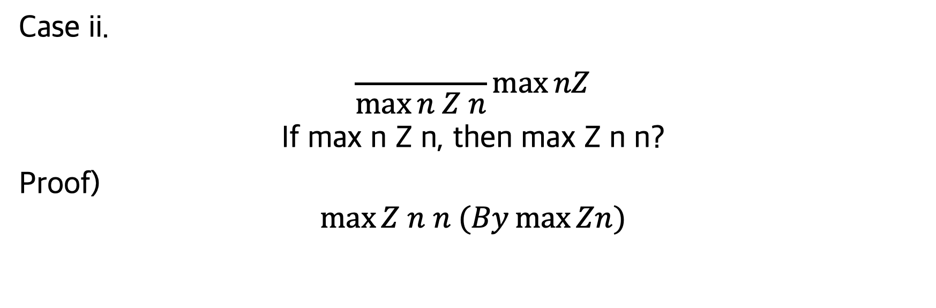
Problem 2 Solution
Case ii.
$$\frac{}{\max{n Z n}}\max{nZ}$$
If max n Z n, then max Z n n?
Proof)
$$\max{Z n n (By\max{Zn)}}$$

Slide 21
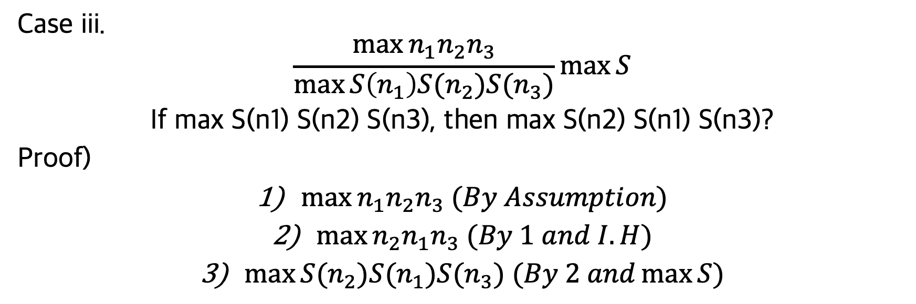
Problem 2 Solution
Case iii.
$$\frac{\max{n_{1}n_{2}n_{3}}}{\max{S\left(n_{1}\right)S(n_{2})S(n_{3})}}\max{S}$$
If max S(n1) S(n2) S(n3), then max S(n2) S(n1) S(n3)?
Proof)
$\max{n_{1}n_{2}n_{3} (By Assumption})$
$\max{n_{2}n_{1}n_{3} (By 1 and I.H})$
$\max{{S(n}_{2}{)S(n}_{1})S(n_{3}) (By 2 and\max{S}})$

Slide 22
Problem 3 Description

Slide 23
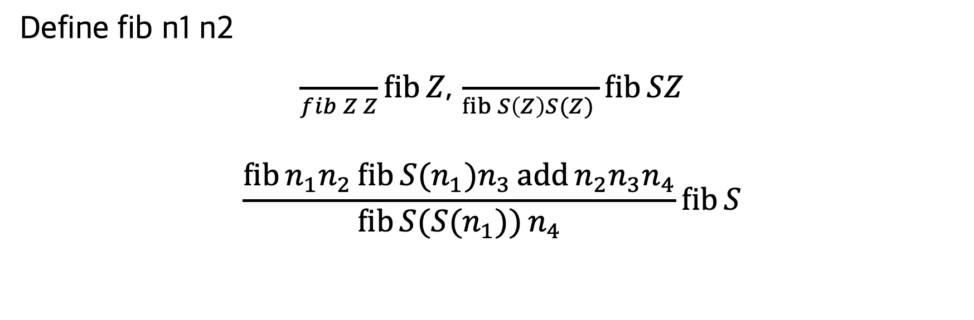
Problem 3 Solution
Define fib n1 n2
$\frac{}{fib Z Z}\operatorname{fib}{Z}$, $\frac{}{\operatorname{fib}{S\left(Z\right)S(Z) }}\operatorname{fib}{SZ}$
$$\frac{\operatorname{fib}{n_{1}n_{2}\operatorname{fib}{{S(n}_{1})n_{3}}\operatorname{add}{n_{2}n_{3}n_{4}}}}{\operatorname{fib}{{S(S(n}_{1}))}n_{4}}\operatorname{fib}{S}$$

Slide 24
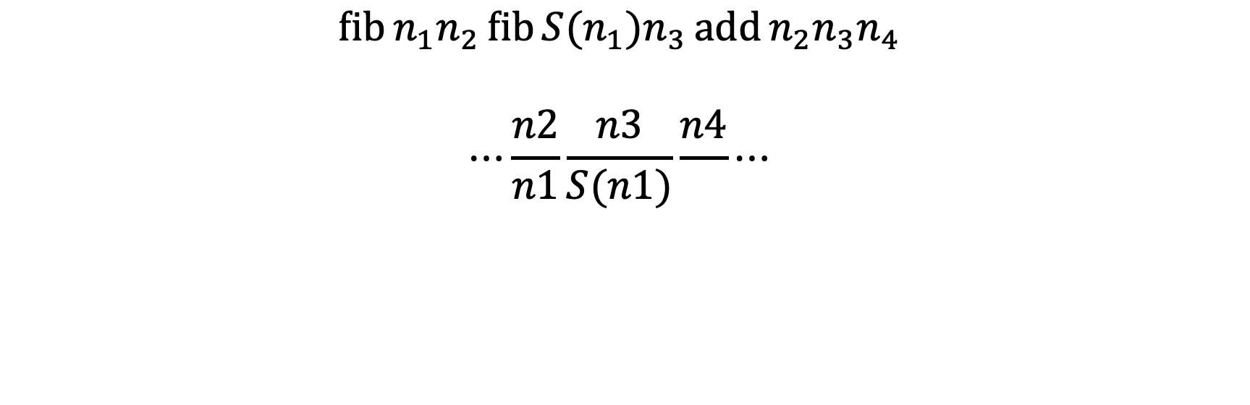
Problem 3 Visualization
$$\operatorname{fib}{n_{1}n_{2}\operatorname{fib}{{S(n}_{1})n_{3}}\operatorname{add}{n_{2}n_{3}n_{4}}}$$
$$⋯\frac{n2}{n1}\frac{n3}{S(n1)}\frac{n4}{}⋯$$

Slide 25
Problem 3 Description

Slide 26
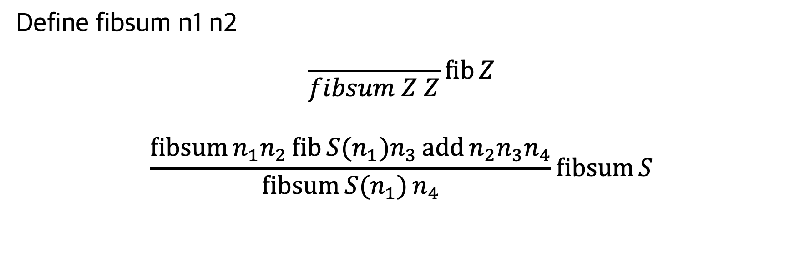
Problem 3 Solution
Define fibsum n1 n2
$$\frac{}{fibsum Z Z}\operatorname{fib}{Z}$$
$$\frac{\operatorname{fibsum}{n_{1}n_{2}\operatorname{fib}{{S(n}_{1})n_{3}}\operatorname{add}{n_{2}n_{3}n_{4}}}}{\operatorname{fibsum}{{S(n}_{1})}n_{4}}\operatorname{fibsum}{S}$$

Slide 27
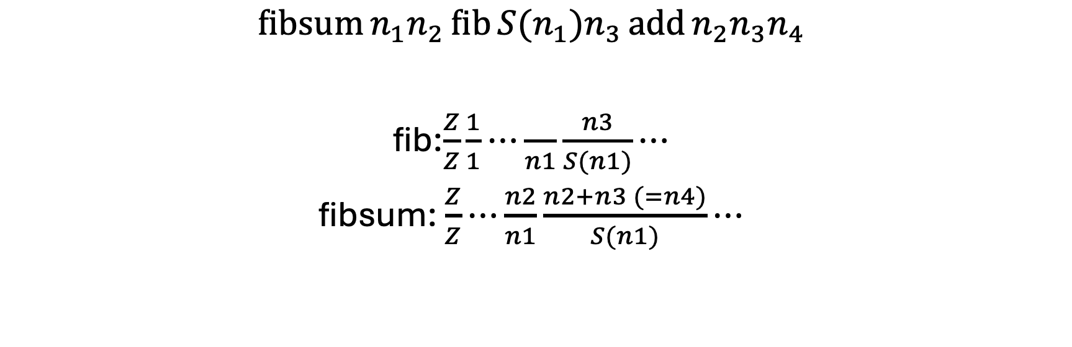
Problem 3 Visualization
$$\operatorname{fibsum}{n_{1}n_{2}\operatorname{fib}{{S(n}_{1})n_{3}}\operatorname{add}{n_{2}n_{3}n_{4}}}$$
fib:$\frac{Z}{Z}\frac{1}{1}⋯\frac{}{n1}\frac{n3}{S(n1)}⋯$
fibsum: $\frac{Z}{Z}⋯\frac{n2}{n1}\frac{n2+n3 (=n4)}{S(n1)}⋯$

Slide 28
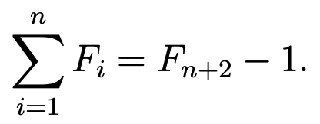
Problem 3 Description

Slide 29
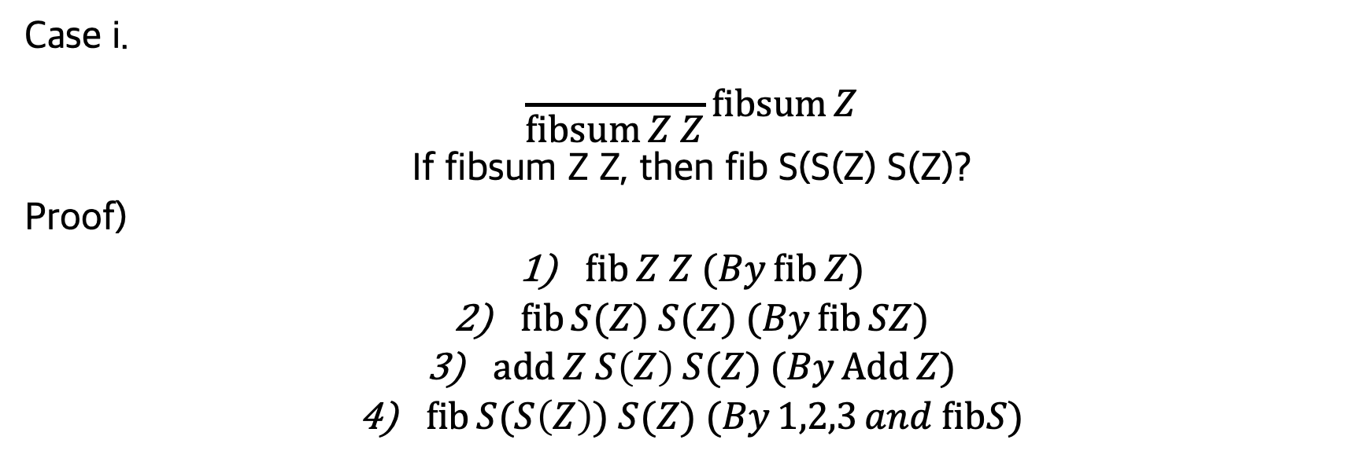
Problem 3 Solution
Case i.
$$\frac{}{\operatorname{fibsum}{Z Z}}\operatorname{fibsum}{Z}$$
If fibsum Z Z, then fib S(S(Z) S(Z)?
Proof)
$\operatorname{fib}{Z Z (By\operatorname{fib}{Z)}}$
$\operatorname{fib}{S(Z) S(Z) (By\operatorname{fib}{SZ)}}$
$\operatorname{add}{Z S\left(Z\right) S(Z) (By\operatorname{Add}{Z)}}$
$\operatorname{fib}{S(S\left(Z\right)) S(Z) (By1,2,3{and fibS)}}$

Slide 30
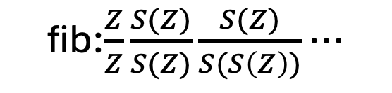
Problem 3 Solution
Case i.
$$\frac{}{\operatorname{fibsum}{Z Z}}\operatorname{fibsum}{Z}$$
If fibsum Z Z, then fib S(S(Z) S(Z)?
Proof)
$\operatorname{fib}{Z Z (By\operatorname{fib}{Z)}}$
$\operatorname{fib}{S(Z) S(Z) (By\operatorname{fib}{SZ)}}$
$\operatorname{add}{Z S\left(Z\right) S(Z) (By\operatorname{Add}{Z)}}$
$\operatorname{fib}{S(S\left(Z\right)) S(Z) (By1,2,3{and fibS)}}$
fib:$\frac{Z}{Z}\frac{S(Z)}{S(Z)}\frac{S(Z)}{S(S\left(Z\right))}⋯$

Slide 31
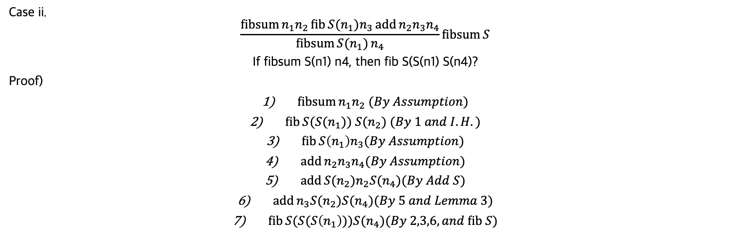
Problem 3 Solution
Case ii.
$$\frac{\operatorname{fibsum}{n_{1}n_{2}\operatorname{fib}{{S(n}_{1})n_{3}}\operatorname{add}{n_{2}n_{3}n_{4}}}}{\operatorname{fibsum}{{S(n}_{1})}n_{4}}\operatorname{fibsum}{S}$$
If fibsum S(n1) n4, then fib S(S(n1) S(n4)?
Proof)
$\operatorname{fibsum}{n_{1}n_{2} (By Assumption)}$
$\operatorname{fib}{S(S(n_{1})) S(n_{2}) (By 1 and I.H.)}$
$\operatorname{fib}{S\left(n_{1}\right)n_{3}(By Assumption)}$
$\operatorname{add}{n_{2}n_{3}n_{4}(By Assumption)}$
$\operatorname{add}{{S(n}_{2})n_{2}{S(n}_{4})(By Add S)}$
$\operatorname{add}{n_{3}S(n_{2}{)S(n}_{4})(By 5 and Lemma 3)}$
$\operatorname{fib}{S(S(S\left(n_{1}\right)){)S(n}_{4})(By 2,3,6, and fib S)}$

Slide 32
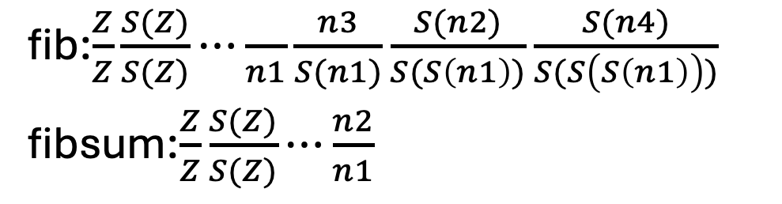
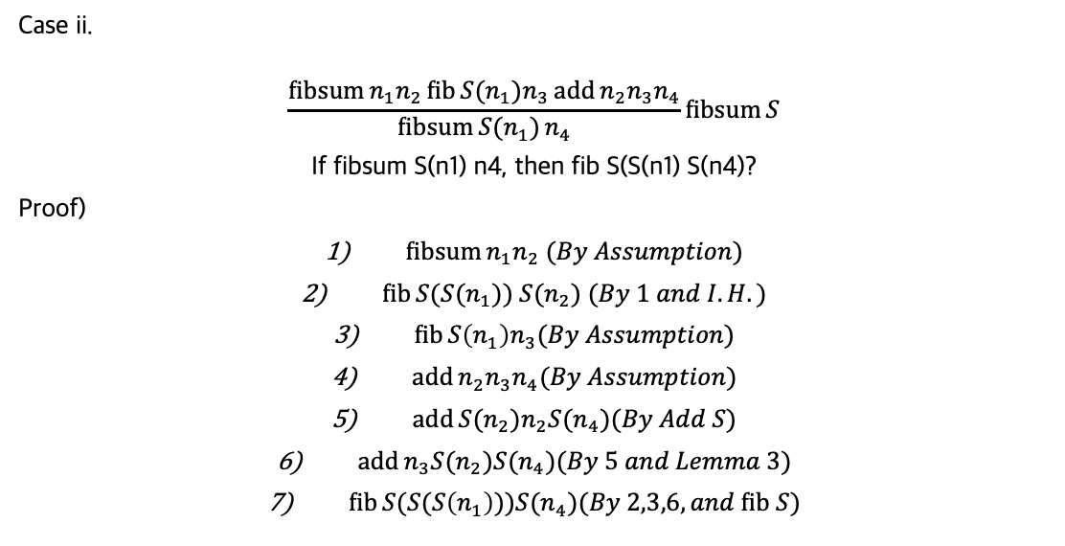
Problem 3 Solution
Case ii.
$$\frac{\operatorname{fibsum}{n_{1}n_{2}\operatorname{fib}{{S(n}_{1})n_{3}}\operatorname{add}{n_{2}n_{3}n_{4}}}}{\operatorname{fibsum}{{S(n}_{1})}n_{4}}\operatorname{fibsum}{S}$$
If fibsum S(n1) n4, then fib S(S(n1) S(n4)?
Proof)
$\operatorname{fibsum}{n_{1}n_{2} (By Assumption)}$
$\operatorname{fib}{S(S(n_{1})) S(n_{2}) (By 1 and I.H.)}$
$\operatorname{fib}{S\left(n_{1}\right)n_{3}(By Assumption)}$
$\operatorname{add}{n_{2}n_{3}n_{4}(By Assumption)}$
$\operatorname{add}{{S(n}_{2})n_{2}{S(n}_{4})(By Add S)}$
$\operatorname{add}{n_{3}S(n_{2}{)S(n}_{4})(By 5 and Lemma 3)}$
$\operatorname{fib}{S(S(S\left(n_{1}\right)){)S(n}_{4})(By 2,3,6, and fib S)}$
fib:$\frac{Z}{Z}\frac{S(Z)}{S(Z)}⋯\frac{}{n1}\frac{n3}{S(n1)}\frac{S(n2)}{S(S\left(n1\right))}\frac{S(n4)}{S(S\left(S\left(n1\right)\right))}$
fibsum:$\frac{Z}{Z}\frac{S(Z)}{S(Z)}⋯\frac{n2}{n1}$

