Slide 1
Tutorial 11
Quiz 14,15 & HW 9
Presenter: Peter​ Zhang
4/1/2026

Slide 2
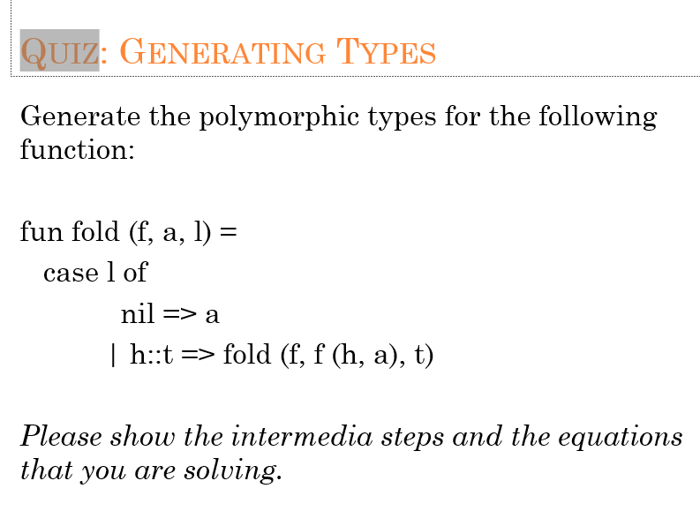
Quiz 14

Slide 3
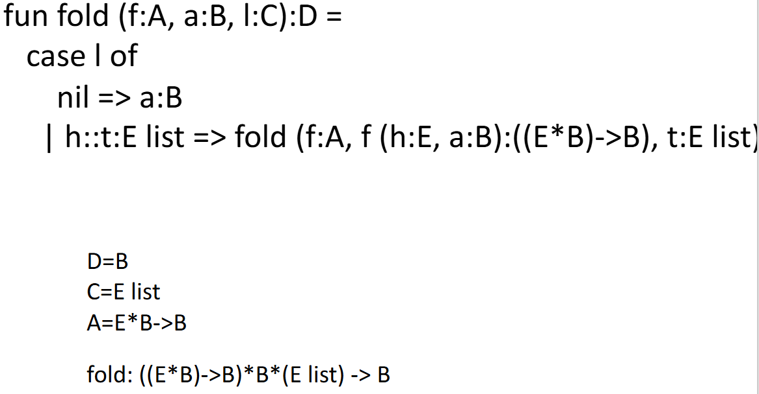

Slide 4
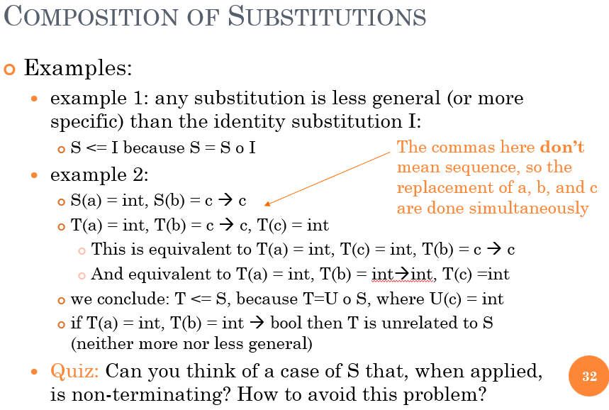
Quiz 15
S(a)=b, S(b)=a
in S(a) = s, s doesn’t contain any type variables that is in dom(S).

Slide 5
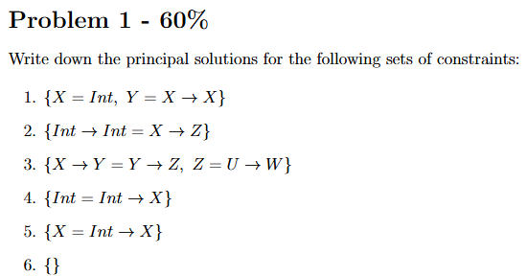

Slide 6



Slide 7



Slide 8

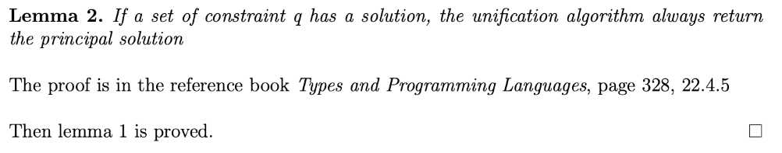

Slide 9
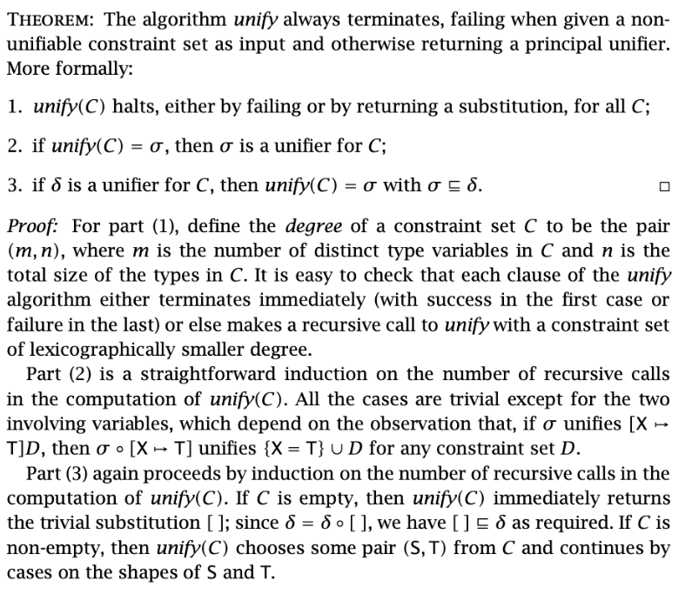

Slide 10
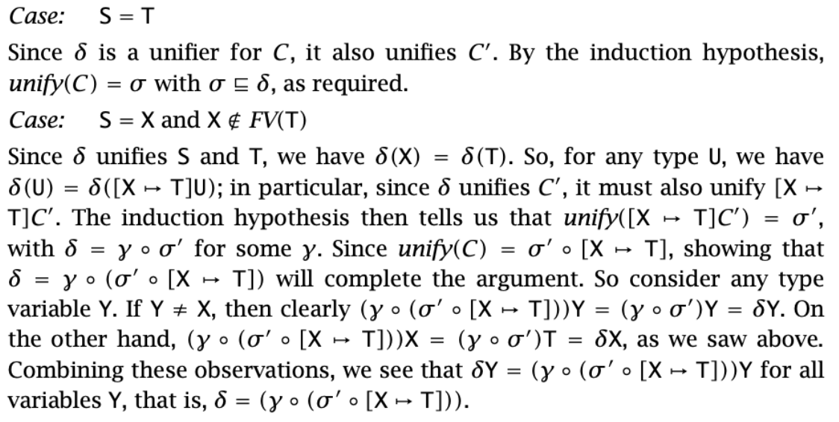

Slide 11
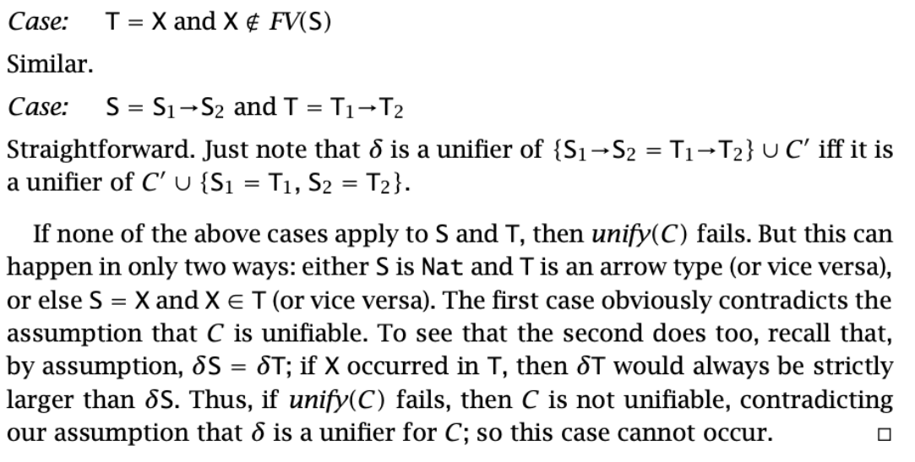

Slide 12
Thank You

