Slide 1
Tutorial 9
Quiz 11 & HW 8
Presenter: Peter​ Zhang
4/1/2026

Slide 2
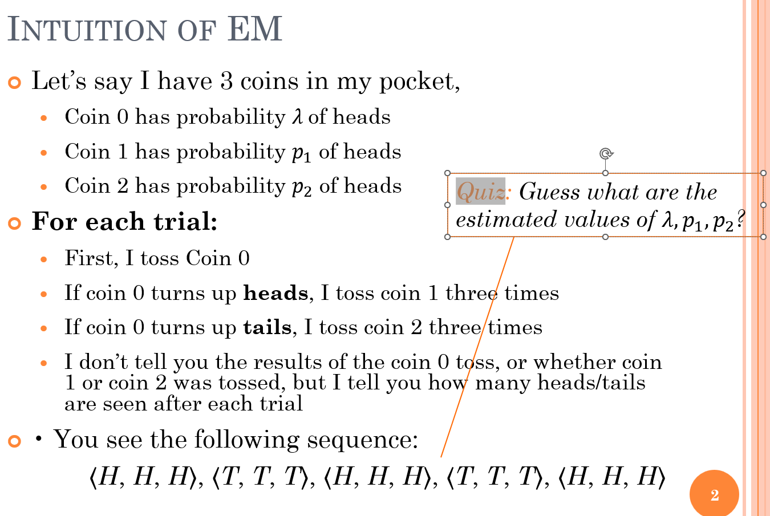
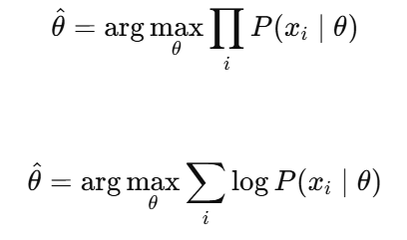

Slide 3
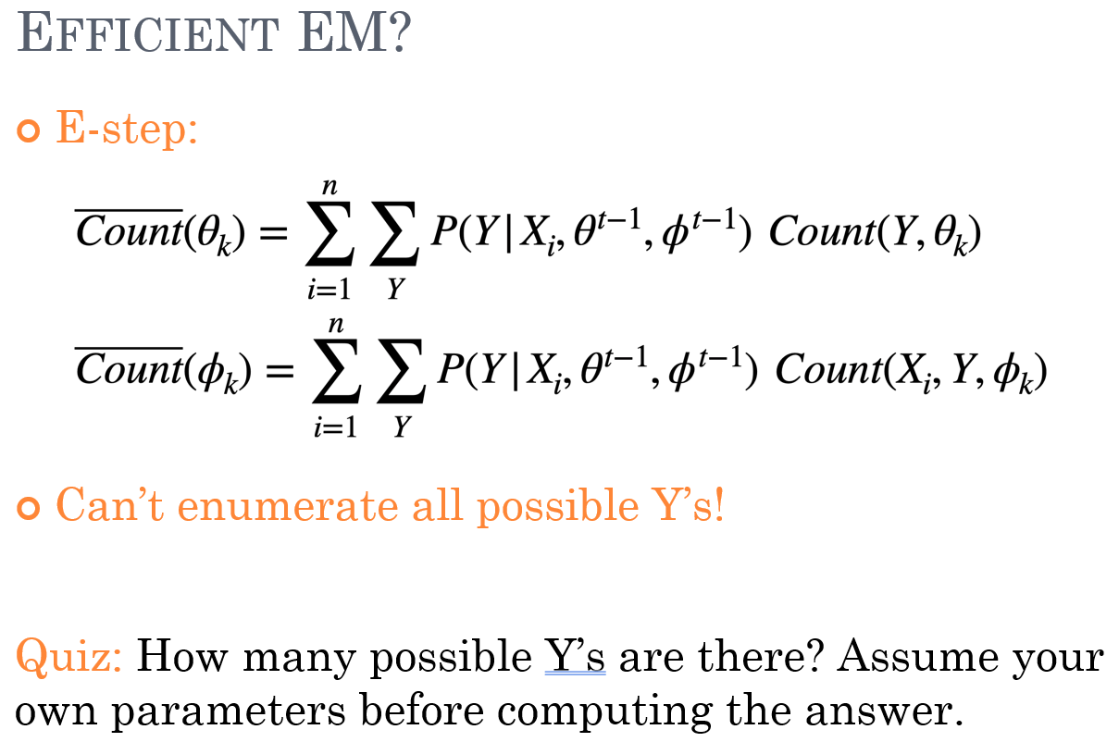

Slide 4
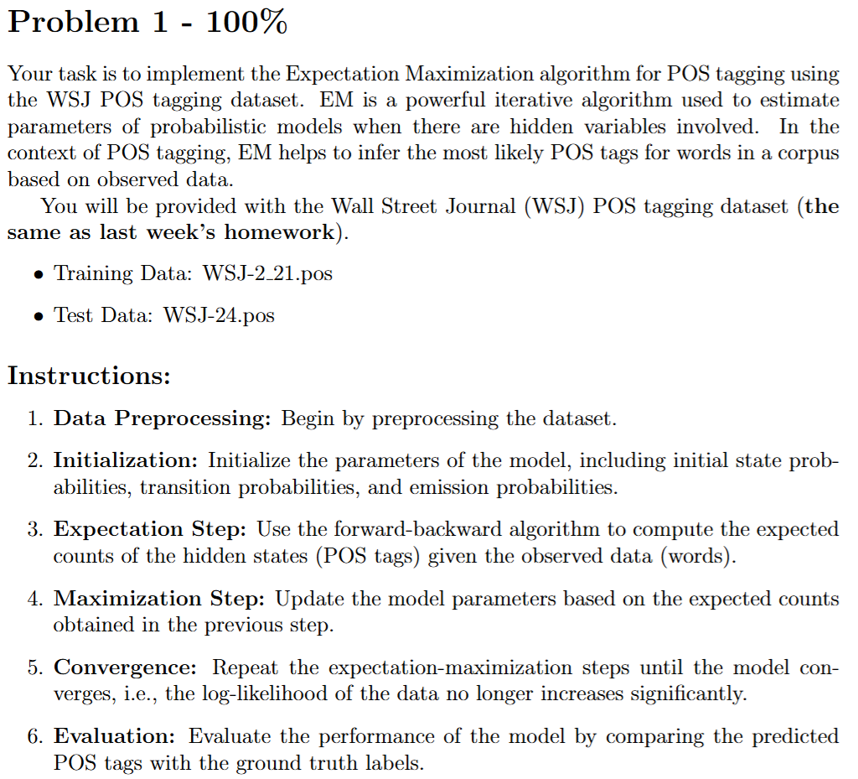
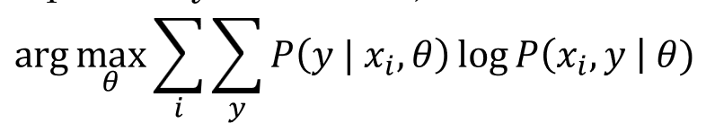

Slide 5
Thank You

