Slide 1
Tutorial 11
Quiz 14 & HW 10
Presenter: Peter​ Zhang
4/15/2026

Slide 2
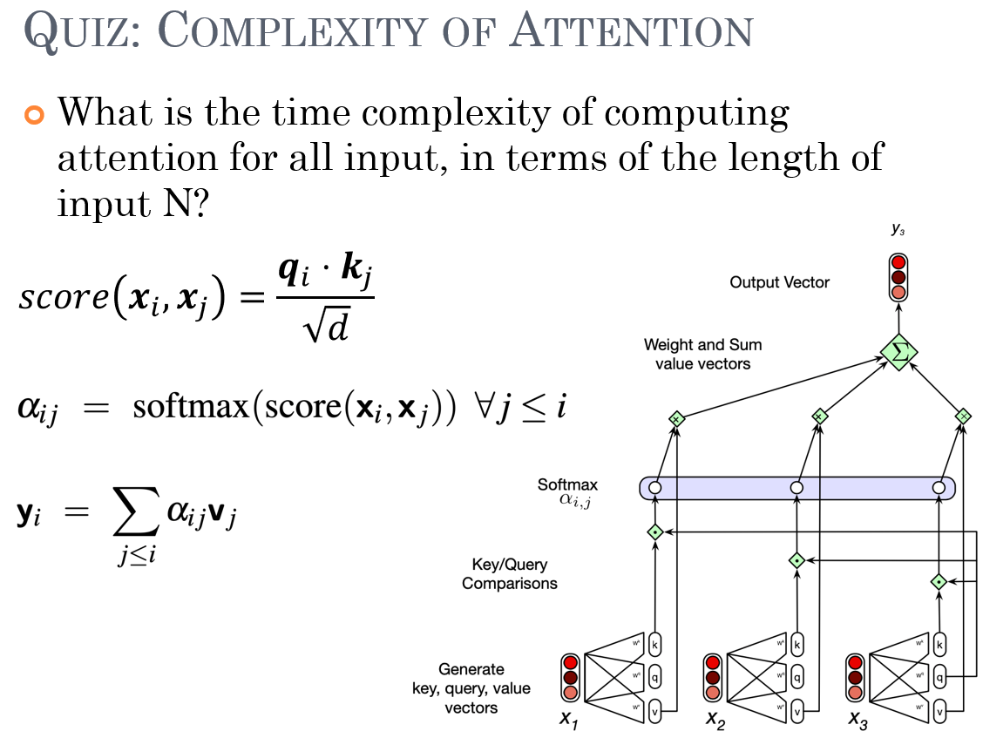

Slide 3
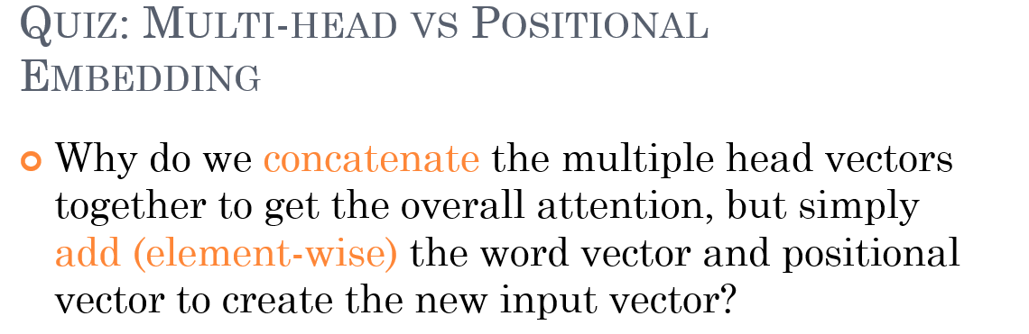

Slide 4
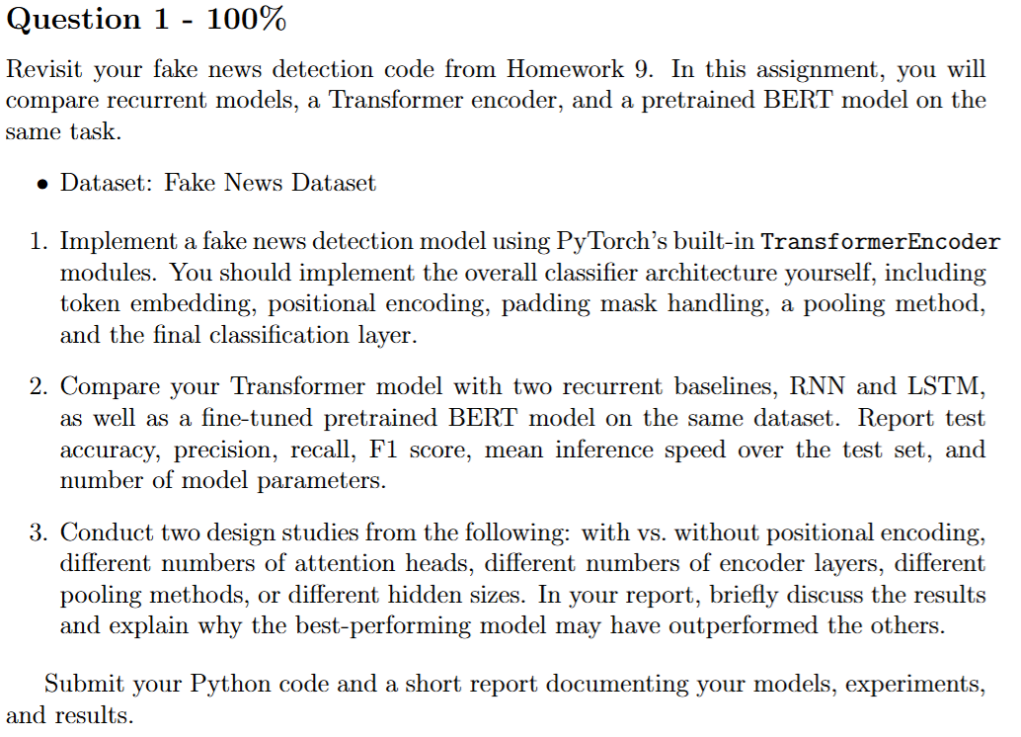

Slide 5
Thank You

