Slide 1
Programming Language Concepts
CSE 3302 / 5307 - Dr. Kenny Zhu
Tutorial 07
Wonjun Park

Slide 2
Homework 6

Slide 3
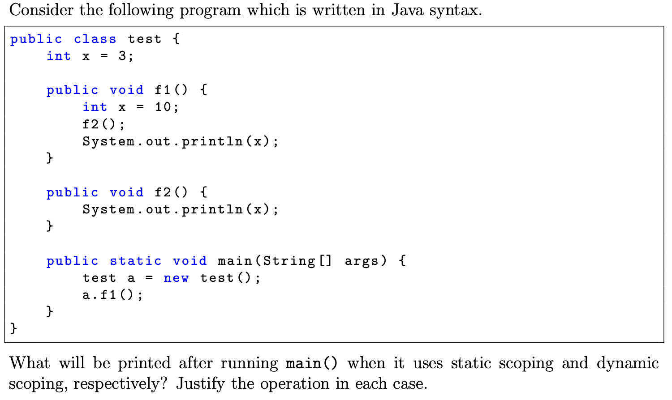
Problem 1 Description

Slide 4
Problem 1 Solution
Static:
3
10
Dynamic:
10
10

Slide 5
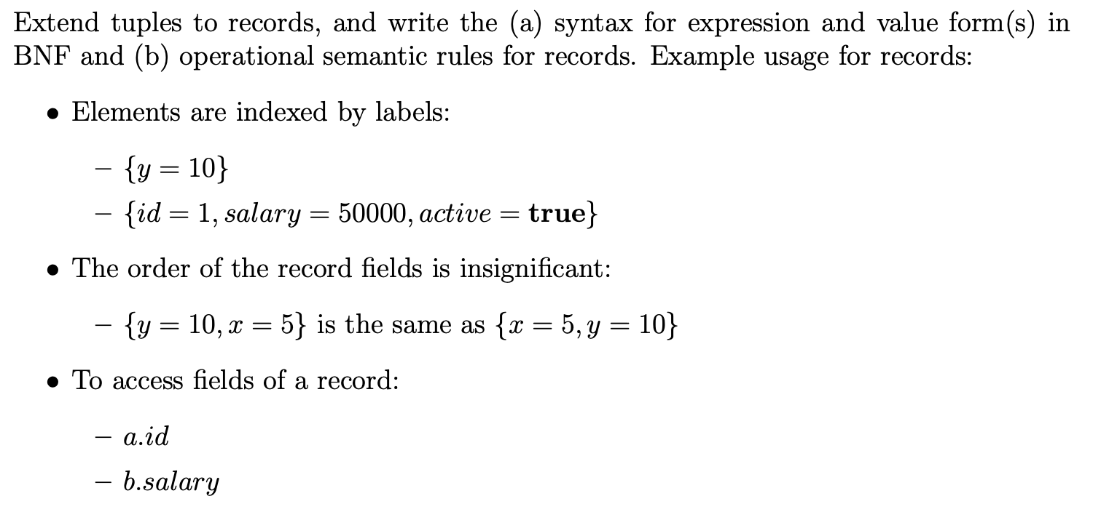
Problem 2 Description

Slide 6
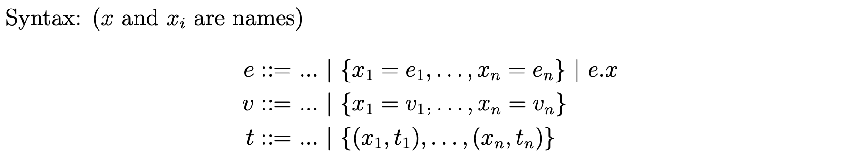
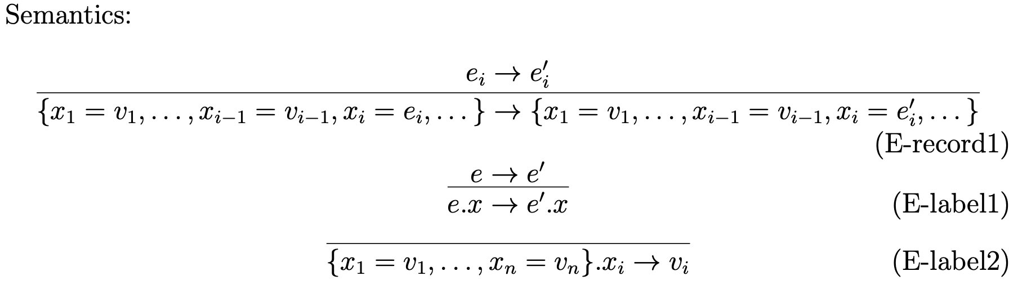
Problem 2 Solution

Slide 7
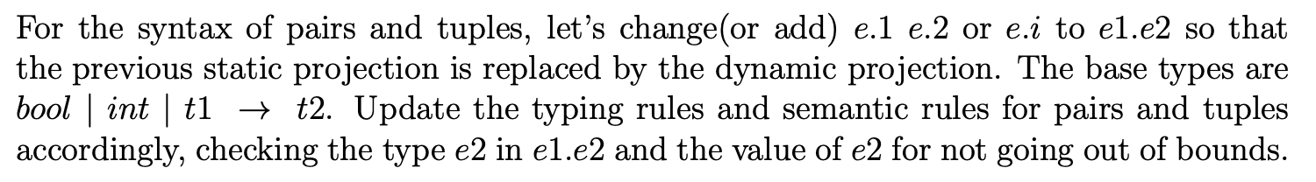
Problem 3 Description

Slide 8
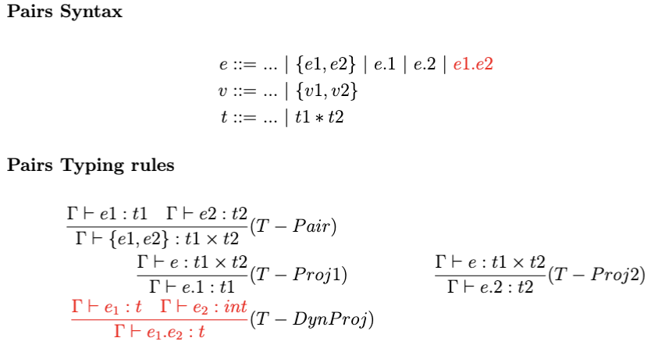
Problem 3 Solution

Slide 9
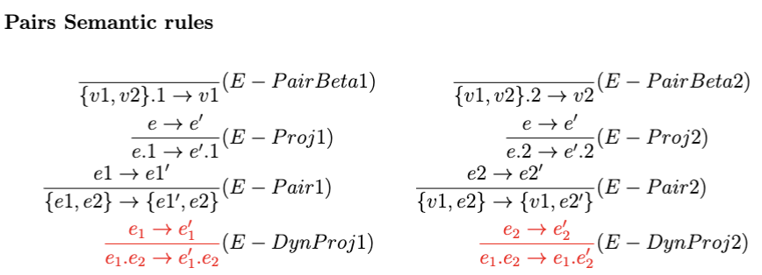
Problem 3 Solution

Slide 10
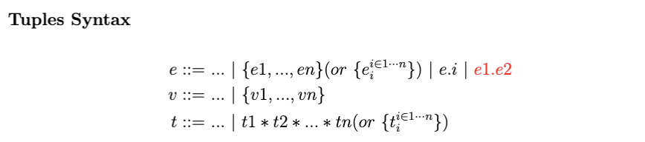
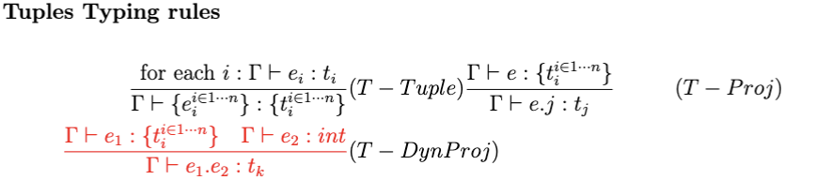
Problem 3 Solution

Slide 11
Problem 3 Solution

Slide 12
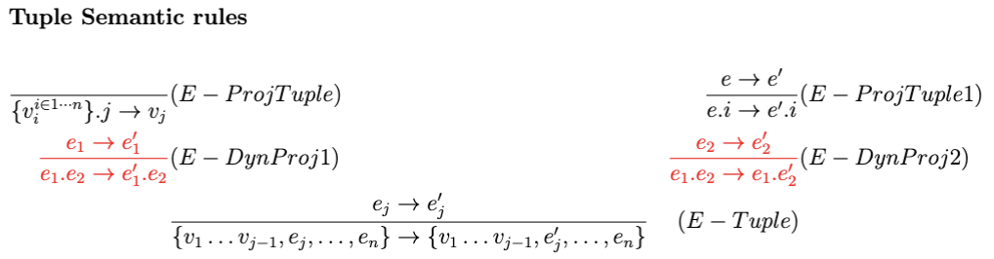
Problem 3 Solution

Slide 13
Quiz

Slide 14
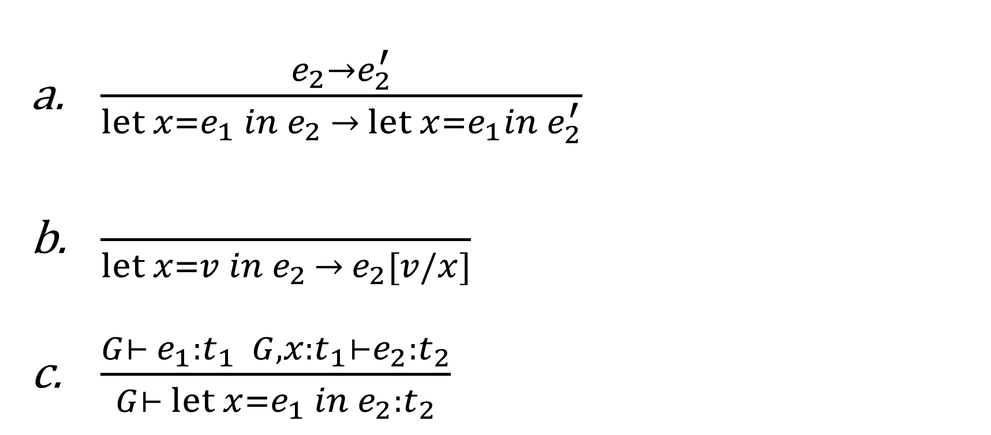
1. Which is not right for let?

Slide 15
2. Which one of the following determines bindings at run time ?
Static scoping
Dynamic scoping

Slide 16
3. Evaluate the following expression with static scoping: let x = (let y = 1 in y) in let y = (let x = 2 in x) in 2x + y
3
4
5
6

Slide 17
4. Which one of the following three languages’ syntax is different from the others? L1: Expr → Expr + Term | Expr – Term| Term Term → 0|1|2|3|4|5|6|7|8|9|(Expr) L2: Expr →Expr Op Expr|Term Term → 0|1|2|3|4|5|6|7|8|9|(Expr) Op → + | - L3: Expr → Expr + Expr | Expr – Expr| Term Term → 0|1|2|3|4|5|6|7|8|9|(Expr)
L1
L2
L3
They are all equal

Slide 18
5. For the following strings, which one doesn’t belong to the language GINT? GINT: Integer -> Integer Digit | Digit Digit -> 0|1|2|3|45|6|7|8|9
345
1245
405
4510

Slide 19
6. What does the following expression evaluate to using static scoping? let x = 3 in let y = (let x = 4 in 2 * x ) in x + y
9
10
11
12

Slide 20
7. Write down the type of pair: {true, {0, 1}}

Slide 21
8. Translate let x = e1 in let y=e2 in e3 into pure lambda expression (suppose e1,e2,e3 are translated to e1’,e2’ and e3’)

Slide 22
9. Which one of the following statements is incorrect?
For every typing context Γ and expression e, there exists at most one t such that Γ |-- e : t.
An expression e in the language L is said to be well-typed, if there exists some type t, such that e : t.
Most modern languages use dynamic scoping.
Binding is an association between a name and the object it represents.

Slide 23
10. The Safety of a type system equals to:
Progress + Preservation
Progress + Well-typedness
Preservation + Well-typedness

