Slide 1
Tutorial-5
TA-Sinong

Slide 2
Quiz-4

Slide 3
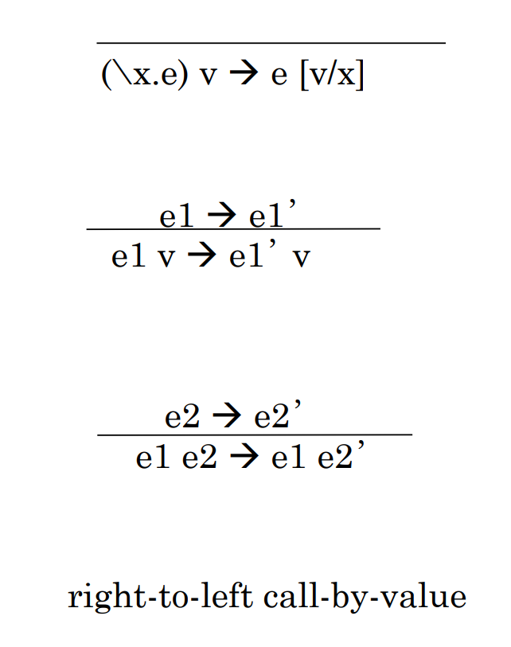
Q1
Write the rules for Right-to-Left call-by-value O.S.

Slide 4
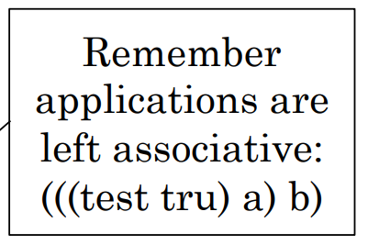
Q2
Step-by-step, evaluate test fls a b.
(\x.\then.\else.x then else) fls a b
->(\then.\else.fls then else) a b
->(\else.fls a else) b
->fls a b
->(\t.\f.f) a b
-> (\f.f) b
-> b

Slide 5
Q1
Define succ in lambda calculus.
\a.b.c. b (a b c)

Slide 6
Homework-4

Slide 7
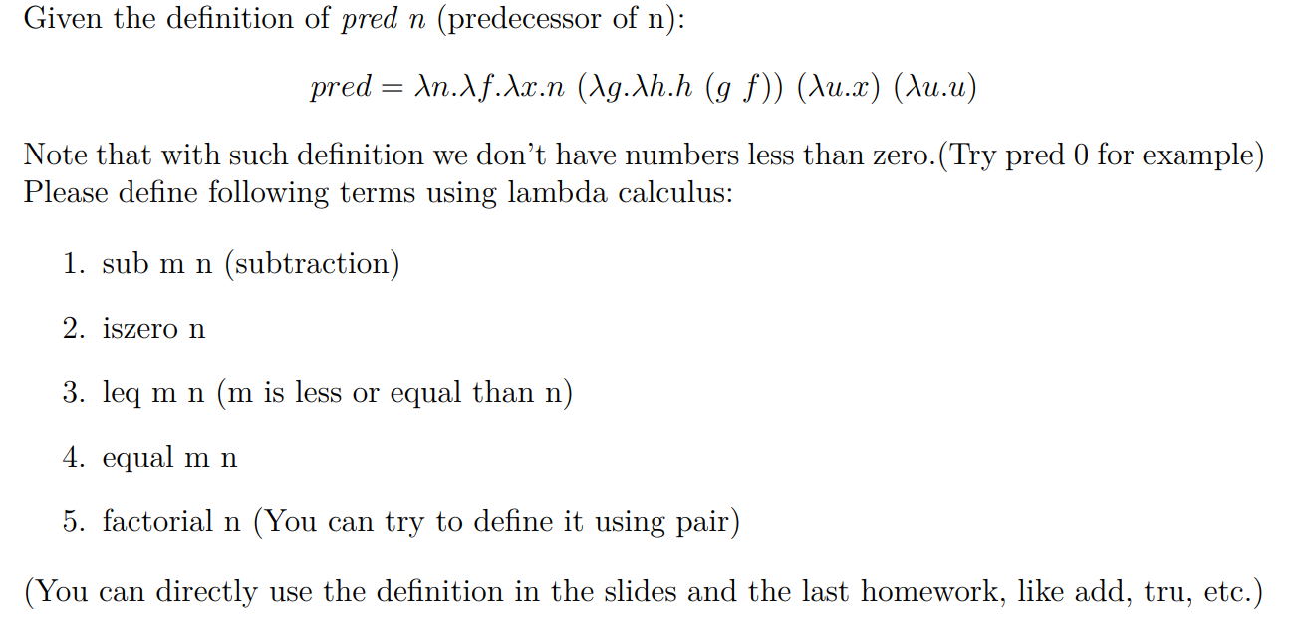
Problem-1

Slide 8
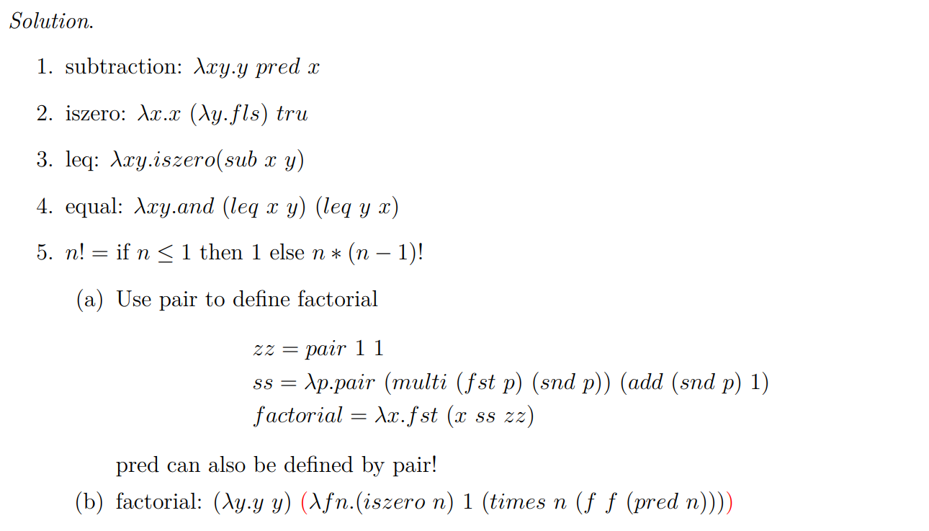
Problem-1

Slide 9
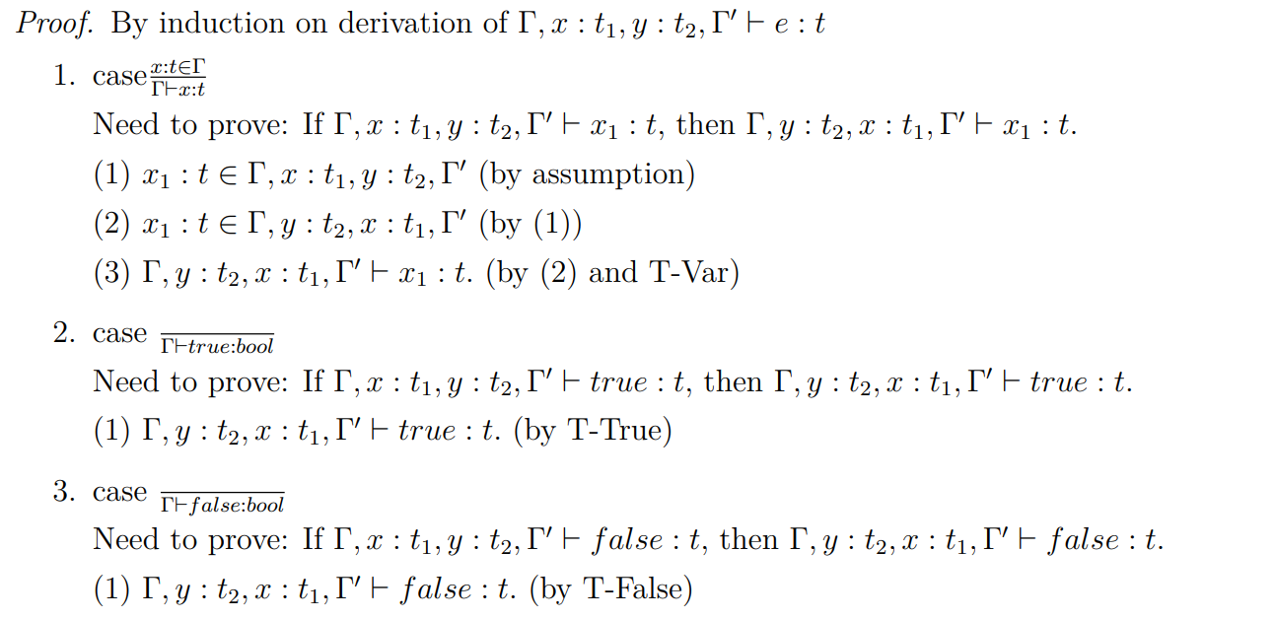
Problem-2

Slide 10
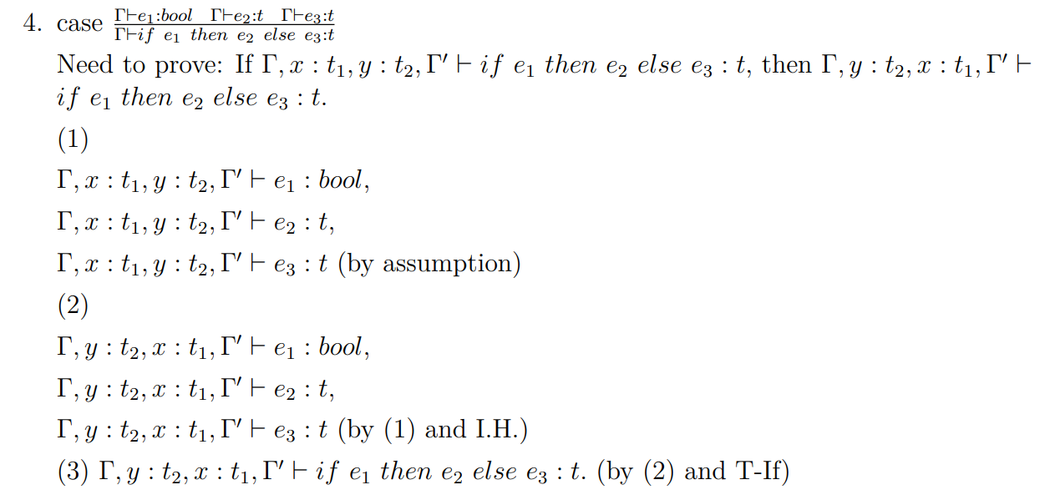
Problem-2

Slide 11
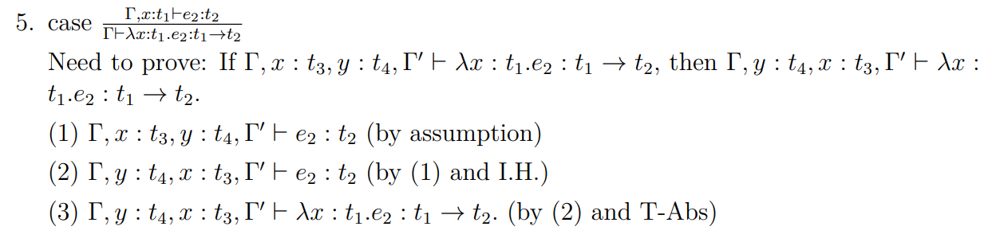
Problem-2

Slide 12
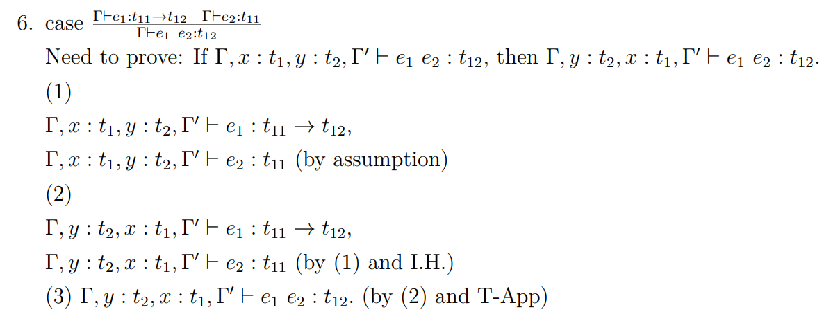
Problem-2

Slide 13
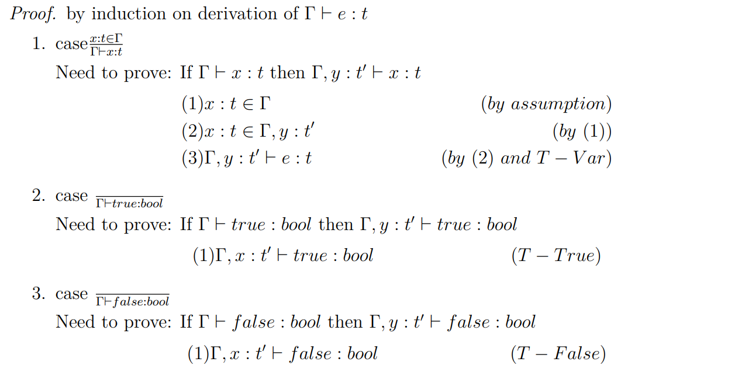
Problem-3

Slide 14
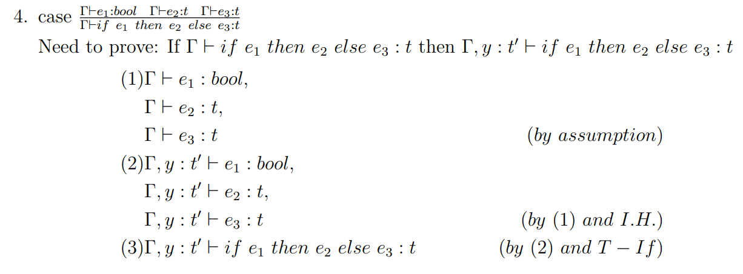
Problem-3

Slide 15
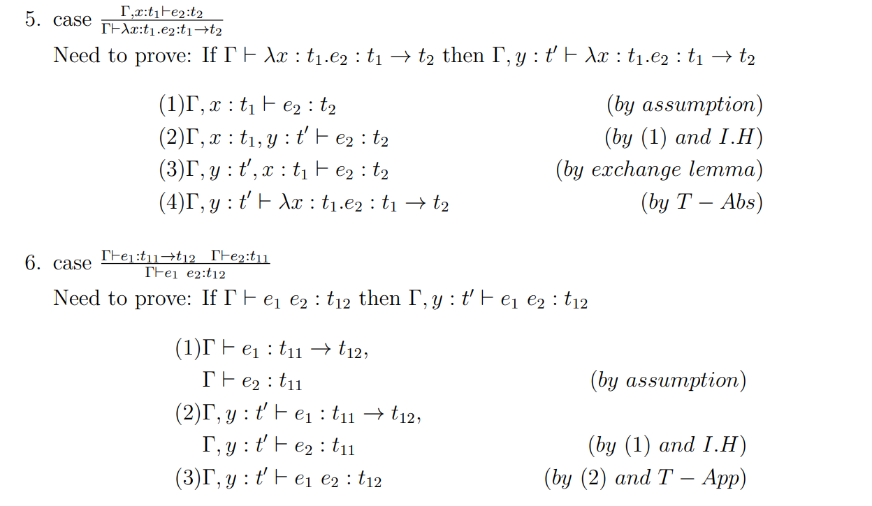
Problem-3

Slide 16
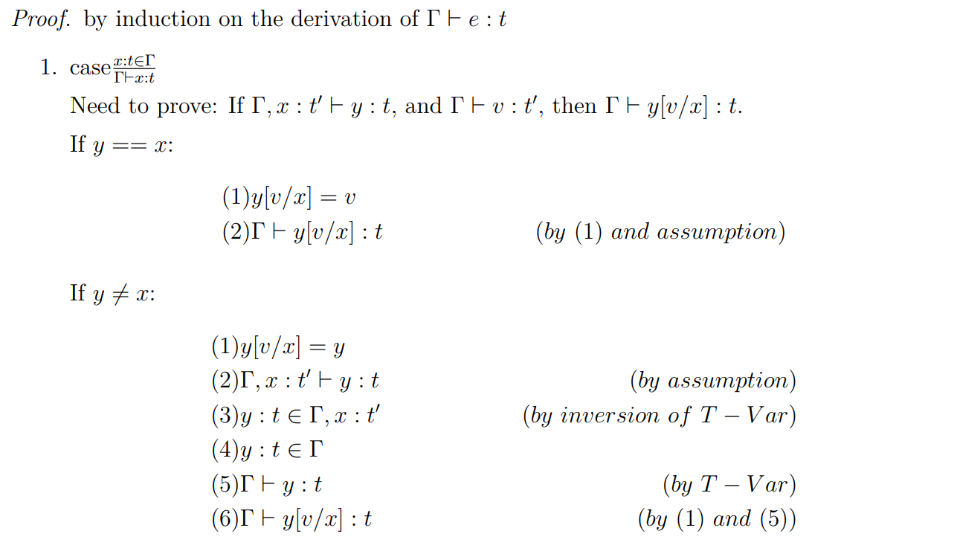
Problem-4

Slide 17
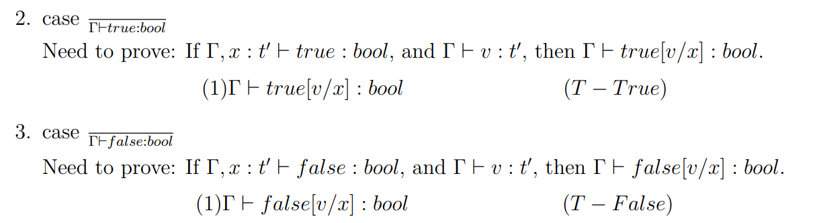
Problem-4

Slide 18
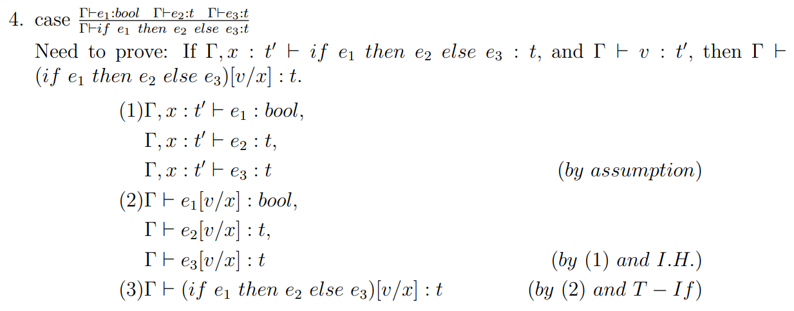
Problem-4

Slide 19
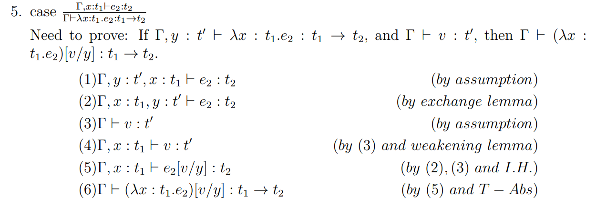
Problem-4

Slide 20
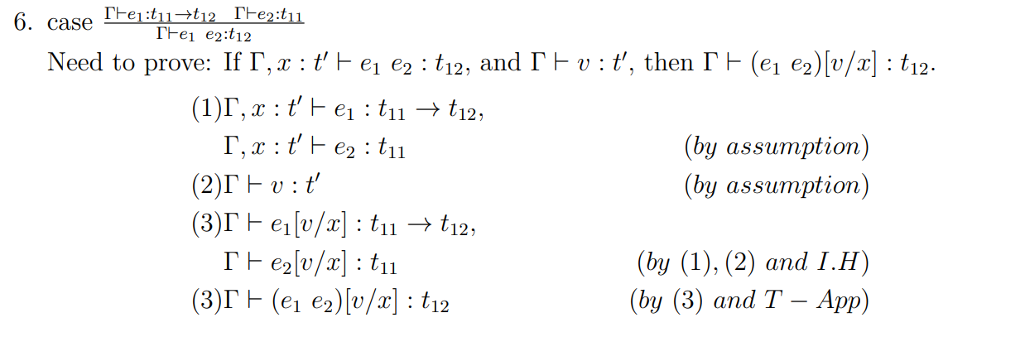
Problem-4

Slide 21

LaTex
LaTeX is a high-quality typesetting system; it includes features designed for the production of technical and scientific documentation.
https://www.latex-project.org/
Online Latex Editor: Overleaf

Slide 22
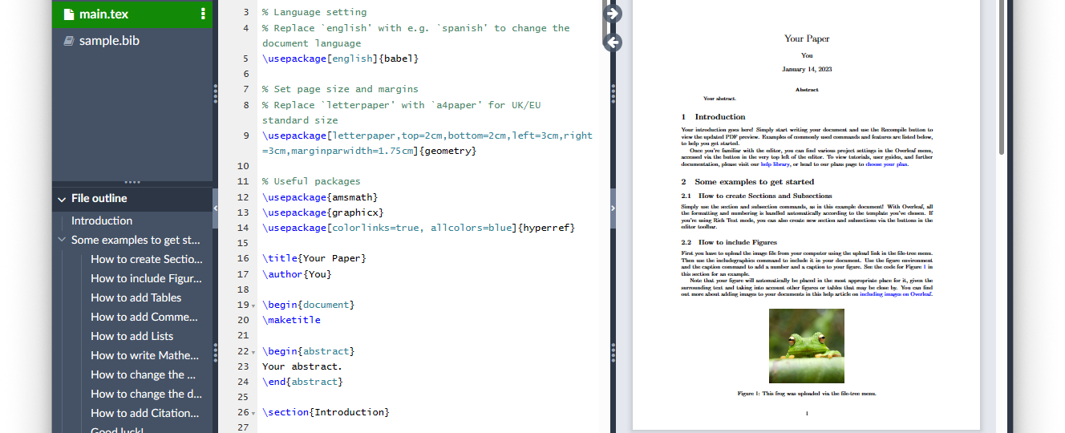
Overleaf: Online Latex Editor
https://www.overleaf.com

