Slide 1
Should you trust your experimental results?
Amer Diwan, Google
Stephen M. Blackburn, ANU
Matthias Hauswirth, U. Lugano
Peter F. Sweeney, IBM Research
Attendees of Evaluate '11 workshop

Slide 2
Why worry?
Experiment
Innovate
For scientific progress we need sound experiments

Slide 3
Unsound experiments
Unsound Experiment
Bad Idea
Make a bad idea look great!

Slide 4
Unsound experiments
Unsound Experiment
Great Idea
Make a great idea look bad!

Slide 5
Thesis
Sound experimentation is critical but requires
Creativity
Diligence
As a community, we must
Learn how to design and conduct sound experiments
Reward sound experimentation
Notes:
Key point: We're a young field, and a very fast moving one. People in other fields have a deep culture of RIGOROUS experimentation.

Slide 6
A simple experiment
Goal: To characterise the speedup of optimization O
Experiment: Measure program P on unloaded machine M with/without O
P
P/O
M
T1
T2
Claim: O speeds up programs by 10%

Slide 7
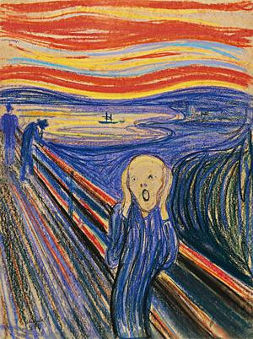
Why is this unsound?
Scope of experiment
<< Scope of claim
The relationship of the two scopes determines if an experiment is sound
Notes:
I think you have to spend more time on two points. First, the goal of every experiment is to support a claim. Compare scope of claim with scope of world. Larger claim scope -> better. However, scope of experimentation must support scope of claim. The four truly-deadly sins are venn diagrams of the scope of the claim and scope of the experiment. Ignored: scope of experiment much smaller than scope of claim. Inappropriate: scope of claim and scope of experiment don't overlap. Inconsistent: two experiment scopes contained in the claim's scope, but the experimental scopes don't overlap but are compared. Ignored has scope of claim, but is missing experimental scope.

Slide 8
Sound experiments
Sufficient for sound experiment:
Scope of claim <= Scope of experiment
Option 1: Reduce claim
Option 2: Extend experiment
What are the common causes of unsound experiments?

Slide 9
The four fatal sins
The deadly sins do not stand in the way of a PLDI acceptance:
It is our pleasure to inform you that your paper titled "Envy of PLDI authors" was accepted to PLDI ...
But the four fatal sins might!

Slide 10

Sin 1: Ignorance
Defn: Ignoring components necessary for Claim
Claim: all computers
Experiment: a particular computer

Slide 11

Sin 1: Ignorance
Defn: Ignoring components necessary for Claim
Experiment: one benchmark
Claim: full suite
avora
Ignorance systematically biases results

Slide 12
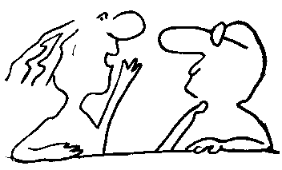
Ignorance is not obvious!
A is better than B
I found just the opposite
Have you had this conversation with a collaborator?

Slide 13
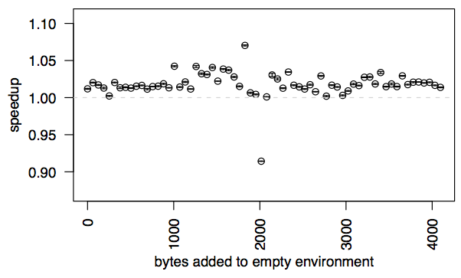
Ignoring Linux environment variables
[Mytkowicz et al., ASPLOS 2009]
Todd's results
My results
Changing the environment can change the outcome of your experiment!

Slide 14
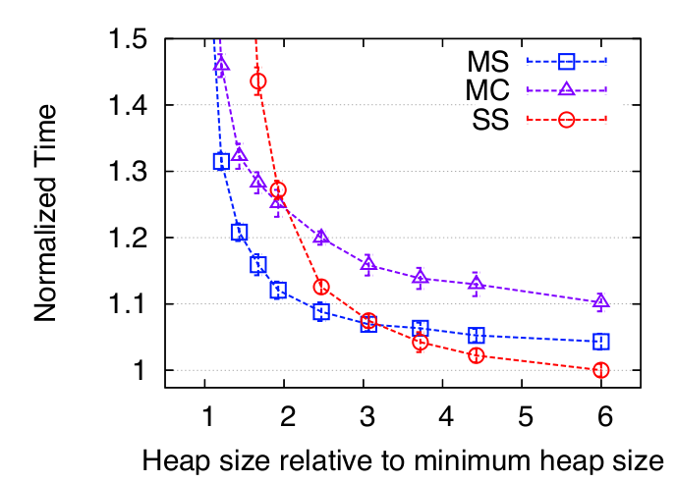
Ignoring heap size
Graph from [Blackburn et al., OOPSLA 2006]
SS is worst!
SS is best!
Changing heap size can change the outcome of your experiment!

Slide 15
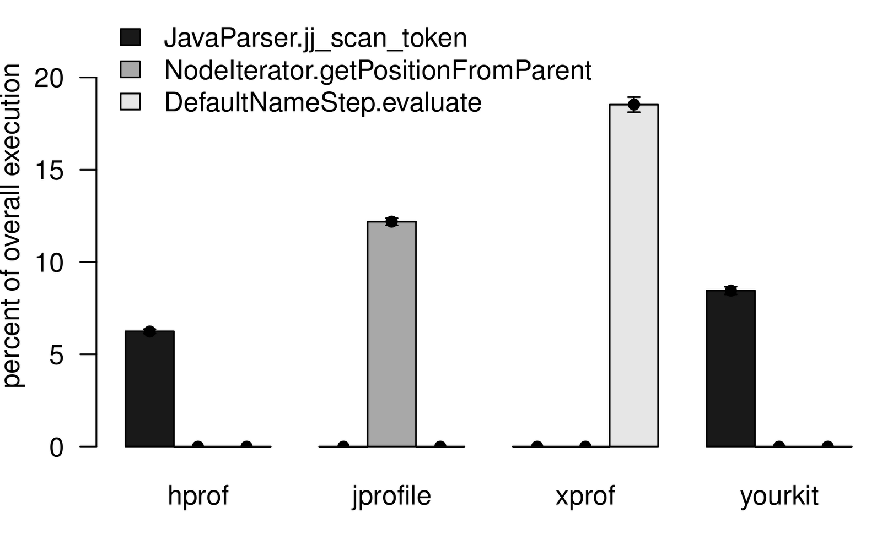
Ignoring profiler bias
[Mytkowicz et al., PLDI 2010]
Different profilers can yield contradictory conclusions!

Slide 16

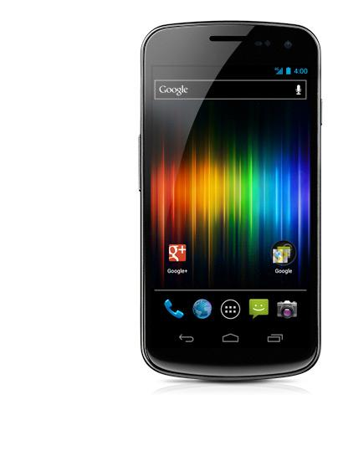
Sin 2: Inappropriateness
Defn: Using components irrelevant for Claim
Experiment: Server applications
Claim: Mobile performance

Slide 17
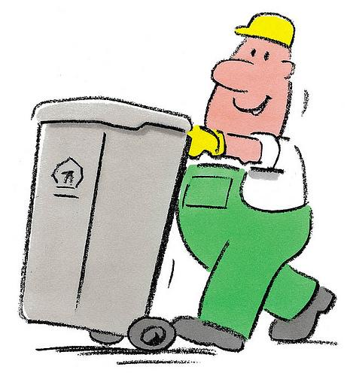
Sin of inappropriateness
Defn: Using components irrelevant for Claim
Experiment: Compute benchmarks
Claim: GC performance
http://www.ivankuznetsov.com/
Inappropriateness produces unsupported claims

Slide 18

Inappropriateness is not obvious!
Has your optimization ever delivered a 10% improvement
...which never materialized in the "wild"?

Slide 19
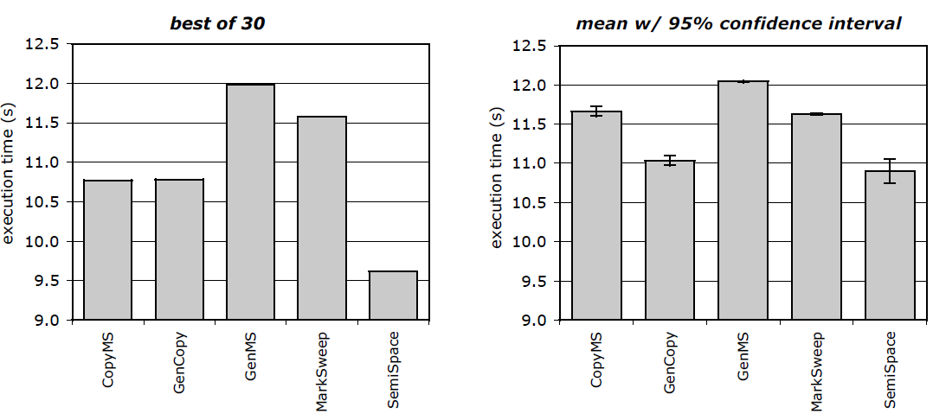
Inappropriate statistics
[Georges and Eeckhout, 2007]:
(SemiSpace is best by far)
(SemiSpace is one of the best)
Have you ever been fooled by a lucky outlier?

Slide 20
Inappropriate data analysis
A
B
99pc: 450
99pc: 50
Mean: 45.0
Mean: 45.0
A single Google search = 100s of RPCs
99th percentile affects a majority of the requests!
A mean is inappropriate if long-tail latency matters!

Slide 21
Inappropriate data analysis
Layered systems often use caches at each level:
Cache Hit
Cache Miss
Mean
Do you check the shape of your data before summarizing it?

Slide 22
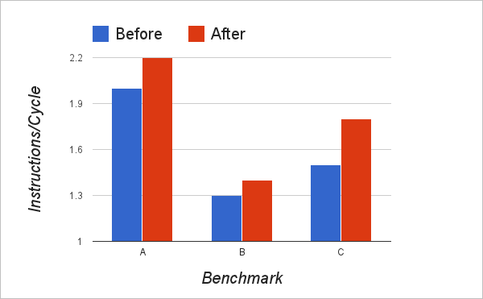
Inappropriate metric
With extra nops
Have you ever picked a metric that was not ends-based?

Slide 23
Inappropriate metric
Program
Program
Pointer analysis A
Pointer analysis B
Mean points-to-set = 2
Mean points-to-set = 2
Claim: B is simpler yet just as precise as A
P
Q
R
P
Q
R
versus
Have you ever used a metric that was inconsistent with "better"?

Slide 24

Sin 3: Inconsistency
Defn: Experiment compares A to B in different contexts

Slide 25
Sin 3: Inconsistency
Defn: Experiment compares A to B in different contexts
Experiment: They used P; We used Q
Claim: B > A
Suite P
Suite Q
System A
System B
d
D
Inconsistency misleads!

Slide 26
Inconsistency is not obvious
Workload
Workload
Measurement Context
Measurement Context
System A
System B
Metrics
Metrics
Workload, context, and metrics must be the same

Slide 27
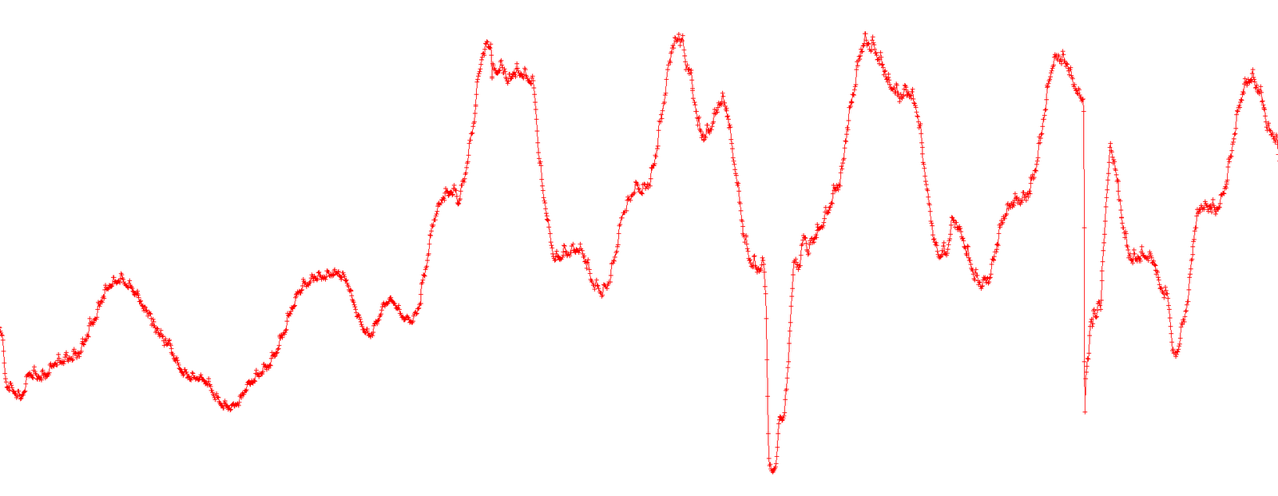
Inconsistent workload
I want to evaluate a new optimization for Gmail
Optimization enabled
Has the workload ever changed from under you?

Slide 28
Inconsistent metric
Issued instructions
Retired instructions
Do you (or even vendors) know what each hardware metric means?

Slide 29
Sin 4: Irreproducibility
Defn: Others cannot reproduce your experiment
Report:
Experiment:
Workload
Measurement Context
System
Metrics
Irreproducibility makes it harder to identify unsound experiments

Slide 30
Irreproducibility is not obvious
Workload
Measurement Context
System
Metrics
Omitting any biases can make results irreproducible

Slide 31
Revisiting the thesis
The four fatal sins
affect all aspects of experiments
cannot be eliminated with a silver bullet
(even with a much longer history, other sciences have them too)
It will take creativity and diligence to overcome these sins!

Slide 32
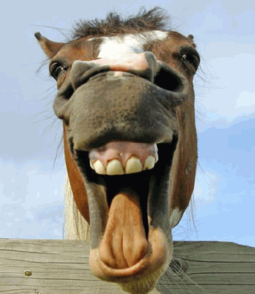
But I can give you one tip
Look your gift horse in the mouth!

Slide 33
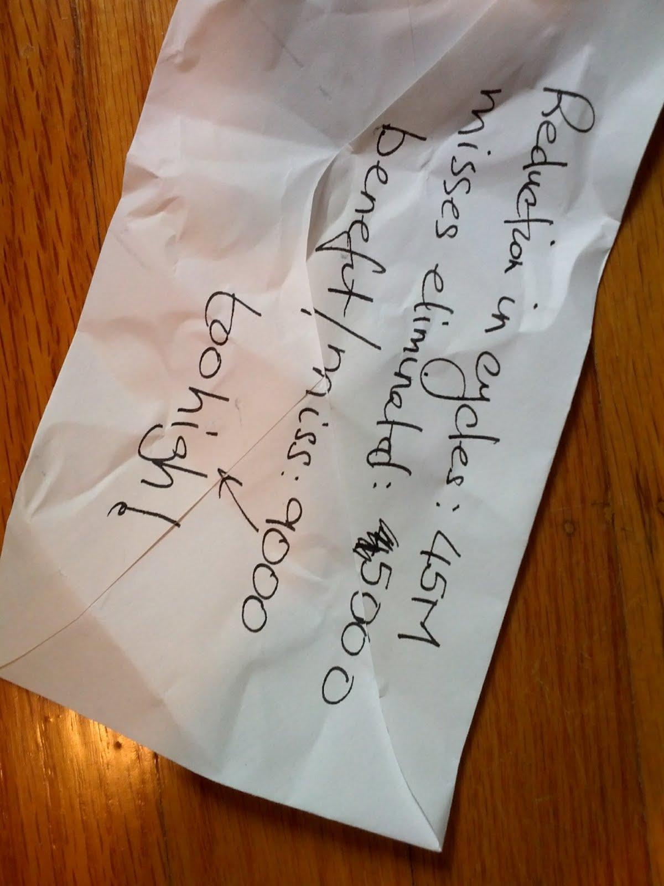
Back of the envelope
Your optimization eliminates memory loads
Can the count of eliminated loads explain speedup?
You blame "cache effects" for results you cannot explain...
Does the variation in cache misses explain results?

Slide 34
Rewarding good experimentation
Evaluates existing ideas; no new algorithms...
Scope of a paper:
Often rejected
Loch Ness Monster
Safe Bet
Quality of experiments
No evidence that the idea works...
Reject
Often rejected
Novelty of algorithm
Is this where we want to be?
Notes:
Note that this quadrant corresponds to entire disciplines of science (observational science). I was just reading a ground beaking study on coffee consumption (May 17 NEJM). 5M person-years of data (!). No real insight, just systematic analysis of a colossal amount of data. Conclusion: coffee consumption is correlated with lower mortality. No idea why. No idea whether there is any causality or mere correlation. This kind of work is upheld in other communities (NEJM is a big deal).

Slide 35
Novel ideas can stand on their own
Novel (and carefully reasoned) ideas expose
New paths for exploration
New ways of thinking
A groundbreaking idea and no evaluation
>> A groundbreaking idea and misleading evaluation

Slide 36
Insightful experiments can stand on their own!
An insightful experiment may
Give insight into leading alternatives
Opens up new investigations
Increase confidence in prior results or approaches
An insightful evaluation and no algorithm
>> An insightful evaluation and a lame algorithm

Slide 37

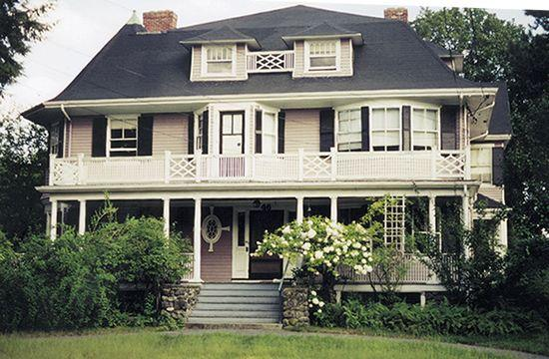
But sound experiments take time!
But not as much as chasing a false lead for years...
How would you feel if you built a product
...based on incorrect data?
Do you prefer to build upon:

Slide 38
Why you should care (revisited)
Has your optimization ever yielded an improvement
...even when you had not enabled it?
Have you ever obtained fantastic results
...which even your collaborators could not reproduce?
Have you ever wasted time chasing a lead
...only to realize your experiment was flawed?
Have you ever read a paper
...and immediately decided to ignore the results?

Slide 39
The end
Experiments are difficult and not just for us
Jonah Lehrer's "The truth wears off"
Other sciences have established methods
It is our turn to learn from them and establish ours!
Want to learn more?
The Evaluate collaboratory (http://evaluate.inf.usi.ch)

Slide 40
Acknowledgements
Todd Mytkowicz
Evaluate 2011 attendees: José Nelson Amaral, Vlastimil Babka, Walter Binder, Tim Brecht, Lubomír Bulej, Lieven Eeckhout, Sebastian Fischmeister, Daniel Frampton, Robin Garner, Andy Georges, Laurie J. Hendren, Michael Hind, Antony L. Hosking, Richard E. Jones, Tomas Kalibera, Philippe Moret, Nathaniel Nystrom, Victor Pankratius, Petr Tuma
My mentors: Mike Hind, Kathryn McKinley, Eliot Moss

