Slide 1
CS383 Programming Languages
Kenny Q. Zhu
Dept. of Computer Science
Shanghai Jiao Tong University

Slide 2
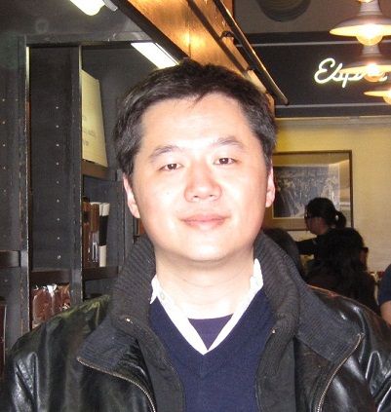
Kenny Q. Zhu
Research Interests:
Artificial Intelligence
Knowledge representation/discovery
Natural language understanding
Natural language generation
Programming Languages (past)
Domain specific languages
Data Processing
Concurrency
Recent Publications:
AAAI, IJCAI, ACL, EMNLP,…
Degrees: National University of Singapore (NUS)
Postdoc: Princeton University
Experiences: Microsoft Redmond, USA
Microsoft Research Asia
Faculty at SJTU since 2009
Director of ADAPT Lab

Slide 3
Administrative Info (I)
All-English Course: everything in English!
Lecturer:
Kenny Zhu, SEIEE #03-407, kzhu@cs.sjtu.edu.cn
Office hours: by appointment or after class
Teaching Assistant:
Bran Li, SEIEE #03-329, likaijian@sjtu.edu.cn
Office hours: Thursday 16:00 - 17:00
Course Web Page (definitive source!): http://www.cs.sjtu.edu.cn/~kzhu/cs383/

Slide 4
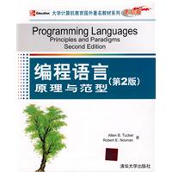
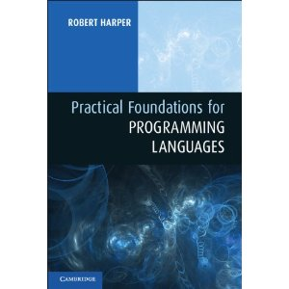
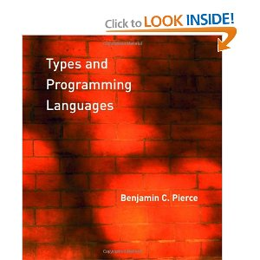
Administrative Info (II)
Format:
Two lecture classes on Monday
Followed by a tutorial on Monday – Led by TA; Your participation is REQUIRED!
Reference Texts:
Programming Languages – Principles and Paradigms, 2nd Edition, by Tucker & Noonan, McGraw Hill / Tsinghua University Press
Practical Foundations for Programming Languages by Robert Harper, Cambridge University Press
Types and Programming Languages by Benjamin C. Pierce, The MIT Press.
Lecture materials on course web page (Canvas)

Slide 5
Administrative Info (III)
3-credit course (16 weeks)
Modes of Assessment:
In-class quizzes: 10%
Tutorial participation: 5%
Assignments: 30%
Programming Project: 25%
Final Exam: 30%
Quizzes
Given out at random times
Usually 10 on-screen multiple choice questions
Bring piece of paper and a pen every time!
Submit answer after class (immediately) to likaijian@sjtu.edu.cn
Tutorials
Typically after every two lectures
Discuss assignment questions and also issues in project
You will be asked to present your answers
Volunteer to win extra scores!

Slide 6
Administrative Info (IV)
Assignments
Released (usually) every week (two lectures)
Due date printed on assignment sheet
Submit solution to Bran’s email likaijian@sjtu.edu.cn
Submit code/data to Bran’s email
Late submission: -30% of full score for each additional day
Assignment solutions to be discussed at the tutorial following the submission (led by Bran)
Programming Project
Individual project
Implement an interpreter for a simple language called simPL
Be able to run test programs and produce correct evaluation results
Produce a report + code + results: due end of semester

Slide 7

Wechat Group

Slide 8
Introduction

Slide 9
Why Do we Learn Programming Languages?

Slide 10
Two Misconceptions about This Course
“This course about programming.”
“This is another compiler course.”
Notes:
Programming is about mastering the use of a language.
Compiler is about implementing a system that can parse a program in a language into intermediate form and then generate machine code. The focus is practical issues such as time and space complexity, code redundancy, and optimization.

Slide 11
What This Course is About
Theoretical aspects of the design and implementation of all programming languages.
The commonalities and differences between various paradigms and languages.
So you can:
Pick the right language for a project;
Design your own language (features);
Do programming language research.

Slide 12
Outline of Today’s Lecture
Principles
Paradigms
Special Topics
A Brief History
On Language Design
Compilers and Virtual Machines
Roadmap of This Course

Slide 13
The Factorial Program
n! = 1 * 2 * … * n
Or
Two different
mathematical
languages
In computing, there are many more ways to do this …

Slide 14
The Factorial Program
C:
int factorial(int n) {
int x = 1;
while (n>1) {
x = x * n;
n = n -1;
}
return x;
}
Java:
class Factorial
{
public static int fact(int n) {
int c, fact = 1;
if ( n < 0 )
System.out.println(“Wrong Input!");
else {
for ( c = 1 ; c <= n ; c++ )
fact = fact*c;
return fact;
}
}
}

Slide 15
The Factorial Program
Scheme:
(define (factorial n)
(if (< n 1) 1
(* n (factorial (- n 1)))
))
Prolog:
factorial(0, 1).
factorial(N, Result) :-
N > 0, M is N - 1,
factorial(M, SubRes), Result is N * SubRes.

Slide 16
Principles
Programming languages have four properties:
Syntax
Names
Types
Semantics
For any language:
Its designers must define these properties
Its programmers must master these properties

Slide 17
Syntax
The syntax of a programming language is a precise description of all its grammatically correct programs.
When studying syntax, we ask questions like:
What is the basic vocabulary?
What is the grammar for the language?
How are syntax errors detected?

Slide 18
Syntax
Vocabulary of
Tokens:
Keywords
Literals
Constants
Punctuations
class Factorial
{
public static int fact(int n) {
int c, fact = 1;
if ( n < 0 )
System.out.println(“Wrong Input!");
else {
for ( c = 1 ; c <= n ; c++ )
fact = fact*c;
return fact;
}
}
}
Notes:
Tokens: Keywords, literals, constants, punctuations

Slide 19
Names
Various kinds of entities in a program have names:
variables, types, functions, parameters, classes, objects, …
An entity is bound to a name (identifier) within the context of:
Scope (static/dynamic)
Visibility (part of scope that is visible)
Lifetime (dynamic and runtime)
Type

Slide 20
Names
class Factorial
{
public static int fact(int n) {
int c, fact = 1;
if ( n < 0 )
System.out.println(“Wrong Input!");
else {
for ( c = 1 ; c <= n ; c++ )
fact = fact*c;
return fact;
}
}
}
Notes:
Define static scope here.

Slide 21
Types
A type is a collection of values and a collection of legal operations on those values.
Simple types
numbers, characters, booleans, …
Structured types
Strings, lists, trees, hash tables, …
Function types
Simple operations like +, -, *, /
More complex/general function: → (arrow) type
Generic types (polymorphism): α
A language’s type system can help:
Determine legal operations
Detect type errors

Slide 22
Types
class Factorial
{
public static int fact(int n) {
int c, fact = 1;
if ( n < 0 )
System.out.println(“Wrong Input!");
else {
for ( c = 1 ; c <= n ; c++ )
fact = fact*c;
return fact;
}
}
}

Slide 23
Semantics
The meaning of a program is called its semantics.
In studying semantics, we ask questions like:
When a program is running, what happens to the values of the variables? (operational semantics)
What does each expression/statement mean? (static semantics)
What underlying model governs run-time behavior, such as function call? (dynamic semantics)
How are objects allocated to memory at run-time?

Slide 24
Semantics
class Factorial
{
public static int fact(int n) {
int c, fact = 1;
if ( n < 0 )
System.out.println(“Wrong Input!");
else {
for ( c = 1 ; c <= n ; c++ )
fact = fact*c;
return fact;
}
}
Static Semantics
Operational Semantics
value
reference
Notes:
a.k.a. l-value and r-value

Slide 25
Paradigms
A programming paradigm is a pattern of problem-solving thought that underlies a particular genre of programs and languages.
There are four main programming paradigms:
Imperative
Object-oriented
Functional
Logic (declarative)
Notes:
Genre is a category of artistic composition, as in music or literature, characterized by similarities in form, style, or subject matter.

Slide 26
Imperative Paradigm
Follows the classic von Neumann-Eckert model:
Program and data are indistinguishable in memory
Program = a sequence of commands
State = values of all variables when program runs
Large programs use procedural abstraction
Example imperative languages:
Cobol, Fortran, C, Ada, Perl, …

Slide 27
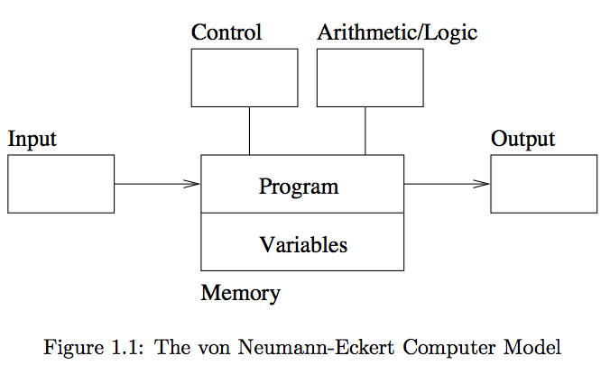
The von Neumann-Eckert Model

Slide 28
Object-oriented (OO) Paradigm
An OO Program is a collection of objects that interact by passing messages that transform the state.
When studying OO, we learn about:
Sending Messages → objects are active
Inheritance
Polymorphism
Example OO languages:
Smalltalk, Java, C++, C#, and Python

Slide 29
Functional Paradigm
Functional programming models a computation as a collection of mathematical functions.
Set of all inputs = domain
Set of all outputs = range
Functional languages are characterized by:
Functional composition
Recursion
No state changes: no variable assignments
x := x + 1 (wrong!)
Example functional languages:
Lisp, Scheme, ML, Haskell, …

Slide 30
Logic Paradigm
Logic programming declares what outcome the program should accomplish, rather than how it should be accomplished.
parent(X, Y) :- father(X, Y).
parent(X, Y) :- mother(X, Y).
grandparent(X, Y) :- parent(X, Z), parent(Z, Y).
?- grandparent(X, jim).
Declarative!
When studying logic programming we see:
Programs as sets of constraints on a problem
Programs that achieve all possible solutions
Programs that are nondeterministic
Example logic programming languages:
Prolog, CLP

Slide 31
Modern Languages are Multi-paradigm
Haskell (F + I)
Scala (F + I + O)
OCaml (F + I + O)
F Sharp (F + I + O)
Python (O + I + F)
…

Slide 32
Special Topics
Concurrency
E.g., Client-server programs
Event handling
E.g., GUIs, home security systems
Correctness
How can we prove that a program does what it is supposed to do under all circumstances?
Why is this important???

Slide 33
A Brief History
How and when did programming languages evolve?
What communities have developed and used them?
Artificial Intelligence – Prolog, CLP, (Python)
Computer Science Education – Pascal, Logo
Science and Engineering – Fortran, Ada, ML, Haskell
Information Systems – Cobol, SQL
Systems and Networks – C, C++, Perl, Python
World Wide Web – HTML, Java, Javascript, PHP

Slide 34
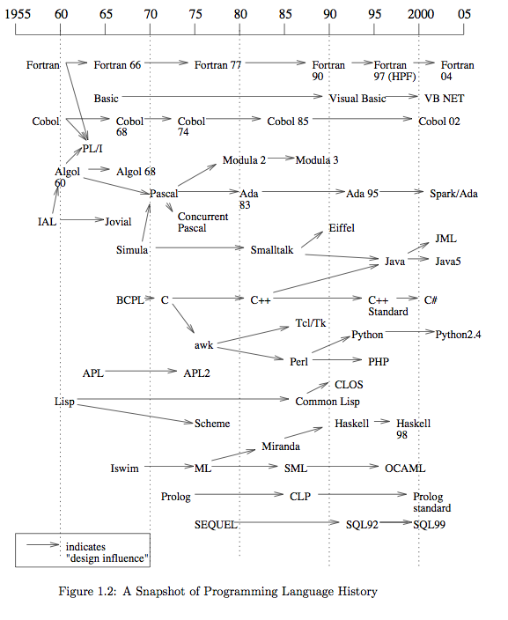

Slide 35
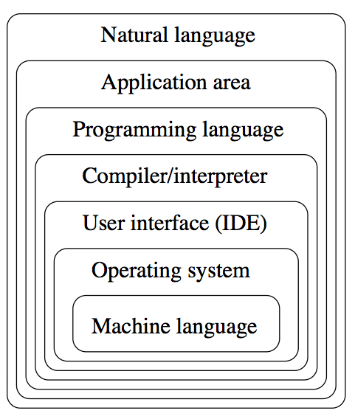
On Language Design
Design Constraints
Computer architecture
Technical setting
Standards
Legacy systems
Design Outcomes and Goals
Levels of abstraction in computing

Slide 36
What makes a successful language?
Key characteristics:
Simplicity and readability
Clarity about binding
Reliability
Support
Abstraction
Orthogonality
Efficient implementation

Slide 37
Simplicity and Readability
Small instruction set
E.g., Java vs. Scheme
Simple syntax
E.g., C/C++/Java vs. Python
Benefits:
Ease of learning
Ease of programming

Slide 38
Clarity about Binding
A language element is bound to a property at the time that property is defined for it.
So a binding is the association between an object and a property of that object
Examples:
a variable and its type
a variable and its value
Early binding takes place at compile-time
Late binding takes place at run time

Slide 39
Reliability
A language is reliable if:
Program behaviour is the same on different platforms
E.g., early versions of Fortran
Type errors are detected
E.g., C vs. Haskell
Semantic errors are properly trapped
E.g., C vs. C++
Memory leaks are prevented
E.g., C vs. Java

Slide 40
Language Support
Accessible (public domain) compilers/interpreters
Java (open) vs. C# (closed)
Good texts and tutorials
Wide community of users
Integrated with development environments (IDEs)
Eclipse vs. vim
Visual Studio vs. Emacs

Slide 41
Abstraction in Programming
Data
Programmer-defined types/classes
Class libraries
Procedural
Programmer-defined functions
Standard function libraries

Slide 42
Orthogonality
A language is orthogonal if its features are built upon a small, mutually independent set of primitive operations.
while loop vs. for loop in C
Fewer exceptional rules = conceptual simplicity
E.g. our tutorials are “usually” on Monday except the last week of each month or when the TA is busy with his research on text generation...
E.g., restricting types of arguments to a function
Tradeoffs with efficiency

Slide 43
Efficient implementation
Embedded systems
Real-time responsiveness (e.g., navigation)
Failures of early Ada implementations
Web applications
Responsiveness to users (e.g., Google search)
Corporate database applications
Efficient search and updating
AI applications
Modeling human behaviors

Slide 44
Compilers and Interpreters
Compiler – produces machine code
Interpreter – executes instructions on a virtual machine
Example compiled languages:
Fortran, Cobol, C, C++
Example interpreted languages:
Scheme, Haskell, Python, Perl
Hybrid compilation/interpretation
The Java Virtual Machine (JVM)
.java → .class
.class executes on JVM

Slide 45
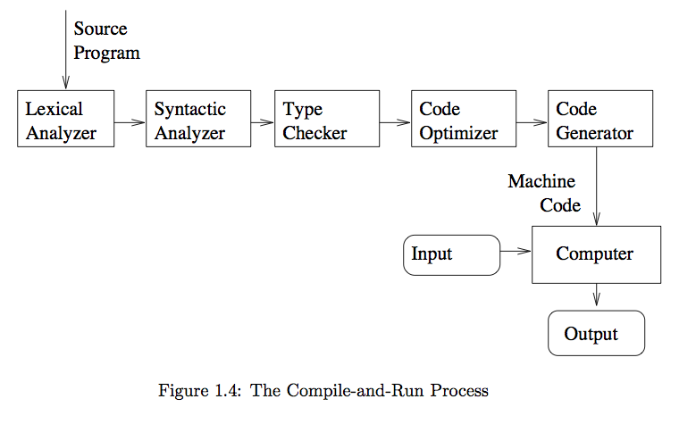
The Compiling Process

Slide 46
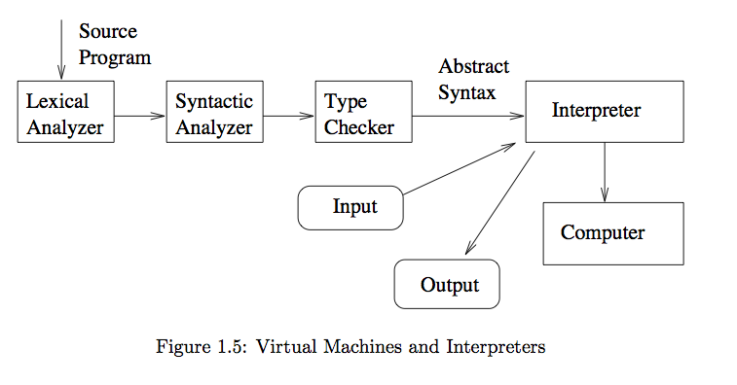
The Interpreting Process

Slide 47
Course Roadmap
Mathematic foundation – inductive definition and inductive proofs
Untyped Lambda Calculus
Simply-typed Lambda Calculus
Extensions to Simply-typed Lambda Calculus
Going Imperative
Memory Management
Subtyping
Type Inference
Case Study: Imperative Programming
Case Study: Object-Oriented Programming
Case Study: Functional Programming
Case Study: Logic Programming
Special Topic: Concurrency

Slide 48
Finally, Enjoy This Video!
“The most popular programming languages 1965-2021”
https://www.bilibili.com/video/BV16t4y1B7Ji/

