Slide 1
Tutorial
Bran & Yvonne

Slide 2
Quiz 1

Slide 3
1. What is the course about?
Programming in a language
How to compile a program
The design and implementation of languages
How to interpret a program

Slide 4
2. Which one of following is not a programming paradigm?
Statement
Object-oriented
Functional
Declarative

Slide 5
3. Which one is not a basic property of programming languages?
Syntax
Names
Types
Values
Syntax, names, types, semantics

Slide 6
4. What is not a major concern of syntax?
Syntax error detection
Types
Grammar
Vocabulary

Slide 7
5. A name (identifier) always refers to the same identity, regardless of the context(scope, visibility, lifetime, type...)
True
False

Slide 8
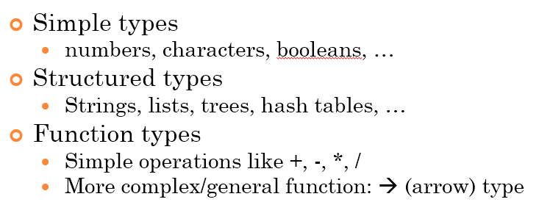
6. Which of the following is not a type in imperative programs?
Arrow (function) type
Boolean
String
Integer

Slide 9
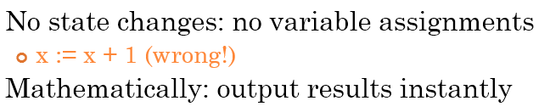
7. Is state change a major feature in function language?
Yes
No

Slide 10
8. Logic programs describes?
How the problem is solved
What is the expected outcome

Slide 11
9. What doesn’t make a successful programming language?
Clarity about binding
Abstraction
Orthogonality
Similarity with human language

Slide 12
10. Which language is Python?
A compiled language: C/C++
An interpreted language: Python
A hybrid compilation/interpretation: Java
None of the above

Slide 13
Homework1
can be used independently, without affecting each other
no exception
No redundancy
No overlap

Slide 14
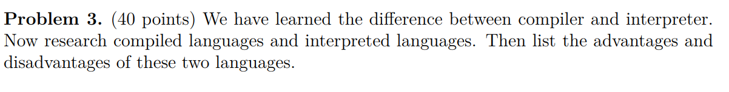
Homework1: Problem3
Runtime speed?
Time for compilation?
Cross-platform?
Program size?
Easy to debug?

Slide 15
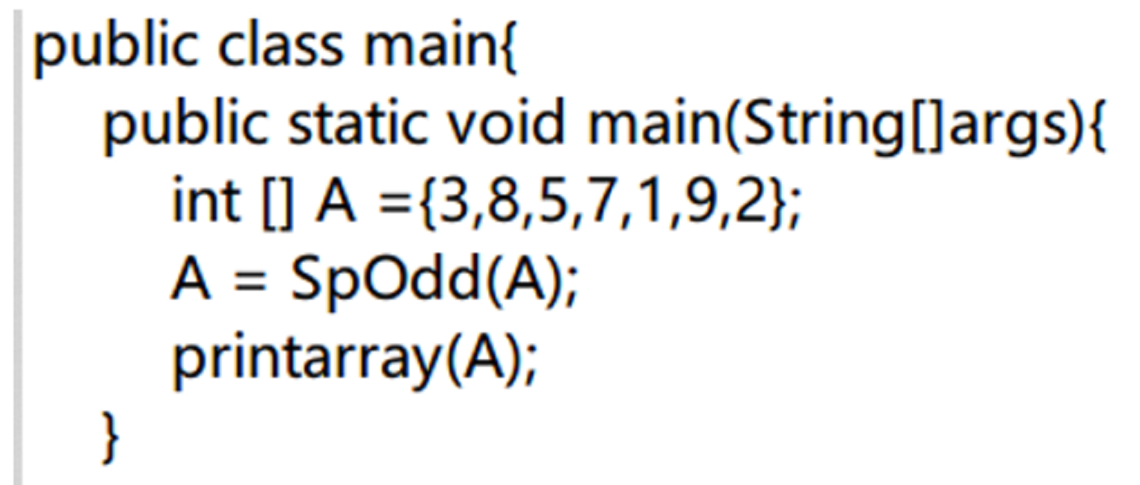
Homework1
method name is the same as the main class
The name of .java file must be the same as the class with main function so that the compiler knows where to start.

Slide 16
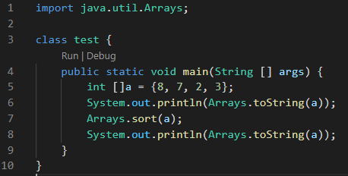

Homework1
Print arrays & sort arrays

Slide 17
Java classes

Slide 18
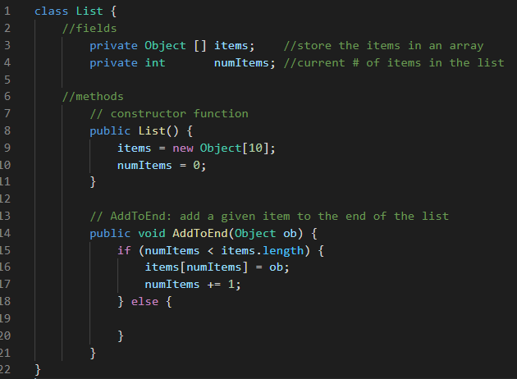
Fields and methods
Java classes contain fields and methods. A field is like a C++ data member, and a method is like a C++ member function.

Slide 19
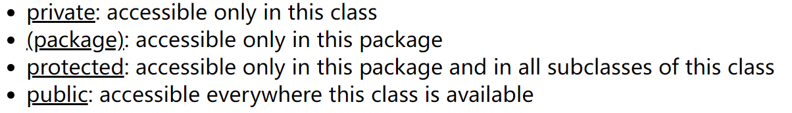
Access level
Each field and method has an access level

Slide 20
Access level
Similarly, each class has one of two possible access levels:
For both fields and classes, package access is the default, and is used when no access is specified.

Slide 21
Access level

Slide 22
Object
Object-oriented programming involves inheritance. In Java, all classes (built-in or user-defined) are (implicitly) subclasses of Object. Using an array of Object in the List class allows any kind of Object (an instance of any class) to be stored in the list. However, primitive types (int, char, etc) cannot be stored in the list.

Slide 23
Constructor function
Are used to initialize each instance of a class.
Have no return type (not even void).
Can be overloaded; you can have multiple constructor functions, each with different numbers and/or types of arguments.
If you don't write any constructor functions, a default (no-argument) constructor (that doesn't do anything) will be supplied.
If you write a constructor that takes one or more arguments, no default constructor will be supplied (so an attempt to create a new object without passing any arguments will cause a compile-time error).

Slide 24
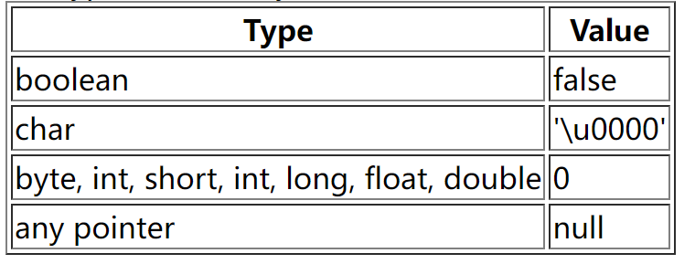
Initialization of fields
If you don't initialize a field (i.e., either you don't write any constructor function, or your constructor function just doesn't assign a value to that field), the field will be given a default value, depending on its type. The values are the same as those used to initialize newly created arrays

Slide 25
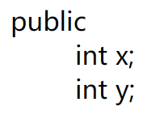
Access Control
Note that the access control must be specified for every field and every method; there is no grouping as in C++.
For example, given these declarations:
only x is public; y gets the default, package access.

Slide 26
Static Fields and Methods
Fields and methods can be declared static
If a field is static, there is only one copy for the entire class, rather than one copy for each instance of the class.

Slide 27
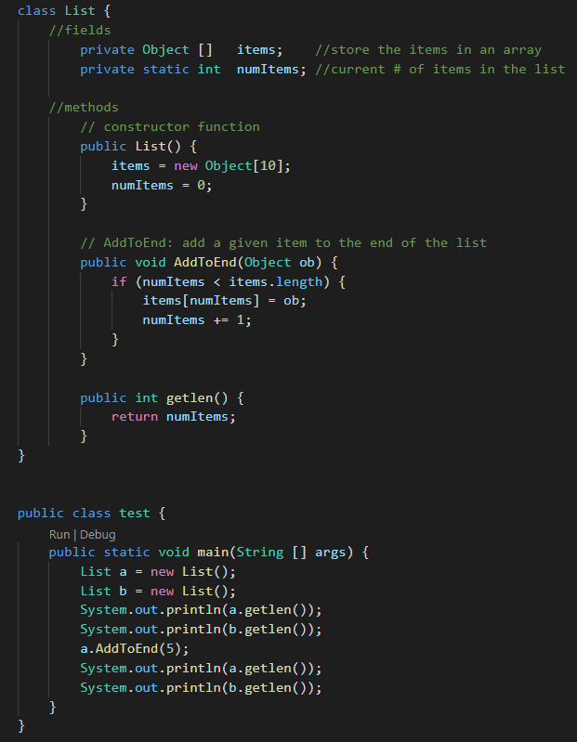

Static Fields and Methods

Slide 28
Static Fields and Methods
A method should be made static when it does not access any of the non-static fields of the class, and does not call any non-static methods. (In fact, a static method cannot access non-static fields or call non-static methods.)
Methods which only manipulate the class's static fields should be static.
For example, if we wanted a function to print the current value of the numItmes field defined above, that function should be defined as a static method of the List class. ( getlen() )

Slide 29
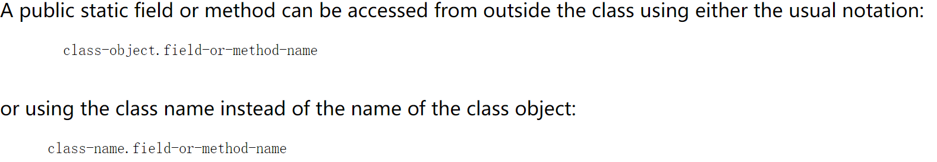
Static Fields and Methods
The preferred way to access a static field or a static method is using the class name (not using a class object). This is because it makes it clear that the field or method being accessed is static.

Slide 30
Final Fields and Methods
Fields and methods can also be declared final. A final method cannot be overridden in a subclass. A final field is like a constant: once it has been given a value, it cannot be assigned to again.

Slide 31
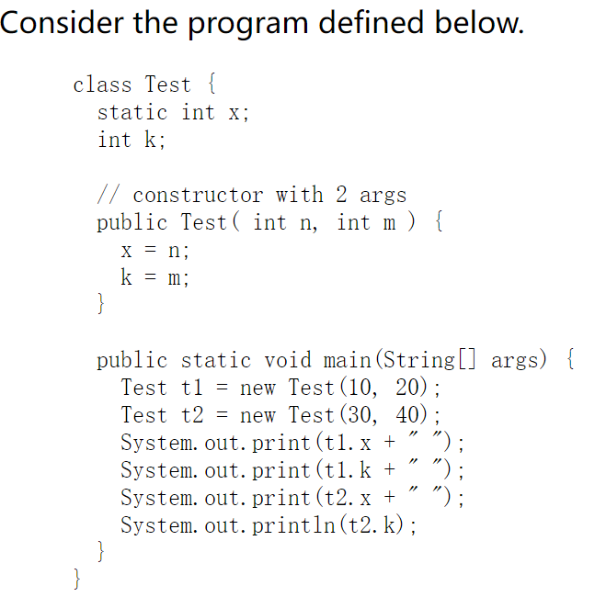
Test 1

Slide 32
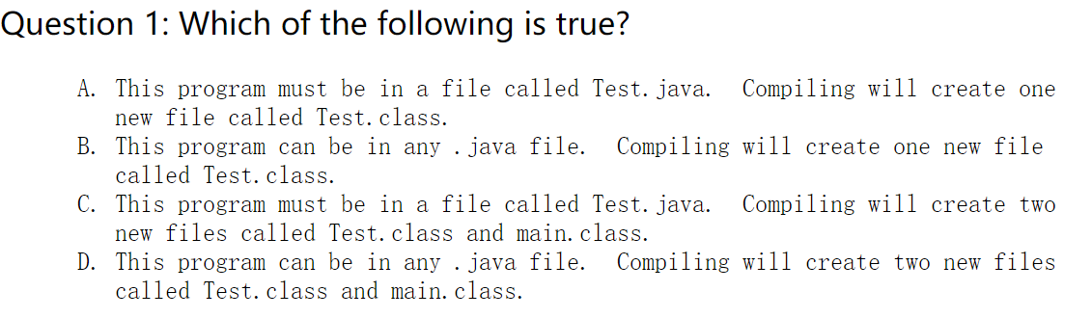

Slide 33
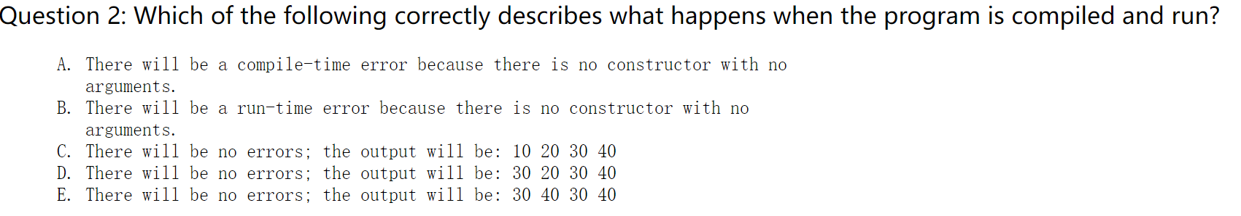

Slide 34
