Slide 1
Tutorial 4
TA Theron(Sinong)

Slide 2
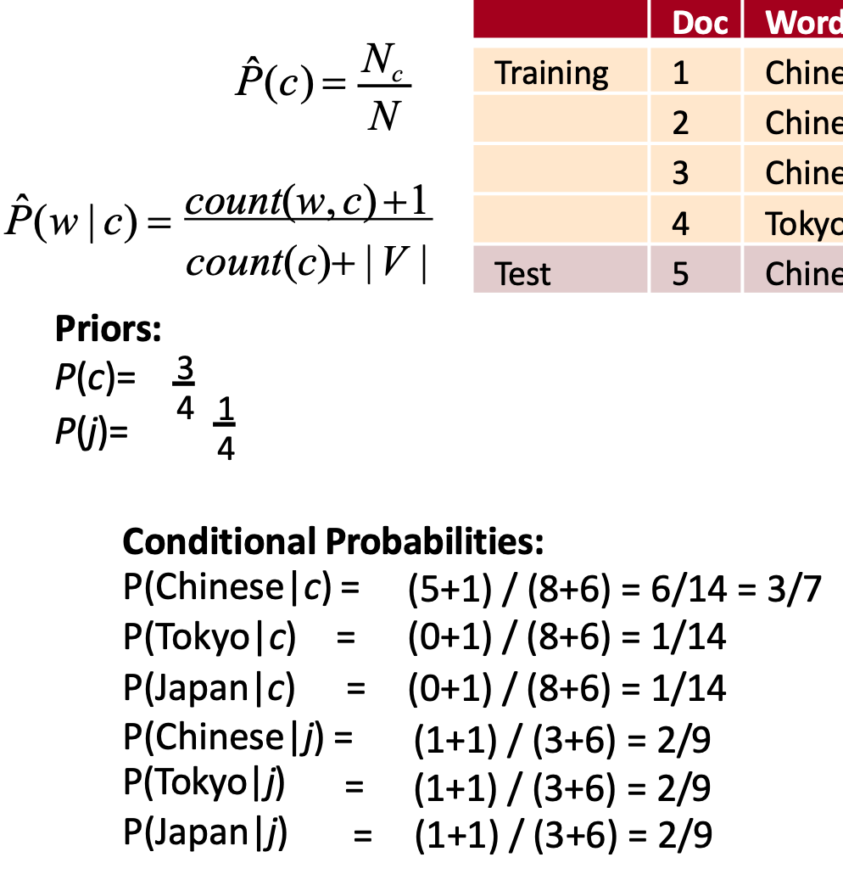

Slide 3
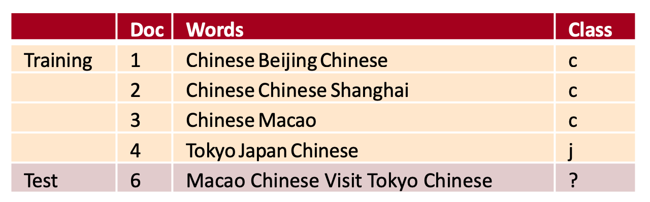
Quiz 5

Slide 4
Quiz-5
P(c|d6) = P(c) * P(Macao|c) * P(Chinese|c) * P(Visit|c) * P(Tokyo|c) * P(Chinese|c)
3/4 * 2/14 * 3/7 * 1/14 * 1/14 * 3/7
= 1e-4

Slide 5
Homework 3

Slide 6
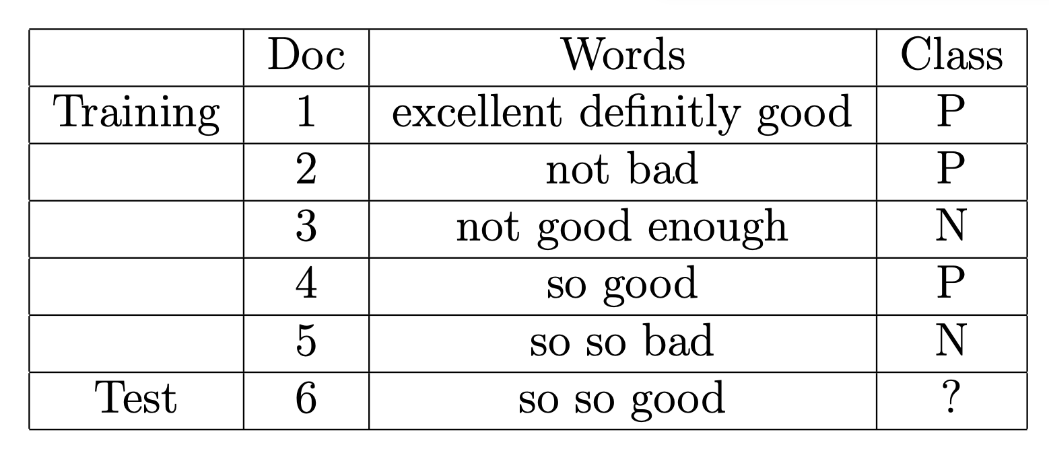
Problem 1

Slide 7
Problem 1
P(excellent|P) = (1+1)/(7+7) = 2/14
P(definitely|P) = (1+1)/(7+7) = 2/14
P(good|P) = (2+1)/(7+7) = 3/14
P(not|P) = (1+1)/(7+7) = 2/14
P(bad|P) = (1+1)/(7+7) = 2/14
P(enough|P) = (0+1)/(7+7) = 1/14
P(so|P) = (1+1)/(7+7) = 2/14
P(excellent|N) = (0+1)/(6+7) = 1/13
P(definitely|N) = (0+1)/(6+7) = 1/13
P(good|N) = (1+1)/(6+7) = 2/13
P(not|N) = (1+1)/(6+7) = 2/13
P(bad|N) = (1+1)/(6+7) = 2/13
P(enough|N) = (1+1)/(6+7) = 2/13
P(so|N) = (2+1)/(6+7) = 3/13
P(P|so so good) = P(P) * P(so|P) * P(so|P) * P(good|P) = 3/5 * 1/7 * 1/7 * 3/14 =
P(N|so so good) = P(N) * P(so|N) * P(so|N) * P(good|N) = 2/5 * 3/13 * 3/13 * 2/13 =

Slide 8
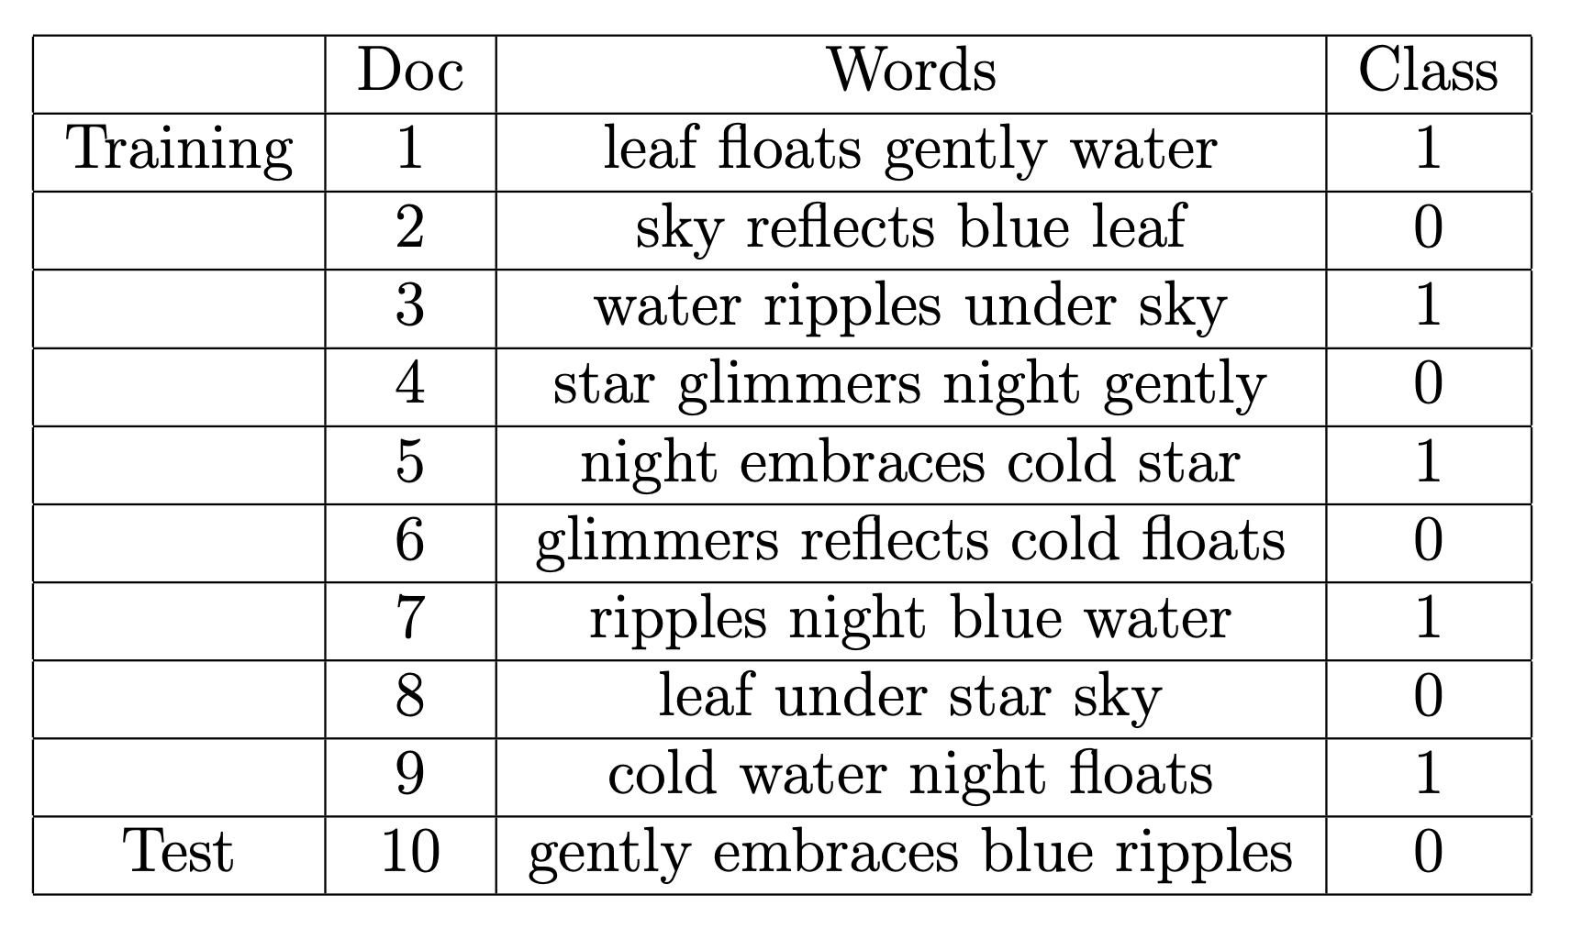
Problem 2

Slide 9
Problem 2
V: 14, C(1) = 20, C(0) = 16
Leaf, floats, gently, water, sky, reflects, blue, ripples, under, star, glimmers, night, embraces, cold,
P(1|gently, embraces, blue, ripples)
= P(gently|1) * P(embraces|1) * P(blue|1) * P(ripples|1) * P(1)
= (1+1)/(14+20) * (1+1)/(14+20) * (1+1)/(14+20) * (2+1)/(14+20) * 20/36 = 9.98e-6
P(0|gently, embraces, blue, ripples)
= P(gently|0) * P(embraces|0) * P(blue|0) * P(ripples|0) * P(0)
= (1+1)/(14+16) * (0+1)/(14+16) * (1+1)/(14+16) * (0+1)/(14+16) * 16/36 = 2.19e-6

Slide 10
Problem 2
Confusion Metrics
0 | 1
0 | 0

Slide 11
Presentation about your Project Proposal
The Problem you are going to solve
The Method you are going to design
The Evaluation Metrics you are going to use
* Time Management

Slide 12
14 Groups
7 Groups a class
Group1 – Group 7 are supposed to present on this Wednesday
Group 8 – Group 14 are supposed to present on next Monday
You can exchange with each group
Each group have 10 min to present your proposal

