Slide 1
Tutorial– Week1
Sinong - TA

Slide 2
Arrangement
Lecture - Monday
Lecture - Wednesday
Tutorial - Wednesday
Disscuss the solution to the former Homeworks and Quizes

Slide 3
Java in this course
Homeworks
Final Project

Slide 4
Get Started
Installation
https://www.oracle.com/java/technologies/downloads/
(compiler, interpreter and other tools)
IDE
VSCode (simple, lightweight)
Online Coding
IntelliJ (powerful)
https://www.tutorialspoint.com/compile_java_online.php

Slide 5
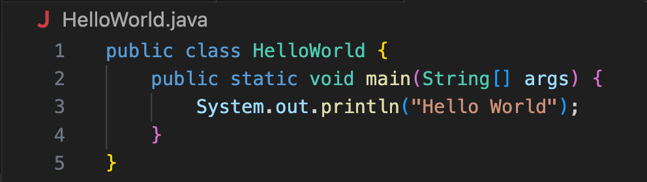
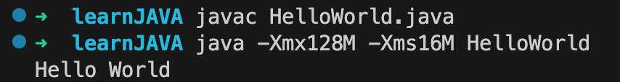
Hello World
”javac” is the compiler, get HelloWorld.class
“java” is the interpreter, run HelloWorld.class
-Xmx128M, -Xms16M limit the Memory, not necessary

Slide 6
Java vs. C++

Slide 7
Basic Syntax
In Java, every variable, constant, and function (including main) must be inside some class.
There is no final semi-colon at the end of the class definition.
2.Function main is a member of class “HelloWorld”(main is the function where the whole program starts, which is similar to C++)
3.main must: (1) be inside some class.
(2) Be public static void.
(3) Have one argument: an array of String. This array contains the command-line arguments. You can use args.length to determine the number of arguments (the number of Strings in the array).
Notes:
Here the green main means the function where the whole program starts, you can also define a general main function and call it, just make sure the compiler can distinguish them. But in c++, you can only have one main function

Slide 8
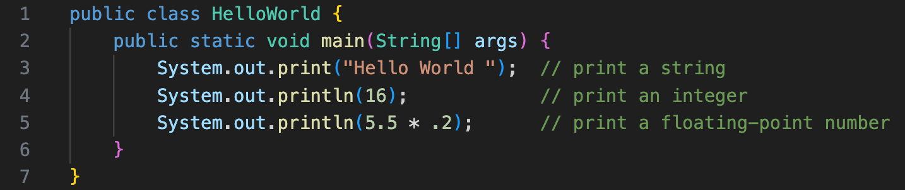
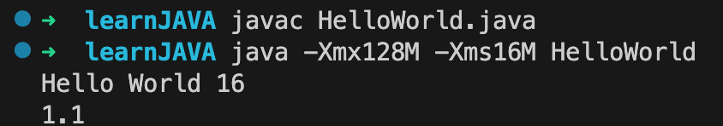
Output function
System.out.println(…)
System.out.print(…)

Slide 9
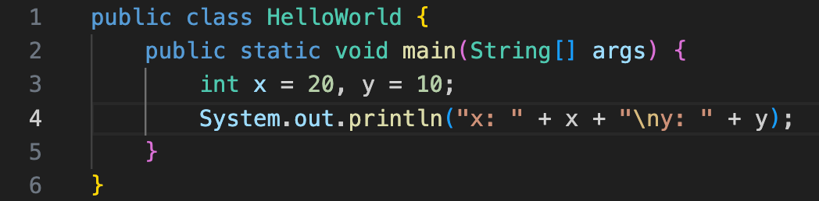
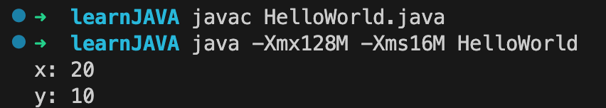
+ Operator
The + operator can be useful when printing.
It is overloaded to work on Strings as follows:
If either operand is a String, it
converts the other operand to a String (if necessary)
creates a new String by concatenating both operands

Slide 10
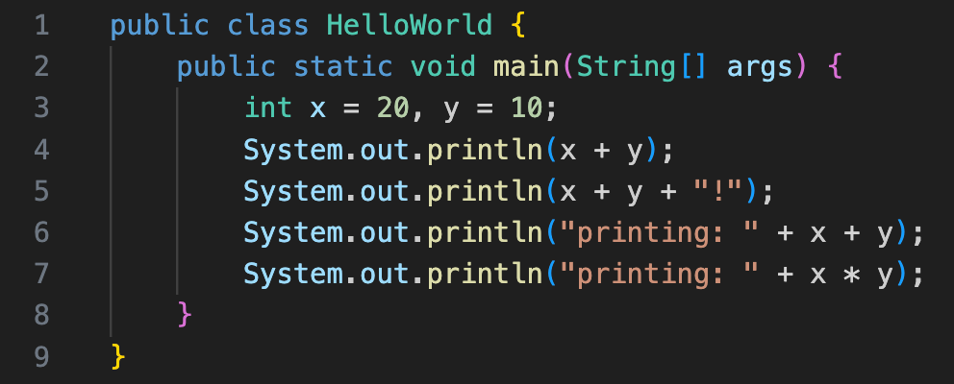
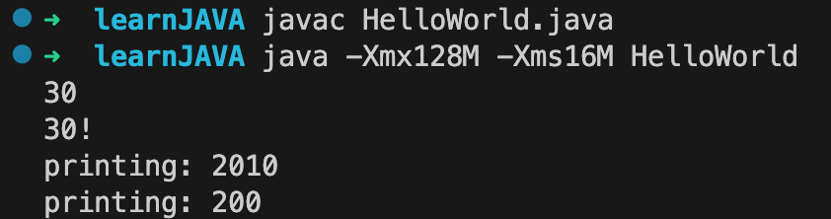
Test 1
Notes:
Can you write down the result of this program without running it?

Slide 11
C++ Files vs. Java Files

Slide 12
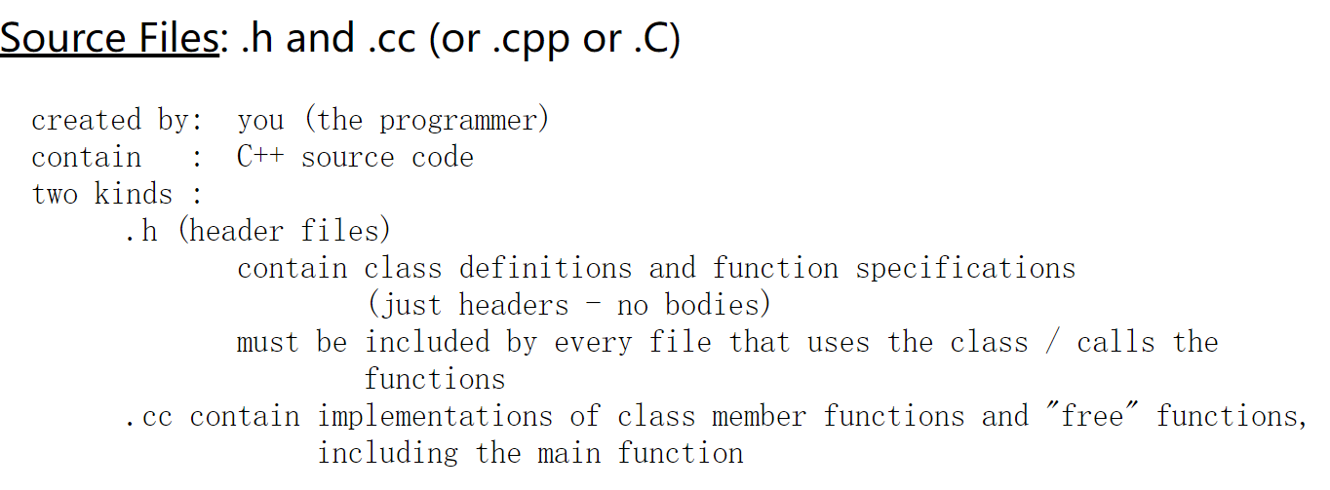
C++ Files

Slide 13
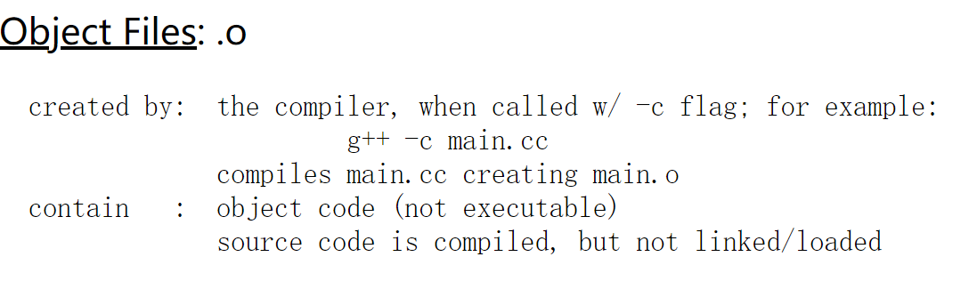
C++ Files

Slide 14
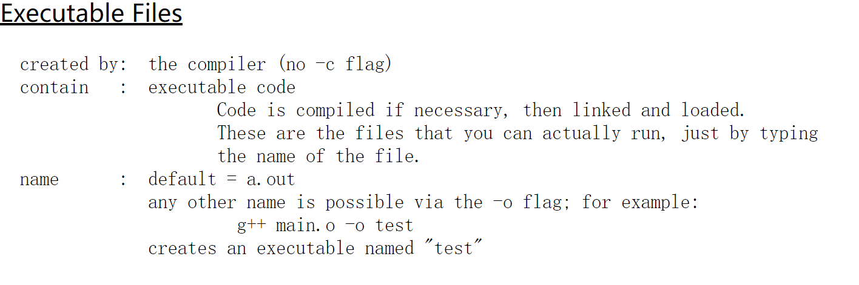
C++ Files

Slide 15
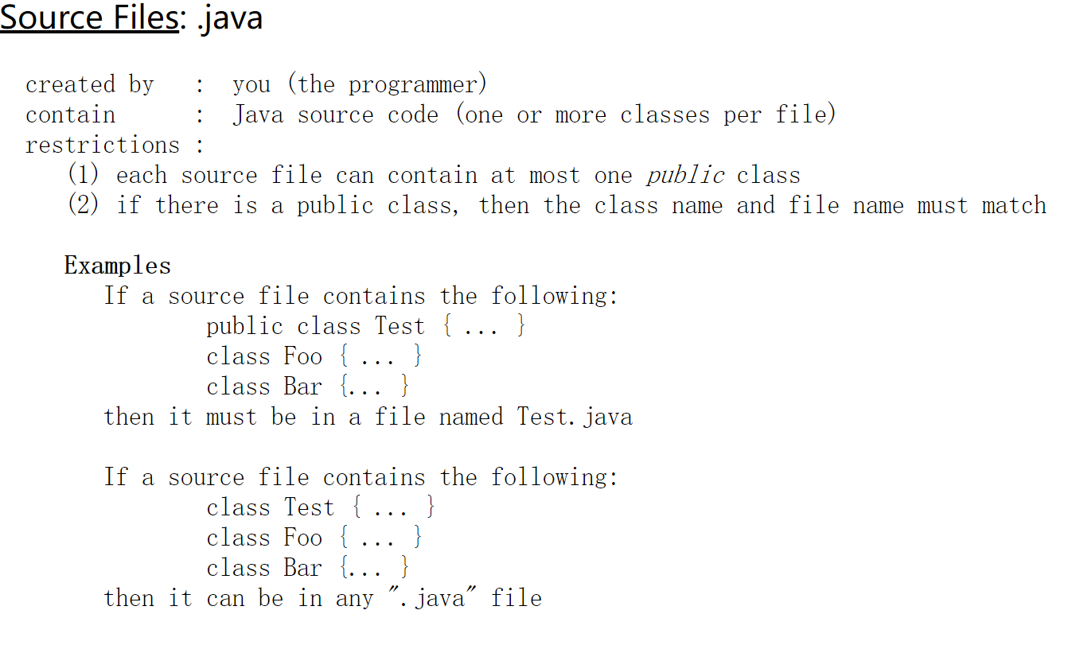
Java Files

Slide 16
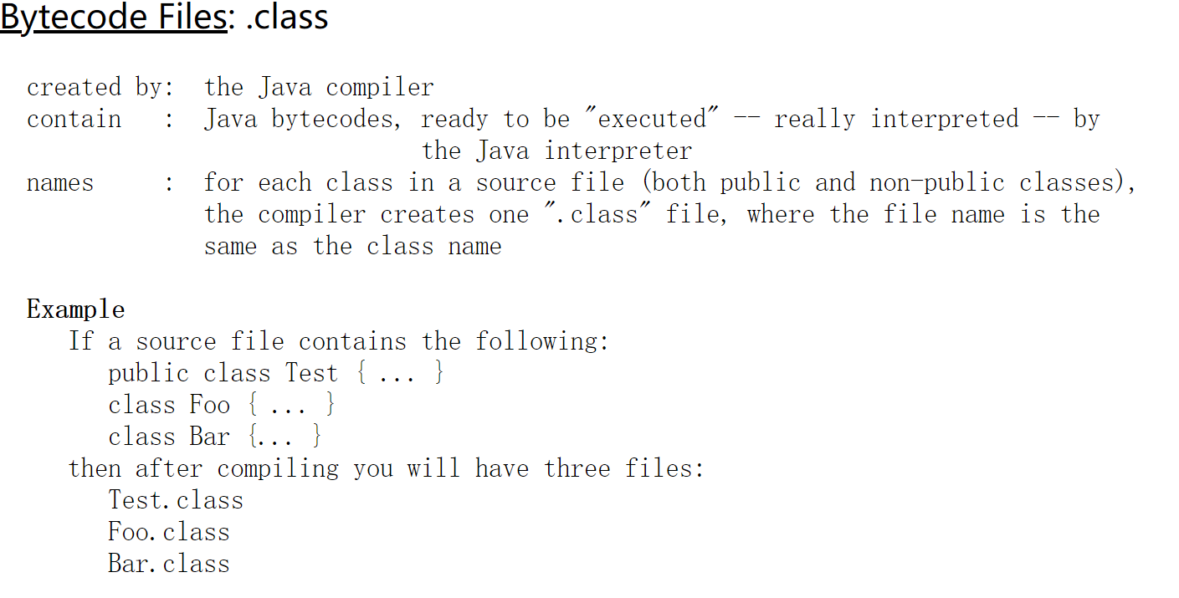
Java Files

Slide 17

Test-2
Write a complete Java program that uses a loop to sum the numbers from 1 to 10 and prints the result like this:
Note: Use variable declarations, and a for or while loop with the same syntax as in C++.

Slide 18
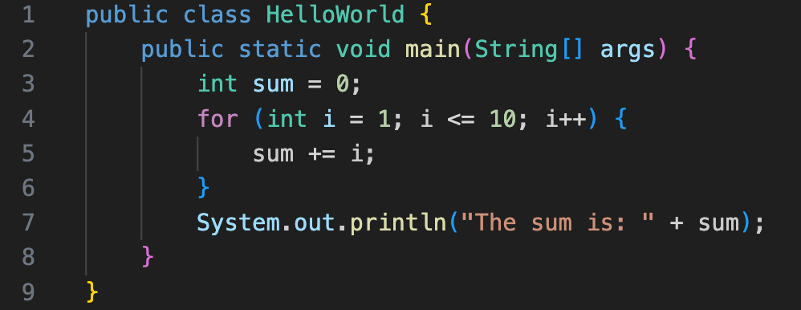
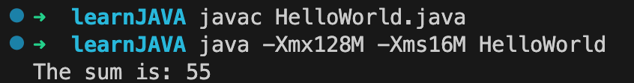
Test-2

Slide 19
Java Types

Slide 20
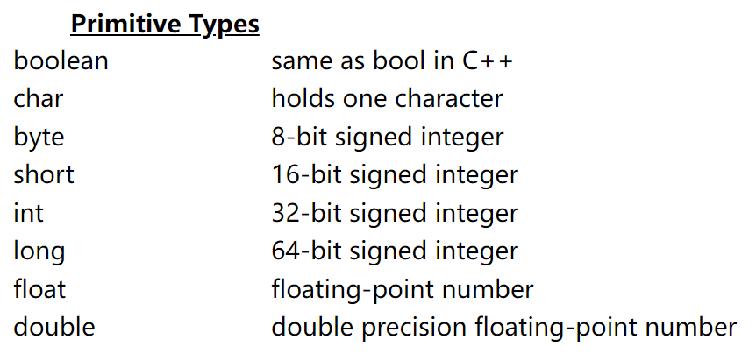
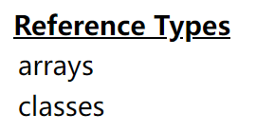
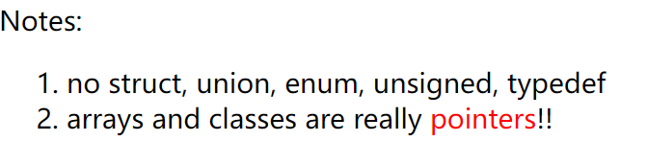
In Java, there are two "categories" of types: primitive types and reference types:
Notes:
These are basic types .
Types like string, it is a class.

Slide 21
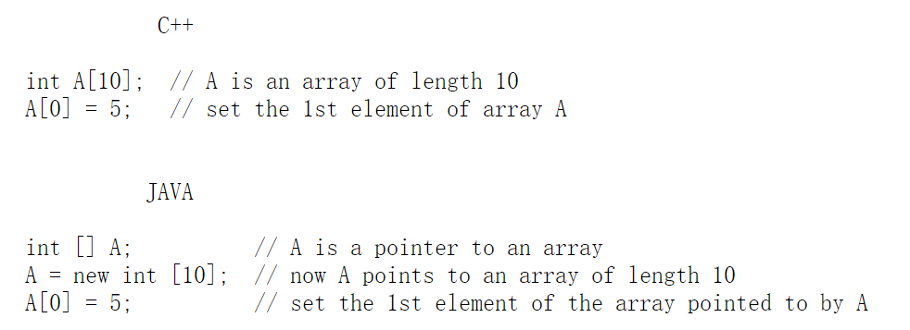
C++ Arrays vs Java Arrays
In C++, when you declare an array, storage for the array is allocated. In Java, when you declare an array, you are really only declaring a pointer to an array; storage for the array itself is not allocated until you use "new":

Slide 22

C++ Arrays vs Java Arrays
In both C++ and Java you can initialize an array using values in curly braces. Here's example Java code:
Notes:
Square bracket

Slide 23
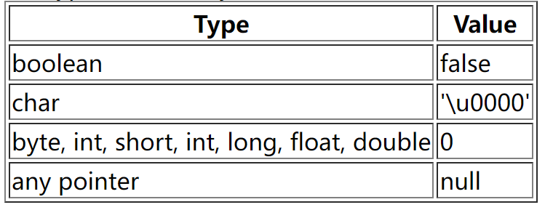
C++ Arrays vs Java Arrays
In Java, a default initial value is assigned to each element of a newly allocated array if no initial value is specified. The default value depends on the type of the array element:

Slide 24
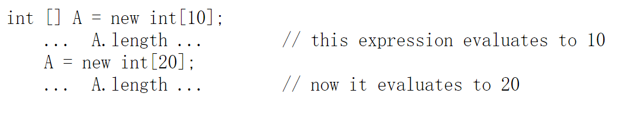
C++ Arrays vs Java Arrays
In Java, an out-of-bounds array index always causes a runtime error.
In Java, you can determine the current length of an array (at runtime) using ".length":
Notes:
Square bracket

Slide 25

Test-3
Write a Java function called NonZeros, using the header given below. NonZeros should create and return an array of integers containing all of the non-zero values in its parameter A, in the same order that they occur in A.
Test NonZeros function in main function. Print the passed arrays and returned arrays as follow:

Slide 26
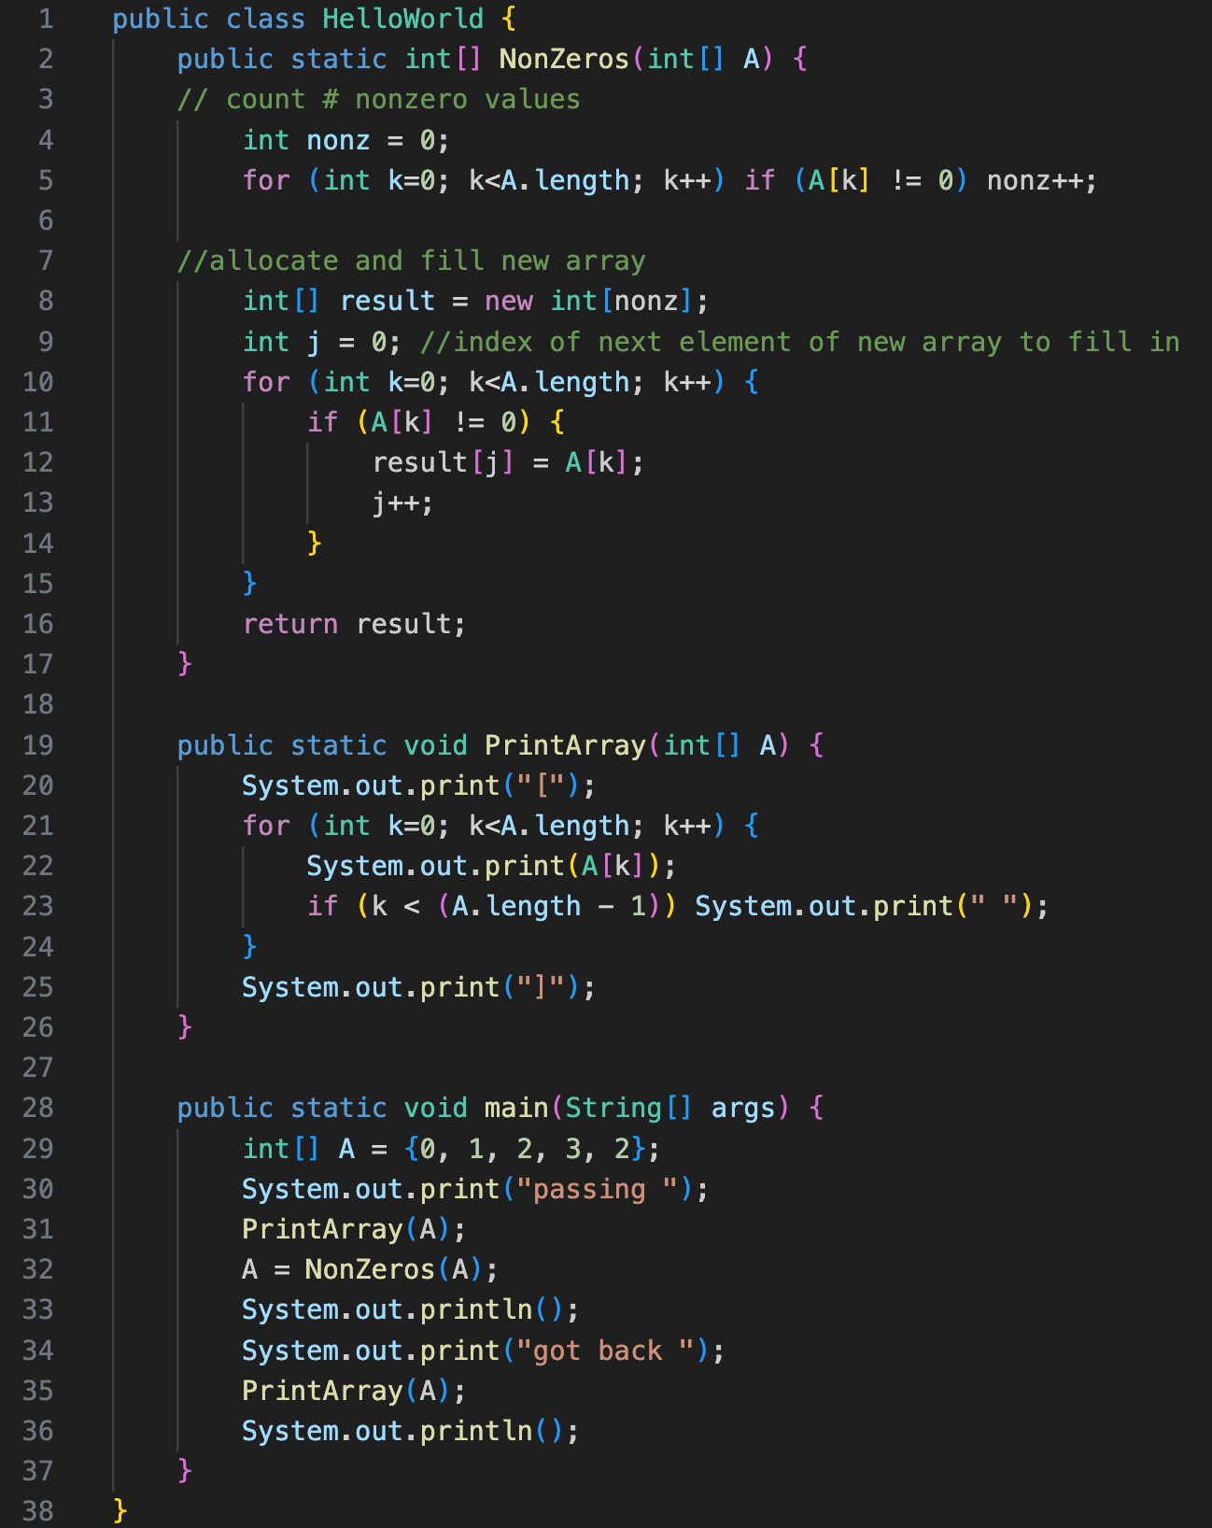
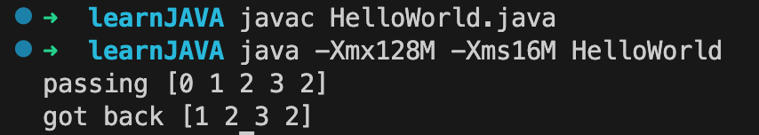
Test-3

Slide 27
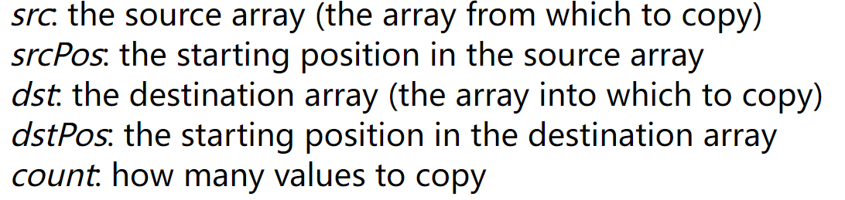
Arraycopy
In Java, you can copy an array using the arraycopy function. Like the output function println, arraycopy is provided in java.lang.System, so you must use the name System.arraycopy. The function has five parameters:

Slide 28
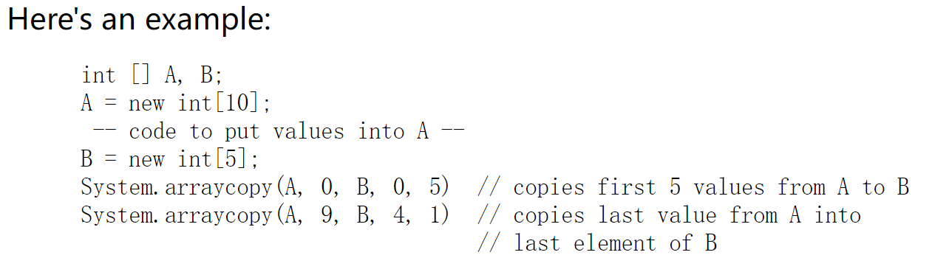
Arraycopy

Slide 29
Arraycopy
The destination array must already exist and it must be large enough to hold all copied values.
The source array must have enough values to copy (i.e., the length of the source array must be at least srcPos+count).
For arrays of primitive types, the types of the source and destination arrays must be the same (so for example, you cannot copy from an array of int to an array of double or vice versa).
For arrays of non-primitive types, System.arraycopy(A, j, B, k, n) is OK if the assignment B[0] = A[0] would be OK.

Slide 30
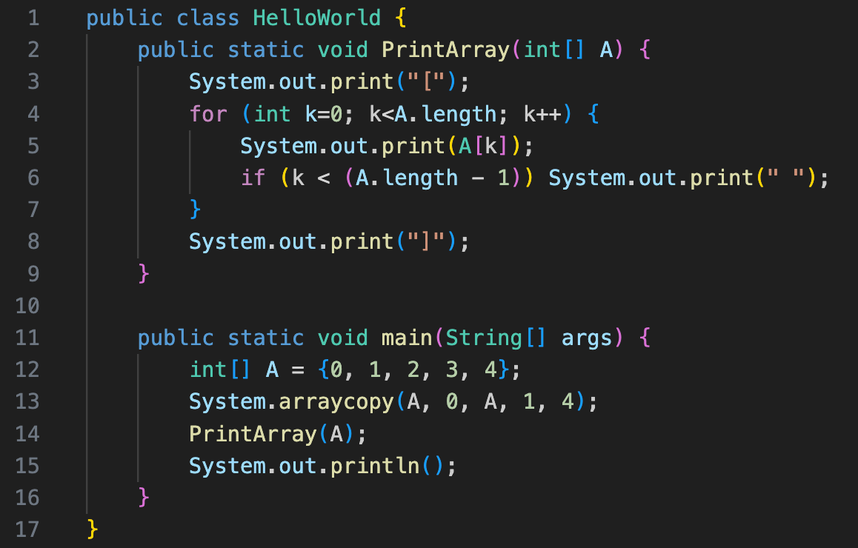
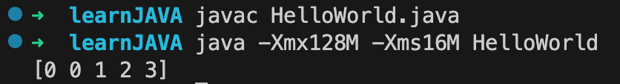
Arraycopy
The arraycopy function also works when the source and destination arrays are the same array; so for example, you can use it to "shift" the values in an array:

Slide 31
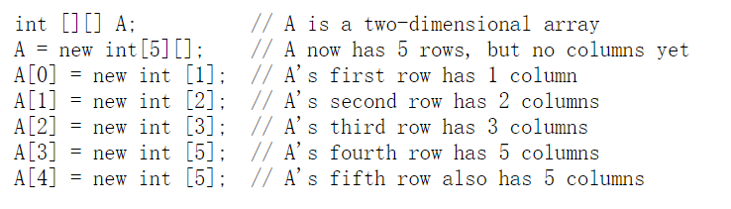
Multidimensional
As in C++, Java arrays can be multidimensional. For example, a 2-dimensional array is an array of arrays. Two-dimensional arrays need not be rectangular. Each row can be a different length. Here's an example:

Slide 32
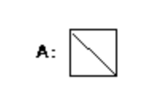

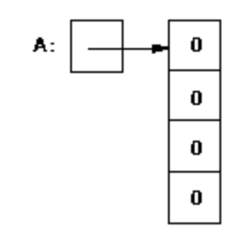

Test-4
Draw the value of “A”. If run error, just write “error”. Here are two examples:

Slide 33
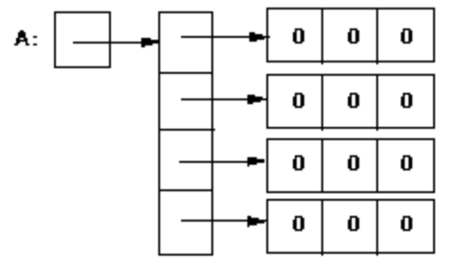

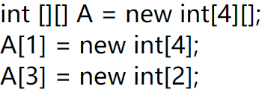
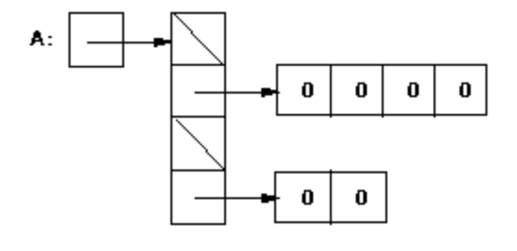
Test-4

Slide 34
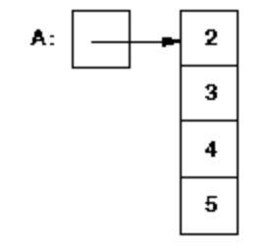
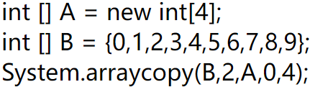
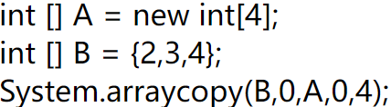
Test-4
error

Slide 35
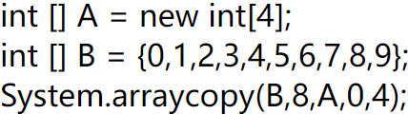
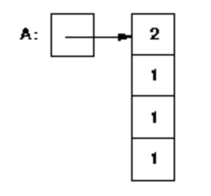
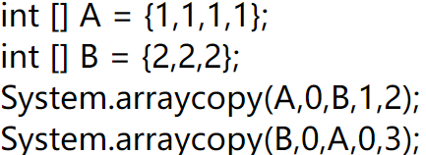
Test-4
error

Slide 36
C++ Classes vs. Java Classes

Slide 37
C++ Classes vs.Java Classes
In C++, when you declare a variable whose type is a class, storage is allocated for an object of that class, and the class's constructor function is called to initialize that instance of the class.
In Java, you are really declaring a pointer to a class object; no storage is allocated for the class object, and no constructor function is called until you use "new".

Slide 38
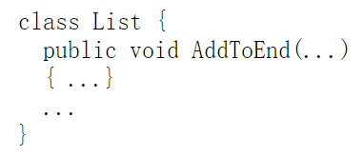
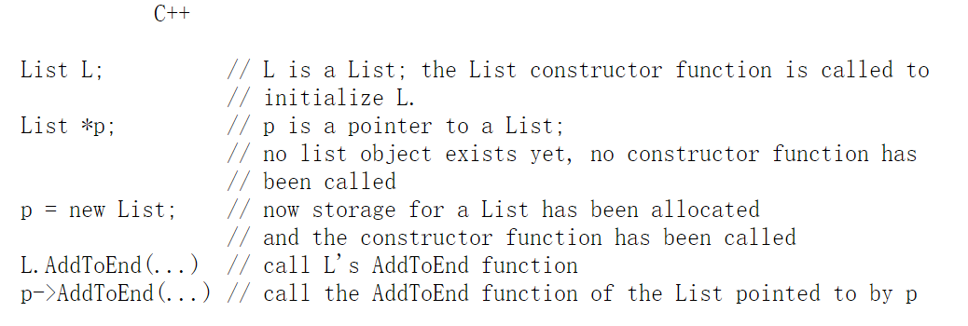
Assume that you have defined a List class as follows:

Slide 39
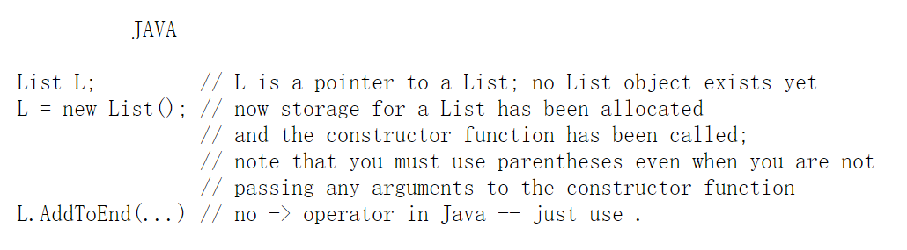
Assume that you have defined a List class as follows:

Slide 40
Aliasing Problems in Java
The fact that arrays and classes are really pointers in Java can lead to some problems:

Slide 41
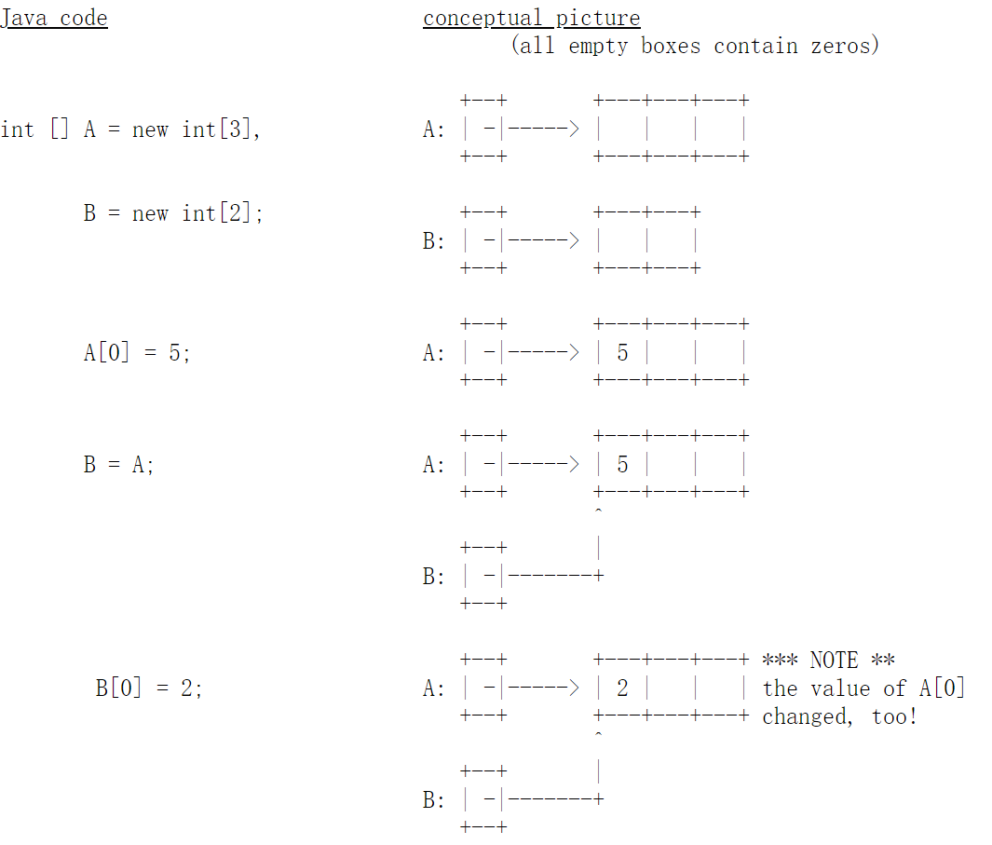

Slide 42
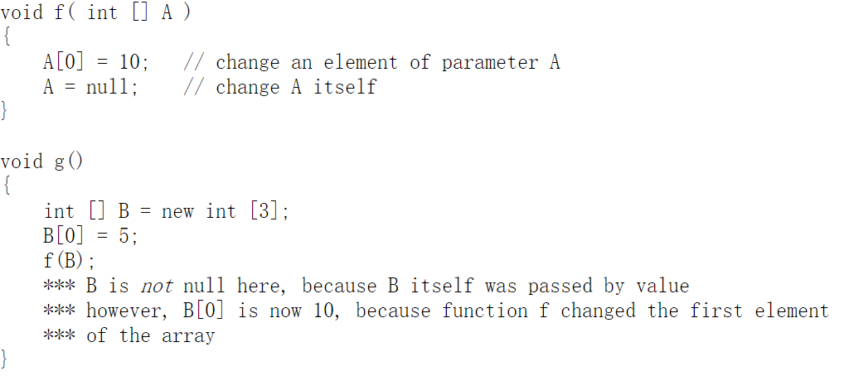

Slide 43
Aliasing Problems in Java
Solution: arraycopy or class’s clone operation

Slide 44
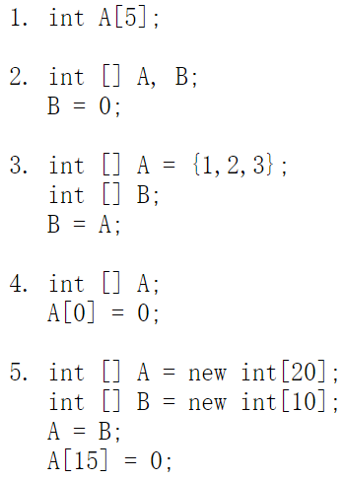
Test 5
For each of the following Java code fragments, say whether it causes a compile-time error, a run-time error, or no error. If there is an error, explain why.

Slide 45
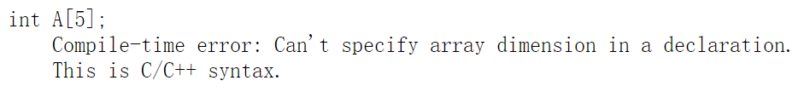
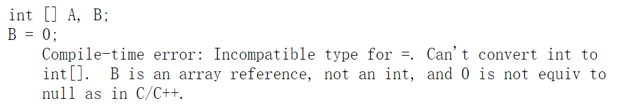
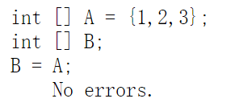
Test 5

Slide 46
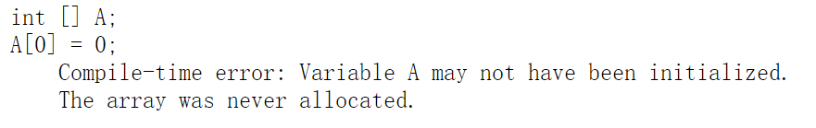
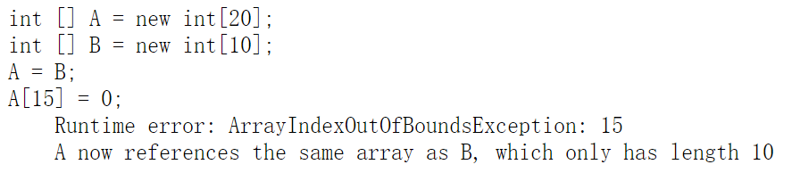
Test 5

Slide 47
Type Conversion

Slide 48
Type conversion
Java is much more limited than C++ in the type conversions that are allowed. Here we discuss conversions among primitive types. Conversions among class objects will be discussed later.
Booleans cannot be converted to other types.
For the other primitive types (char, byte, short, int, long, float, and double), there are two kinds of conversion: implicit and explicit.

Slide 49

Implicit conversion
An implicit conversion means that a value of one type is changed to a value of another type without any special directive from the programmer.
A char can be implicitly converted to an int, a long, a float, or a double.
For example, the following will compile without error:

Slide 50
Implicit conversion
For the other (numeric) primitive types, the basic rule is that implicit conversions can be done from one type to another if the range of values of the first type is a subset of the range of values of the second type.
For example,
a byte can be converted to a short, int, long or float;
a short can be converted to an int, long, float, or double, etc.

Slide 51

Explicit conversion
Explicit conversions are done via casting: the name of the type to which you want a value converted is given, in parentheses, in front of the value.
Casting can be used to convert among any of the primitive types except boolean.
casting can lose information; for example, floating-point values are truncated when they are cast to integers (e.g., the value of k in the code fragment given above is 5)
casting among integer types can produce wildly different values (because upper bits, possibly including the sign bit, are lost)

Slide 52
Test 6
Fill in the table below as follows:
If the declaration will compile as is, put a check in the second column, and write the value of the declared variable in the last column.
If the declaration will not compile as is, but can be made to compile by adding an explicit cast, rewrite the declaration with the correct explicit cast in the third column, and write the value of the declared variable in the last column.
If the declaration will not compile, and cannot be fixed by adding an explicit cast, put a check in the fourth column.

Slide 53

Test 6

Slide 54

Test 6

Slide 55
Reference
https://pages.cs.wisc.edu/~hasti/cs368/JavaTutorial/

Slide 56
Final Project

Slide 57
Goal
In this project, you are required to implement an interpreter for the programming language SimPL(pronounced simple). SimPL is a simplified dialect of ML, which can be used for both functional and imperative programming.
Principles
Syntax, Names, Types, Semantics

Slide 58

Notes:
This is an example of calculating 1 + 2
Blue words are key words
We define a function add which has two parameters x and y, and output 1 + 2
The green words are comments
The results should be 3

Slide 59
Thanks

