Slide 1
Tutorial-3
TA Sinong

Slide 2
Quiz2

Slide 3
1. “succ(n) nat” is a judgement or judgement form ?
a. judgement
b. Judgement form
Whether sth is a natural number
Judgement= instance,
particular object or objects having that property
Judgement form=abstract structure (schema)
（can’t be ‘more abstract’）

Slide 4
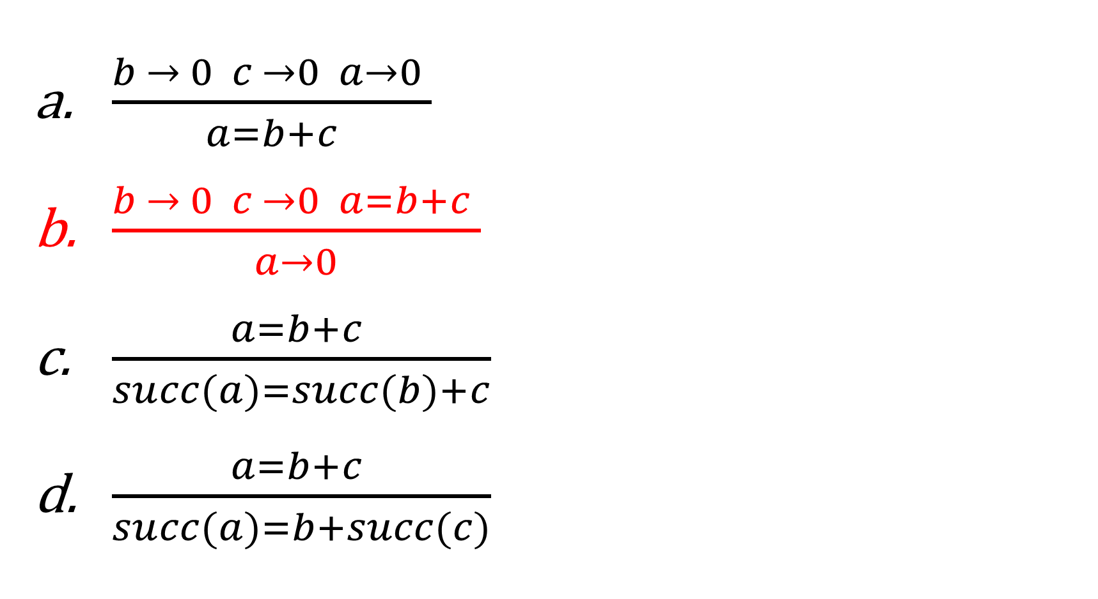
2. Which one of the following is NOT a rule of definition of judgement form a = b + c?

Slide 5
3. A top-down derivation of a judgement starts from ?
Proper rules
Axioms
Premises
Conclusion
Opposite(due to tree representation)

Slide 6
4. Which one of the following is NOT a part of doing an inductive proof?
Clearly state the induction hypothesis.
Make a proper inductive definition.
Clearly state what you are doing induction on.
Show one case for each rule in the inductive definition.

Slide 7
Theorem 2: If n nat, then either even n or odd n.
Proof: By induction on the derivation of n nat.
Case:
even Z (By rule evenZ)
Case:
(1) even n or (2) odd n (By I.H.)
Need to prove: even (S n) or odd (S n)
Assuming (1):
odd (S n) (By (1) and rule oddS)
Assuming (2):
even (S n) (By (2) and rule evenS)
QED.
Clearly state what you are doing induction on.
Show one case for each rule in the inductive definition.
Clearly state the induction hypothesis.(property you try to prove)

Slide 8
5. If the structure of your induction hypothesis is “If X or Y then A”, which of the following things is proper for you to assume and prove?
Assume X or Y, prove A
Assume X and Y, prove A
Assume X prove A, or Assume Y prove A
Assume X prove A, and Assume Y prove A

Slide 9
6. If the structure of your induction hypothesis is “If X and Y then A”, which of the following things is proper for you to assume and prove?
Assume X or Y, prove A
Assume X and Y, prove A
Assume X prove A, or Assume Y prove A
Assume X prove A, and Assume Y prove A

Slide 10
Homework-2

Slide 11
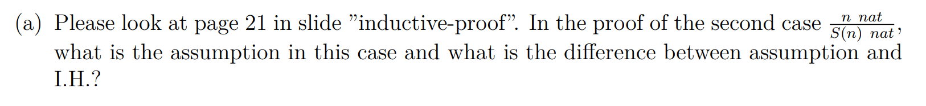
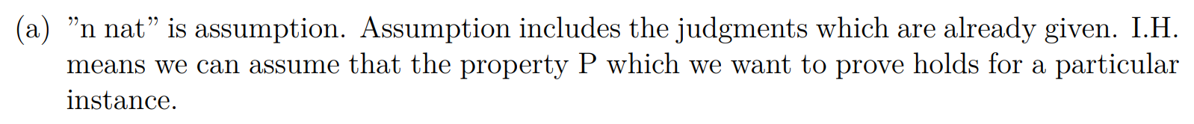
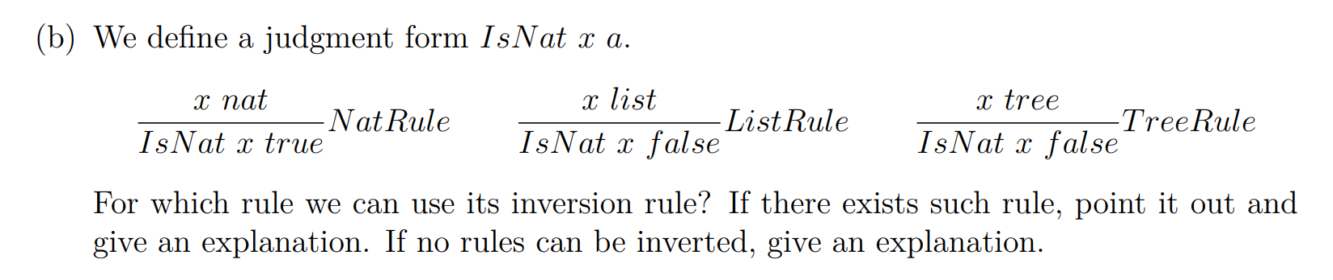
Problem-1

Slide 12
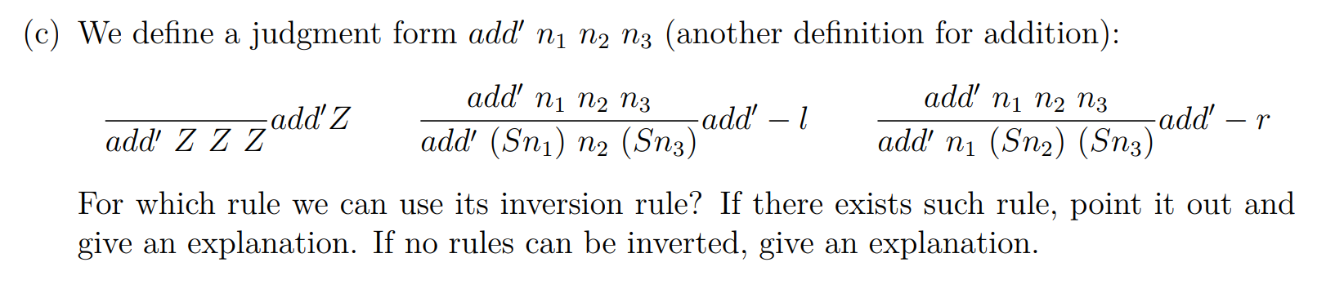
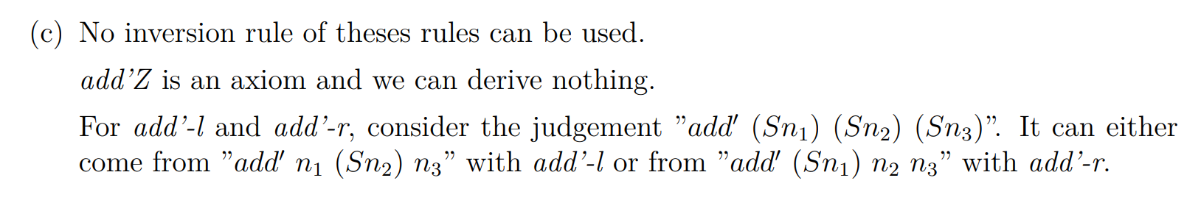

Slide 13
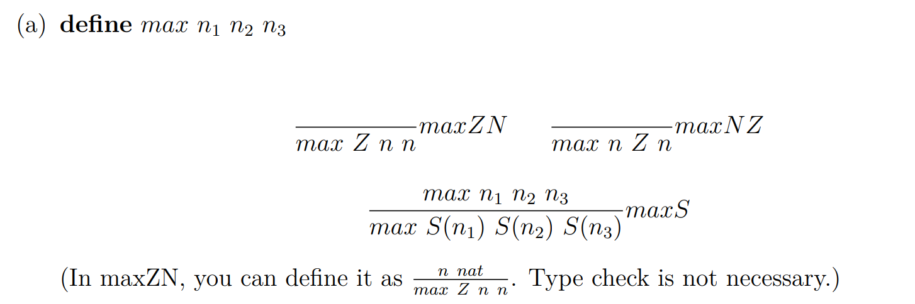
Problem-2

Slide 14
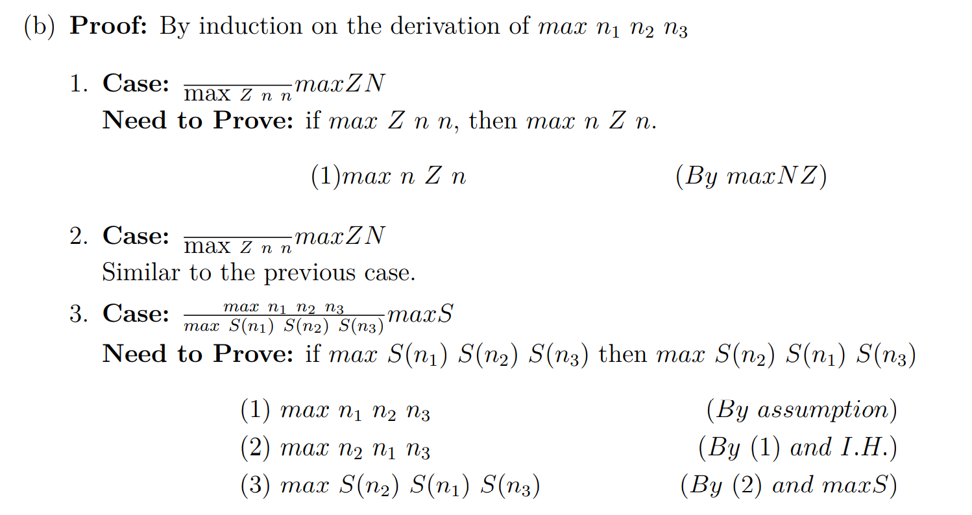
Problem-2

Slide 15
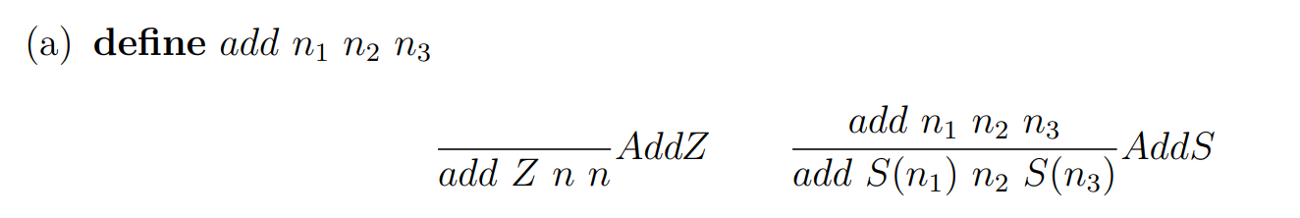
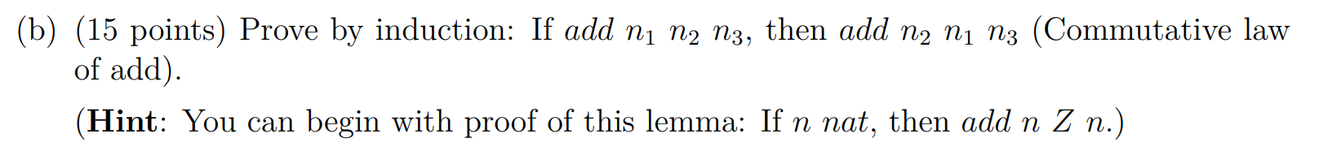
Problem-3

Slide 16
Problem-3

Slide 17
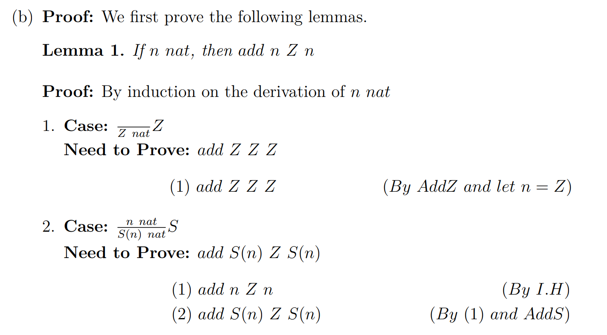
Problem-3

Slide 18
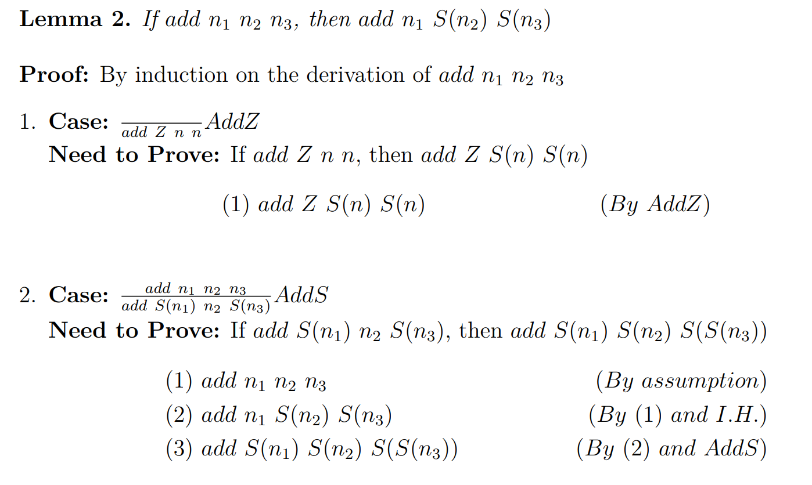
Problem-3

Slide 19
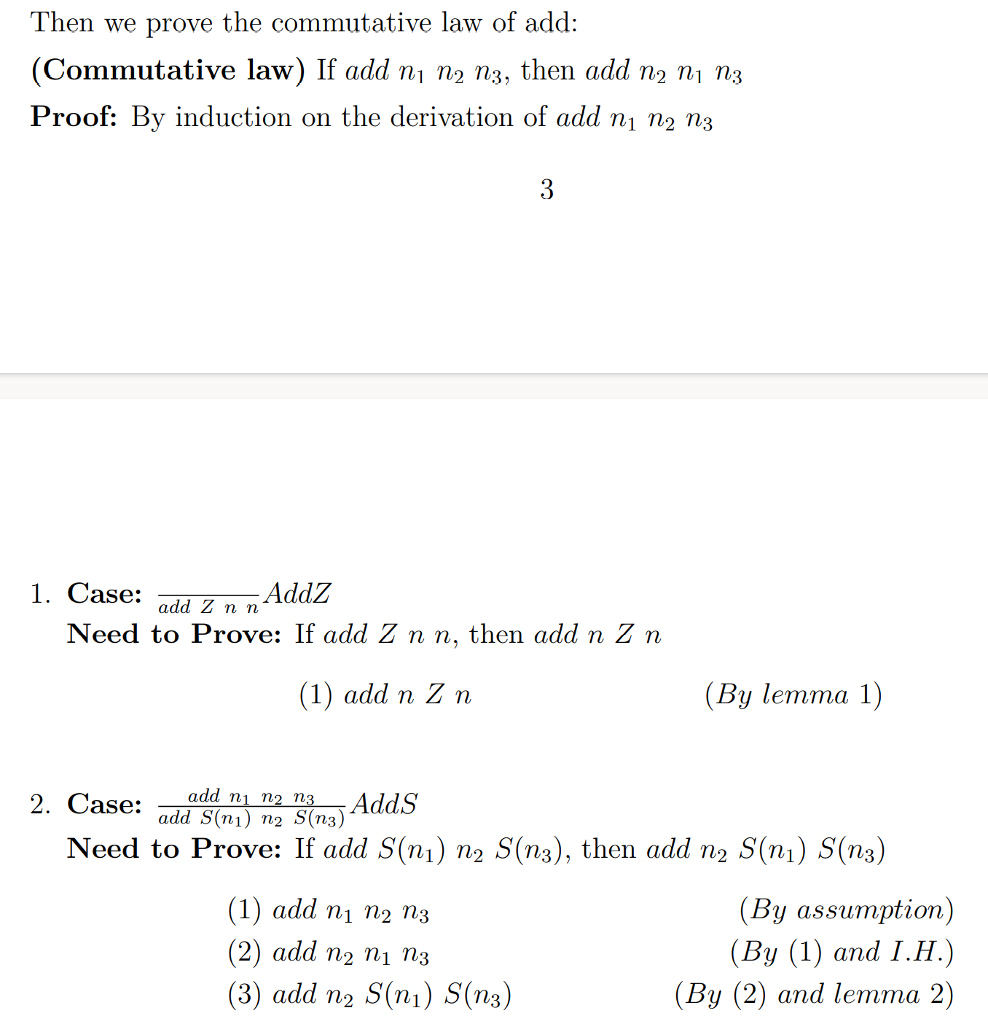
Problem-3

Slide 20
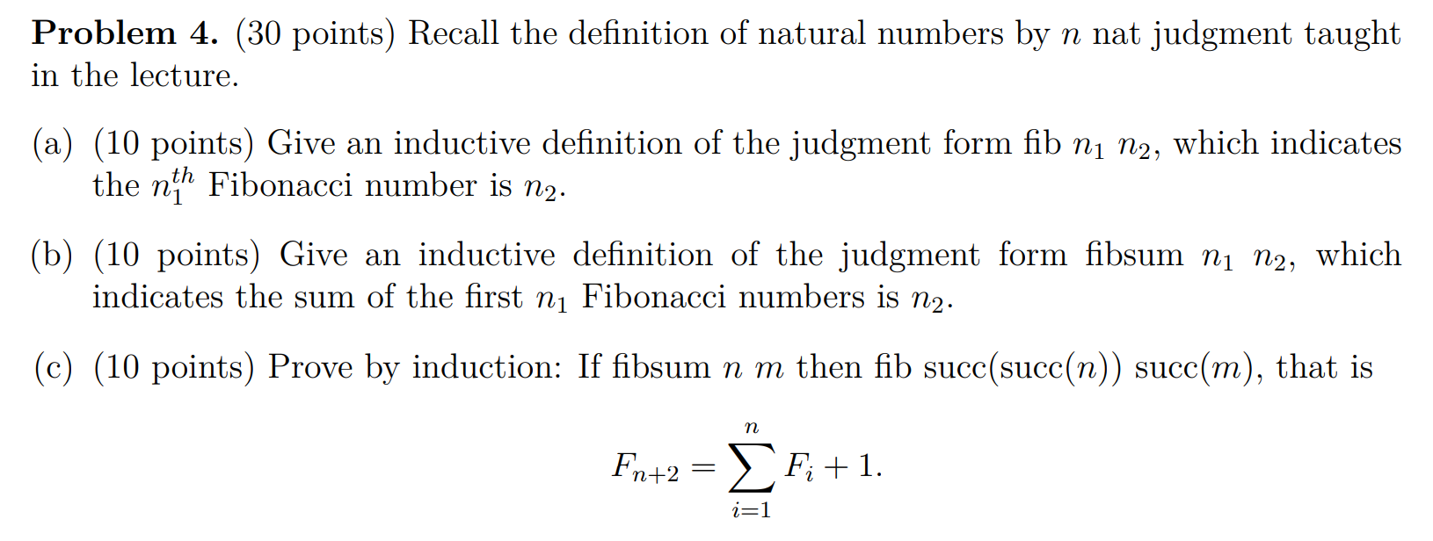
Problem-4

Slide 21
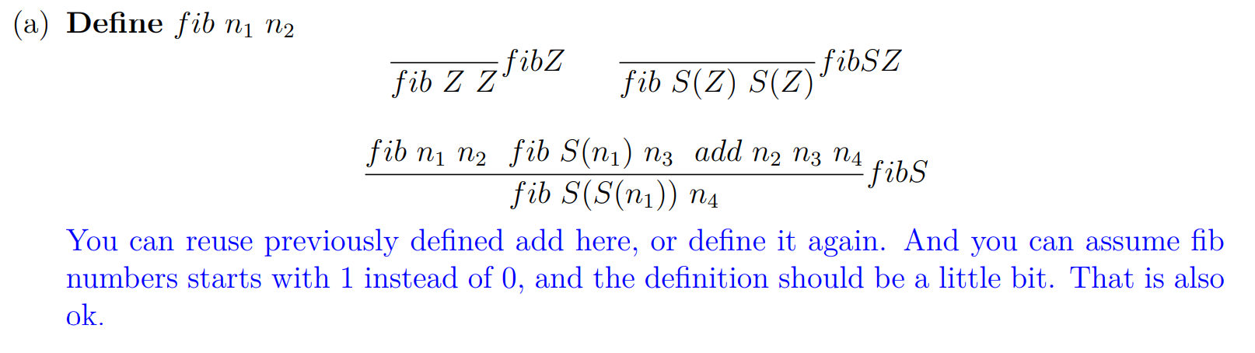
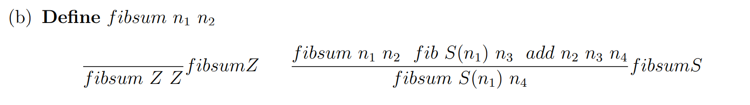
Problem-4

Slide 22
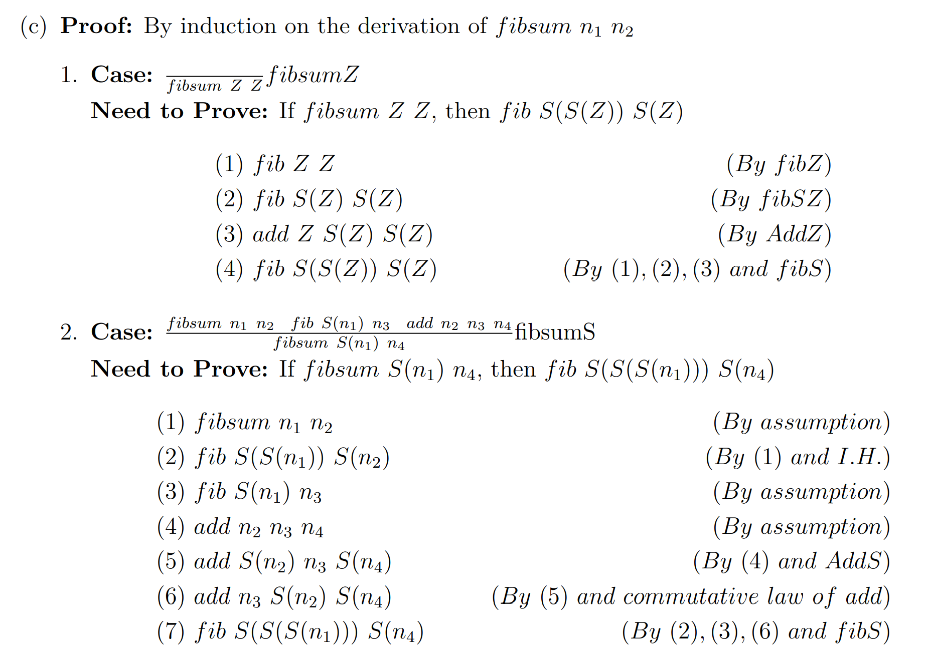
Problem-4

Slide 23
Remark
Please upload .pdf file
Please rename your file
Format:HW_{x}_{firstname}_{10digitID}.pdf
Example:HW_3_Sinong_1001001000.pdf

