Slide 1
Tutorial-6
TA Sinong

Slide 2
Quiz-5

Slide 3
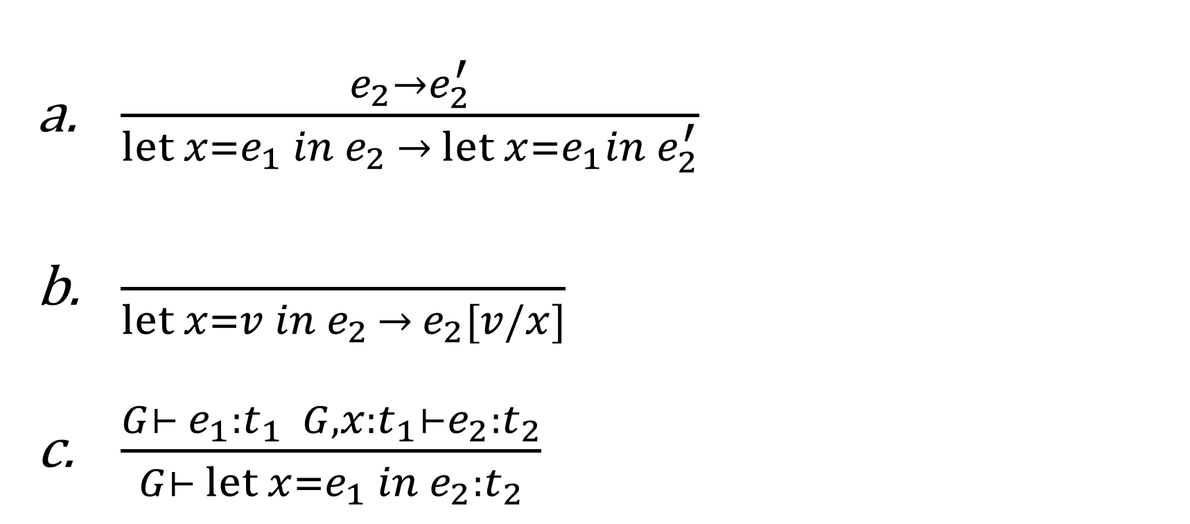
Q1 Which is not right for let?

Slide 4
Q1 Which is not right for let?

Slide 5
Q2 Whose bounding is determined at run time ?
Static scoping
Dynamic scoping

Slide 6
Q3 . Evaluate the following expression with static scoping: let x = (let y = 1 in y) in let y = (let x = 2 in x) in 2x + y
3
4
5
6

Slide 7
Q3 . Evaluate the following expression with static scoping: let x = (let y = 1 in y) in let y = (let x = 2 in x) in 2x + y
3
4
5
6

Slide 8
Q4. Which one of the following three languages’ syntax is different from the others?
L1: Expr → Expr + Term | Expr – Term| Term Term → 0|1|2|3|4|5|6|7|8|9|(Expr) L2: Expr →Expr Op Expr|Term Term → 0|1|2|3|4|5|6|7|8|9|(Expr) Op → + | - L3: Expr → Expr + Expr | Expr – Expr| Term Term → 0|1|2|3|4|5|6|7|8|9|(Expr)
L1
L2
L3
They are all equal

Slide 9
Q4. Which one of the following three languages’ syntax is different from the others?
L1: Expr → Expr + Term | Expr – Term| Term Term → 0|1|2|3|4|5|6|7|8|9|(Expr) L2: Expr →Expr Op Expr|Term Term → 0|1|2|3|4|5|6|7|8|9|(Expr) Op → + | - L3: Expr → Expr + Expr | Expr – Expr| Term Term → 0|1|2|3|4|5|6|7|8|9|(Expr)
L1
L2
L3
They are all equal

Slide 10
Q5. 5. For the following strings, which one doesn’t belong to the language GINT? GINT: Integer -> Integer Digit | Digit Digit -> 0|1|2|3|45|6|7|8|9
345
1245
405
4510

Slide 11
Q5. 5. For the following strings, which one doesn’t belong to the language GINT? GINT: Integer -> Integer Digit | Digit Digit -> 0|1|2|3|45|6|7|8|9
345
1245
405
4510

Slide 12
Q6. What does the following expression evaluate to using static scoping? let x = 3 in let y = (let x = 4 in 2 * x ) in x + y
9
10
11
12

Slide 13
Q6. What does the following expression evaluate to using static scoping? let x = 3 in let y = (let x = 4 in 2 * x ) in x + y
9
10
11
12

Slide 14
Q7. Write down the type of pair: {true, {0, 1}}

Slide 15
Q7. Write down the type of pair: {true, {0, 1}}
Bool*(int*int)

Slide 16
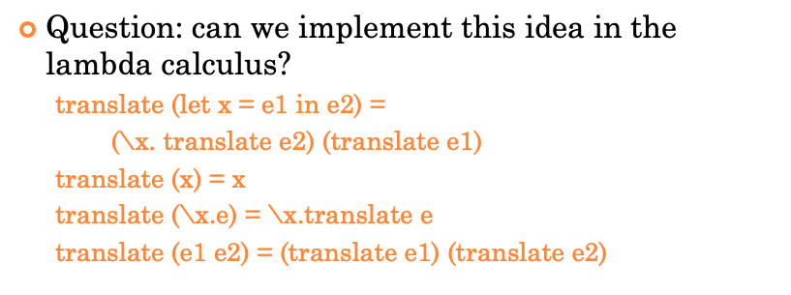
Q8. Translate let x = e1 in let y=e2 in e3 into lambda calculus (suppose e1,e2,e3 are translated to e1’,e2’ and e3’)

Slide 17
Q8. Translate let x = e1 in let y=e2 in e3 into lambda calculus (suppose e1,e2,e3 are translated to e1’,e2’ and e3’)
(\x.(\y.e3’) e2’) e1’

Slide 18
Homework-5

Slide 19
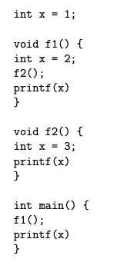
Problem-1
What will be printed after running main() when it uses
static scoping?
dynamic scoping?

Slide 20
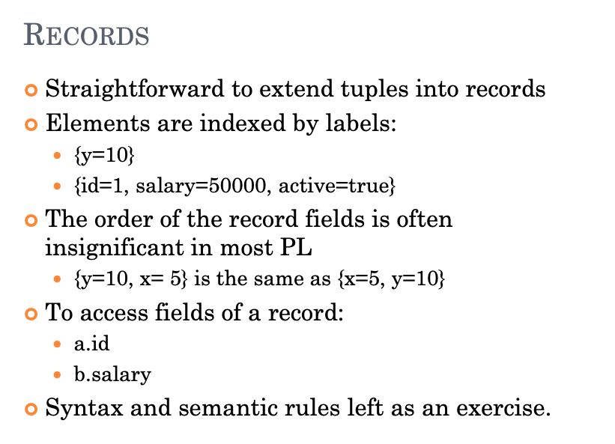
Problem-2

Slide 21
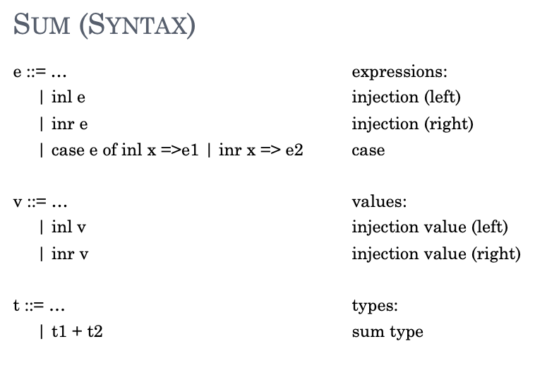
Problem-2

Slide 22
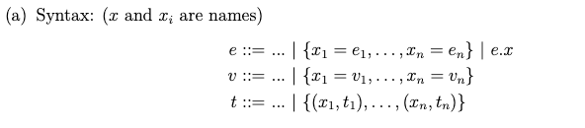
Problem-2

Slide 23
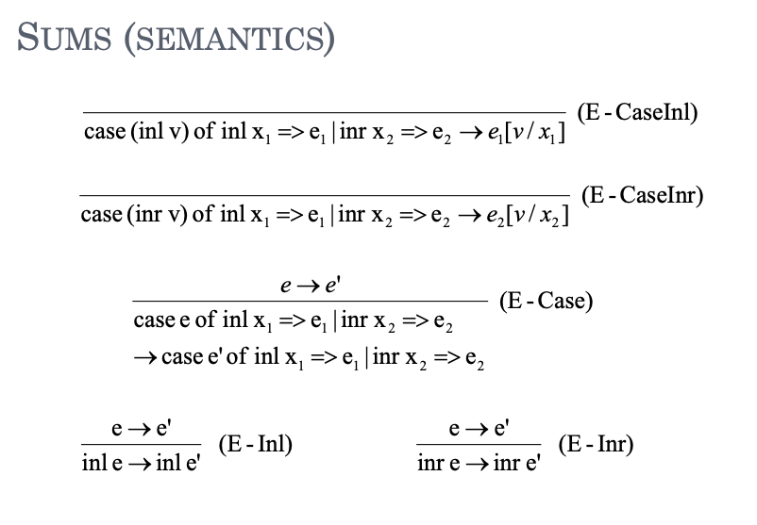
Problem-2

Slide 24
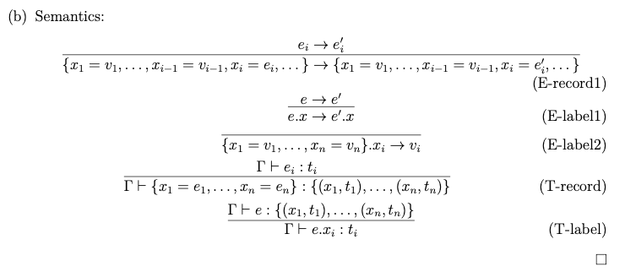
Problem-2

Slide 25
Problem-3

Slide 26
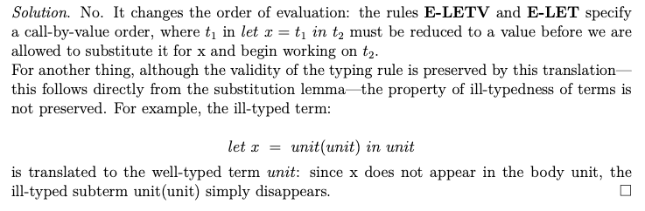
Problem-3

Slide 27
Project
https://kenzhu2000.github.io/cse3302/web/project.html
In this project, you are required to implement an interpreter in Java for the programming language SimPL (pronounced simple). SimPL is a simplified dialect of ML*, which can be used for both functional and imperative programming.
*Robin Milner, Mads Tofte, Robert Harper, and David MacQueen. The Definition of Standard ML: Revised 1997. The MIT Press, 1997.

Slide 28
Project
A project skeleton is provided at skeleton.rar . You can start writing your interpreter using the provided skeleton. It includes a ready-to-import Eclipse project, a source code formatter style (formatter.xml), a full-featured parser for SimPL, and skeleton files for abstract syntax tree (AST) nodes, types, and values.Given the project skeleton, you may finish coding the course project within 24 hours, if you fully understand the specification and the lectures.

Slide 29
Project
Deadline: 2023/12/01 23:59:59
Send your exported JAR file, the source code file and a project document, to Canvas before deadline. Your filename MUST like "CSE3302_project_Name_StudentID", e.g. "CSE3302_project_JohnSmith_5140309117".
You should package the JAR file, the source code file and the project document into a compressed file with your name and student number as file name, e.g. "JohSmith_5140309117.rar".
The document should include your implementation method and explanation. The structure of your document is as the specification.

Slide 30
Grade
Upload homework on Canvas
Grade of HW-1,2,3 are Released
Comments include the number of wrong problem

