Slide 1
Course Review
Presenter: Peter​ Zhang
4/27/2026

Slide 2
Principles
Programming languages have four properties:
Syntax
Names
Types
Semantics
There are four main programming paradigms:
Imperative
Object-oriented
Functional
Logic (declarative)

Slide 3
Inductive Definition
Inductive Definition
Axioms
Proper Rules
Derivation (Tree)
Proof by Induction
If X then A
Proof: by induction on the derivation of J
Use cases belongs to part of X

Slide 4
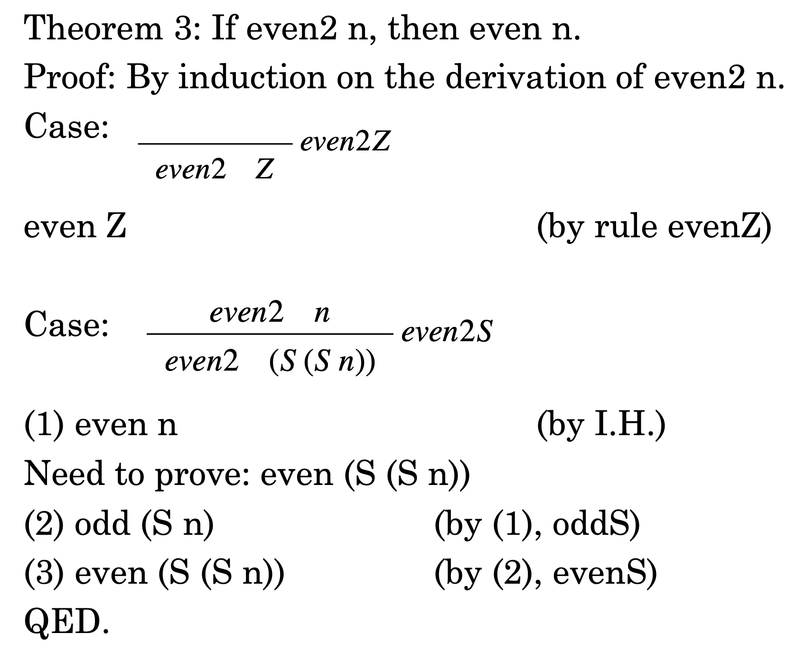

Slide 5
Lambda Calculus (Theory)
Basic Syntax
Variable
Function
Application
Binding – Scope
Free Variable
Substitution
Evaluation Strategies
Call by Value
Call by Name
Multi-Step Operation

Slide 6
Lambda Calculus (Practical)
Tru = \t.\f. t
Fls = \t.f. f
And = \b.\c. b c Fls
Succ = \n.\f.\x. f (n f x)

Slide 7
Step-by-step, evaluate or tru fls?
tru = \t.\f. t fls = \t.\f. f or = \b.\c. b tru c
or tru fls = (\b.\c. b tru c) tru fls
->(\c. tru tru c) fls -> tru tru fls = (\t.\f. t) tru fls -> (\f. tru) fls
->tru

Slide 8
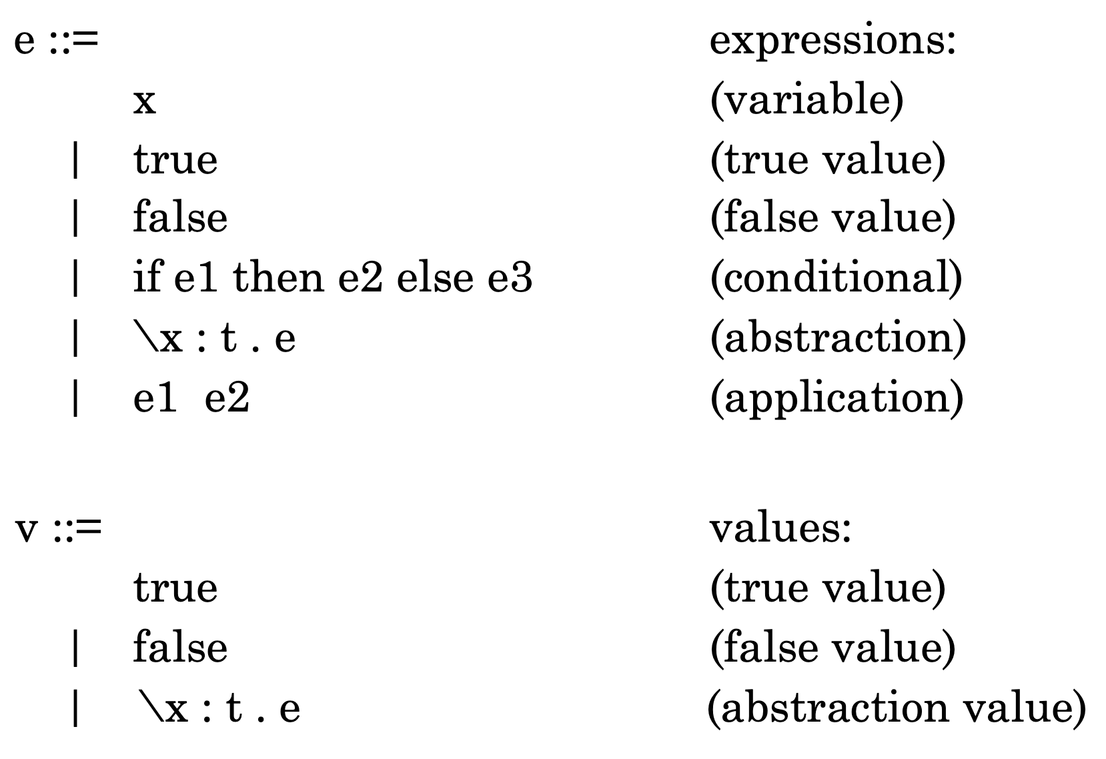
Simply-Typed Lambda Calculus
Syntax

Slide 9
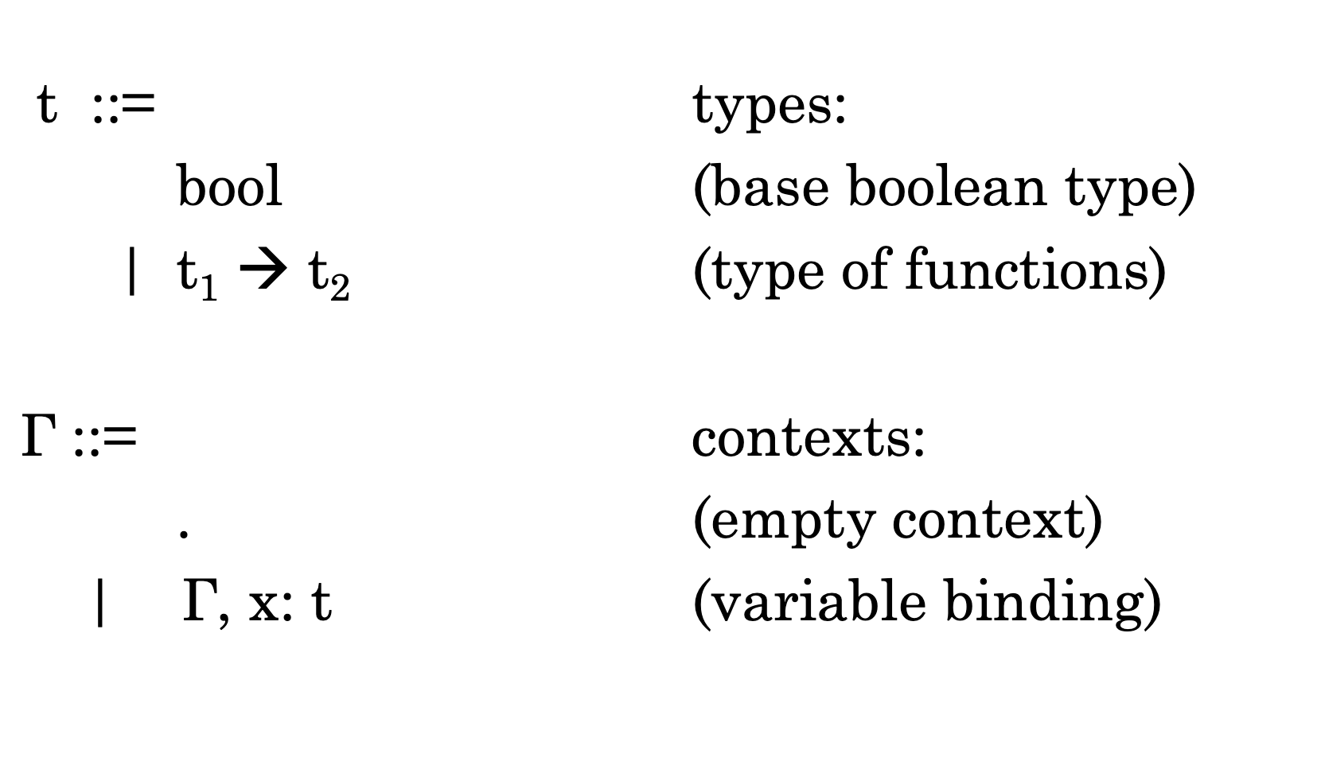
Simply-Typed Lambda Calculus

Slide 10
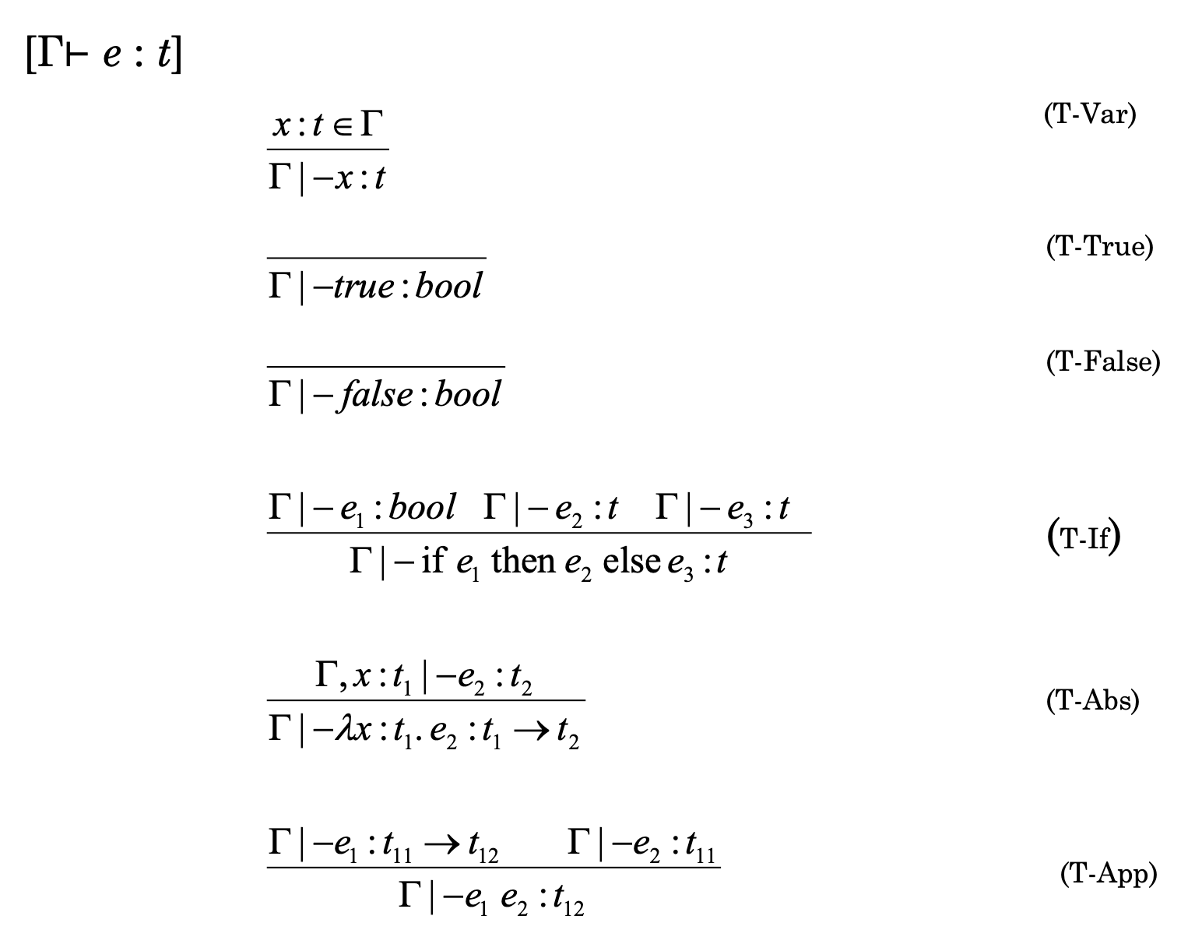
Simply-Typed Lambda Calculus
Typing

Slide 11
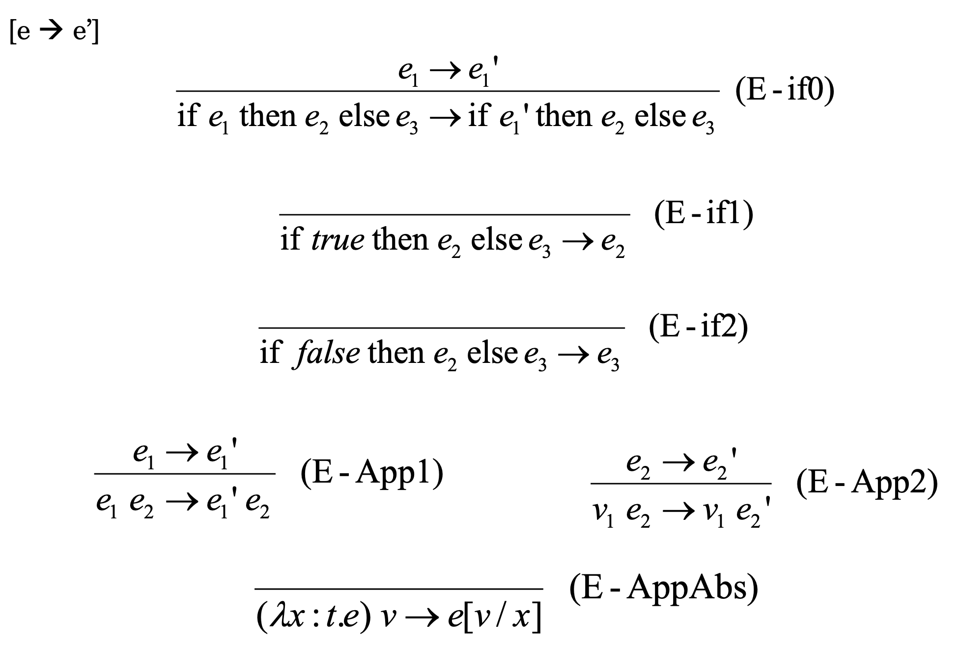
Simply-Typed Lambda Calculus
Semantics

Slide 12
Simply-Typed Lambda Calculus
Properties of Simply-Typed Lambda Calculus
Uniqueness of Typing
Inversion for Typing
Well-typedness
Exchange Lemma
Weakening Lemma
Progress Theorem
Preservation Theorem

Slide 13
Simply-Typed Lambda Calculus
Let Function
Static and Dynamic Scoping
Pairs
Tuples
Records
Sums
Recursive function
Fix-point Combinator(Y combinator)

Slide 14
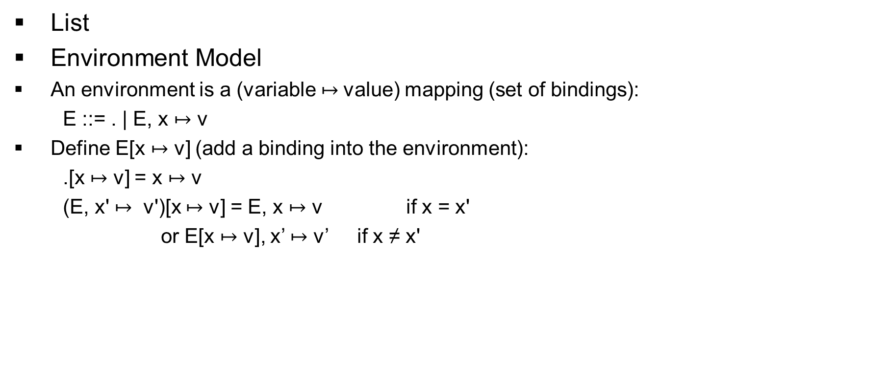
Simply-Typed Lambda Calculus
List
Environment Model
An environment is a (variable $↦$value) mapping (set of bindings):
E ::= . | E, x $↦$ v
Define E[x $↦$ v] (add a binding into the environment):
.[x $↦$ v] = x $↦$ v
(E, x' $↦$ v')[x $↦$ v] = E, x $↦$ v if x = x'
or E[x $↦$ v], x’ $↦$ v’ if x ≠ x'

Slide 15
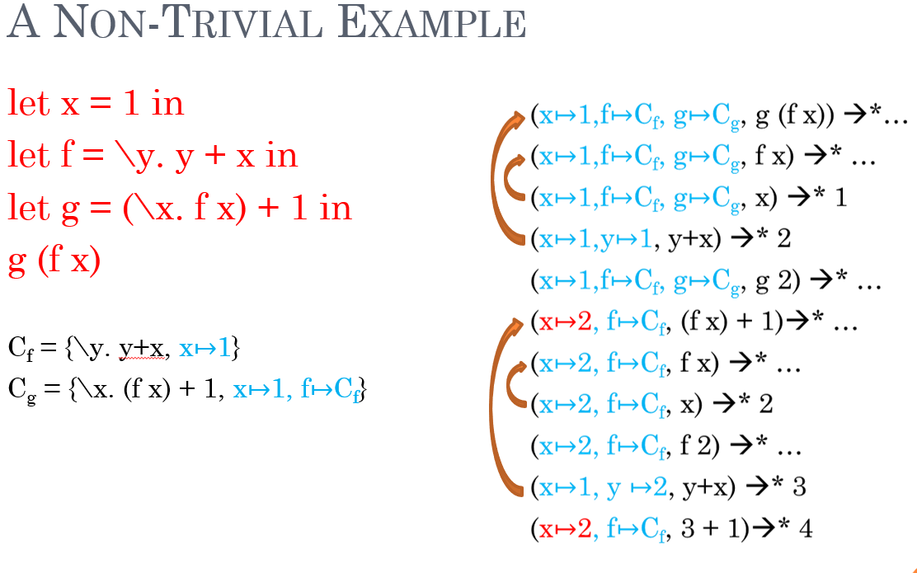
Simply-Typed Lambda Calculus

Slide 16
Imperative
Lambda calculus with value
Y = ref 1
!Y
References(Machine State)
M is a partial function from location to values
𝚺 is a type relation for memory store
Sequence

Slide 17
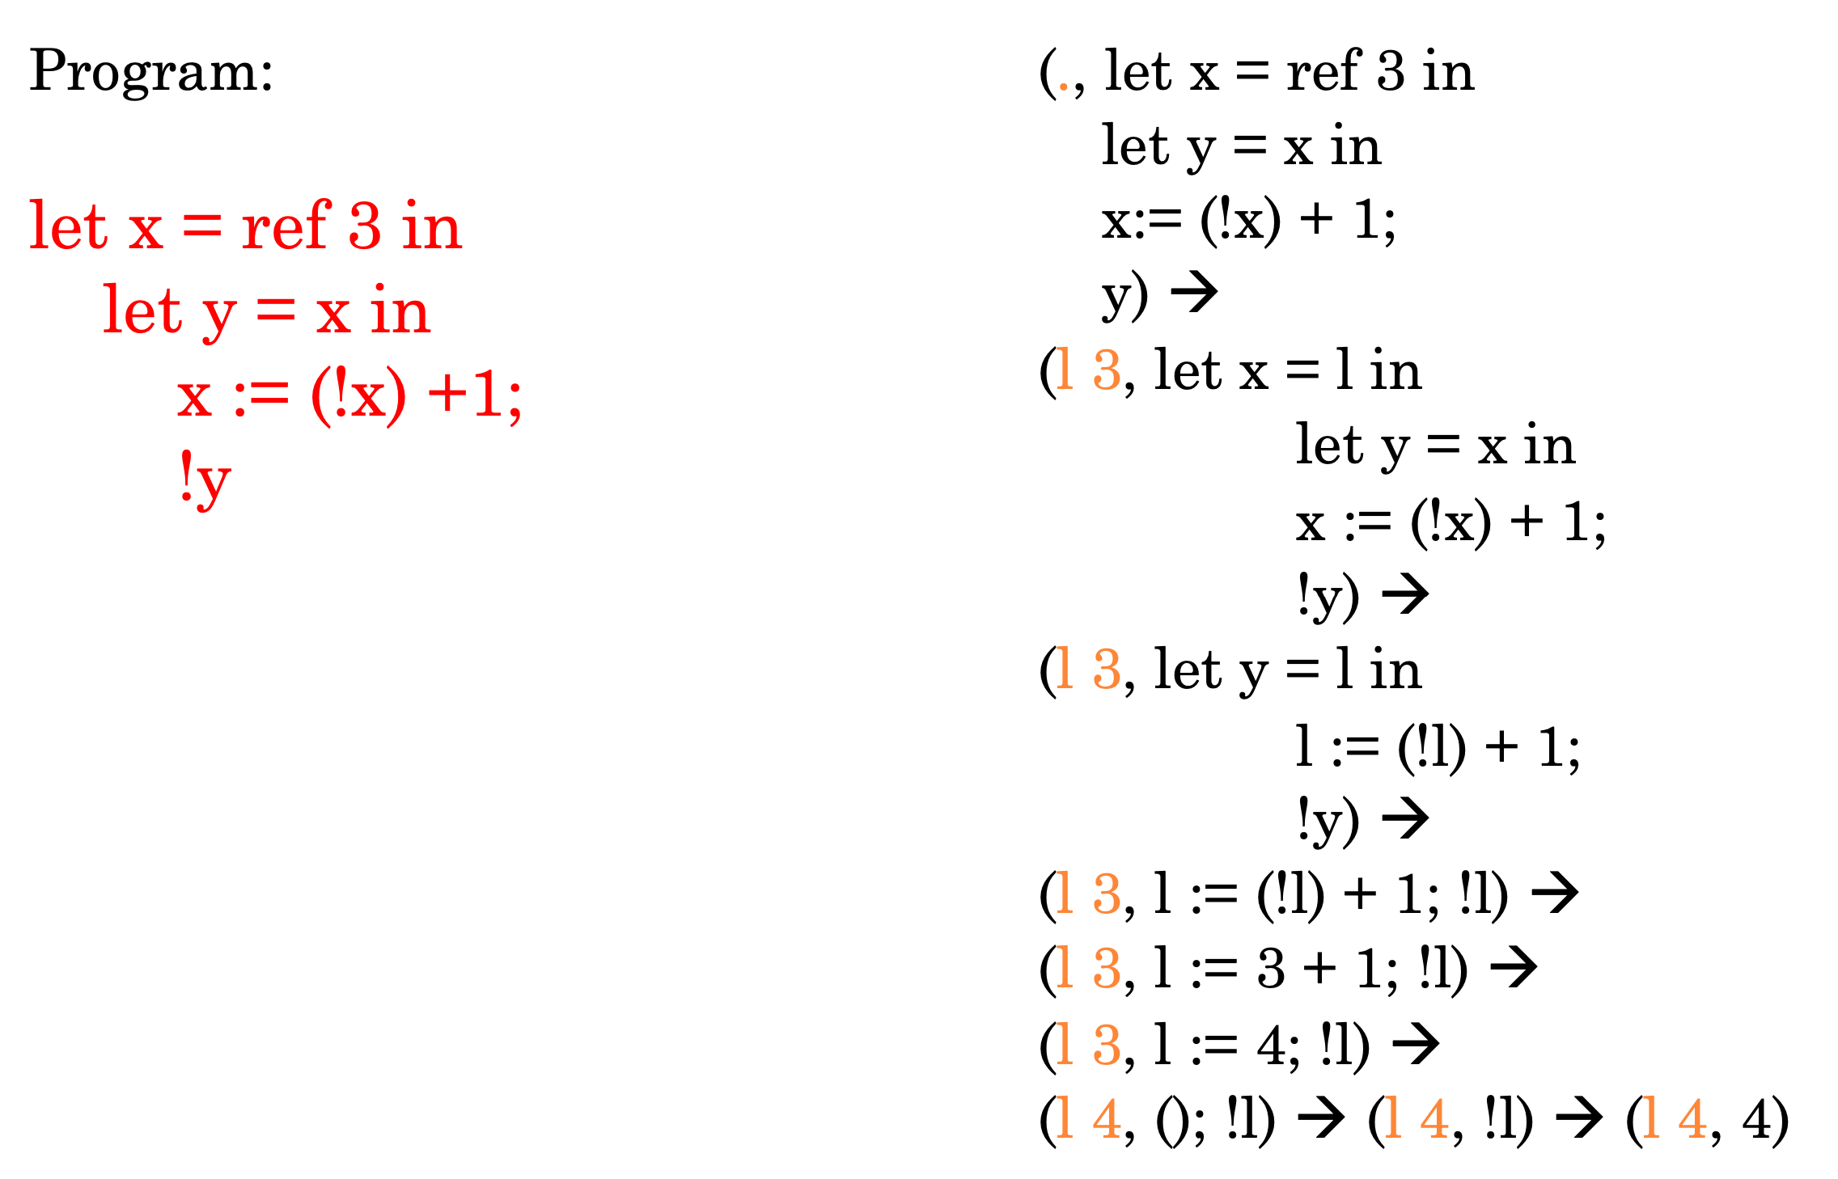
Example Evaluation

Slide 18
Imperative
Type Safety
Weakening
Preservation Theorem
Progress Theorem
While loop
Factorial(Example)
Exception Handling
Exception

Slide 19
Memory Management
(Bonus point in Project)
Memory Organization
Static area
Run-time stack
Heap
Garbage Collection
Reference counting (RC)
Mark-and-Sweep (MB)
Copy collection (Half Space)

Slide 20
Type Inference
Step1: Add Type Schemes
Step2: Generate Constraints
Step3: Solve Constraints
Step4: Generate Types
Constraint Generation Rules -> a set of constraints
Composition of Substitutions
Preservation of Typing under type substitution
Principle Solution

Slide 21
Type Inference
Unification
(S, q)->(S’, q’)
Unification Machine
Termination
Properties of Solution
Let Polymorphism
Let id = \x.x in (id 25, id true)

Slide 22
Subtyping
Subtype polymorphism
Universal Polymorphism
Existential Poly morphism
Basic Properties
Reflexivity
Transitivity
Top-Subsumption
Top
Sub

Slide 23
Subtyping
Tuples
Sums
Functions
Properties
Canonical Forms Lemma
Progress Lemma
Inversion of Subtyping Lemma
Component Typing Lemma
Substitution Lemma
Preservation Lemma
Polymorphism
Subtype polymorphism
Parametric polymorphism
Ad-hoc polymorphism

Slide 24
Object-Oriented Programming
Data Abstraction
Encapsulation
Ada
Smalltalk

Slide 25
Thank You

