Slide 1
Tutorial-2
TA – Sinong(Theron)

Slide 2
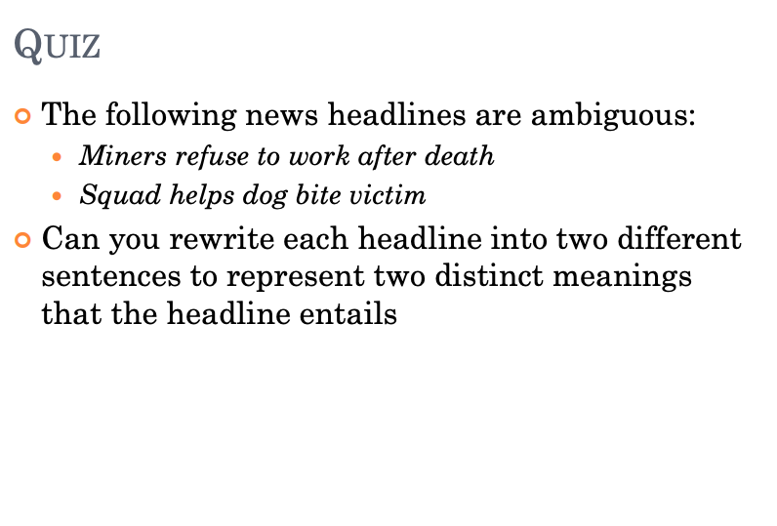
Quiz-1

Slide 3
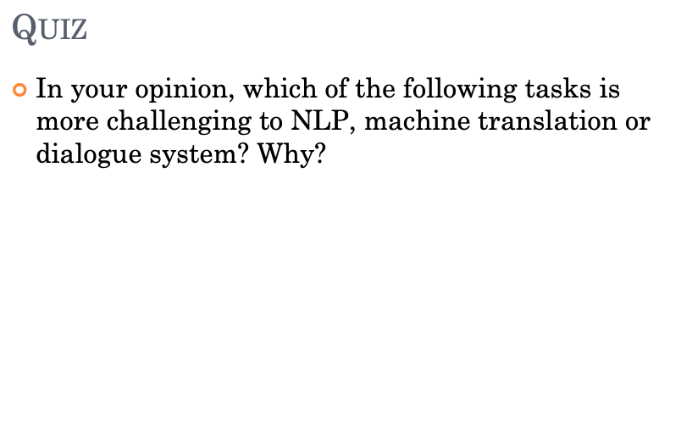
Quiz-2

Slide 4
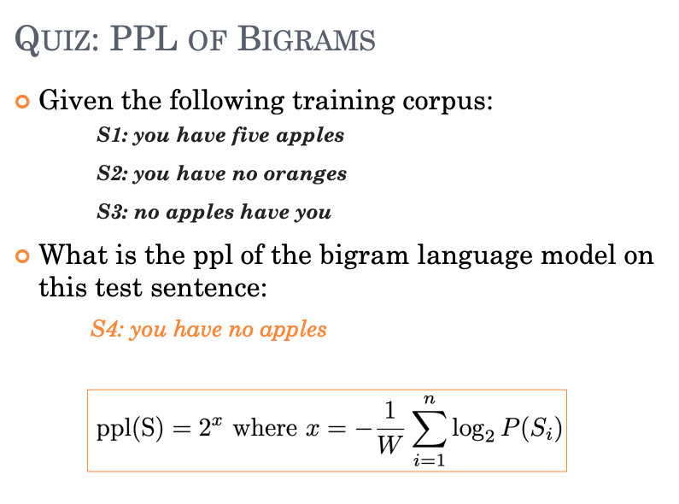
Quiz-3

Slide 5
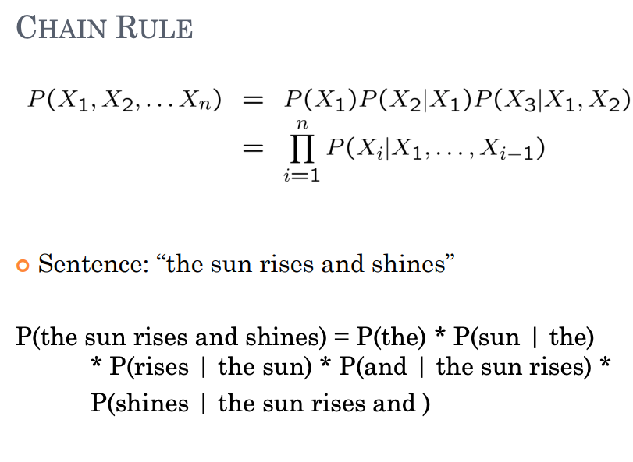
Quiz-3

Slide 6
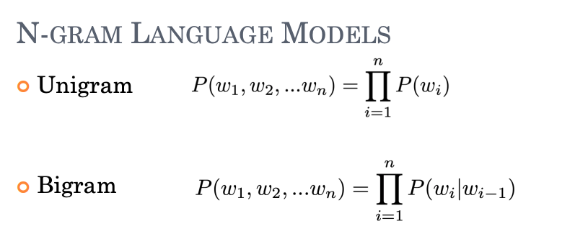
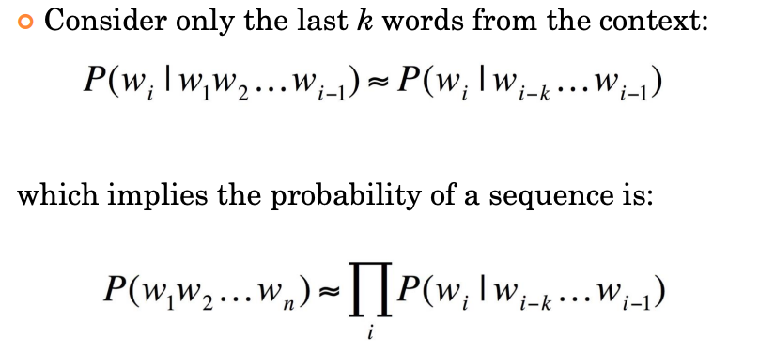
Quiz-3

Slide 7
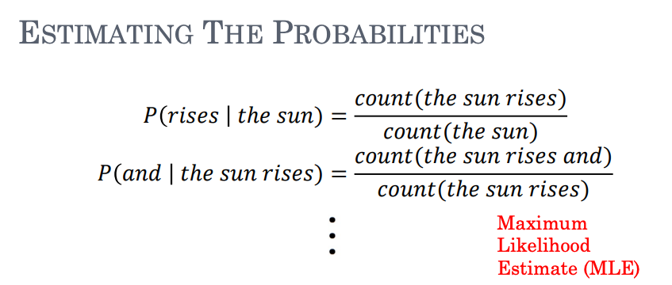
Quiz-3

Slide 8
Quiz-3

Slide 9
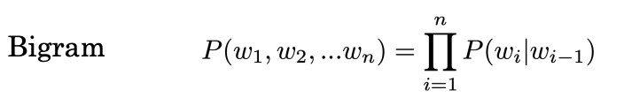
Quiz-3
Unigram:
You: 3, have: 3, five: 1, apples: 2, no: 2, oranges: 1
Bigram
You have: 2, have five: 1, five apples: 1, have no: 1,
no oranges: 1, no apples: 1, apples have: 1, have you: 1
P(You) = 3/12
P(have | you) = Count(you have) / Count(you) = 2/3
P(no | have) = Count(have no) / Count(have) = 1/3
P(apples | no) = Count(no apples) / Count(no) = 1/2

Slide 10
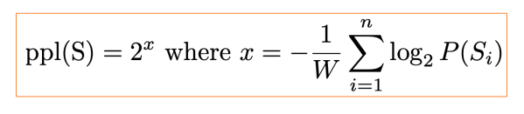

Quiz-3
P(S) = 3/12 * 2/3 * 1/3 * 1/2 = 1 / 36
$PPL\left(S\right)={(\prod_{i=1}^{n}{P(S_{i}}))}^{−\frac{1}{W}}$
PPL(S) = sqrt(6) = 2.449

Slide 11
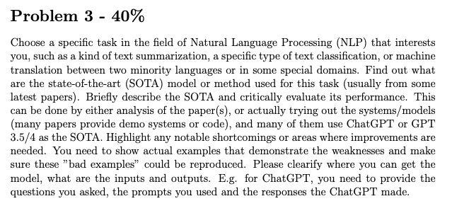
Assignment-1

