Slide 1
Tutorial 6
TA Sinong (Theron)

Slide 2
Quiz Using one-hot vectors to represent words, why is there no way to encode similarity between the words?
Orthogonality: The vectors are orthogonal to each other. The dot product of any two different one-hot vectors is always 0. This means there is no numerical similarity between the vectors.
Equal Distance: The Euclidean distance between any two one-hot vectors is constant. The distance is always sqrt(2)​, regardless of the meaning or similarity between the words.

Slide 3
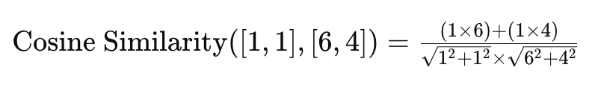
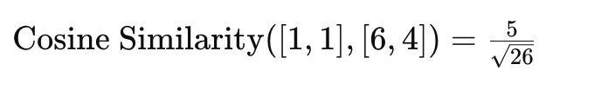
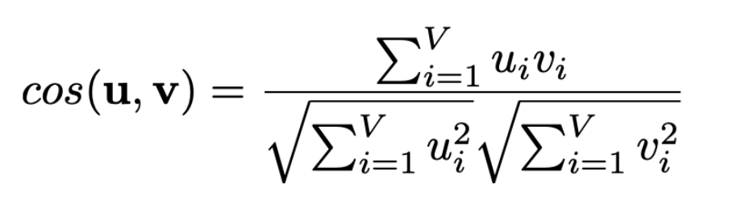
Quiz Compute the cosine similarity between “digital” [1, 1] and “information” [6, 4].

Slide 4
Quiz Suppose the vocab is V in the corpus, how many parameters in to train in total?
2d|v|
Each word has two d-dimensional vectors, so it is 2 × |V| × d.

Slide 5
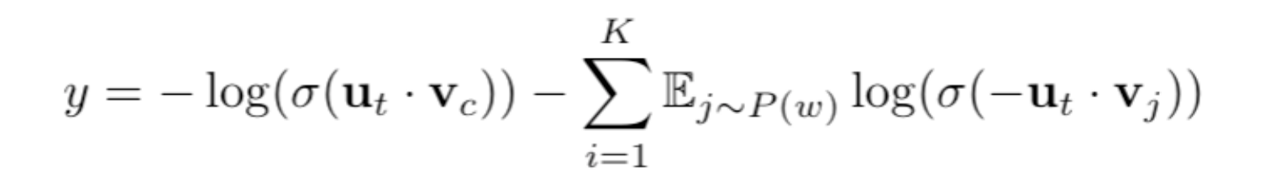
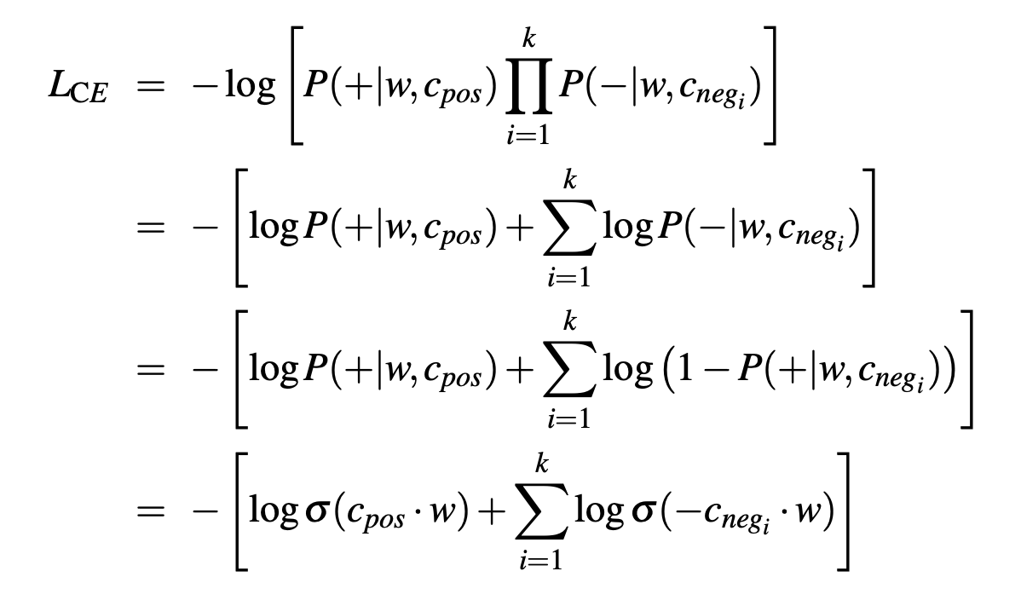
Homework Derive the gradient of SGNS

Slide 6
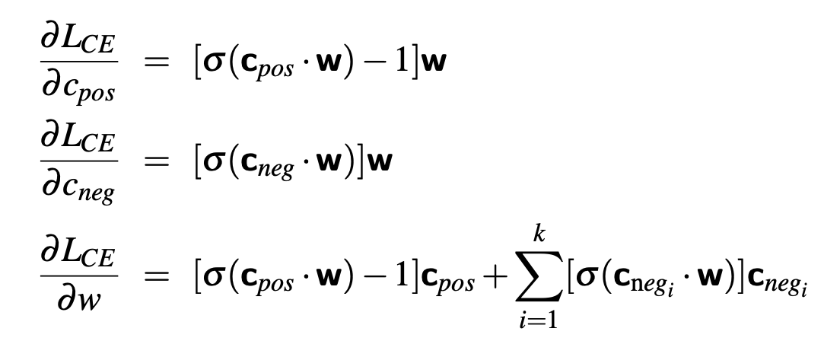
Homework Derive the gradient of SGNS

Slide 7
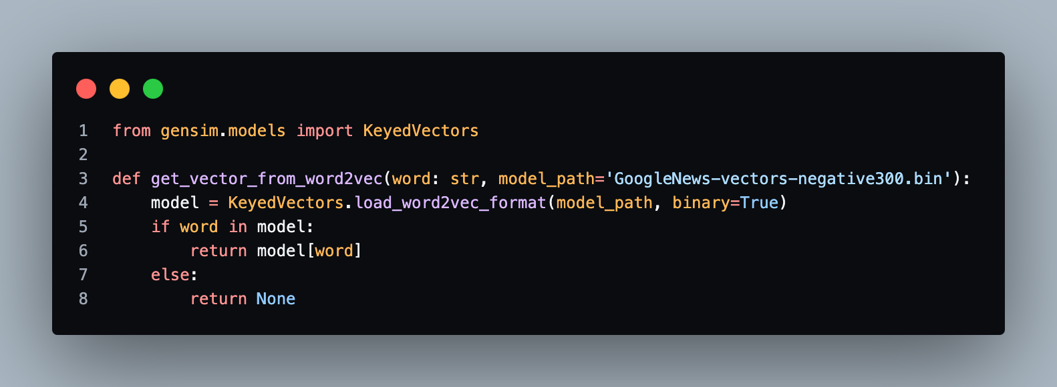
Homework Calculate semantic similarities

Slide 8
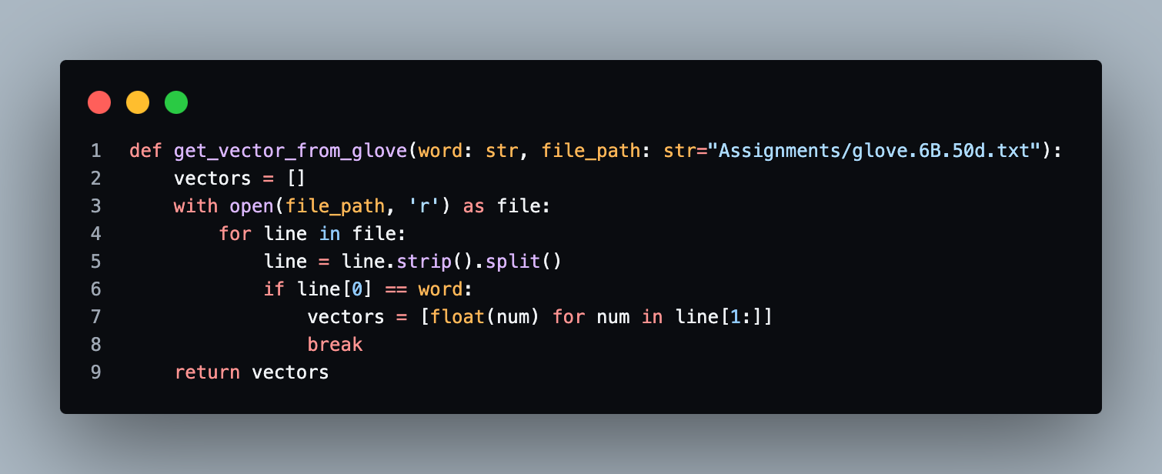
Homework Calculate semantic similarities

Slide 9
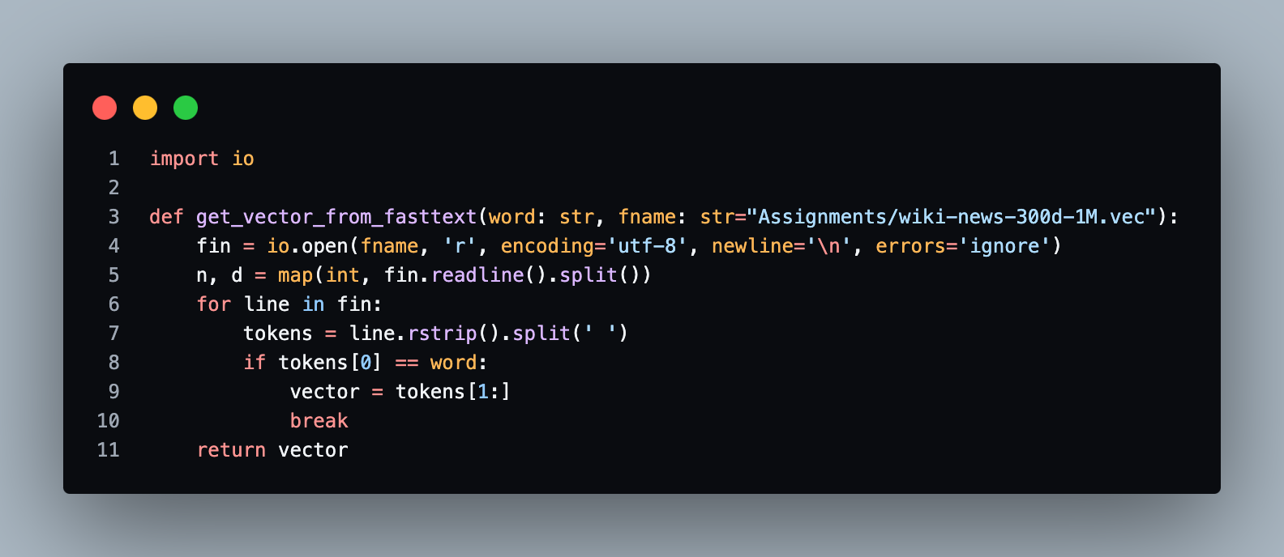
Homework Calculate semantic similarities

Slide 10
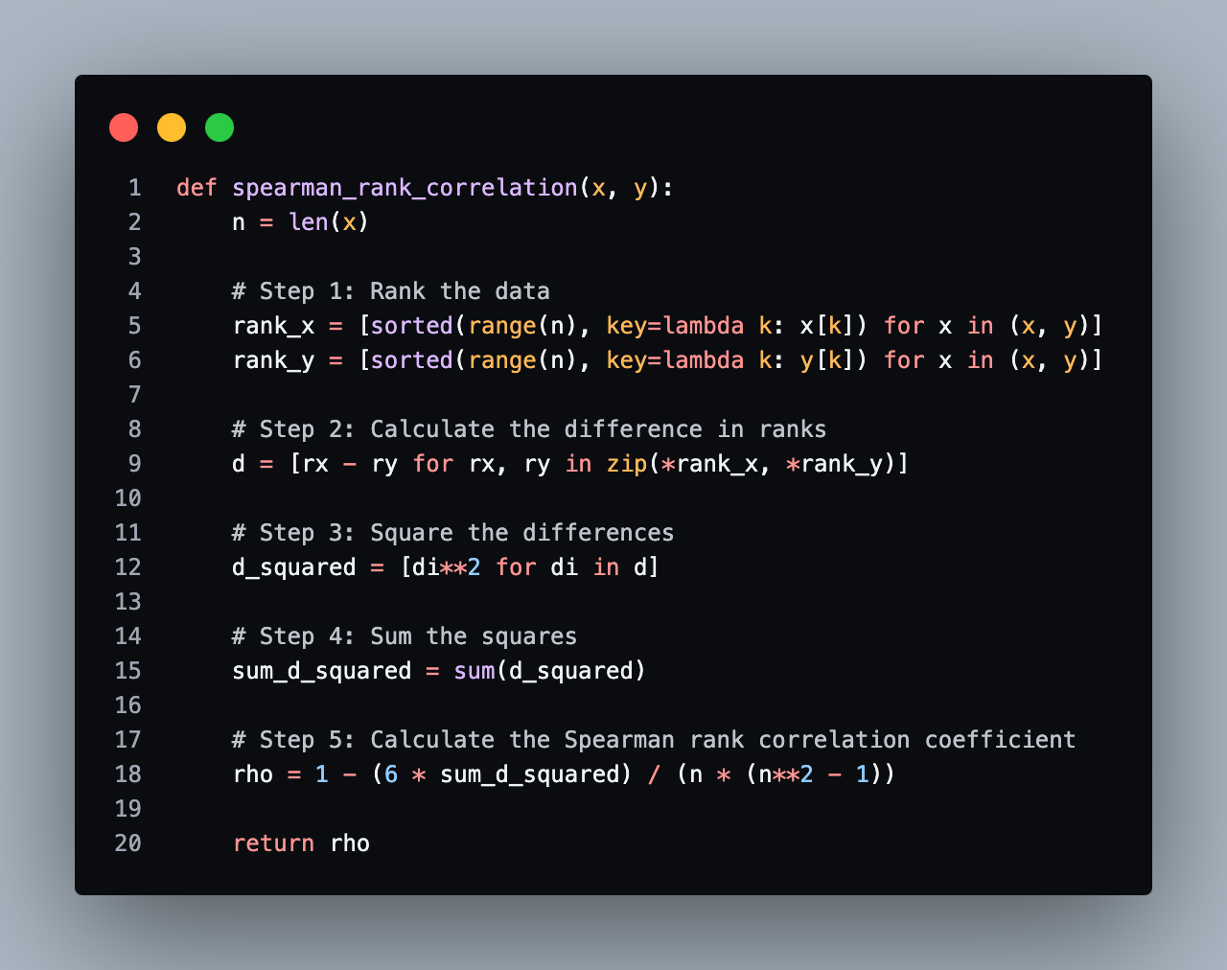
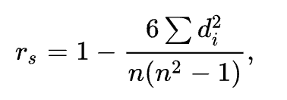
Spearman’s rank coefficient

Slide 11
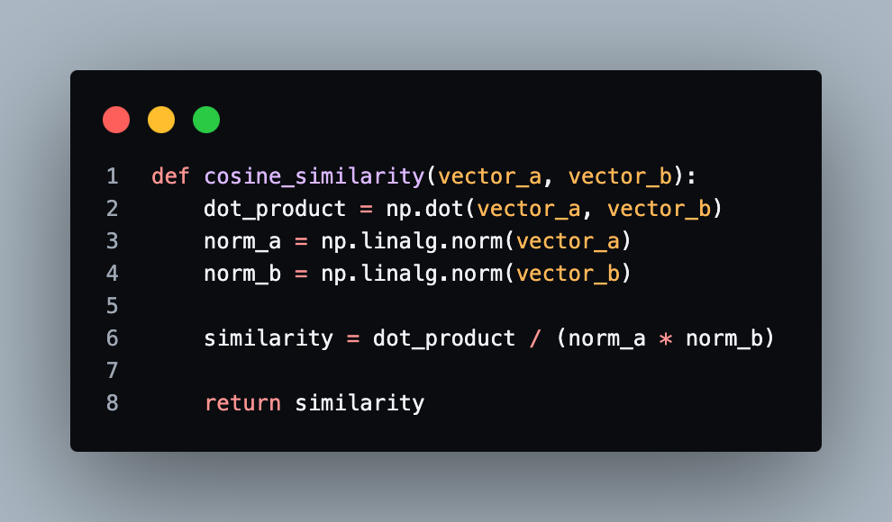
Cosine Similarity

