Slide 1
Tutorial 7
TA Sinong(Theron)

Slide 2
Quiz 1 What if we remove the activation function?
Without an activation function, the neural network becomes a linear model, which is limited in its capacity to learn and represent non-linear patterns in the data.
Inability to Learn Complex Patterns

Slide 3
Quiz 2 What are the advantages of ReLU over Sigmoid as an activation function?
Sparsity of Activation
More efficient
Avoidance of Vanishing Gradient
Avoidance of Gradient Exploding

Slide 4


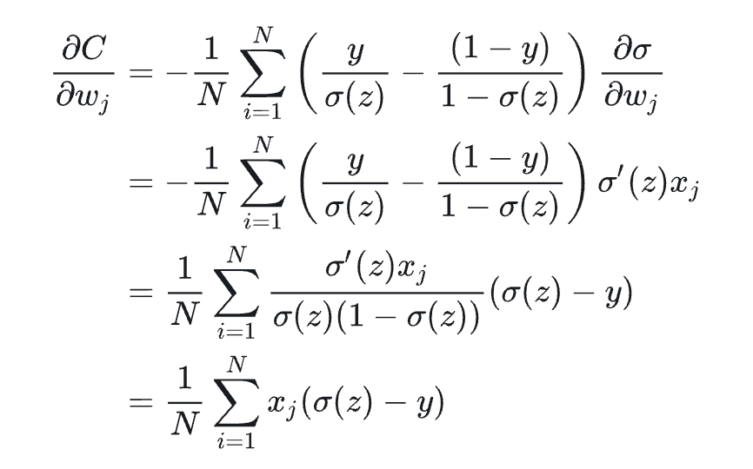

Homework 1

Slide 5
Please share
“initialization”, “forward propagation”, “back propagation” and “parameter update” codes
Feature you used
Final accuracy

Slide 6
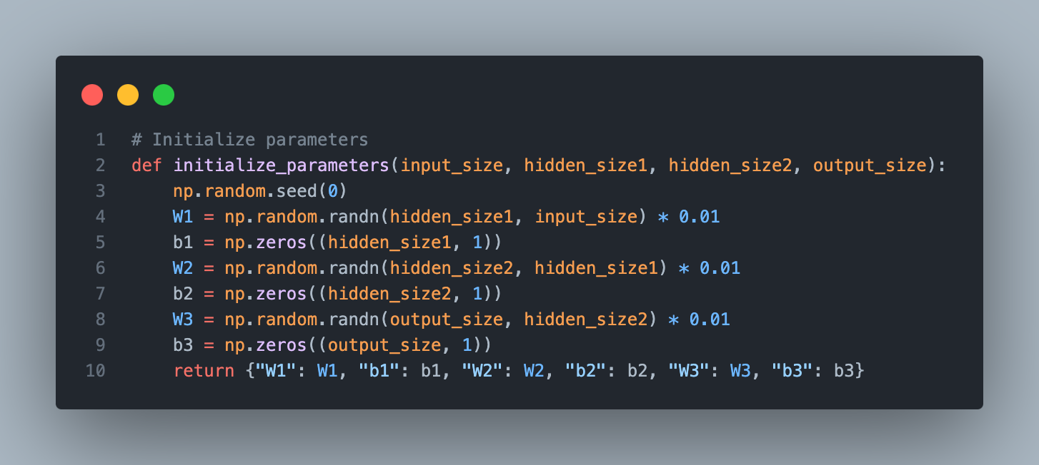

Slide 7
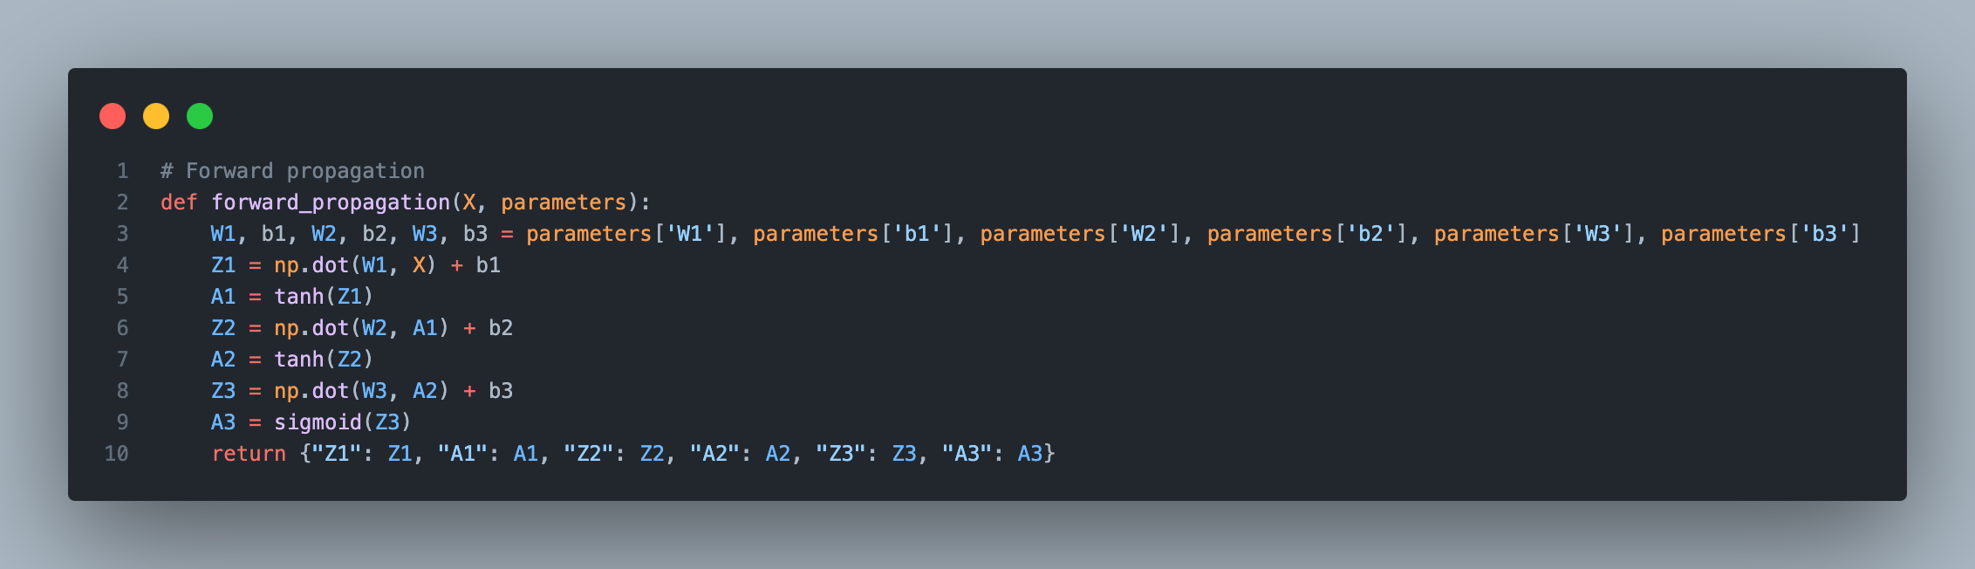

Slide 8
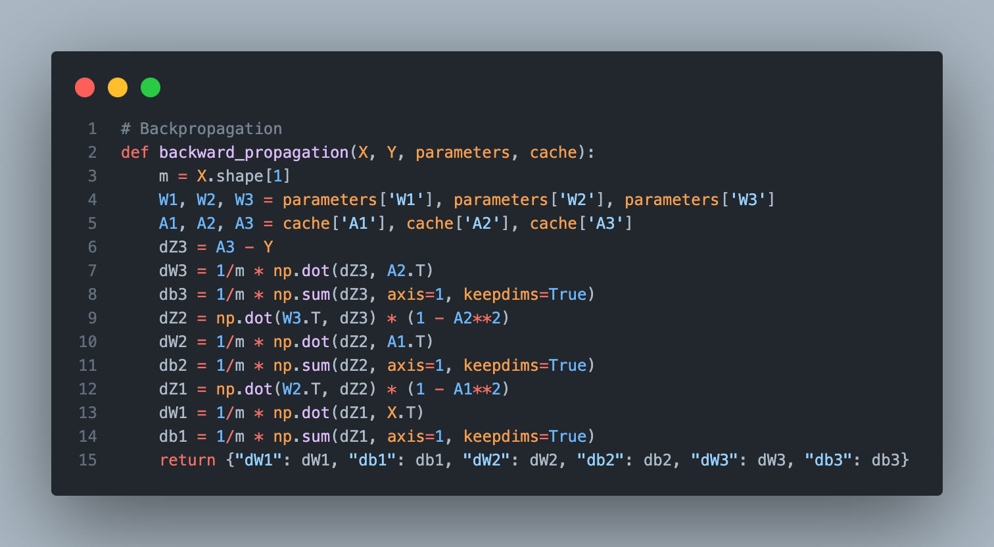

Slide 9
