Slide 1
CSE 3302 / 5307 Programming Language Concepts
Tutorial 04
Wonjun Park

Slide 2
Homework 3

Slide 3
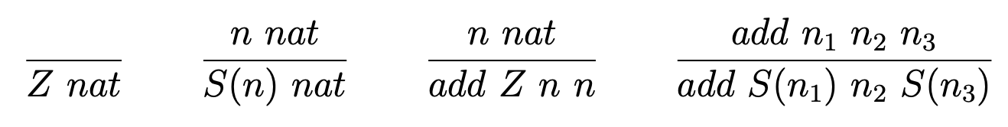
Problem 1 Description

Slide 4
Problem 1 Solution

Slide 5
Problem 1 Description

Slide 6
Problem 1 Solution

Slide 7
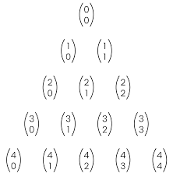
Problem 1 Explanation

Slide 8
Problem 1 Description

Slide 9
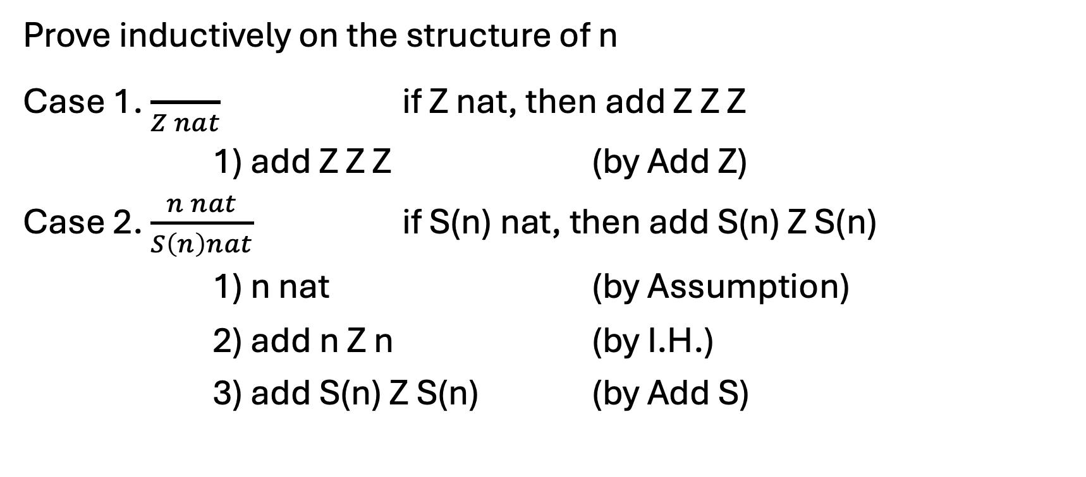
Problem 1 Solution
Prove inductively on the structure of n
Case 1. $\frac{}{Z nat}$ if Z nat, then add Z Z Z
1) add Z Z Z (by Add Z)
Case 2. $\frac{n nat}{S\left(n\right)nat}$ if S(n) nat, then add S(n) Z S(n)
1) n nat (by Assumption)
2) add n Z n (by I.H.)
3) add S(n) Z S(n) (by Add S)

Slide 10
Problem 1 Description

Slide 11
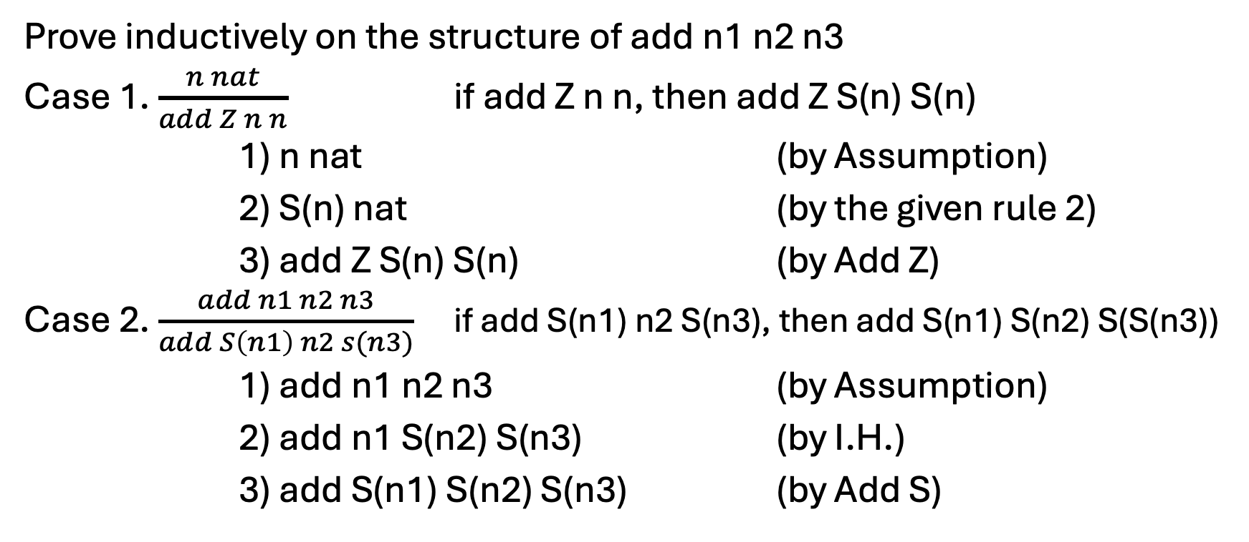
Problem 1 Solution
Prove inductively on the structure of add n1 n2 n3
Case 1. $\frac{n nat}{add Z n n}$ if add Z n n, then add Z S(n) S(n)
1) n nat (by Assumption)
2) S(n) nat (by the given rule 2)
3) add Z S(n) S(n) (by Add Z)
Case 2. $\frac{add n1 n2 n3}{add S\left(n1\right) n2 s(n3)}$ if add S(n1) n2 S(n3), then add S(n1) S(n2) S(S(n3))
1) add n1 n2 n3 (by Assumption)
2) add n1 S(n2) S(n3) (by I.H.)
3) add S(n1) S(n2) S(n3) (by Add S)

Slide 12
Problem 1 Description

Slide 13
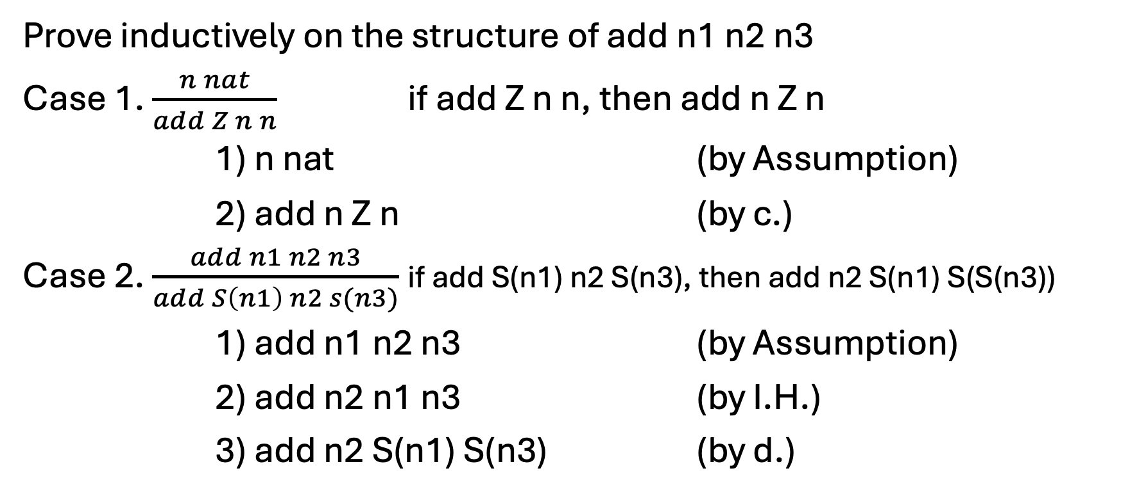
Problem 1 Solution
Prove inductively on the structure of add n1 n2 n3
Case 1. $\frac{n nat}{add Z n n}$ if add Z n n, then add n Z n
1) n nat (by Assumption)
2) add n Z n (by c.)
Case 2. $\frac{add n1 n2 n3}{add S\left(n1\right) n2 s(n3)}$ if add S(n1) n2 S(n3), then add n2 S(n1) S(S(n3))
1) add n1 n2 n3 (by Assumption)
2) add n2 n1 n3 (by I.H.)
3) add n2 S(n1) S(n3) (by d.)

Slide 14
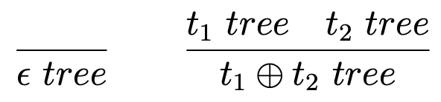
Problem 2 Description

Slide 15
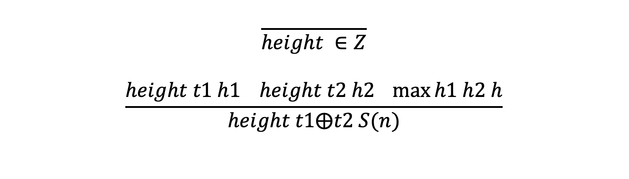
Problem 2 Solution
$$\frac{}{height ∈Z}$$
$$\frac{height t1 h1 height t2 h2 \max{h1 h2 h}}{height t1⨁t2 S(n)}$$

Slide 16
Problem 2 Description

Slide 17
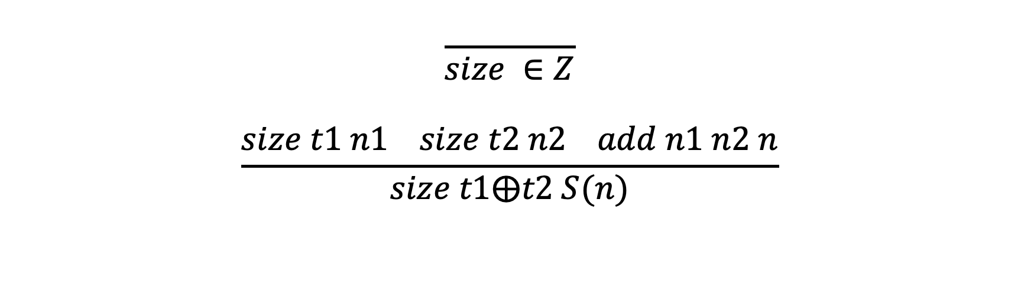
Problem 2 Solution
$$\frac{}{size ∈Z}$$
$$\frac{size t1 n1 size t2 n2 add n1 n2 n}{size t1⨁t2 S(n)}$$

Slide 18
Problem 2 Description

Slide 19
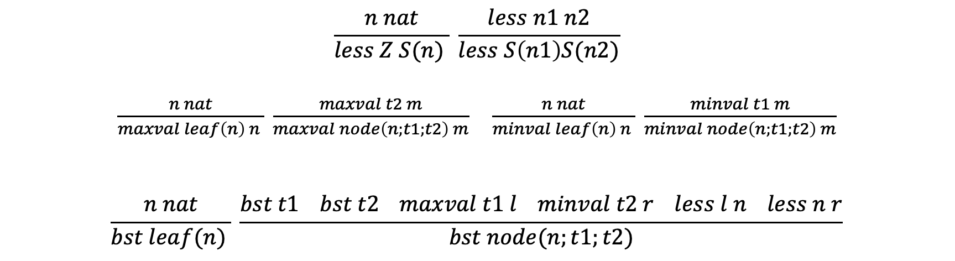
Problem 2 Solution
$$\frac{n nat}{less Z S(n) } \frac{less n1 n2}{less S\left(n1\right)S(n2)}$$
$\frac{n nat}{maxval leaf\left(n\right) n } \frac{maxval t2 m}{maxval node\left(n;t1;t2\right) m}$ $\frac{n nat}{minval leaf\left(n\right) n } \frac{minval t1 m}{minval node\left(n;t1;t2\right) m}$
$$\frac{n nat}{bst leaf(n) } \frac{bst t1 bst t2 maxval t1 l minval t2 r less l n less n r}{bst node(n;t1;t2)}$$

Slide 20
Problem 2 Description

Slide 21
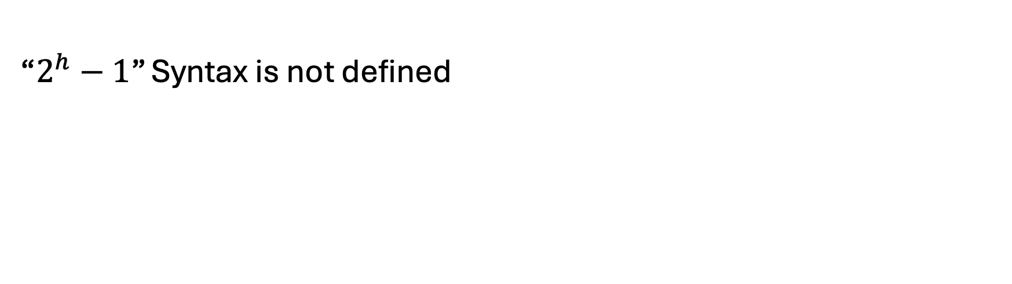
Problem 2 Solution
“$2^{h}−1$” Syntax is not defined

Slide 22
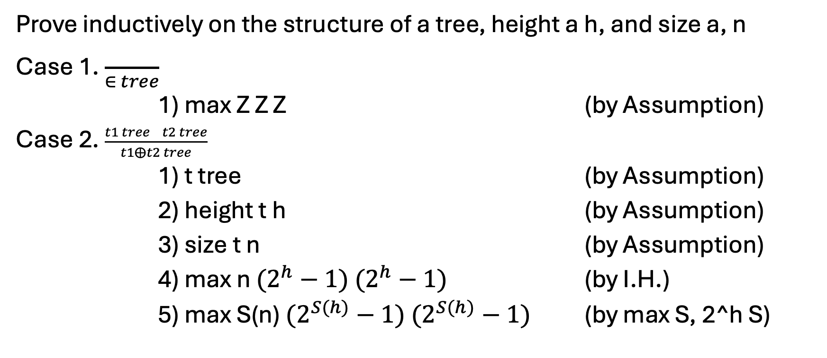
Problem 2 Solution
Prove inductively on the structure of a tree, height a h, and size a, n
Case 1. $\frac{}{∈ tree}$
1) max Z Z Z (by Assumption)
Case 2. $\frac{t1 tree t2 tree}{t1⨁t2 tree}$
1) t tree (by Assumption)
2) height t h (by Assumption)
3) size t n (by Assumption)
4) max n $(2^{h}−1)$ $(2^{h}−1)$ (by I.H.)
5) max S(n) $(2^{S(h)}−1)$ $(2^{S(h)}−1)$ (by max S, 2^h S)

Slide 23
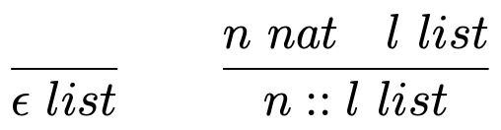
Problem 3 Description

Slide 24

Problem 3 Solution
$$\frac{n nat}{append n∈(n∷∈)}$$
$$\frac{append n l l^{′} n^{′}nat}{append n (n^{′}∷l)(n^{′}∷l^{′})}$$

Slide 25
Problem 3 Description

Slide 26

Problem 3 Solution
$$\frac{}{reverse∈ ∈}$$
$$\frac{reverse l l^{′} append n l^{′}l′′}{reverse \left(n∷l\right) l′′}$$

Slide 27
Problem 3 Description

Slide 28

Problem 3 Solution
$$\frac{}{sum∈Z} Sum Z$$
$$\frac{sum l n^{′} add n n^{′}n′′}{sum \left(n∷l\right) n′′} Sum N$$

Slide 29
Problem 3 Description

Slide 30
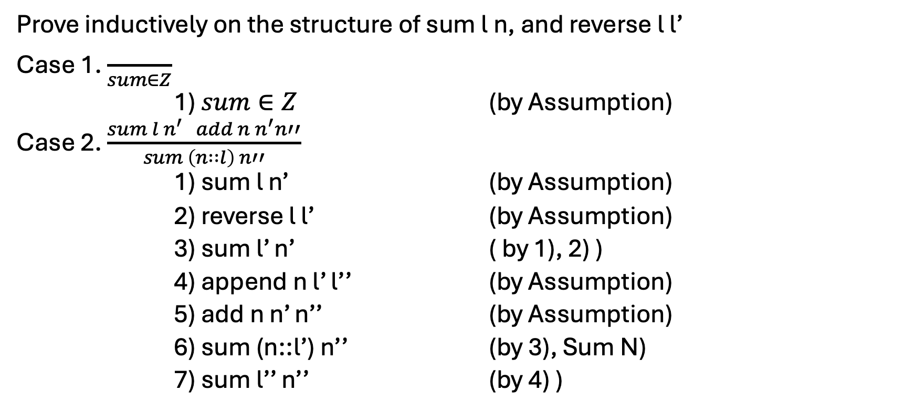
Problem 3 Solution
Prove inductively on the structure of sum l n, and reverse l l’
Case 1. $\frac{}{sum∈Z}$
1) $sum∈Z$ (by Assumption)
Case 2. $\frac{sum l n^{′} add n n^{′}n′′}{sum \left(n∷l\right) n′′}$
1) sum l n’ (by Assumption)
2) reverse l l’ (by Assumption)
3) sum l’ n’ ( by 1), 2) )
4) append n l’ l’’ (by Assumption)
5) add n n’ n’’ (by Assumption)
6) sum (n::l’) n’’ (by 3), Sum N)
7) sum l’’ n’’ (by 4) )

