Slide 1
Tutorial 5
TA Sinong

Slide 2
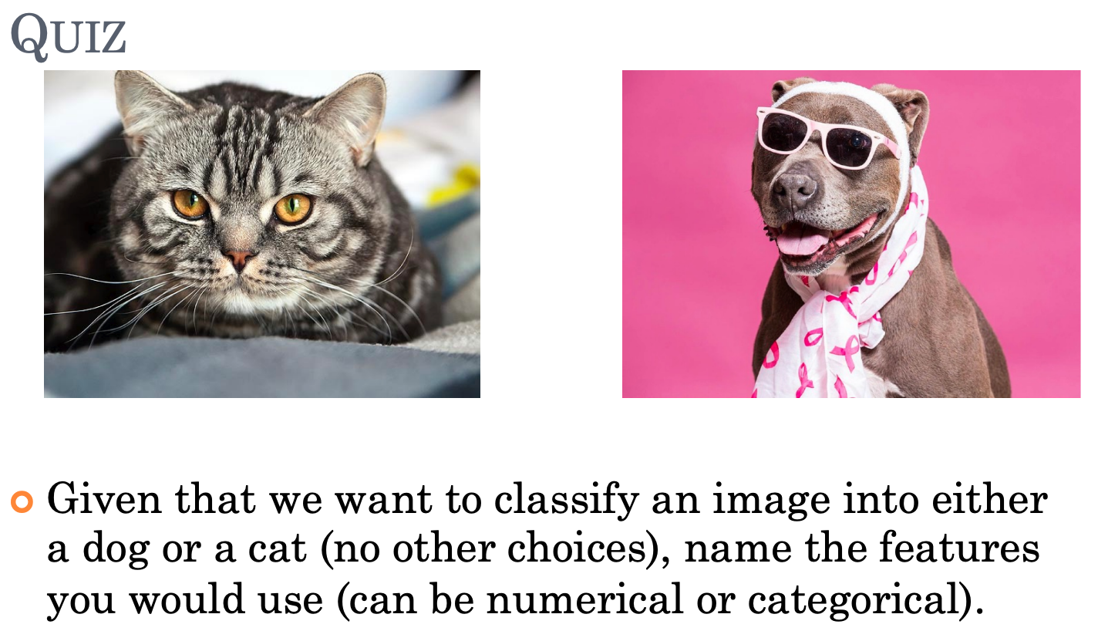
Quiz Lecture 4

Slide 3
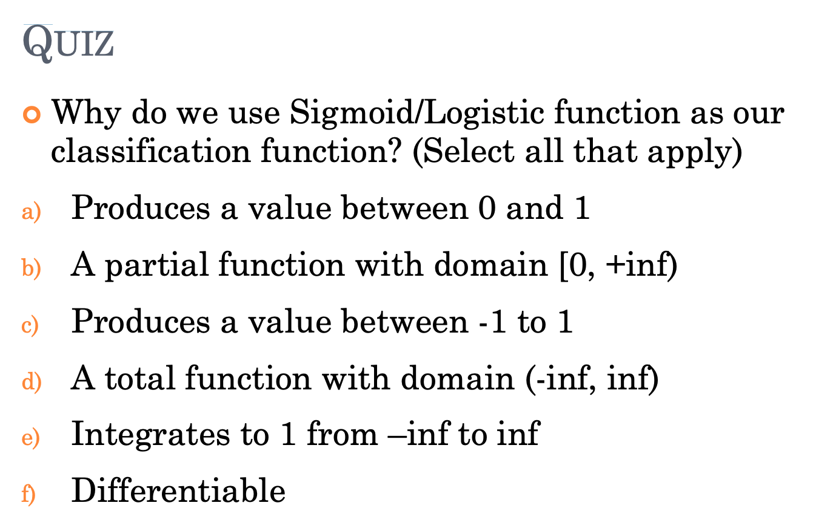

Slide 4
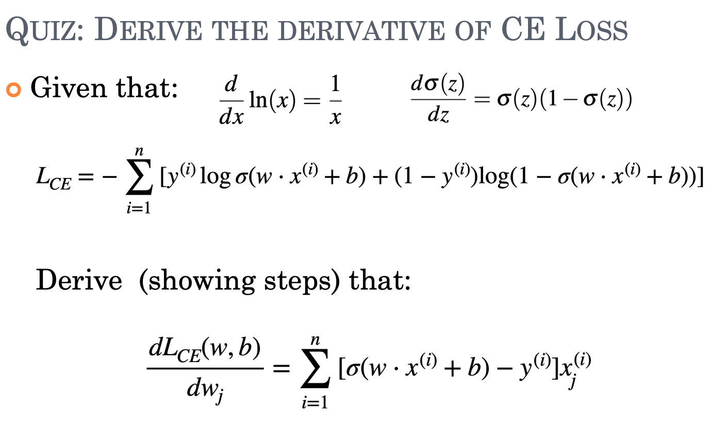

Slide 5
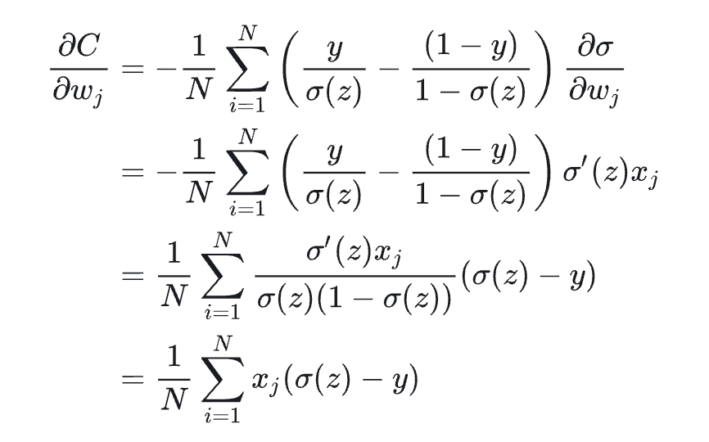

Slide 6
Homework 4
Data Preprocessing
drop nan
Feature Extraction
Bag of Words
TF-IDF
Word embedding
Logistic Linear Regression
K-fold Cross Validation
Evaluation Metrics

