Slide 1
Tutorial-1
TA - Theron

Slide 2
Outline
Administrative Info
Deadlines for grade disputes
Assignments Format
Latex
Coding Skill Requirements
Python
Numpy
PyTorch
Project Overview
Topics
Methodology

Slide 3
Administrative Info
Make sure a smooth workflow in our class

Slide 4

Deadlines for grade disputes
Your grade will be released on Canvas before the tutorial.
If you have any doubt about your grade, please find me in one week.
This ‘week’ will be counted from the next tutorial.

Slide 5

Deadlines for grade disputes
Only paper proof related to medical and academic matters can be used as evidence to exempt grades.
There is no make up for any quizzes.

Slide 6
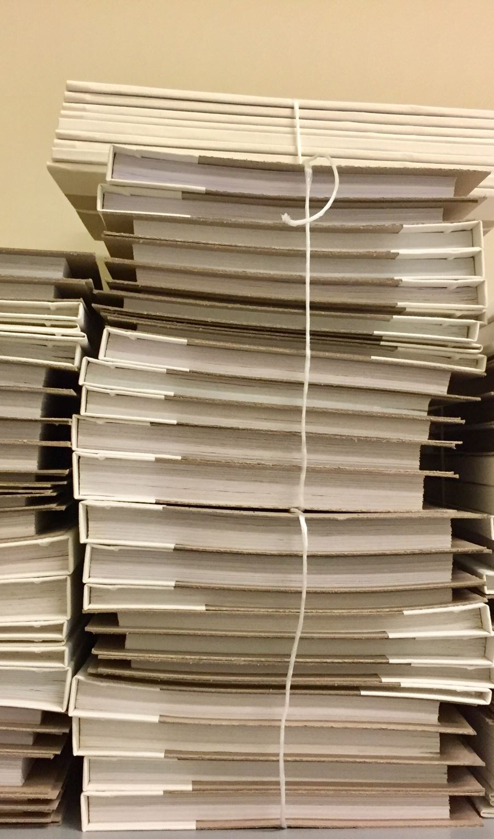
Assignments Format
Only pdf and zip format are accepted.
Submitting through Canvas is the only way to submit your assignments and the project.
Codes should be separated from the pdf you submit.

Slide 7


Assignments Format
Assignments will be released after one lecture.
The formats of Assignments are provided on the website are .tex and .pdf
We highly recommend you learning Latex which is a programming language for the production of technical and scientific documentation.
You can learn LaTeX: https://www.latex-project.org/
Or use Overleaf: https://www.overleaf.com/

Slide 8
Coding Skill Requirements
The cornerstone of your Research Project

Slide 9
Related Library
Python: https://www.learnpython.org/
Numpy: https://numpy.org/learn/
Pytorch: https://pytorch.org/tutorials/beginner/deep_learning_60min_blitz.html

Slide 10

Project Overview
First Step to a complete Research

Slide 11
Potential Topics (non-exclusive)
Text Classification
Named entity Recognition(NER)
Machine Translation
Text Generation
Question-Answering
Speech Recognition
Text Summarization
Sentiment Analysis
Language Understanding (Modeling)
...

Slide 12
Text Classification
Compare the performance of different classification algorithms or models on specific datasets or domains.
Investigate the impact of different feature engineering techniques (e.g., n-grams, TF-IDF) on text classification accuracy.
Explore techniques to handle imbalanced datasets in text classification, such as sampling methods or class weighting.

Slide 13
Named Entity Recognition
Explore the performance of various NER models on different types of named entities (e.g., people, organizations, locations) or specific domains.
Investigate the transferability of NER models trained on one language to another language.
Address the challenge of overlapping or nested named entities and propose novel approaches to handle them.

Slide 14
Machine Translation
Investigate the effectiveness of different neural machine translation architectures (e.g., Transformers) on specific language pairs.
Explore techniques to improve translation quality for low-resource languages.
Evaluate the impact of pre-training techniques or transfer learning in machine translation tasks.

Slide 15
Text Generation
Investigate techniques to improve the fluency and coherence of generated text.
Explore methods to control the style or tone of generated language.
Address the challenge of generating diverse and creative outputs in language generation tasks.

Slide 16
Question-Answering
Compare the performance of different question answering models (e.g., retrieval-based, reading comprehension-based) on specific question types or datasets.
Investigate techniques to handle multi-hop or complex questions in question answering systems.
Explore methods to improve the explainability and interpretability of question answering models.

Slide 17
Speech Recognition
Investigate end-to-end speech recognition architectures (e.g., Listen-Attend-Spell, Connectionist Temporal Classification) and compare their performance with traditional hybrid models.
Explore techniques to handle long-form or continuous speech recognition using end-to-end approaches.
Investigate methods to improve the robustness and accuracy of end-to-end speech recognition systems.

Slide 18
Text Summarization
Compare different text summarization algorithms or models (e.g., extractive, abstractive) on specific document types or domains.
Investigate techniques to incorporate user preferences or constraints into the summarization process.
Explore methods to evaluate the quality and coherence of generated summaries.

Slide 19
Sentiment Analysis
Investigate the effectiveness of different sentiment analysis algorithms or models on specific domains or languages.
Explore the impact of different pre-processing techniques (e.g., stemming, lemmatization) on sentiment classification performance.
Analyze the influence of different feature representations (e.g., bag-of-words, word embeddings) on sentiment analysis accuracy.

Slide 20
Language Understanding
Compare the performance of different models for specific language understanding tasks (e.g., semantic role labeling, coreference resolution).
Investigate techniques to handle challenges like ambiguity, context dependency, or domain adaptation in language understanding tasks.
Explore methods to incorporate linguistic knowledge or syntactic structures into language understanding models.

Slide 21
Where you can find a paper
Google Scholar
https://scholar.google.com
DBLP
https://dblp.org
ACL anthology
https://aclanthology.org
IEEE Xplore
https://ieeexplore.ieee.org
ACM Digital Library
https://dl.acm.org

Slide 22
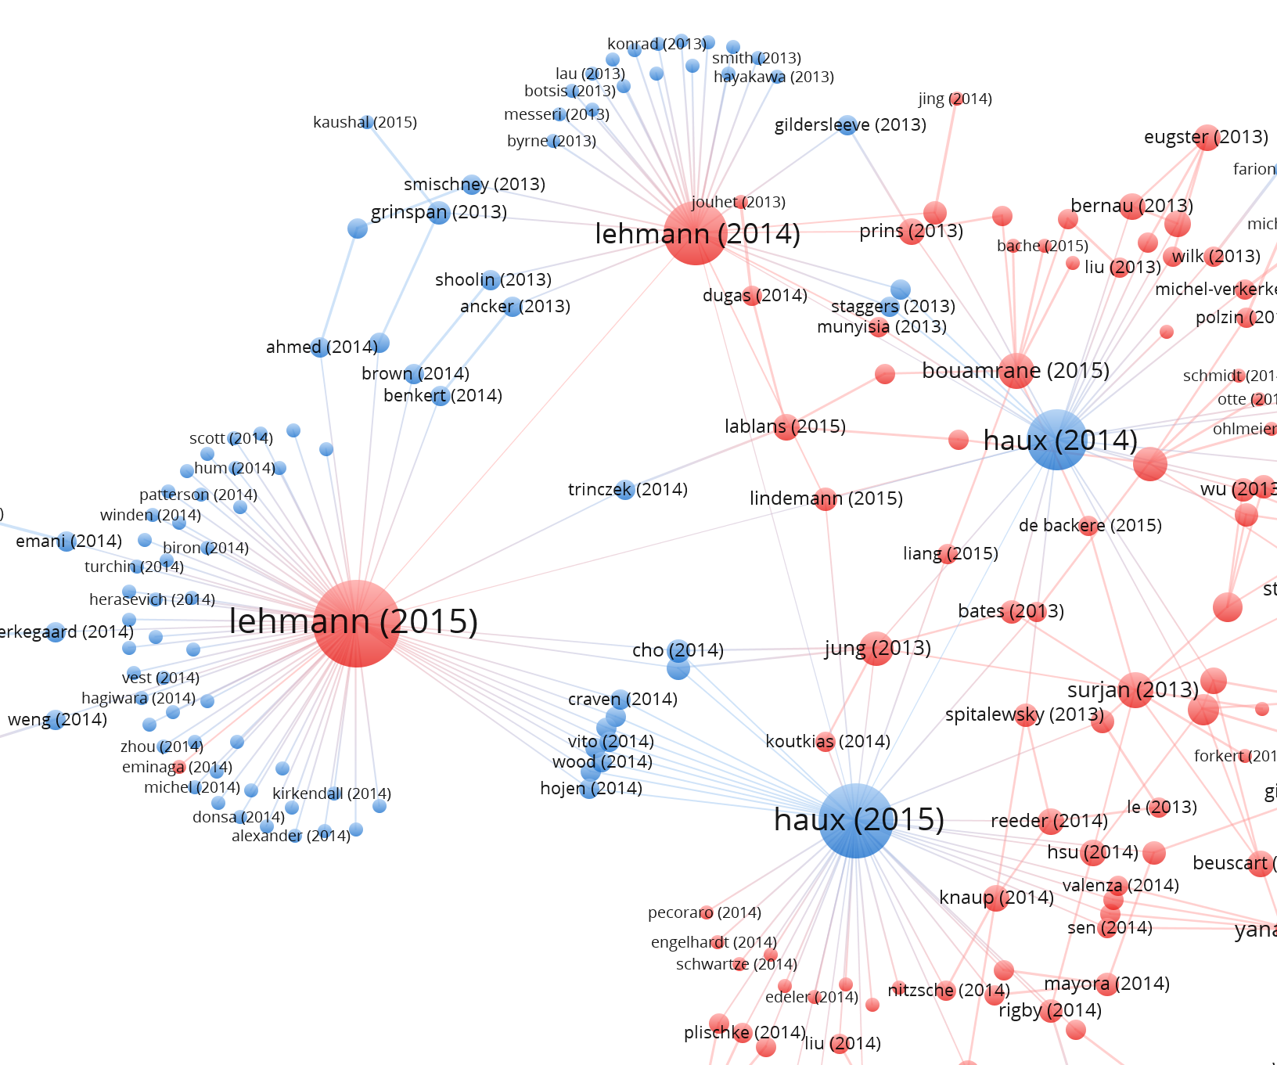
Citation, &Cited

Slide 23
General Structure for Research paper
Introduction
Problem Definition (Optional)
Approach
Evaluation
Relation Work
Conclusion

Slide 24
Experiment
Cloud Computing Platforms
Google Colab: https://colab.research.google.com/

Slide 25
Structure for a Research Proposal
Motivation (background)
Problem (why it’s interesting and important)
Proposed solutions
Designs/models
Data Collection & Analysis
Evaluation methods
Expected Outcomes
Milestones (timeline)

