Slide 1
CSE 3302 / 5307 Programming Language Concepts
Tutorial 02
Wonjun Park

Slide 2
Problem 1 Description

Slide 3
Problem 1 Wrap-up
Orthogonal: A small set of features that work independently and combine freely. If you can use feature X anywhere feature Y expects it, and the meaning doesn’t change, that is orthogonal
ex. while and for loop in C
Non-orthogonality: Features interact in ad-hoc ways so that the meaning of code depends on specific combinations, contexts, or types.

Slide 4
Problem 1 C
Orthogonality: `void*` (generic pointers). You can form a pointer to any object type and pass/store it uniformly, then cast when using it
Non-orthogonality: Arrays decay to pointers; arrays can’t be assigned/returned by value

Slide 5
Problem 1 C++
Orthogonality: templates apply uniformly
ex. `std::sort()` works with both vector<int> and vector<std::string>
Non-orthogonality: `new` and `delete` mistmatch
ex. int* p = new int[3]; -> delete[] p; // not delete p;

Slide 6
Problem 1 JAVA
Orthogonality: Interfaces. Any class can implement any number of interfaces; calls through an interface reference work uniformly regardless of the class’s place in the hierarchy.
Non-orthogonality: Generic and primitives. Generics only accept reference types.
ex. List<int> xs = new ArrayList<>(); // error
List<Integer> xs2 = new ArrayList<>();

Slide 7
Problem 2 Description

Slide 8
Problem 2 C
(signed, unsigned)
char
short, int, long, long long
bool
float, double, long double
void
enum

Slide 9
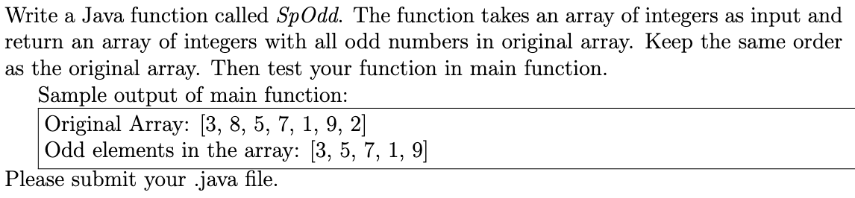
Problem 3 Description

Slide 10
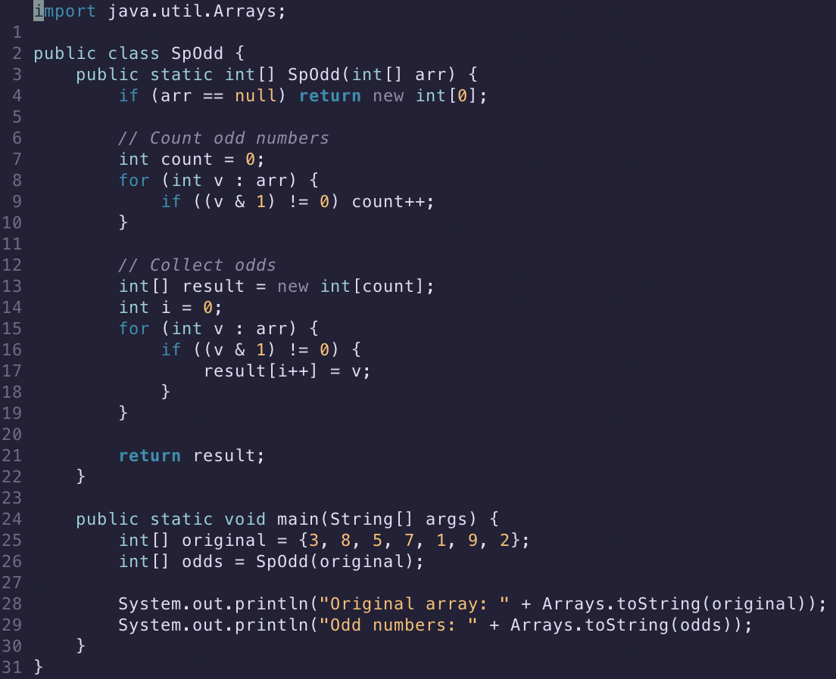
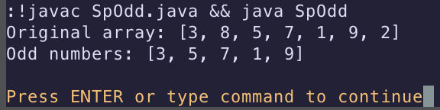
Problem 3 Example Solution

Slide 11
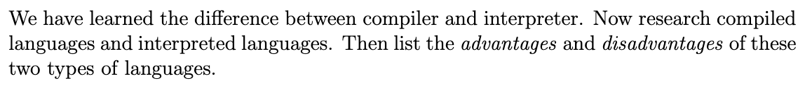
Problem 4 Description

Slide 12
Problem 4 Example Solution
Compiled Languages (C/C++, Rust, Go)
Pros: 1) speed, 2) no interpreter dependency, 3) error catching at compile time (early), and 4) predictable performance
Cons: 1) Slower edit-build-run cycle, 2) Portability costs (recompile at each platform/arch), ..
Interpreted Languages (Python, Ruby, Javascript)
Pros: 1) Portability, 2) Faster Pipeline, …
Cons: 1) Slower execution, 2) Runtime dependencies (interpreter, libraries, packages, versions)

Slide 14
Announcement
Please note that
additional credits could be given,
if someone can present own work
from the next week.

