Slide 1
Programming Language Concepts
CSE 3302 / 5307 - Dr. Kenny Zhu
Tutorial 06
Wonjun Park

Slide 2
Grading Policy In Each Sub-Problem (Case)
100%, if you correct
50%, if your idea(or answer) is correct
but does not follow proper proof template (two-column)
Description in sentences is not a proper template
0%, if your answer is incorrect

Slide 3
Homework 5

Slide 4
Problem 1 Description

Slide 5
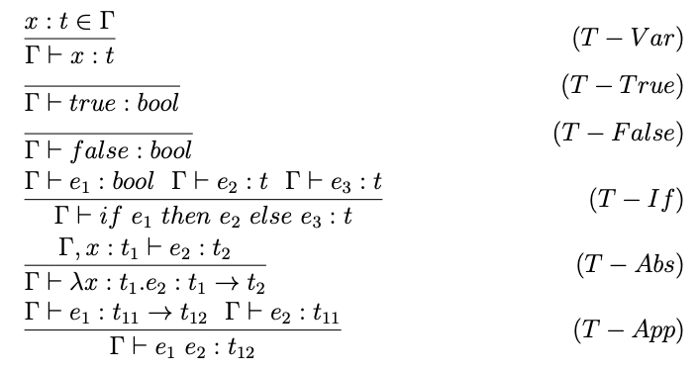
Problem 1 Background

Slide 6
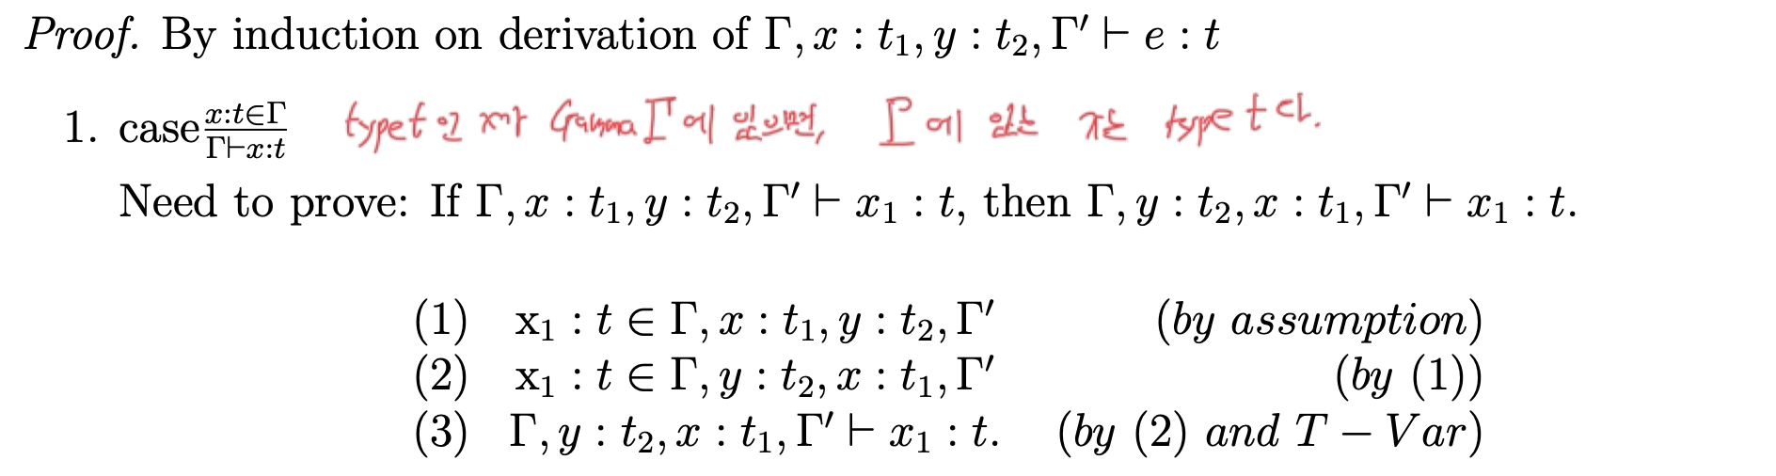
Problem 1 Solution
? / 5

Slide 7
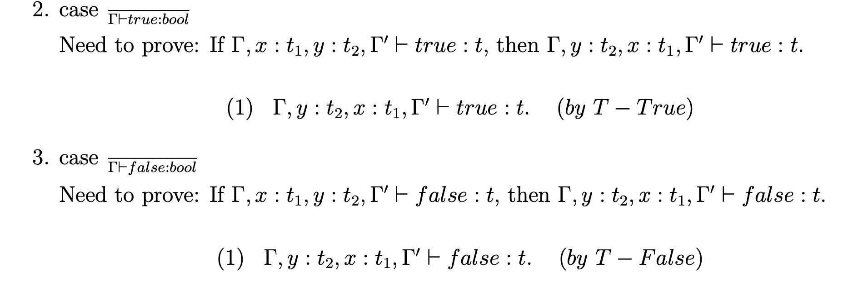
Problem 1 Solution
? / 5
bool
? / 5
bool

Slide 8
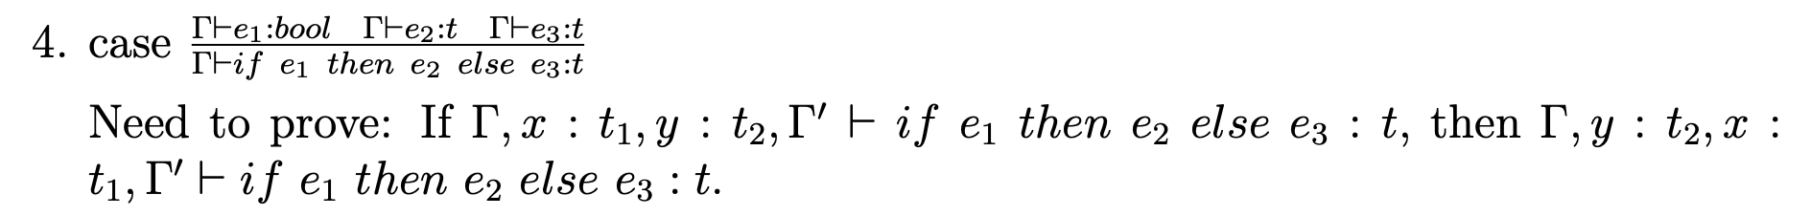
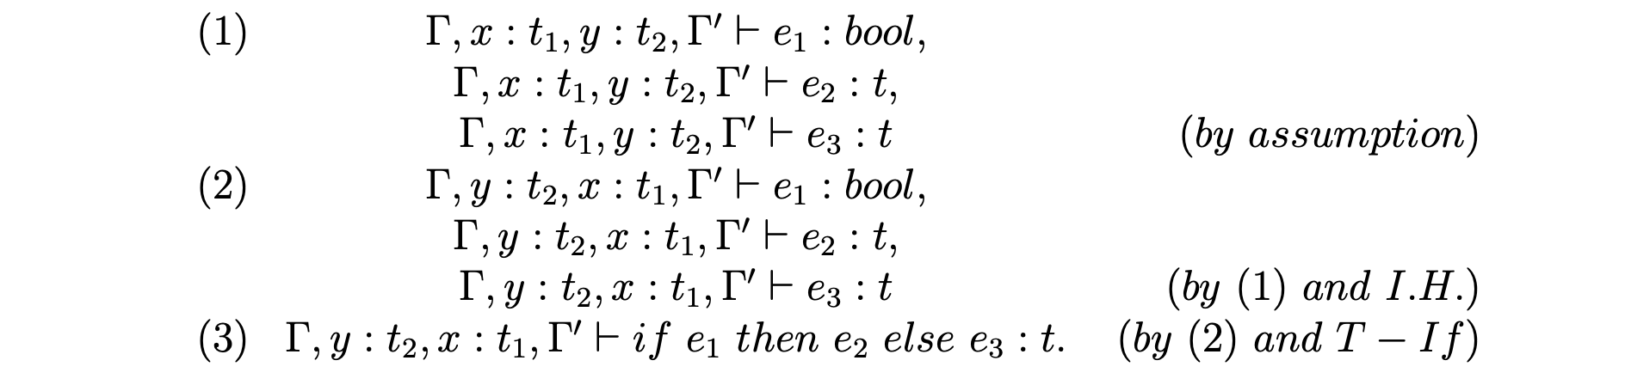
Problem 1 Solution
? / 5

Slide 9
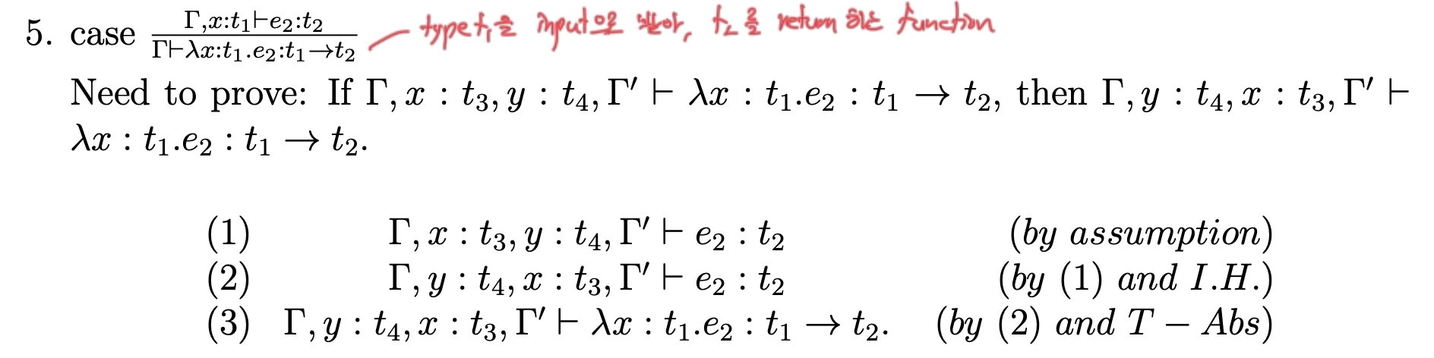
Problem 1 Solution
? / 5

Slide 10
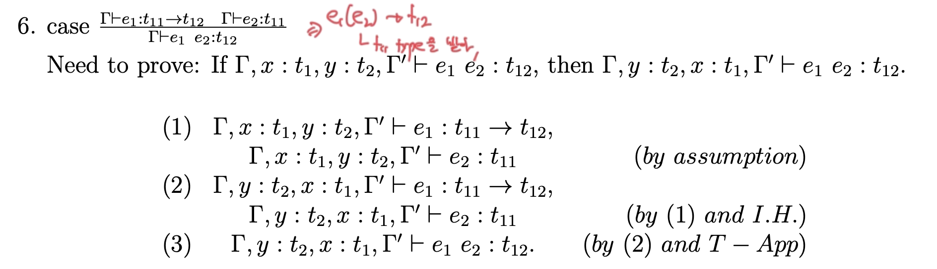
Problem 1 Solution
? / 5

Slide 11
Problem 2 Description

Slide 12
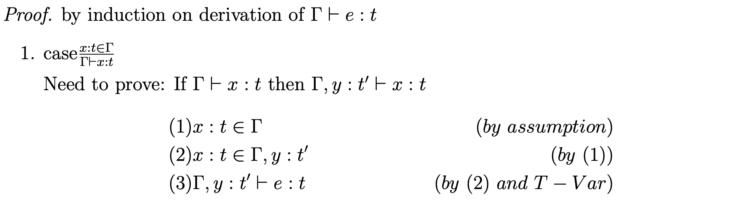
Problem 2 Solution
? / 5
x

Slide 13
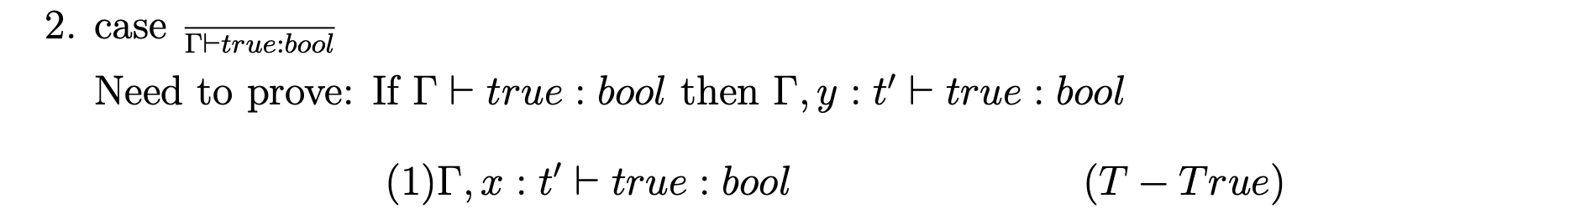
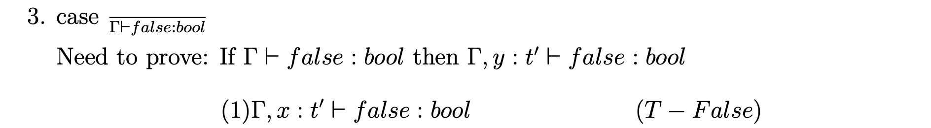
Problem 2 Solution
? / 5
? / 5

Slide 14
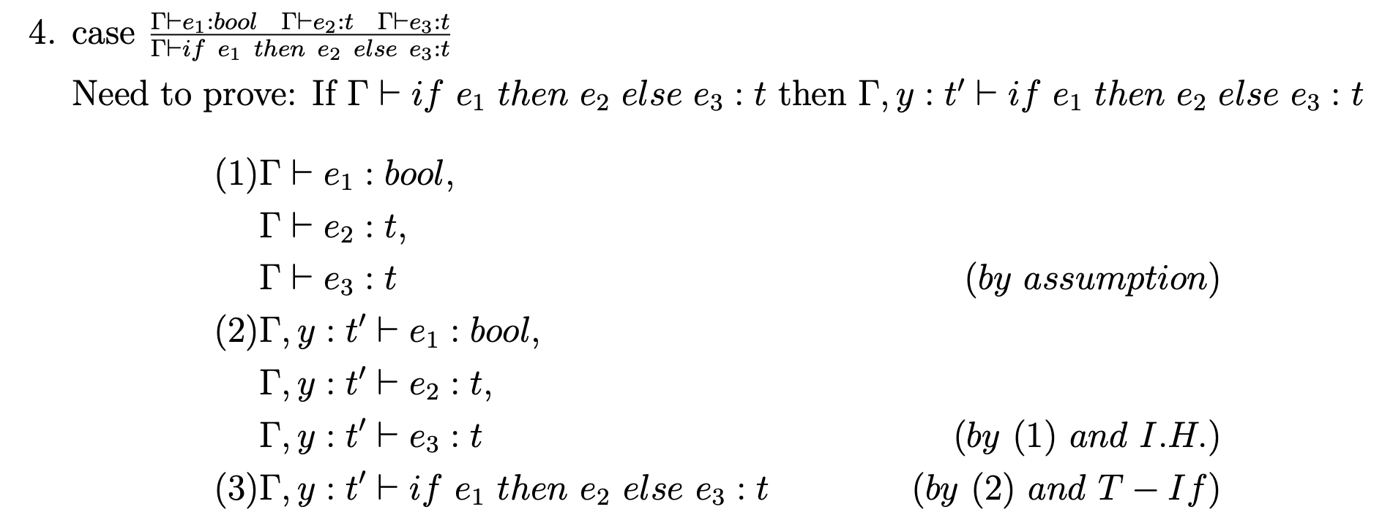
Problem 2 Solution
? / 5

Slide 15
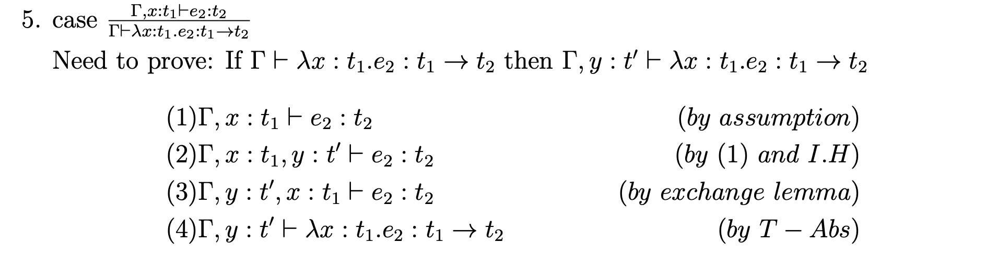
Problem 2 Solution
? / 5

Slide 16
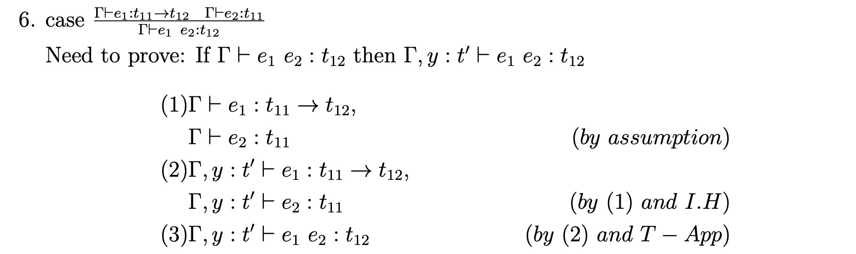
Problem 2 Solution
? / 5

Slide 17
Problem 3 Description

Slide 18
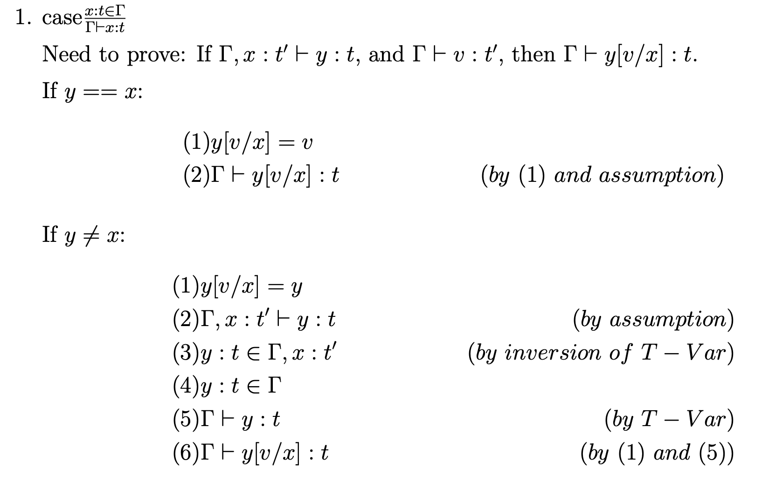
Problem 3 Solution
? / 5

Slide 19
Problem 3 Solution
? / 5

Slide 20
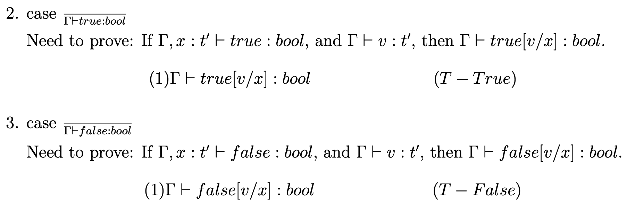
Problem 3 Solution
? / 6
? / 6

Slide 21
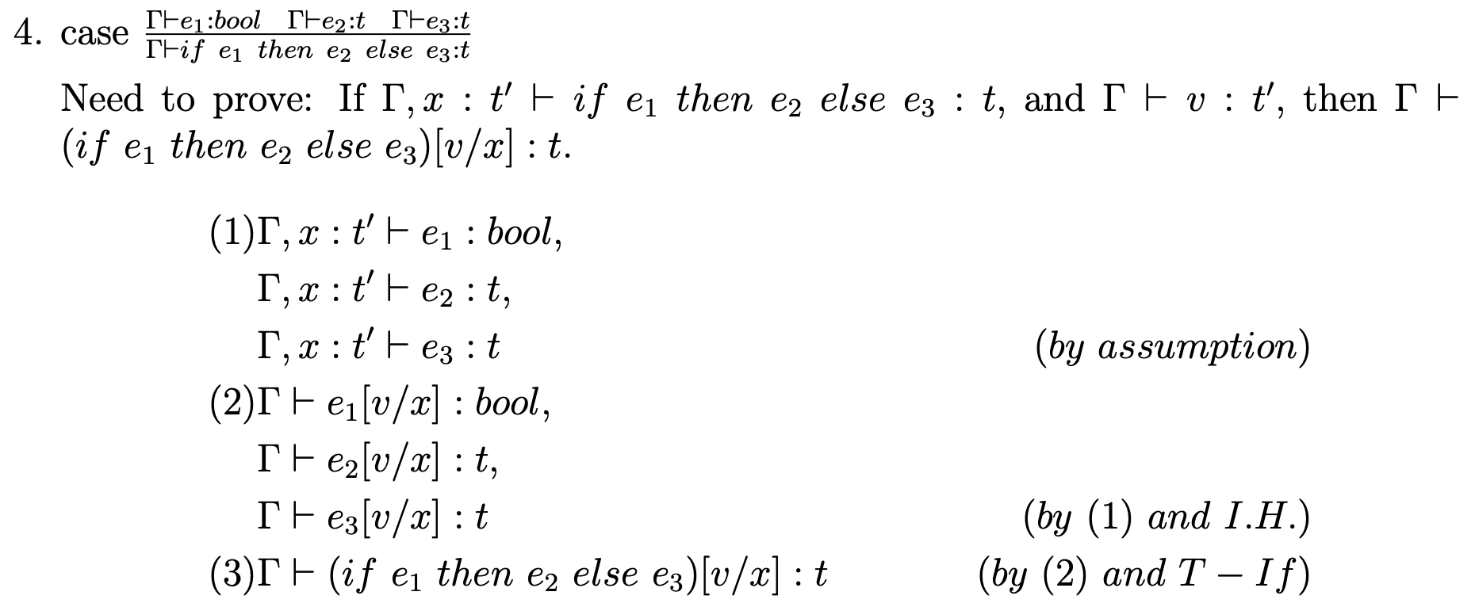
Problem 3 Solution
? / 6

Slide 22
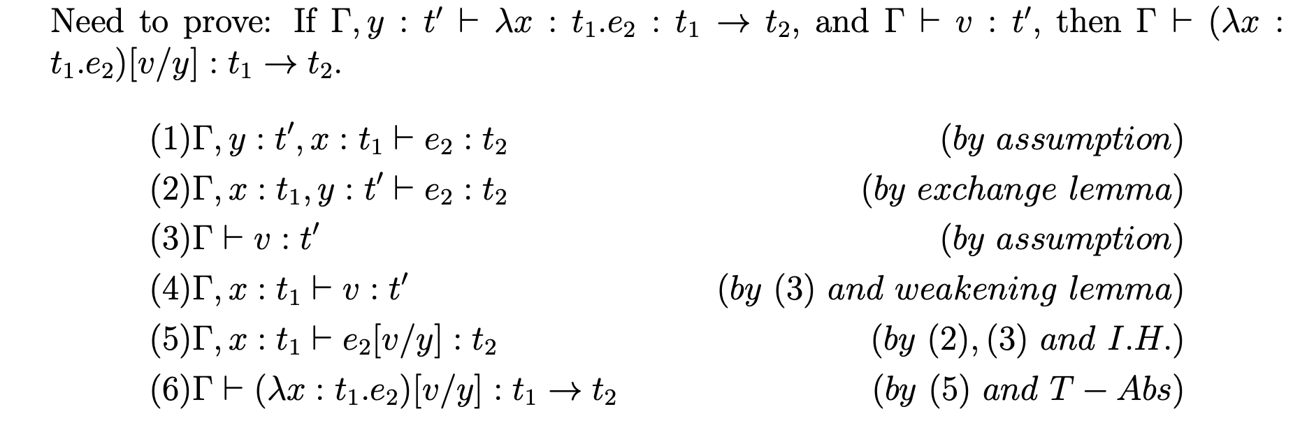
Problem 3 Solution
? / 6

Slide 23
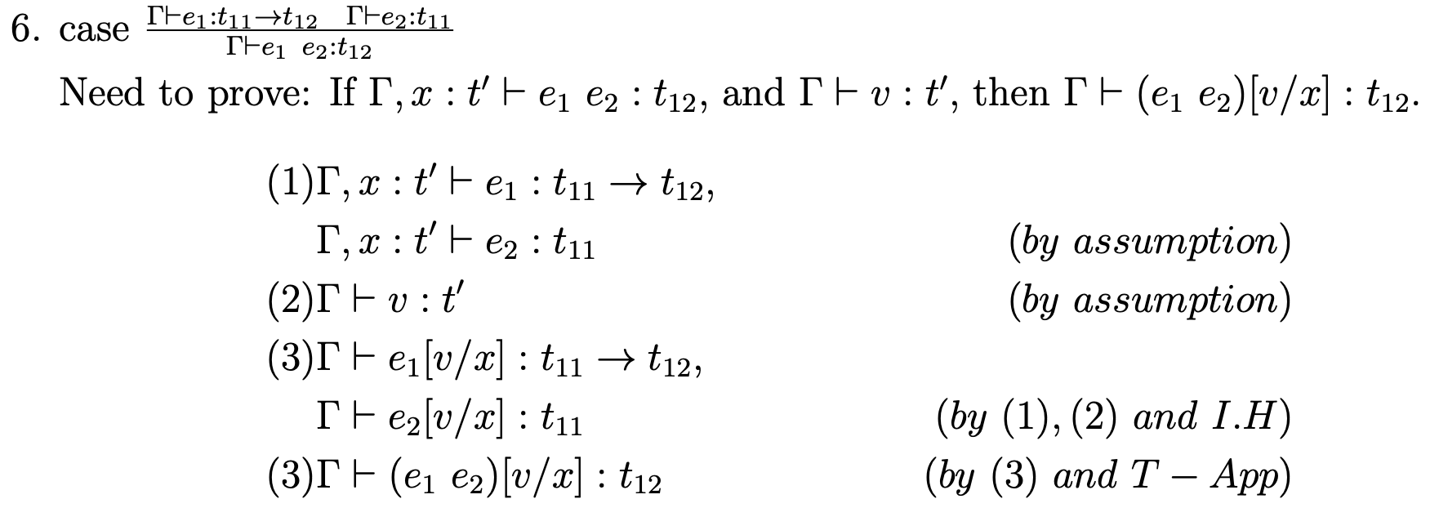
Problem 3 Solution
? / 6

