Slide 1
Programming Language Concepts
CSE 3302 / 5307 - Dr. Kenny Zhu
Tutorial 09
Wonjun Park

Slide 2
Quiz

Slide 3
1. Which is not a major area of the memory?
a. static area
b. heap
c. free list
d. runtime stack

Slide 4
2. What is the structure of runtime memory?
Memory
address
0
1
a. A: static area; B: stack; C: heap
b. A: stack; B: static area; C: heap
c. A: static area; B: stack; C: heap
d. A: stack ; B: heap; C: static area
A
B
C
n

Slide 5
3. Runtime stack holds global variables that can be statically allocated.
True
False

Slide 6
4. Why don’t we put the heap on the top of the address space?

Slide 7
5. Which of the following C/C++ statements doesn’t allocate memory from Memory Heap?
char s[] = "abc";
p = malloc (sizeof (int));
int* a = new int (4);
array[i] = new int [n];

Slide 8
6. Garbage collection is __?
a syntactic component
a semantic feature
always invoked by programmer
a practical consideration

Slide 9
7. Which of the following programming languages doesn’t have inherent Garbage Collection mechanism?
Lisp
Scheme
C
Haskell

Slide 10
8. Which one is not a classical garbage collection strategy mentioned on class?
Reference Counting
Mark-and-Sweep
Early Detection
Copy Collection

Slide 11
9. Which of the following is incorrect about Reference Counting?
Its biggest defect is in its inability to deallocate circular structures.
It is relatively easy to implement.
Its cost is proportional to the size of the heap or to the percentage of it in use or not at any time.
It comes with space overhead since additional space needed for reference count.

Slide 12
10. Which is not one of the disadvantages for the mark-and-sweep GC algorithm?
Normal execution must be suspended.
May touch all virtual memory pages.
Fail to detect inaccessible circular structure.
d. Heap may fragment.

Slide 13
Homework 8

Slide 14
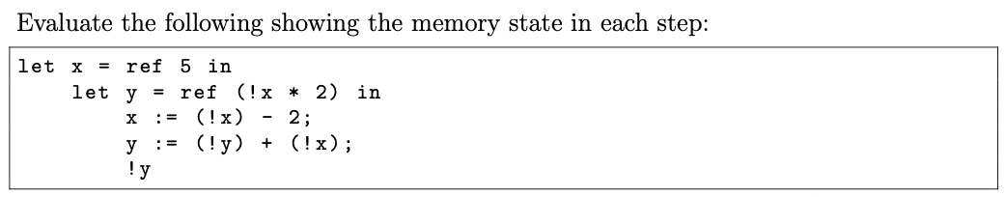
Problem 1 Description

Slide 15
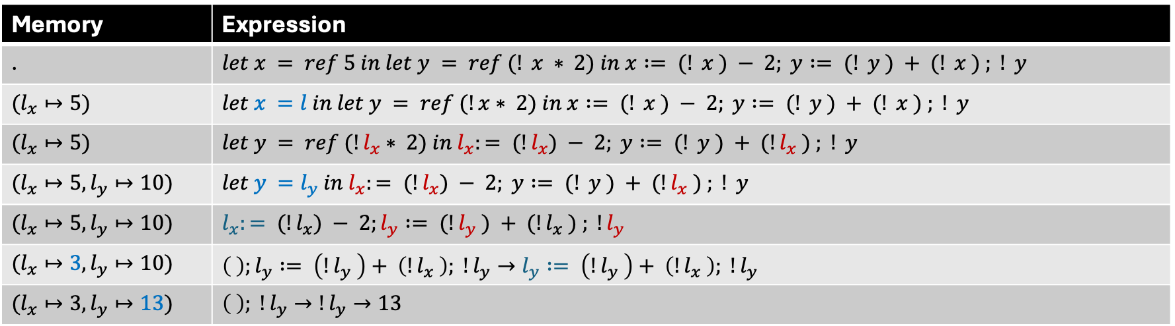
Problem 1 Solution
Memory | Expression
. | $$let x = ref 5 in let y = ref (! x ∗ 2) in x := (! x ) − 2; y := (! y ) + (! x ) ; ! y$$
$$(l_{x}↦5)$$ | $$let x =l in let y = ref (!x∗ 2) in x := (! x ) − 2; y := (! y ) + (! x ) ; ! y$$
$$(l_{x}↦5)$$ | $$let y = ref (!l_{x}∗ 2) in l_{x}:= (!l_{x}) − 2; y := (! y ) + (!l_{x} ) ; ! y$$
$$(l_{x}↦5, l_{y}↦10)$$ | $$let y =l_{y} in l_{x}:= (!l_{x}) − 2; y := (! y ) + (!l_{x} ) ; ! y$$
$$(l_{x}↦5, l_{y}↦10)$$ | $$l_{x}:= (!l_{x}) − 2;l_{y} := (!l_{y} ) + (!l_{x} ) ; !l_{y}$$
$$(l_{x}↦3, l_{y}↦10)$$ | $$\left( \right);l_{y} := \left(!l_{y} \right)+ \left(!l_{x} \right); !l_{y}→l_{y} := \left(!l_{y} \right)+ \left(!l_{x} \right); !l_{y}$$
$$(l_{x}↦3, l_{y}↦13)$$ | $$\left( \right); !l_{y}→!l_{y}→13$$

Slide 16
Problem 2 Description

Slide 17
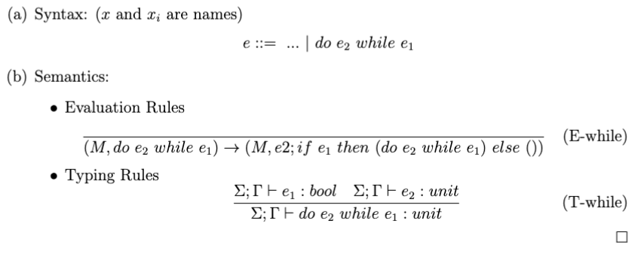
Problem 2 Solution

Slide 18
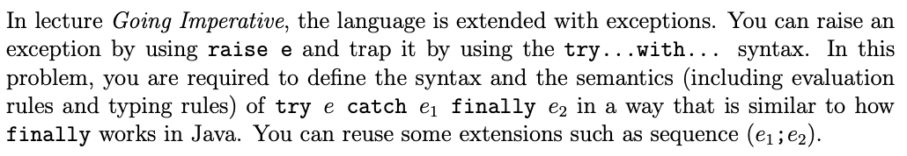
Problem 3 Description

Slide 19
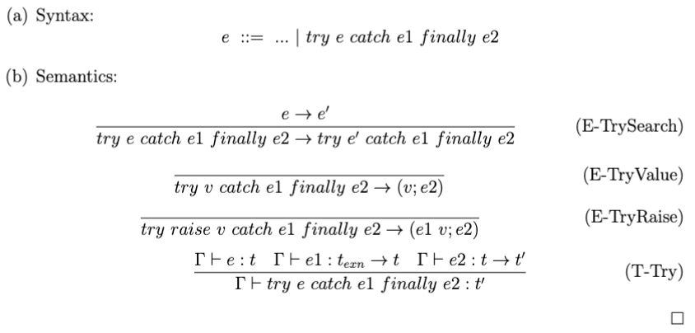
Problem 3 Solution

