Slide 1
Tutorial-10
TA Theron(Sinong)

Slide 2
Quiz

Slide 3

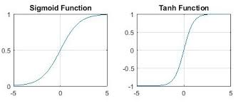

Slide 4
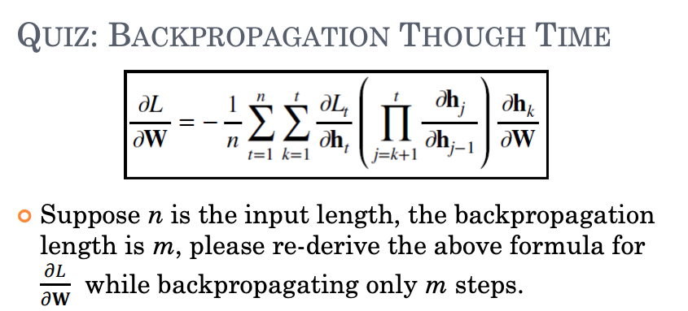


Slide 5
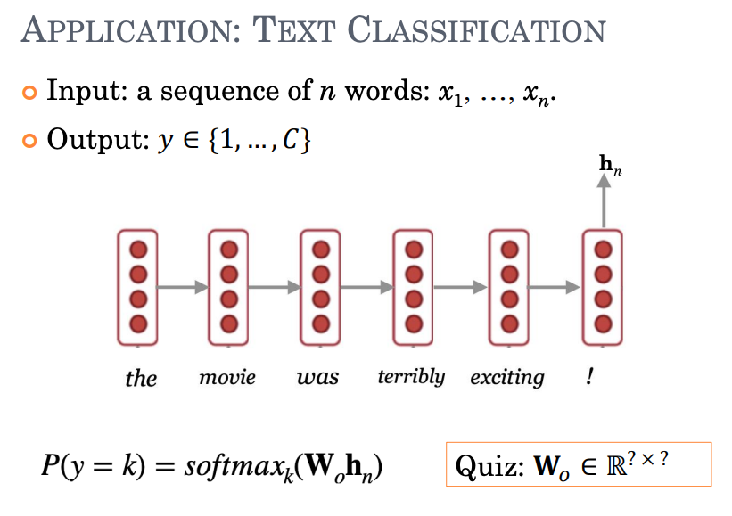
C * d

Slide 6
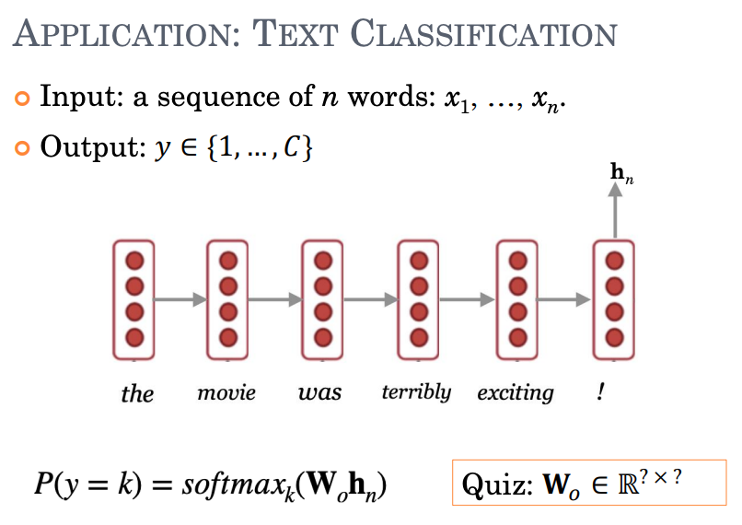
C * d

Slide 7
Homework

