Slide 1
Tutorial 8
Quiz 9,10 & HW 6
Presenter: Peter​ Zhang
3/4/2026

Slide 2
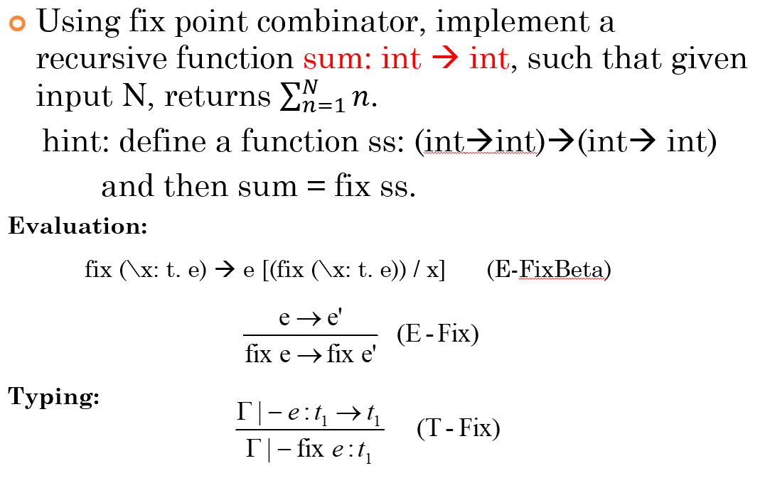
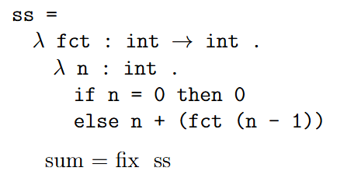
Quiz 9

Slide 3
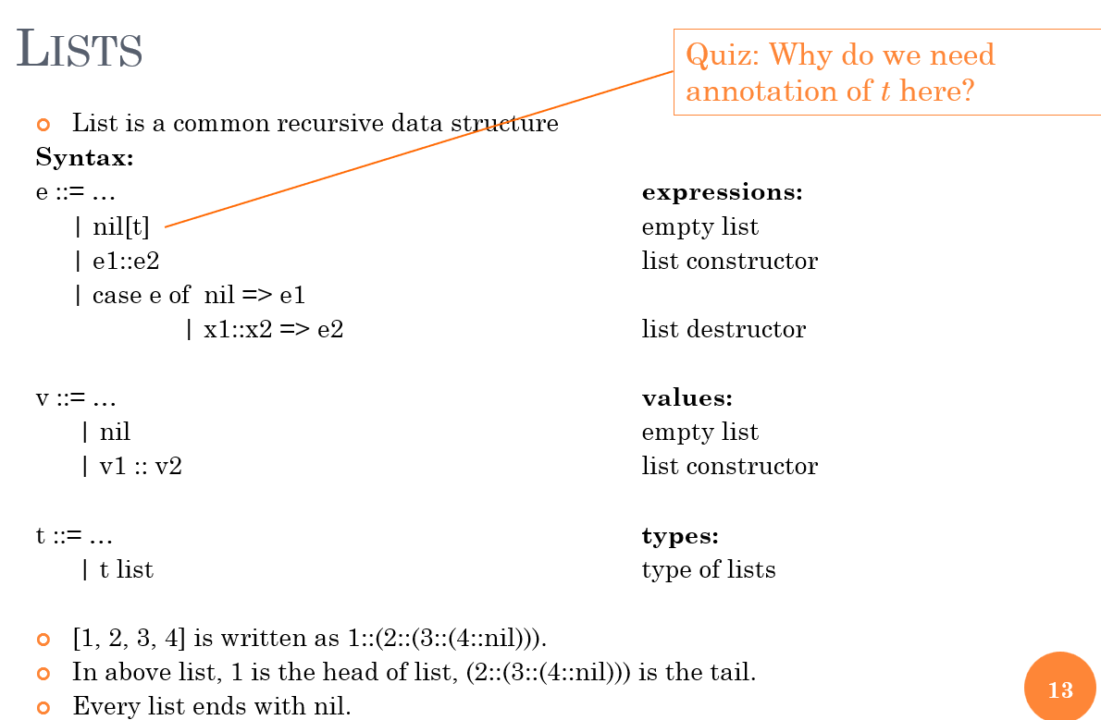

Slide 4
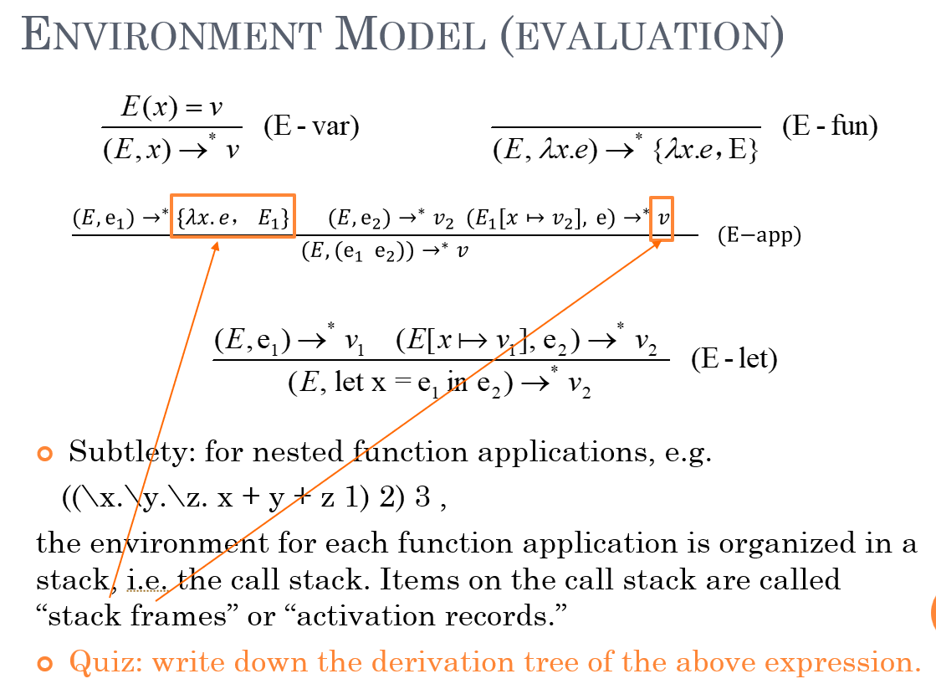
Quiz 10

Slide 5

This is the complete derivation tree!
(E-app)

Slide 6
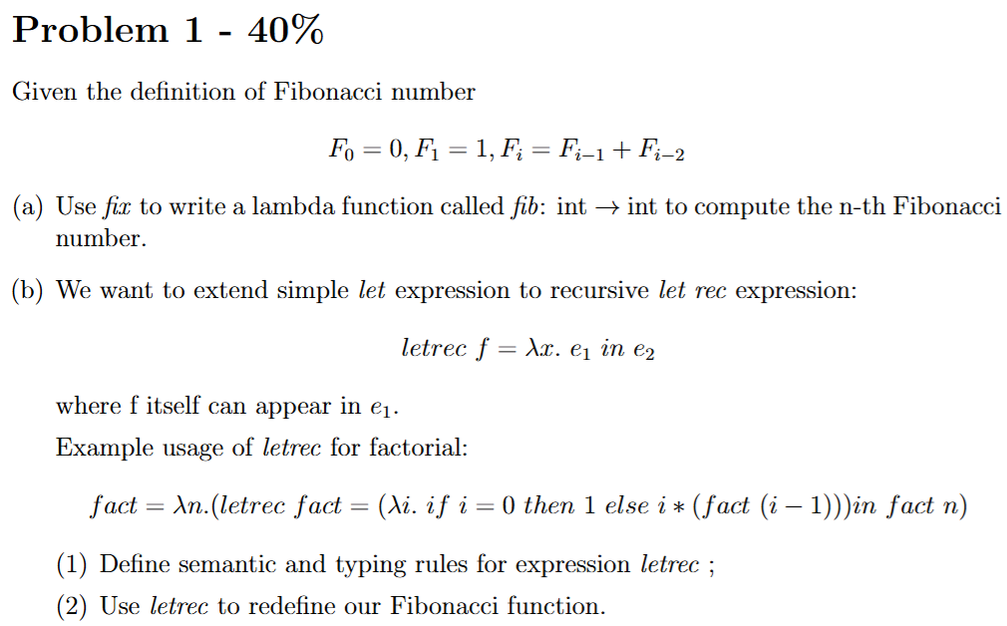
HW 6

Slide 7
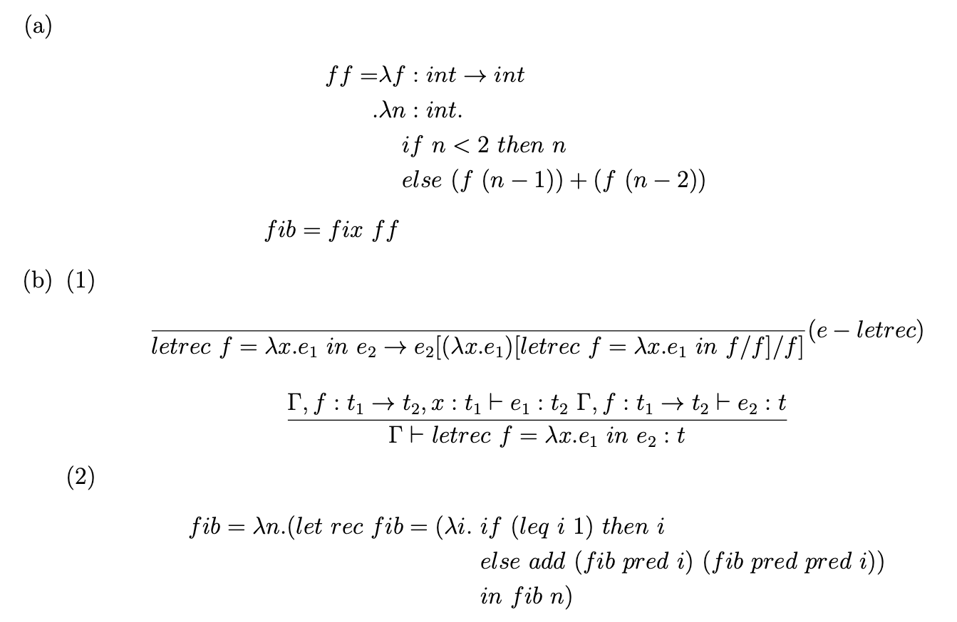

Slide 8

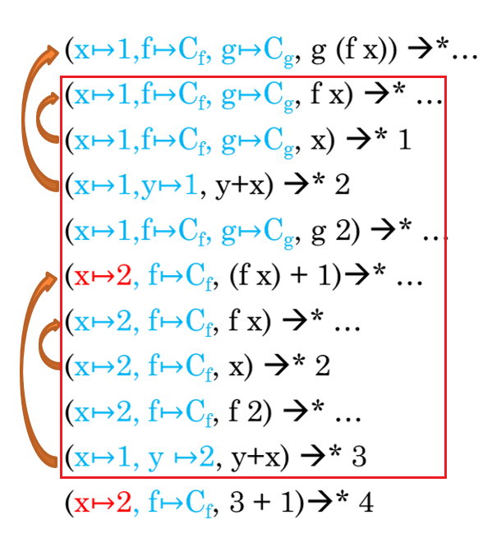

Slide 9



Please refer to Quiz 10 and see how to draw the complete derivation tree,
this is only the intermediate step for reference.

Slide 10
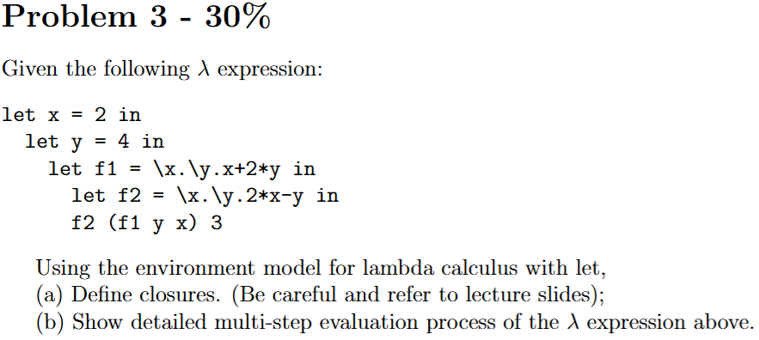

Slide 11
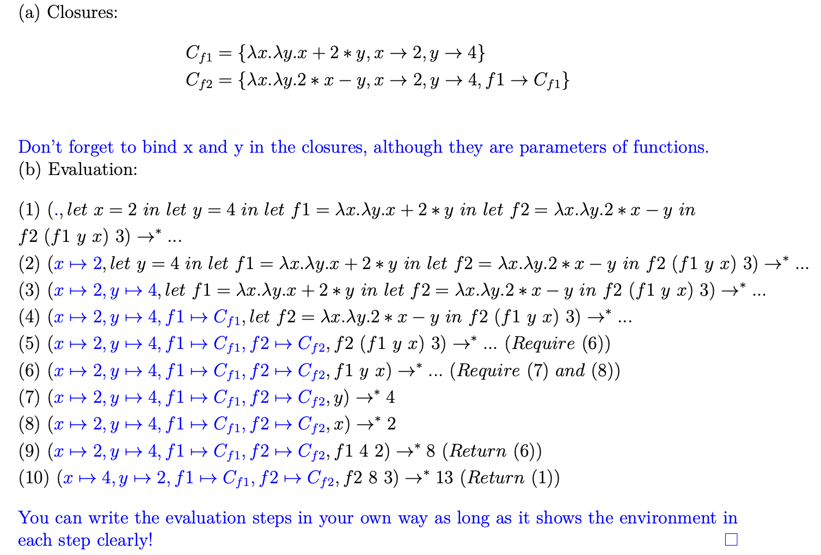
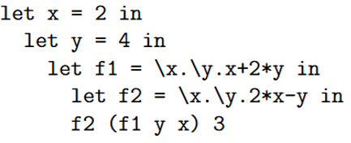

Slide 12
Thank You

