Slide 1
Tutorial 7
Quiz 9 & HW 6
Presenter: Peter​ Zhang
3/4/2026

Slide 2
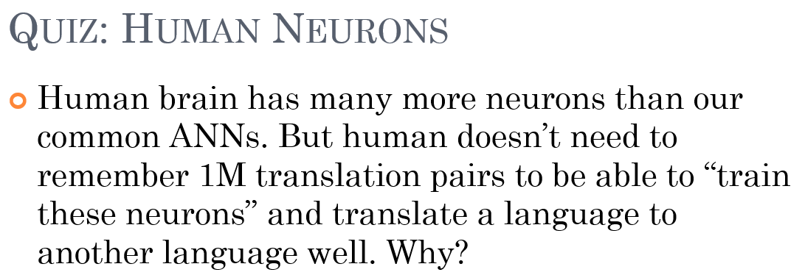
Quiz 9

Slide 3
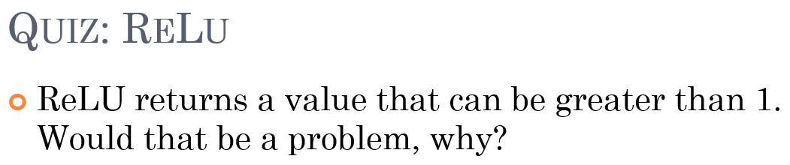

Slide 4
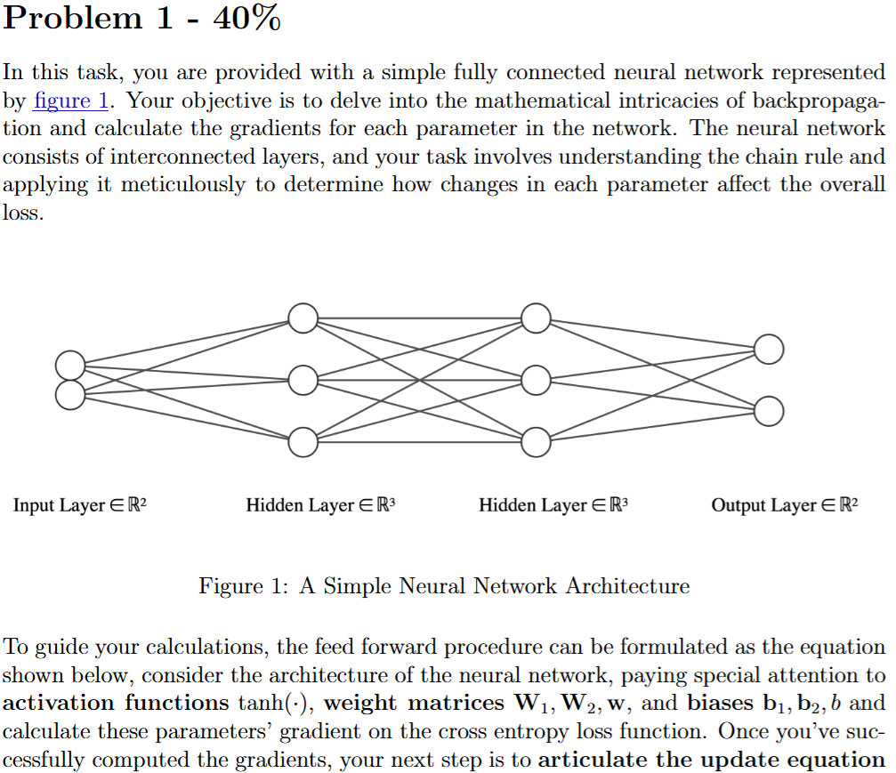
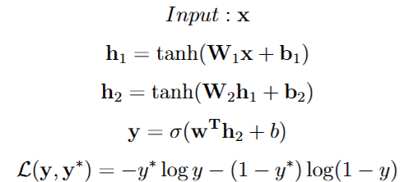

Slide 5


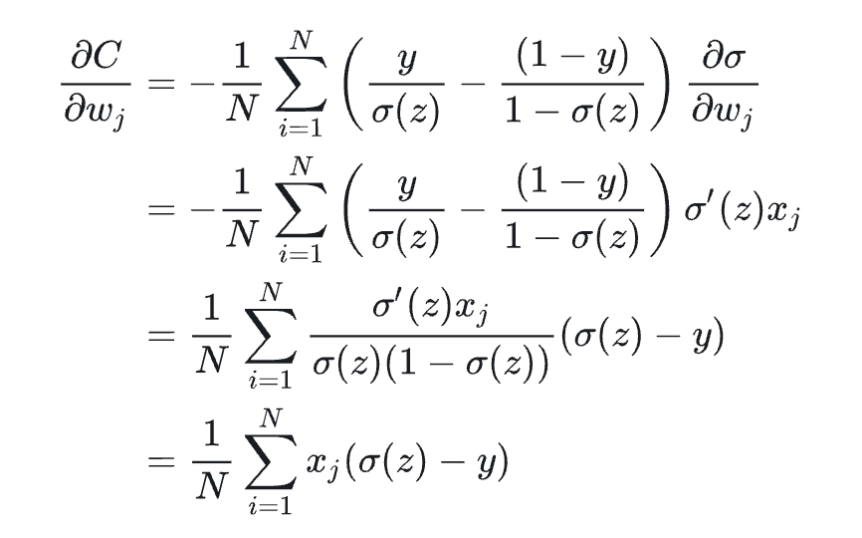


Slide 6
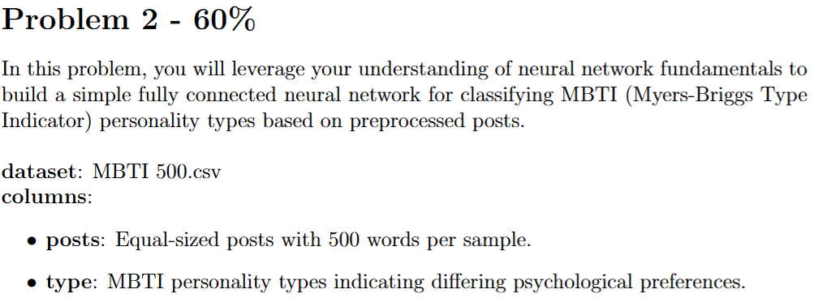

Slide 7
Thank You

