Slide 1
Tutorial 12
Quiz 15 & HW 11
Presenter: Peter​ Zhang
4/22/2026

Slide 2
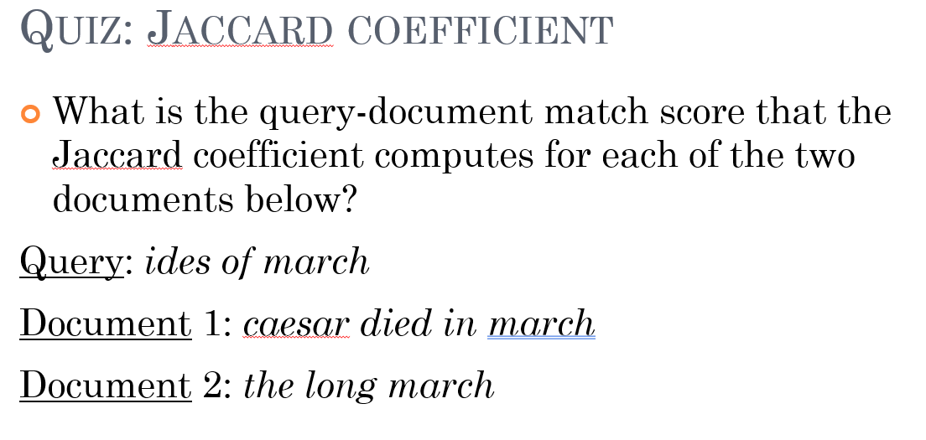

Slide 3
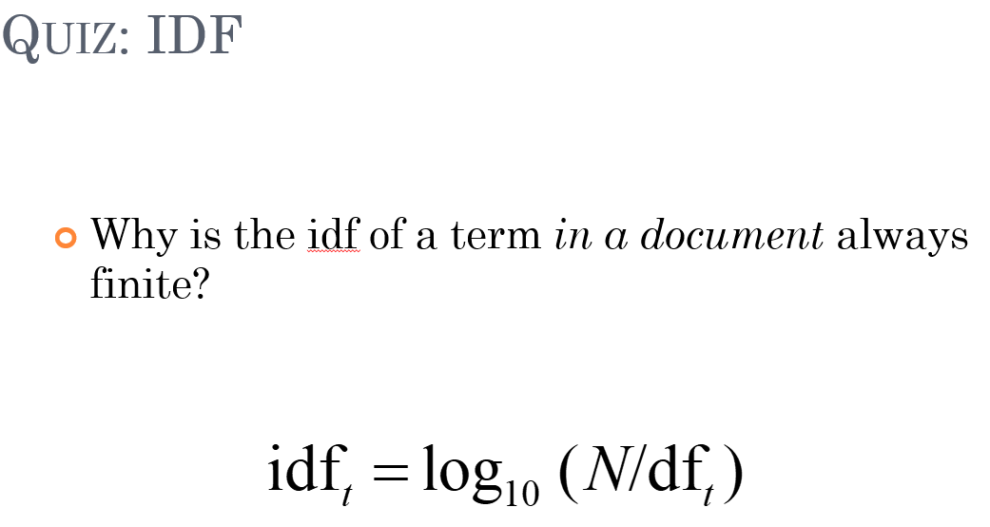

Slide 4
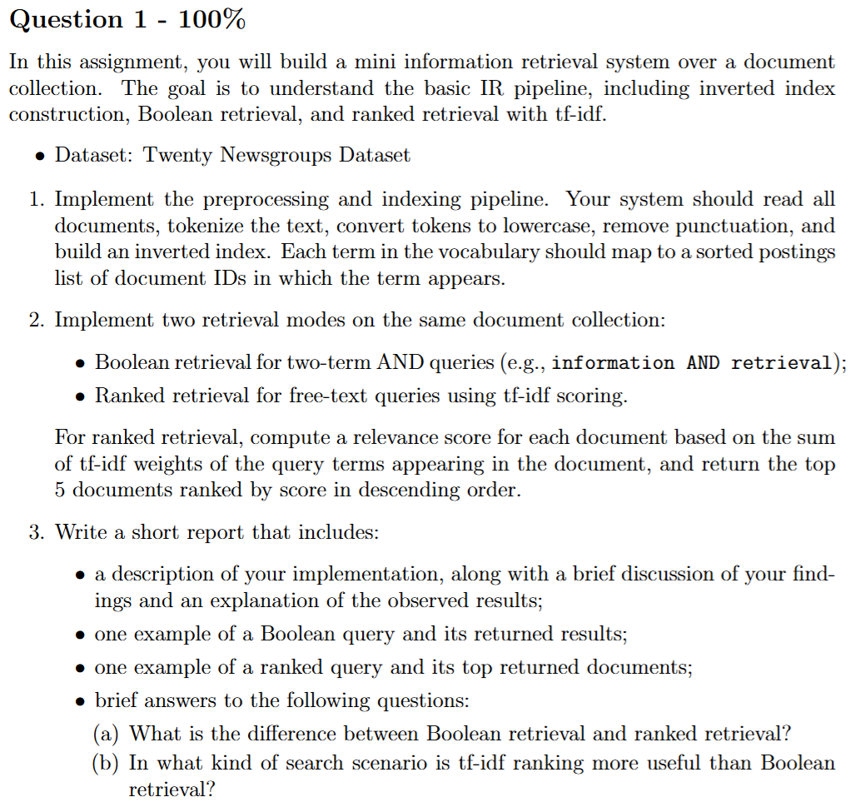

Slide 5
Thank You

