Slide 1
Tutorial – Week2
Sinong TA

Slide 2
Quiz-1

Slide 3
1. What is the course about?
Programming in a language
How to compile a program
The design and implementation of languages
How to interpret a program

Slide 4
2. Which one of following is not a programming paradigm?
Statement
Object-oriented
Functional
Declarative

Slide 5
3. Which one is not a basic property of programming languages?
Syntax
Names
Types
Values
Syntax, names, types, semantics

Slide 6
4. What is not a major concern of syntax?
Syntax error detection
Types
Grammar
Vocabulary

Slide 7
5. A name (identifier) always refers to the same identity, regardless of the context(scope, visibility, lifetime, type...)
True
False

Slide 8
Homework – Week1

Slide 9
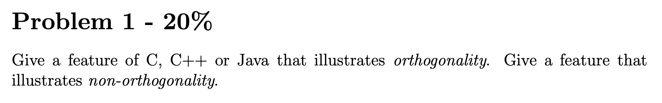

Slide 10
can be used independently, without affecting each other
no exception
No redundancy
No overlap

Slide 11
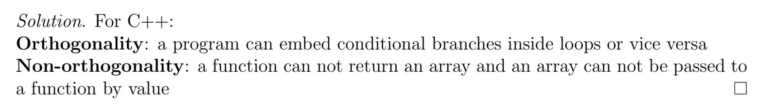

Slide 12
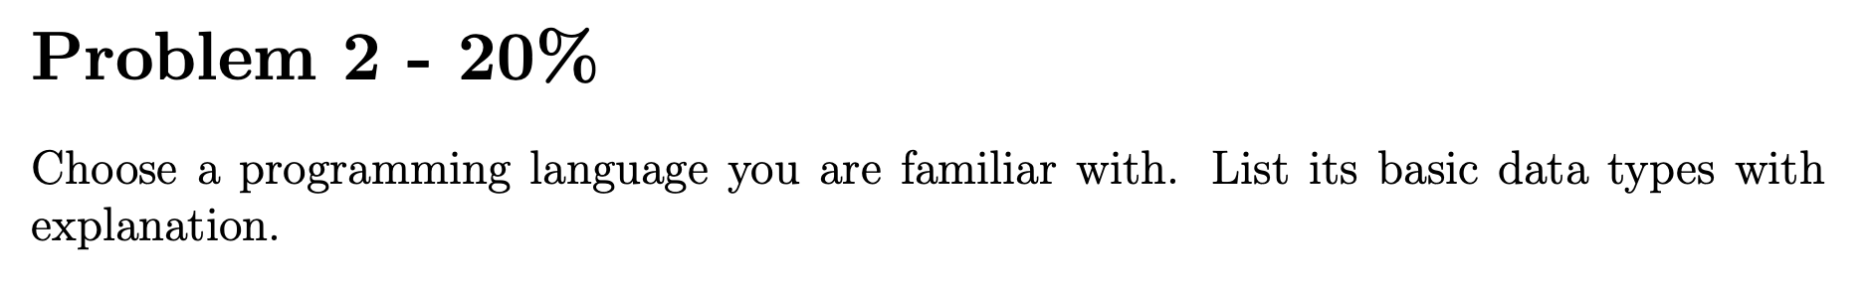

Slide 14
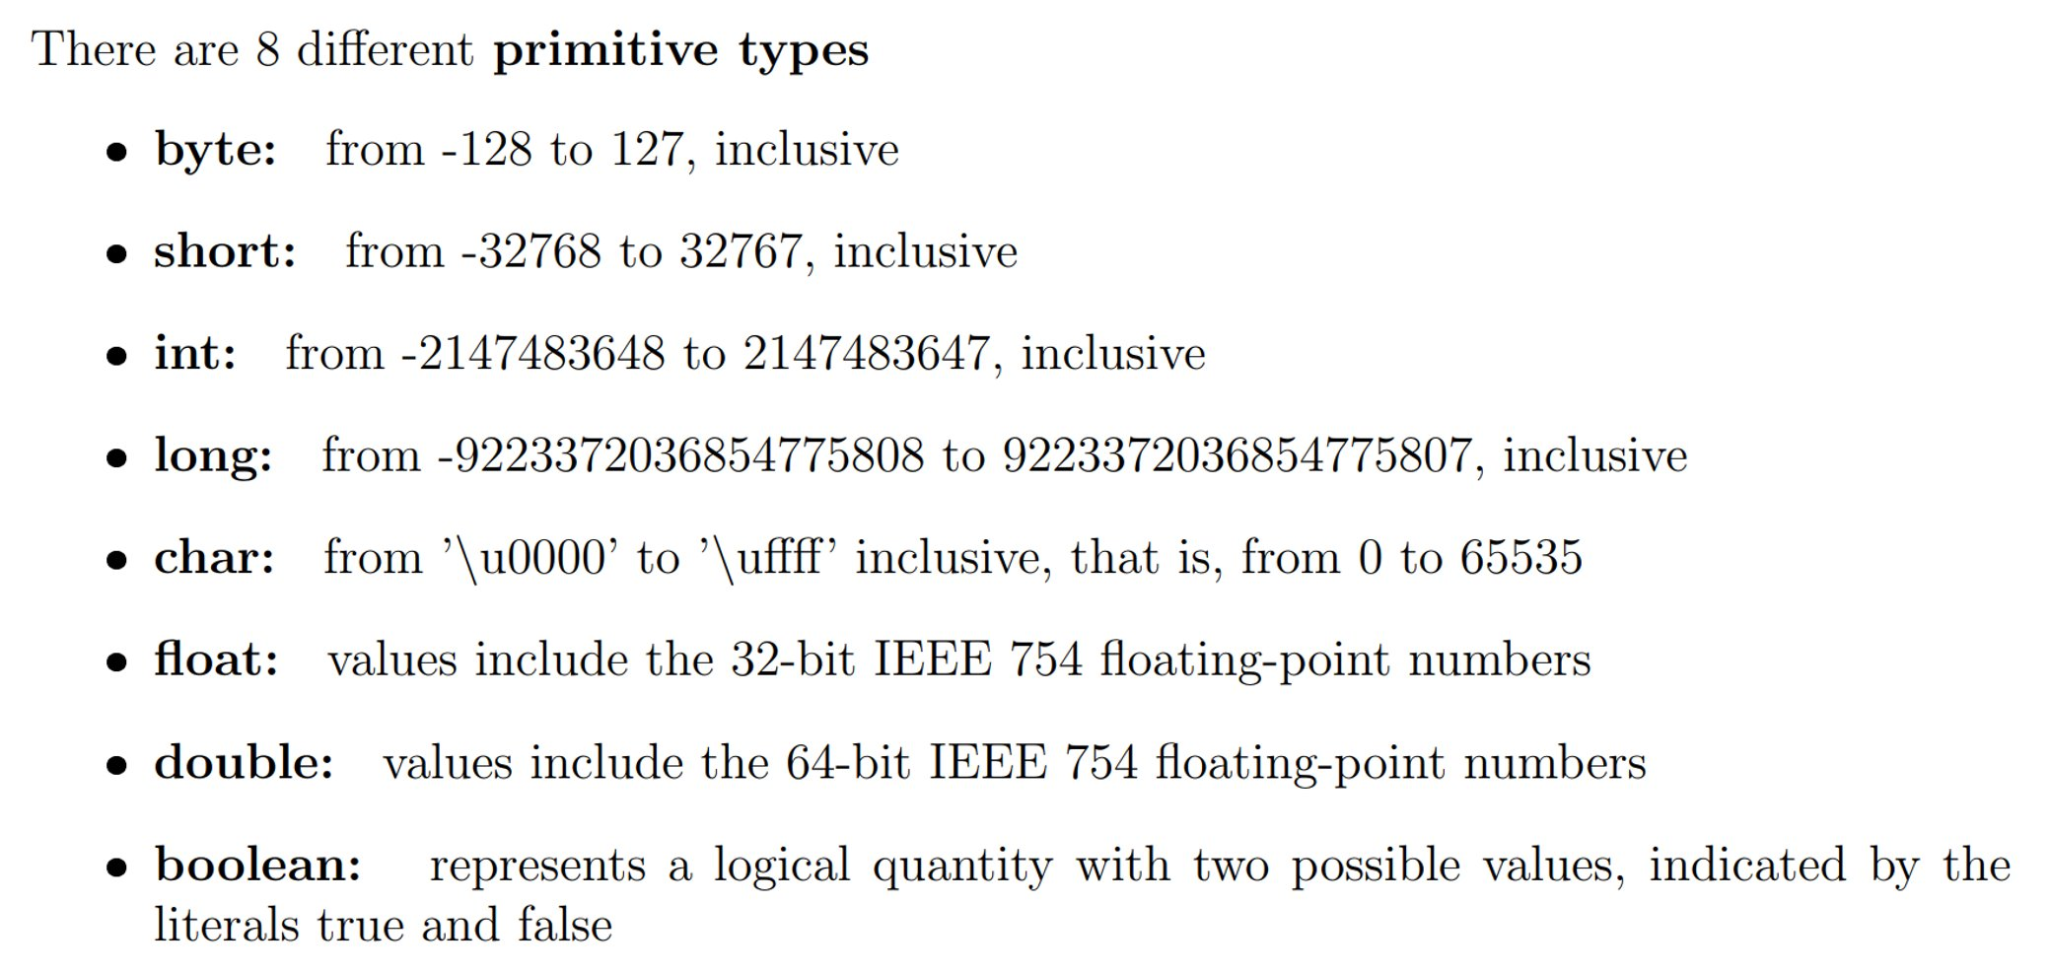
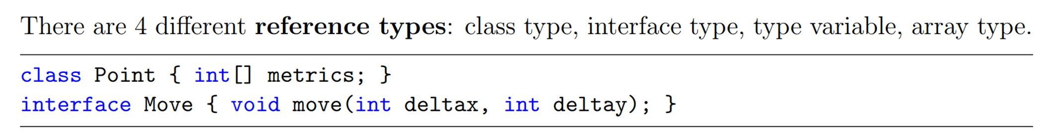

Slide 15
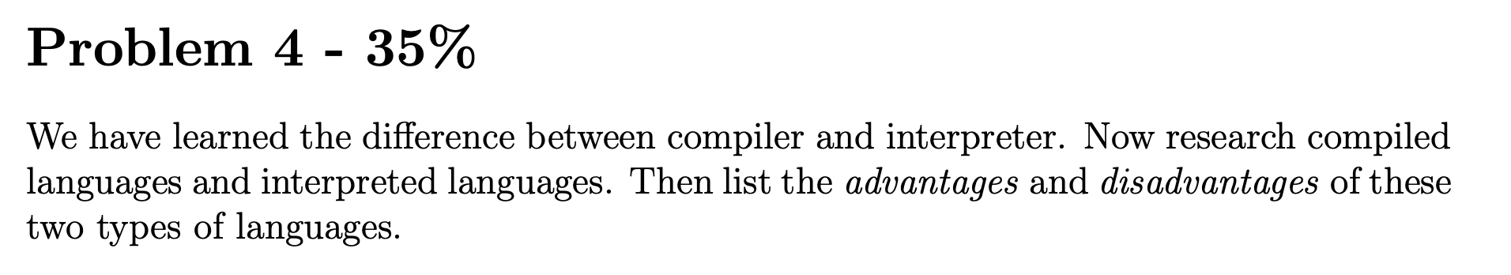

Slide 16
Runtime speed?
Time for compilation?
Cross-platform?
Program size?
Easy to debug?

Slide 17
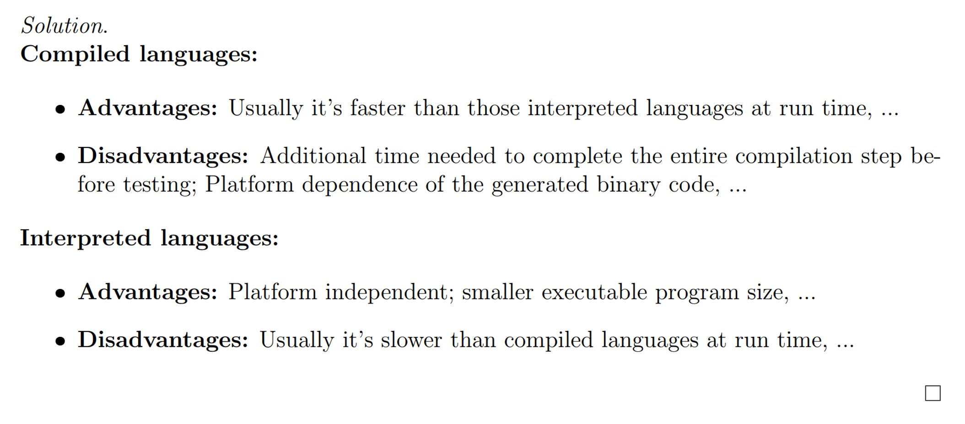
Runtime speed?
Time for compilation?
Cross-platform?
Program size?
Easy to debug?

Slide 18
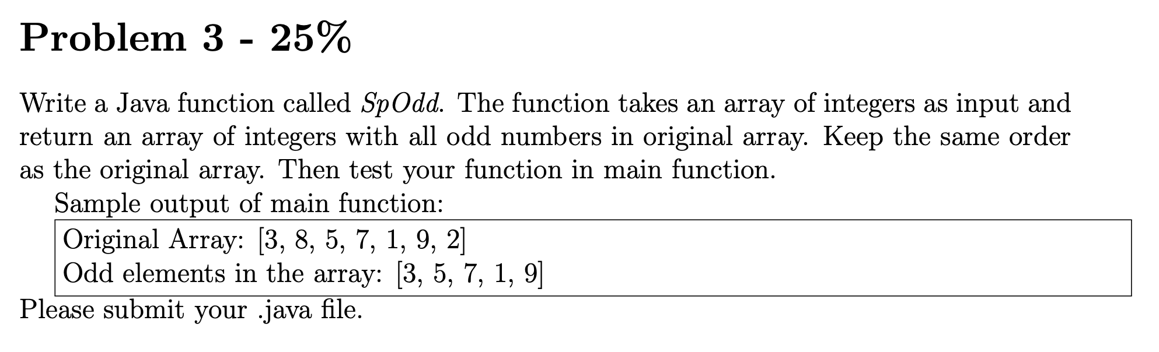

Slide 19
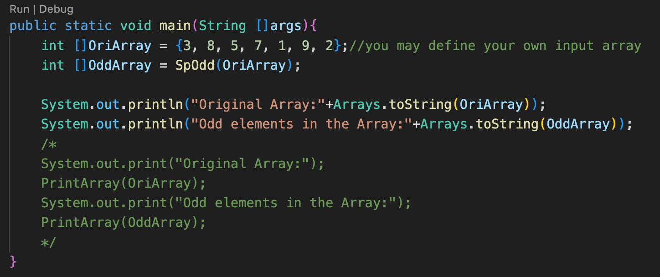
method name is the same as the main class
The name of .java file must be the same as the class with main function so that the compiler knows where to start.

Slide 20
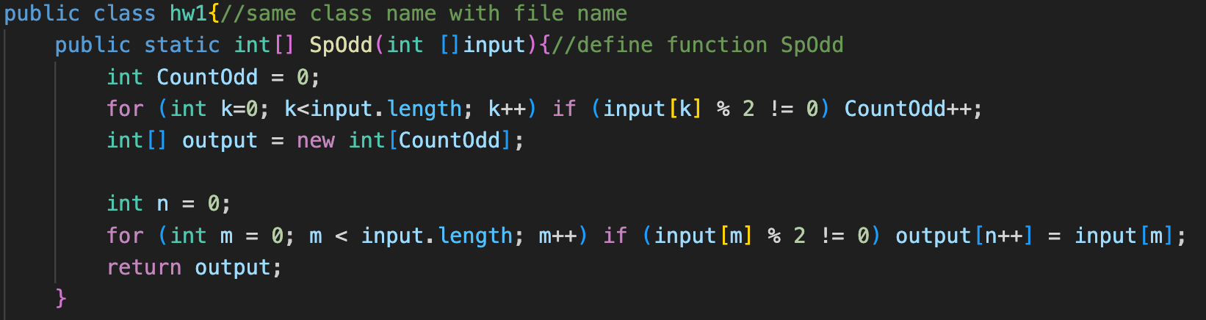
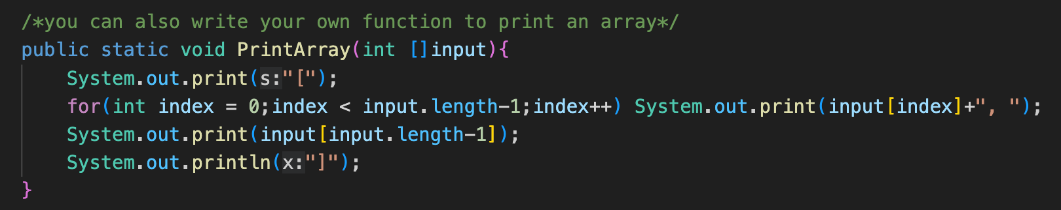

Slide 21
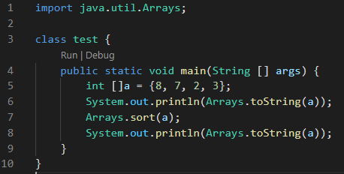

Homework1
Print arrays & sort arrays

