Slide 1
Programming Language Concepts
CSE 3302 / 5307 - Dr. Kenny Zhu
Tutorial 10
Wonjun Park

Slide 2
Quiz

Slide 3
1. Which is not correct about polymorphism?
A term can be used in many concrete contexts with different concrete types.
It is the ability of an object to take on many forms.
It makes typed constructs useful in more contexts.
Existential polymorphism is about code reuse.

Slide 4
2. Typed language need type inference.
True
False

Slide 5
3. Which one is not a step of type inference?
Add type schemas
Generate type constraints
Determine subtypes
Solve type constraints

Slide 6
4. In the step of constraint generation, which simple rule is not totally correct?
G |-- x ==> x : s, {}
G |-- 2 ==> 2 : int, {}
G |-- false ==> false : bool, {}
G |-- true ==> true : bool, {}

Slide 7
5. Try to write down the constraint generation rules of function application. (Here is the rule of + operation)
G |-- u1 ==> e1 : t1, q1 G |-- u2 ==> e2 : t2, q2
------------------------------------------------------------------------
G |-- u1 + u2 ==> e1 + e2 : int, q1 U q2 U {t1 = int, t2 = int}

Slide 8
6. If type variable a is not in the domain of substitution S, then S(a) = ?

Slide 9
7. What is the application order of (U o S) (a)

Slide 10
8. What is the principal solution for the following equations?
q = {a = b, b = c->c, c = int}

Slide 11
Homework 9

Slide 12
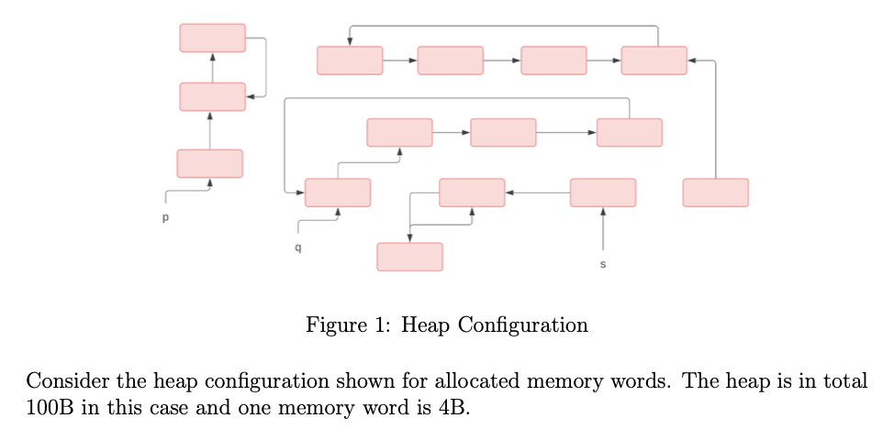
Problem 1 Description –(a)

Slide 13
Problem 1 Solution –(a)

Slide 14
Problem 1 Description –(b)

Slide 15
Problem 1 Solution –(b)

Slide 16
Problem 1 Description –(c)

Slide 17
Problem 1 Solution –(c)
Reference Counting: 16B, Mark and Sweep: 0B

Slide 18
Problem 1 Description –(d)

Slide 19
Problem 1 Solution –(d)
It will traverse the reference graph which will cover all reachable cells and mark them in the mark step.
Any unmarked cell will be considered to be free in the sweep step

Slide 20
Problem 1 Description –(e)

Slide 21
Problem 1 Solution –(e)
Cycles are less likely to occur
Applications that should not have long pause times (e.g. real-time systems)

Slide 22

Problem 2 Description

Slide 23
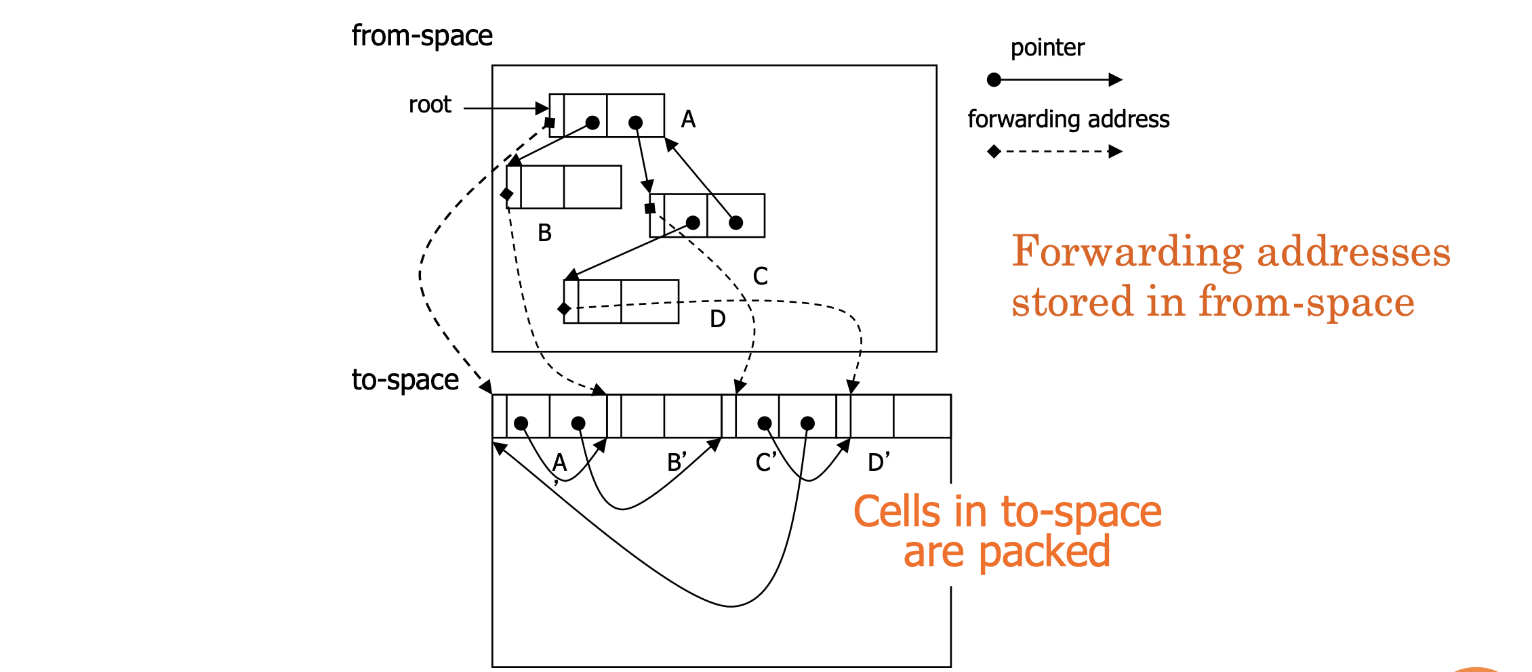
Problem 2 Solution
Even if estimating the forward addresses is possible while mapping for forward pointers.
It’s not possible to estimate for backward pointers (A is gone; need to look up the address).

Slide 24
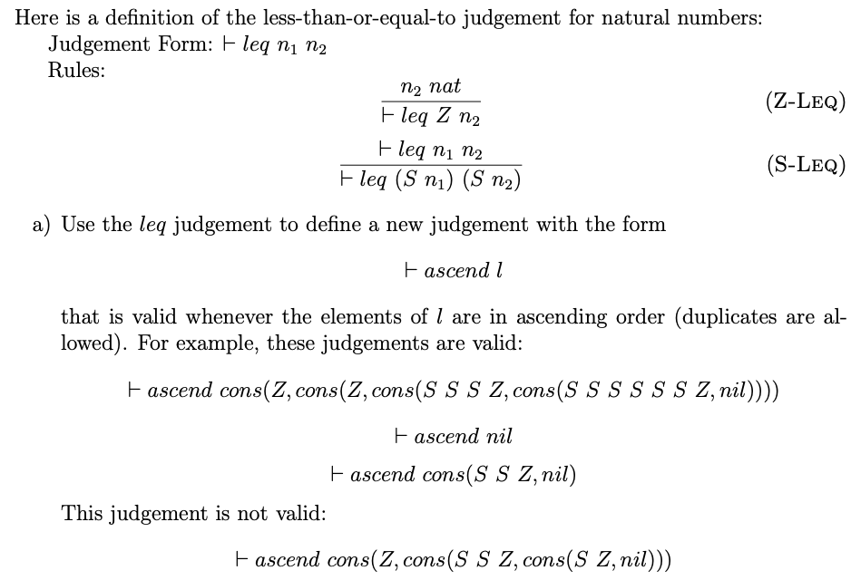
Problem 3 Description –(a)

Slide 25
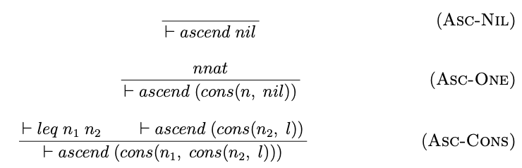
Problem 3 Solution –(a)

Slide 26
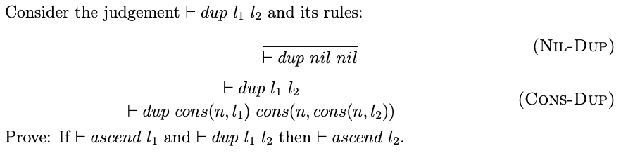
Problem 3 Description –(b)

Slide 27
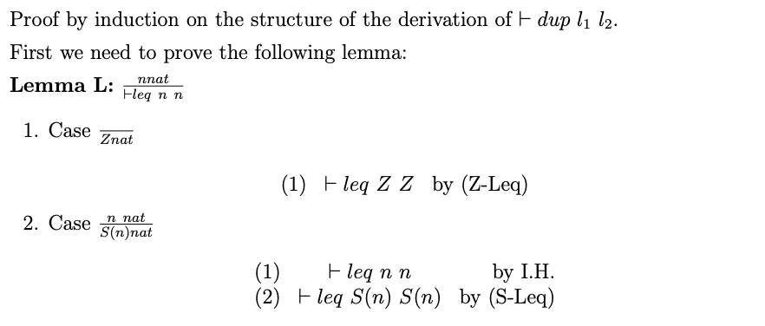
Problem 3 Solution –(b)

Slide 28
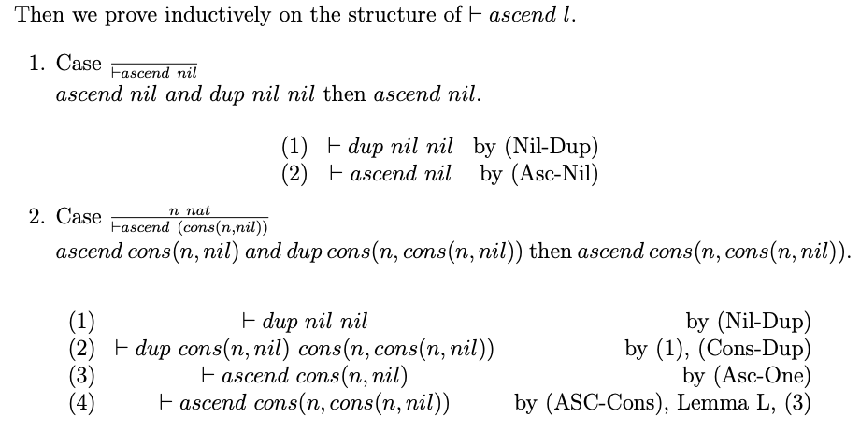
Problem 3 Solution –(b)
Ascend cons(n, nil) and dup cons(n, cons(n, nil)) then ascend cons(n, cons(n, nil))

Slide 29
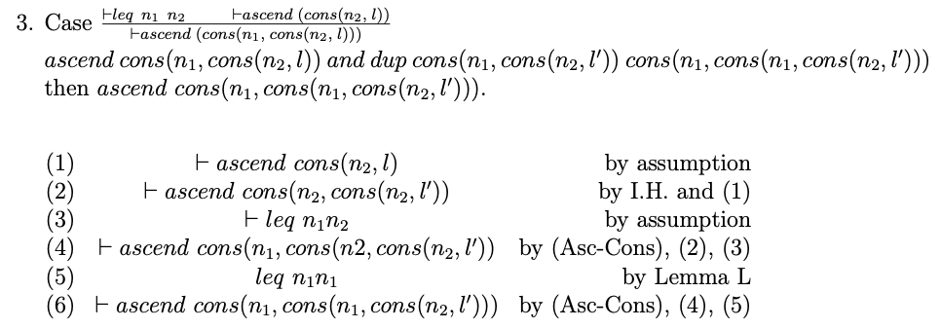
Problem 3 Solution –(b)
Ascend cons(n1, cons(n2, l)) and dup cons(n1, cons(n2, l)) cons(n1, cons(n1, cons(n2,l)))
Then ascend cons(n1, cons(n1, cons(n2,l)))

