Slide 1
Programming Language Concepts
CSE 3302 / 5307 - Dr. Kenny Zhu
Tutorial 08
Wonjun Park

Slide 2
Homework 7

Slide 3
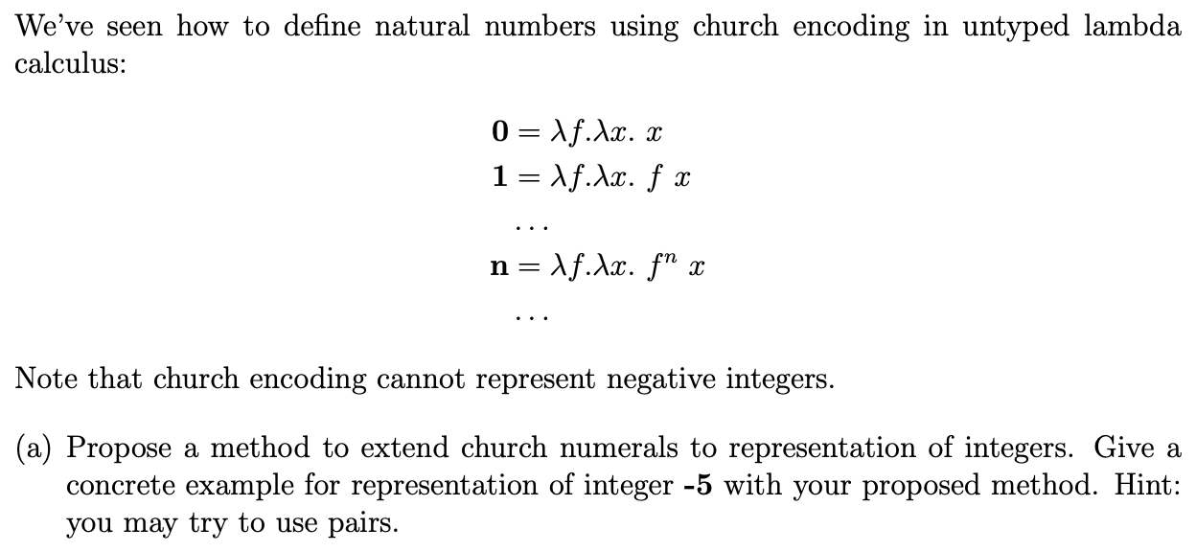
Problem 1 Description (a)

Slide 4
Problem 1 Solution (a)
n = a – b
where Pair(a,b)
z = λf x.
iszero (fst x) x
(iszero (snd x) x
(f (pair (pred (fst x)) (pred (snd x)))))
zero = fix z

Slide 5
Problem 1 Description (b)

Slide 6
Problem 1 Solution (b)

Slide 7
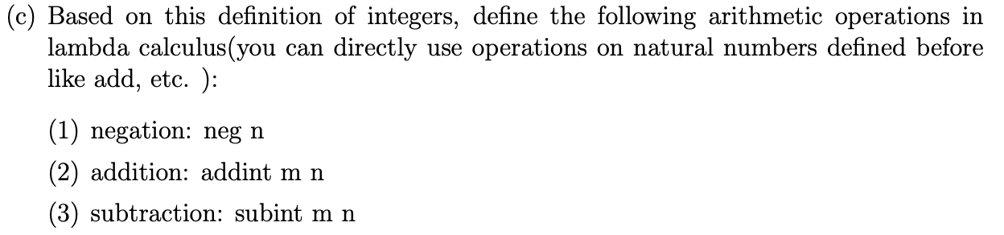
Problem 1 Description (c)

Slide 8
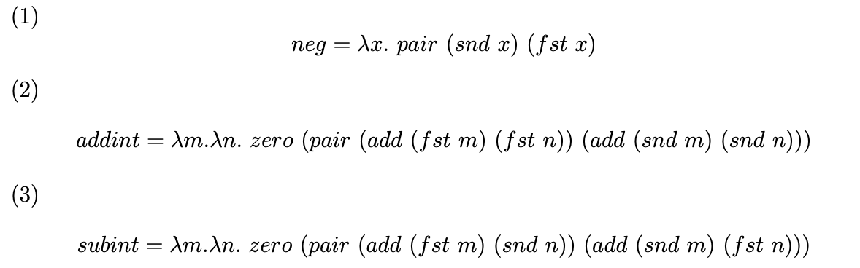
Problem 1 Solution (c)
Notes:
(2) (a−b)+(c−d)=(a+c)−(b+d)

Slide 9
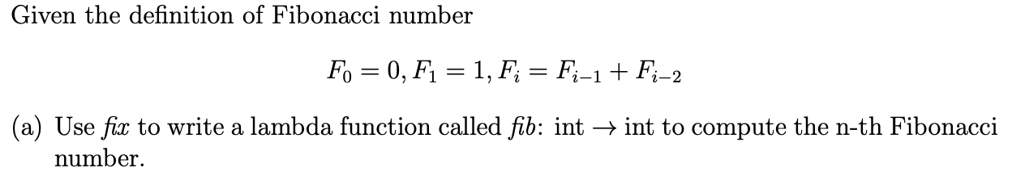
Problem 2 Description (a)

Slide 10
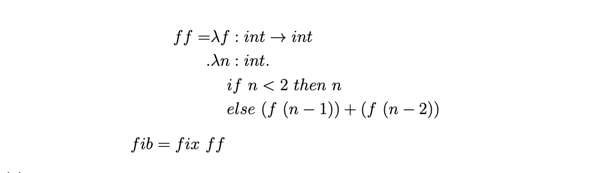
Problem 2 Solution (a)

Slide 11
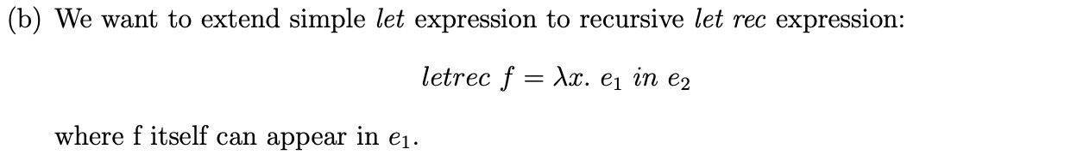
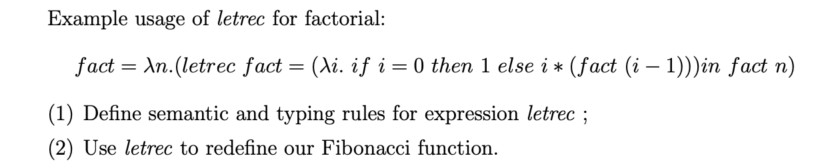
Problem 2 Description (b)

Slide 12
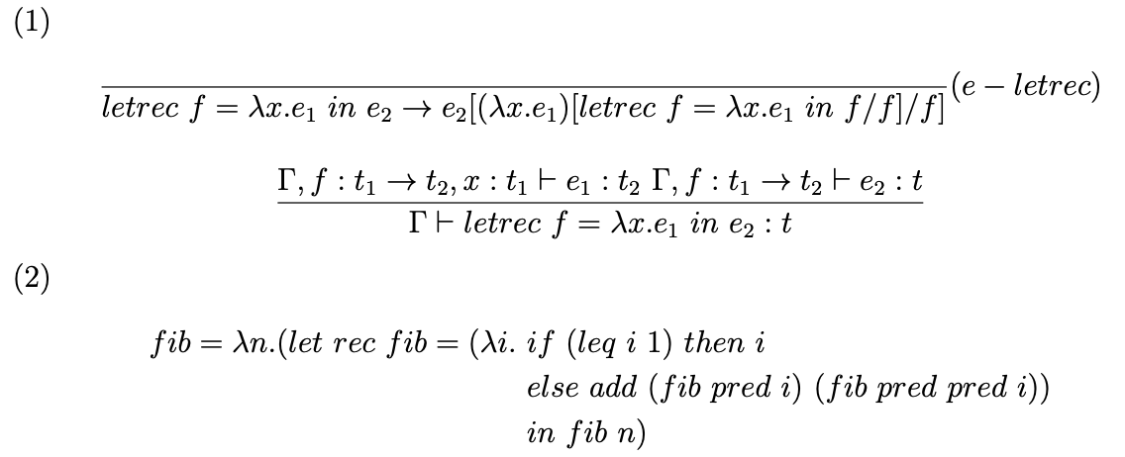
Problem 2 Solution (b)

Slide 13
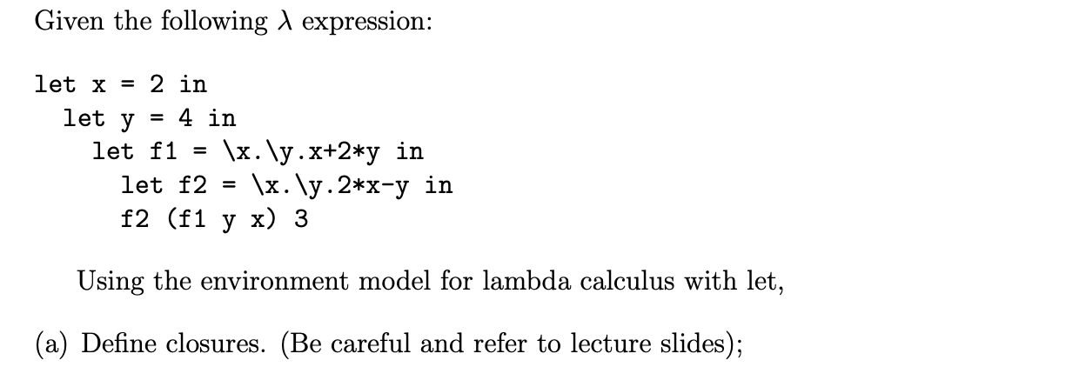
Problem 3 Description (a)

Slide 14
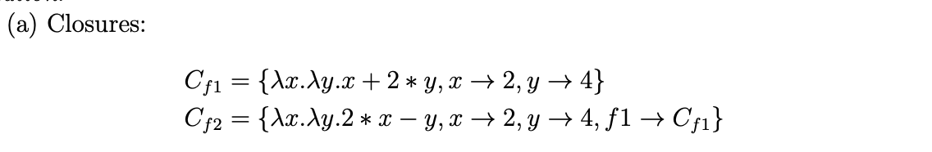
Problem 3 Solution (a)

Slide 15
Problem 3 Description (b)

Slide 16
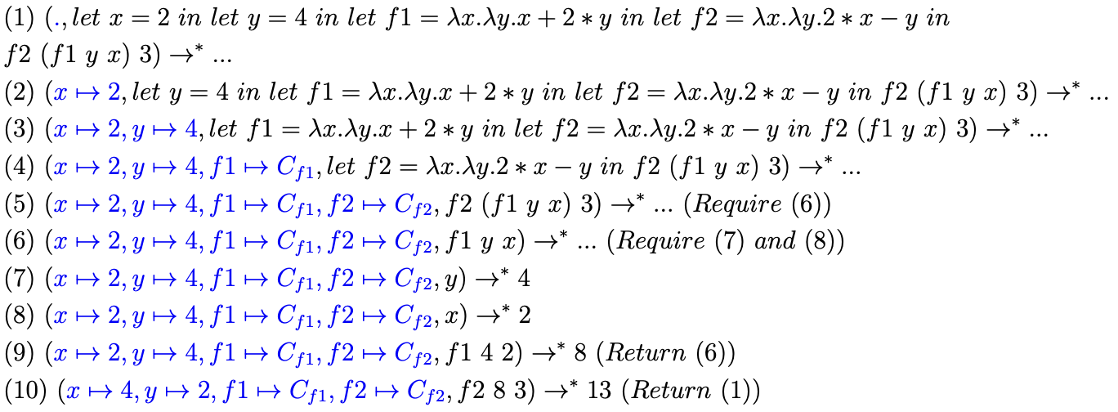
Problem 3 Solution (b)

