Slide 1
Tutorial 8
TA: Theron(Sinong)

Slide 2
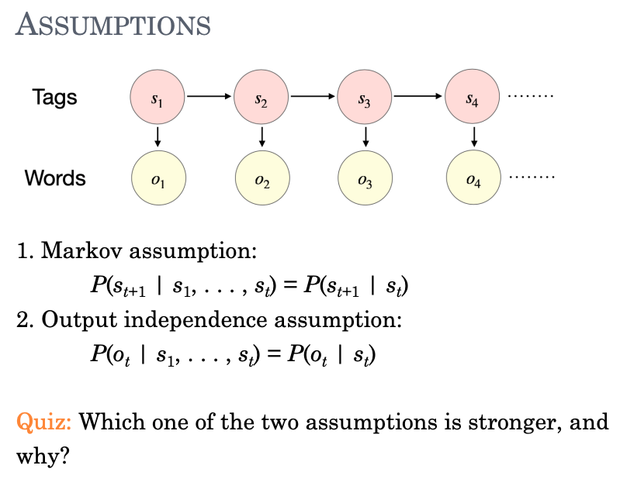
Quiz

Slide 3
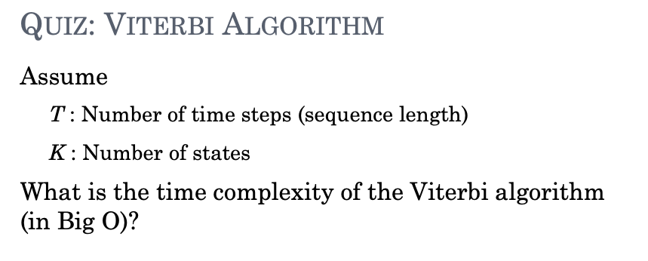

Slide 4
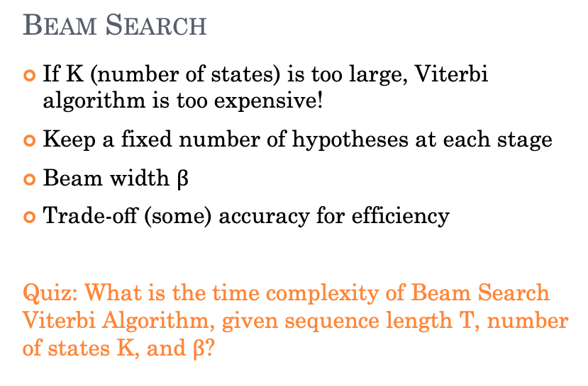

Slide 5
Homework

Slide 6
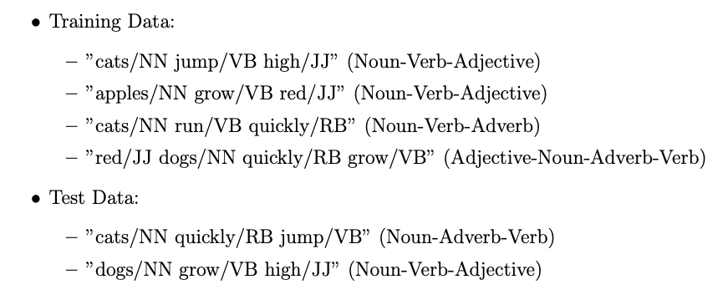
 | NN | VB | JJ | RB
NN | 0 | 0 | 1/3 | 0
VB | 3/4 | 0 | 0 | 1/2
JJ | 0 | 1/2 | 0 | 0
RB | 1/4 | 1/4 | 0 | 0
P(‘cats’|NN) = ½, P(‘apples’|NN) = ¼, P(‘dogs’|NN) = ¼
P(‘grow’|V) = ½, P(‘jump’|V) = ¼, P(‘run’|V) = ¼
P(‘high’|JJ) = 1/3, P(’red’|JJ)=2/3
P(‘quickly|RB) = 1
P(t1=NN) = 3/4, P(t1=JJ) = ¼, P(t1=VB) = 0, P(t1=RB) = 0

Slide 7
 | NN | VB | JJ | RB
NN | 0 | 0 | 1/3 | 0
VB | 3/4 | 0 | 0 | 1/2
JJ | 0 | 1/2 | 0 | 0
RB | 1/4 | 1/4 | 0 | 0
P(‘cats’|NN) = ½, P(‘apples’|NN) = ¼, P(‘dogs’|NN) = ¼
P(‘grow’|V) = ½, P(‘jump’|V) = ¼, P(‘run’|V) = ¼
P(‘high’|JJ) = 1/3, P(’red’|JJ)=2/3
P(‘quickly|RB) = 1
P(t1=NN) = 3/4, P(t1=JJ) = ¼, P(t1=VB) = 0, P(t1=RB) = 0
NN | 3/8 | 0 | 0
VB | 0 | 0 | 3/192
JJ | 0 | 0 | 0
RB | 0 | 3/24 | 0
 | cats | quickly | jump

Slide 8
 | NN | VB | JJ | RB
NN | 0 | 0 | 1/3 | 0
VB | 3/4 | 0 | 0 | 1/2
JJ | 0 | 1/2 | 0 | 0
RB | 1/4 | 1/4 | 0 | 0
P(‘cats’|NN) = ½, P(‘apples’|NN) = ¼, P(‘dogs’|NN) = ¼
P(‘grow’|V) = ½, P(‘jump’|V) = ¼, P(‘run’|V) = ¼
P(‘high’|JJ) = 1/3, P(’red’|JJ)=2/3
P(‘quickly|RB) = 1
P(t1=NN) = 3/4, P(t1=JJ) = ¼, P(t1=VB) = 0, P(t1=RB) = 0
NN | 3/16 | 0 | 0
VB | 0 | 9/128 | 0
JJ | 0 | 0 | 3/256
RB | 0 | 0 | 0
 | dogs | grow | high

Slide 9




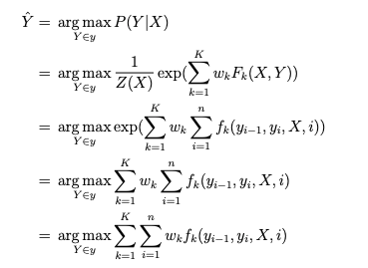

Slide 10
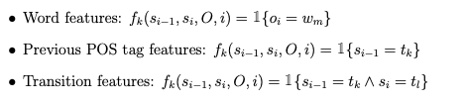
f_0(o_i) = 1 if o_i == ‘cats’ else 0
f_1(o_i) = 1 if o_i == ‘dogs’ else 0
…
f_9(s_i-1) = 1 if s_i-1 == NN else 0
…
f_13(s_i-1, si) = 1 if s_i-1 == NN and s_i == NN else 0
…
F_28…

Slide 11
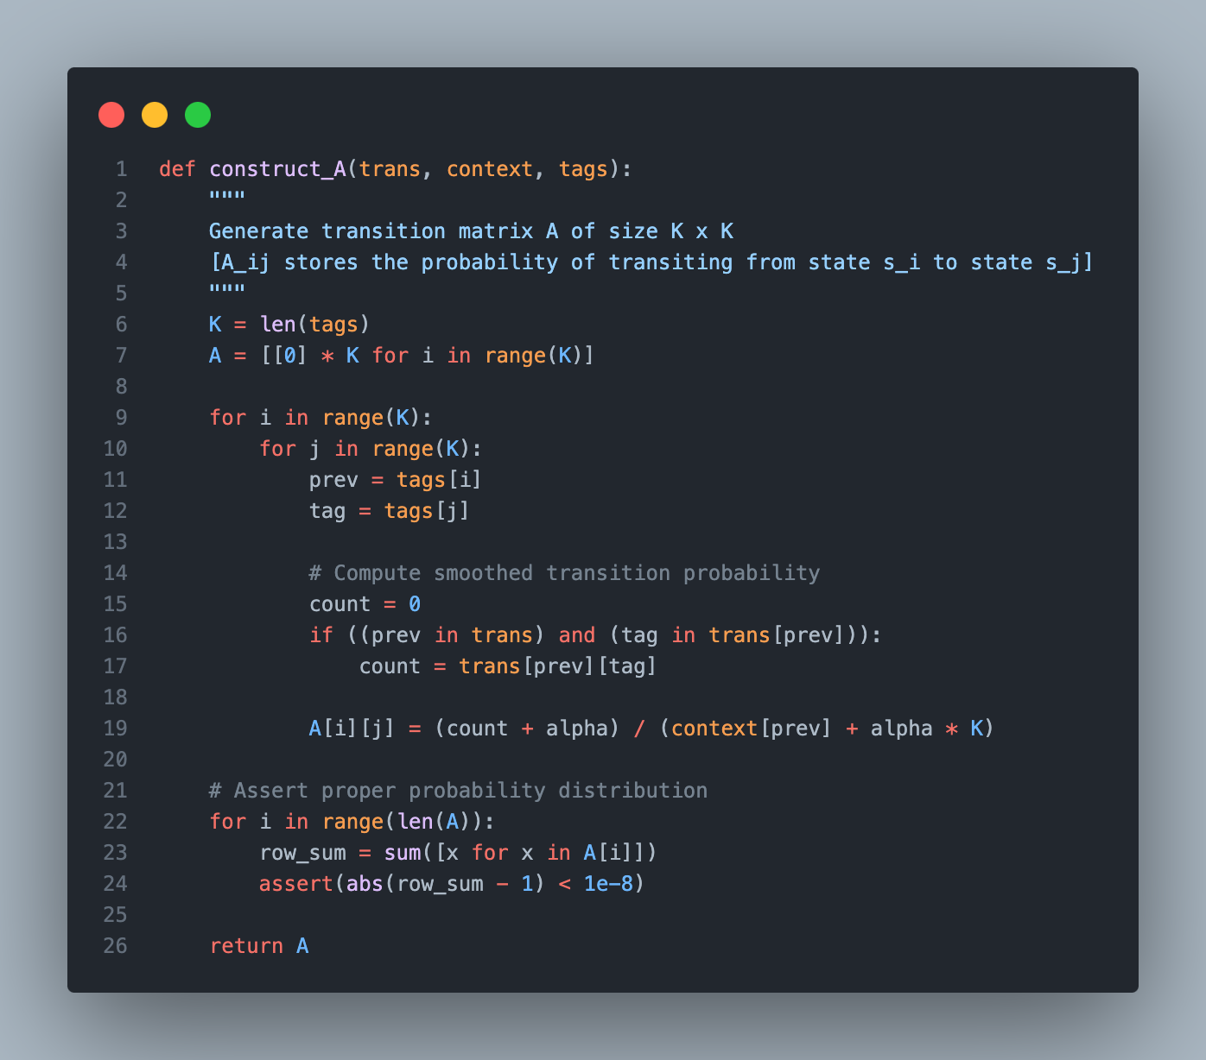

Slide 12
