Slide 1
Tutorial-3
TA Sinong

Slide 2
Quiz3

Slide 3
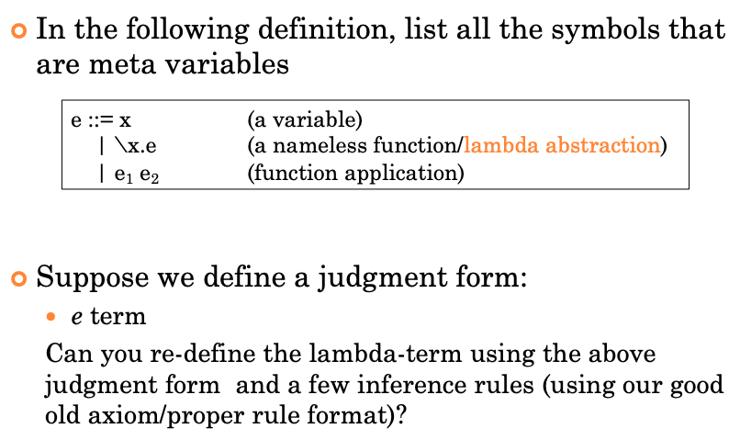
Question1
x, e, e15, e2 are mate variables
x term e term e1 term e2 term s
x term \x.e term e1 e52 term

Slide 4
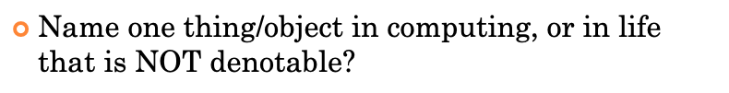
Question2
Time, Atom, Truth, Energy, ..., something is indivisible

Slide 5
Question3
Why don’t we make changes to \x.e1 when substituting e for x ?
\x.e1[e/x], \x.e1[[e/x]]
x in the e1 is binded

Slide 6
Homework-4

Slide 7

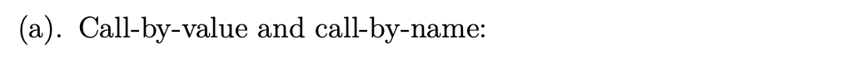
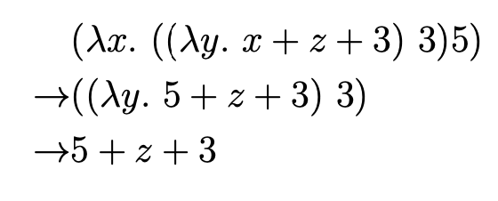
Problem-1

Slide 8

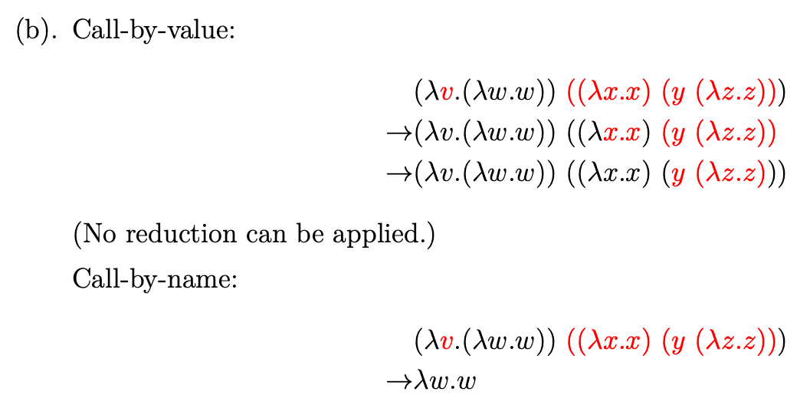
Problem-1

Slide 9

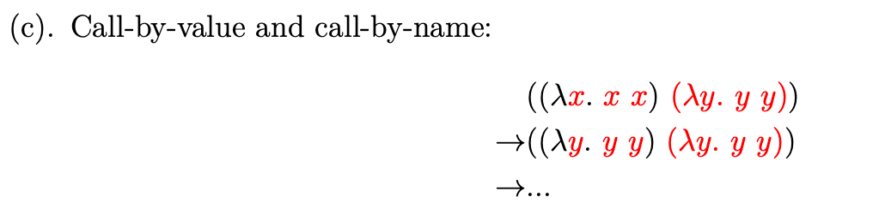
Problem-1

Slide 10

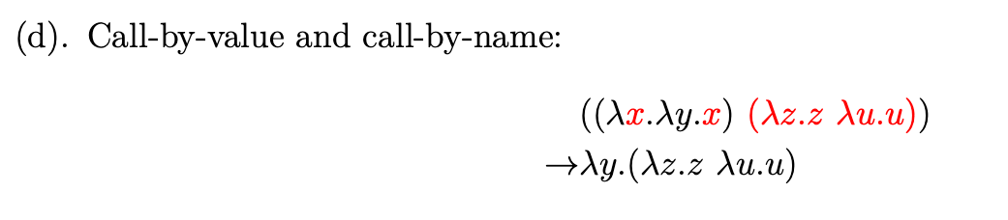
Problem-1

Slide 11
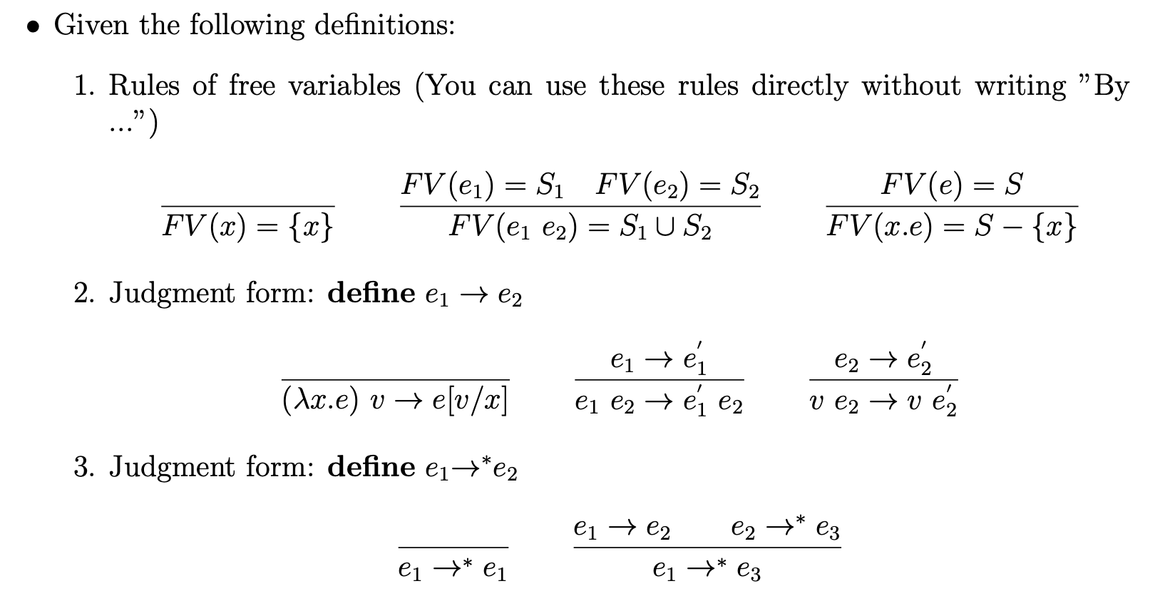
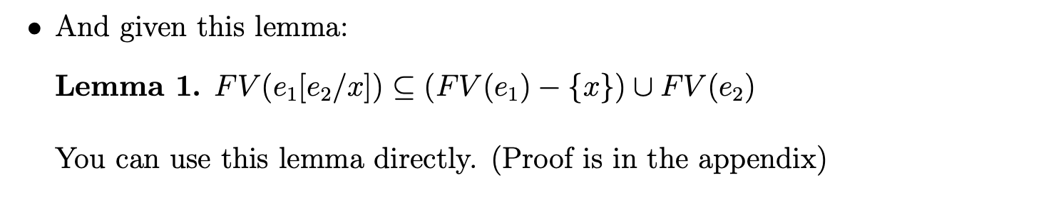

Slide 12
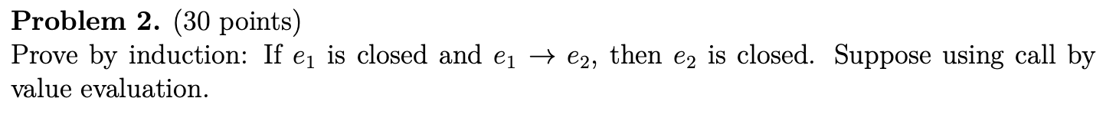
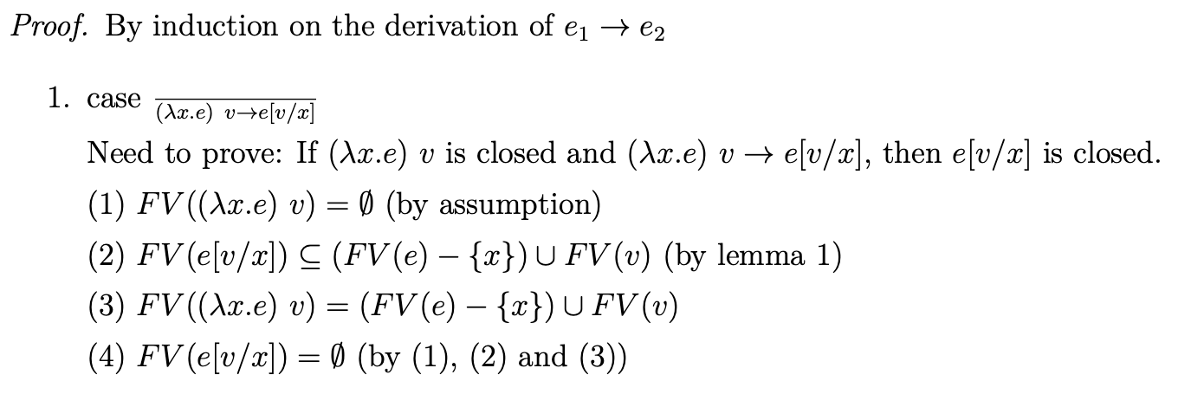
Problem-2

Slide 13
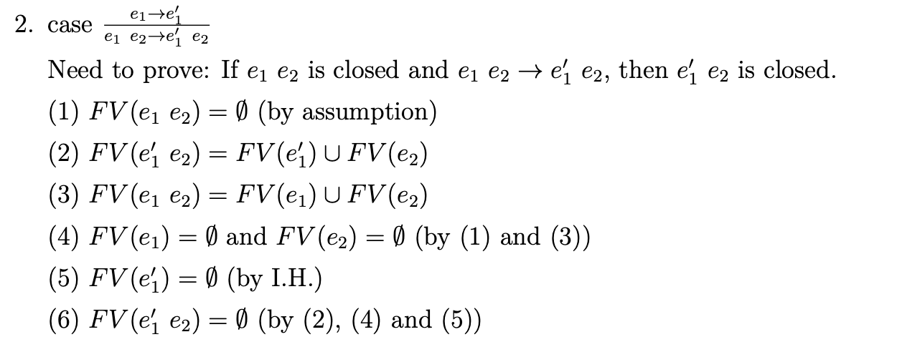
Problem-2

Slide 14
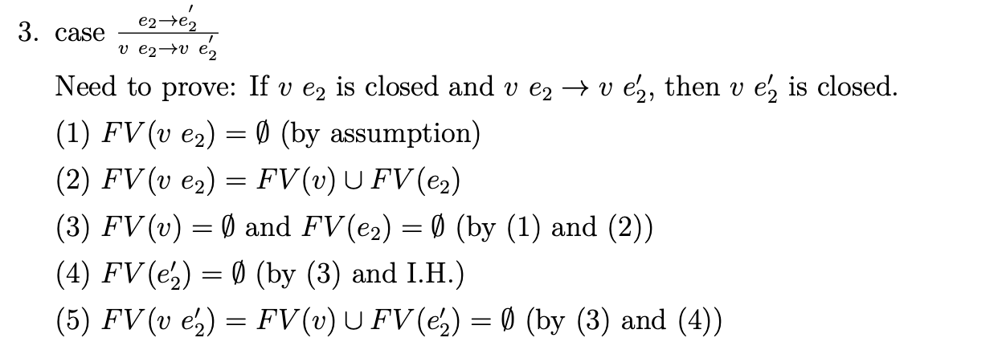
Problem-2

Slide 15
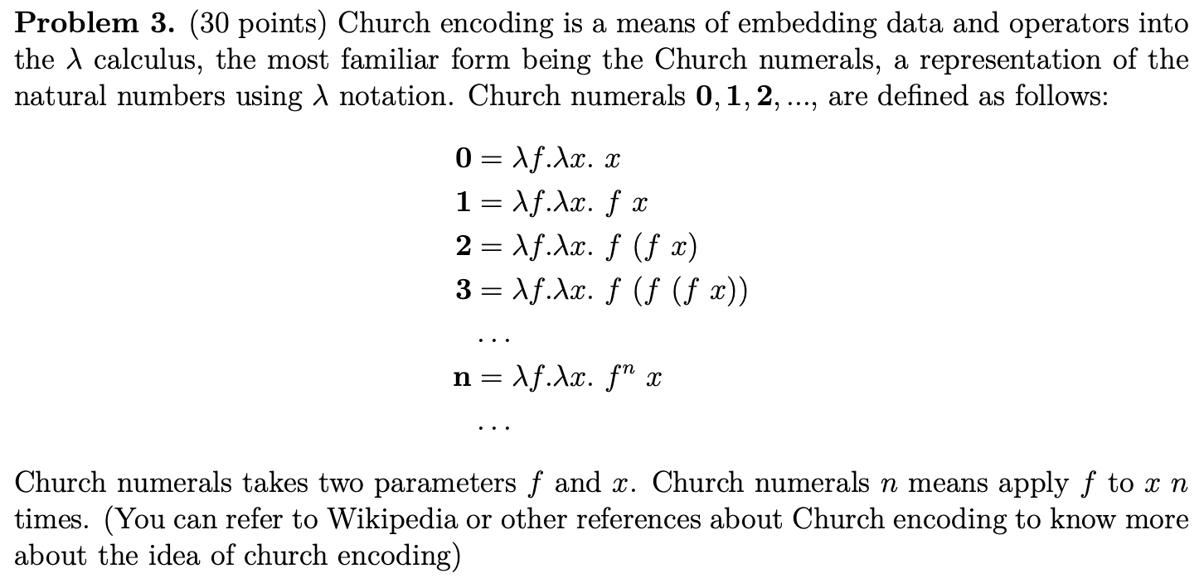
Problem-3

Slide 16
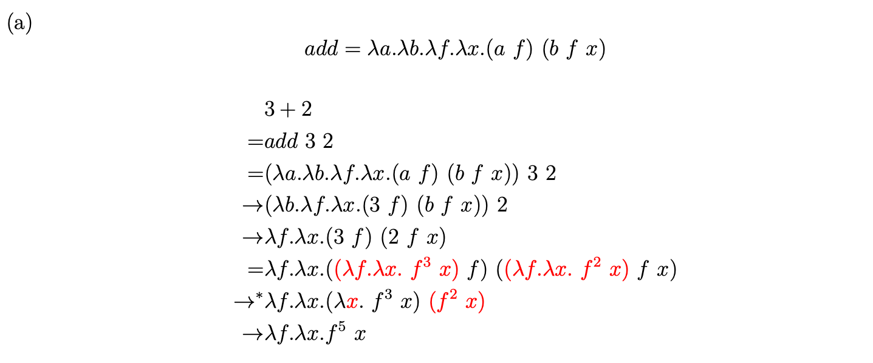
Problem-3

Slide 17
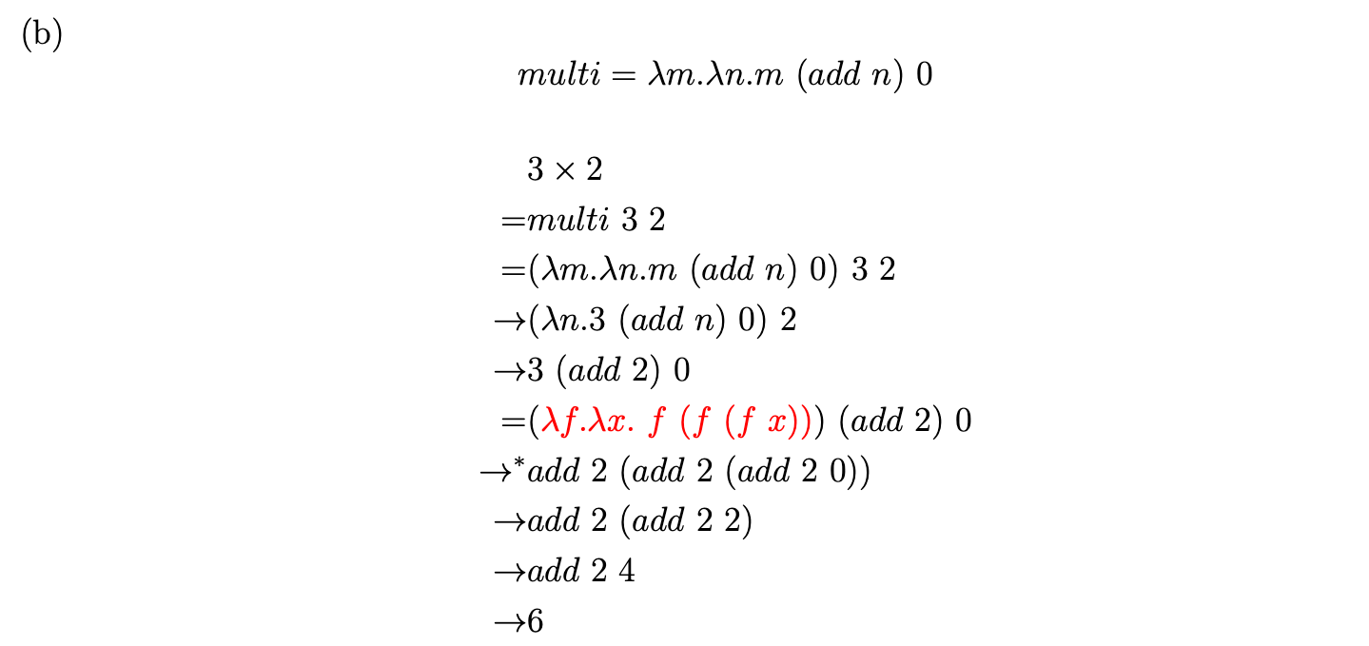
Problem-3

Slide 18
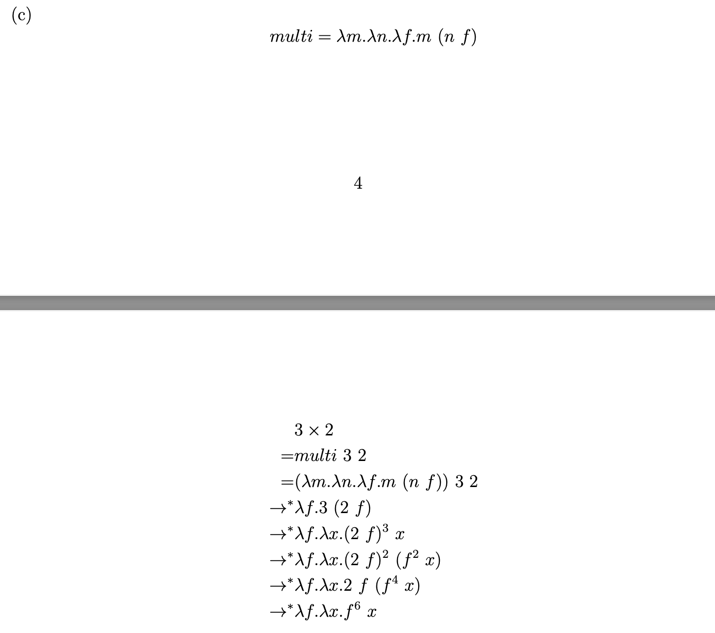
Problem-3

Slide 19
Remark
Please email .pdf file to TA
Please rename your file
Format:HW_{x}_{firstname}_{10digitID}.pdf
Example:HW_3_Sinong_1001001000.pdf

