Slide 1
Tutorial 10
Quiz 12, 13 & HW 9
Presenter: Peter​ Zhang
4/8/2026

Slide 2

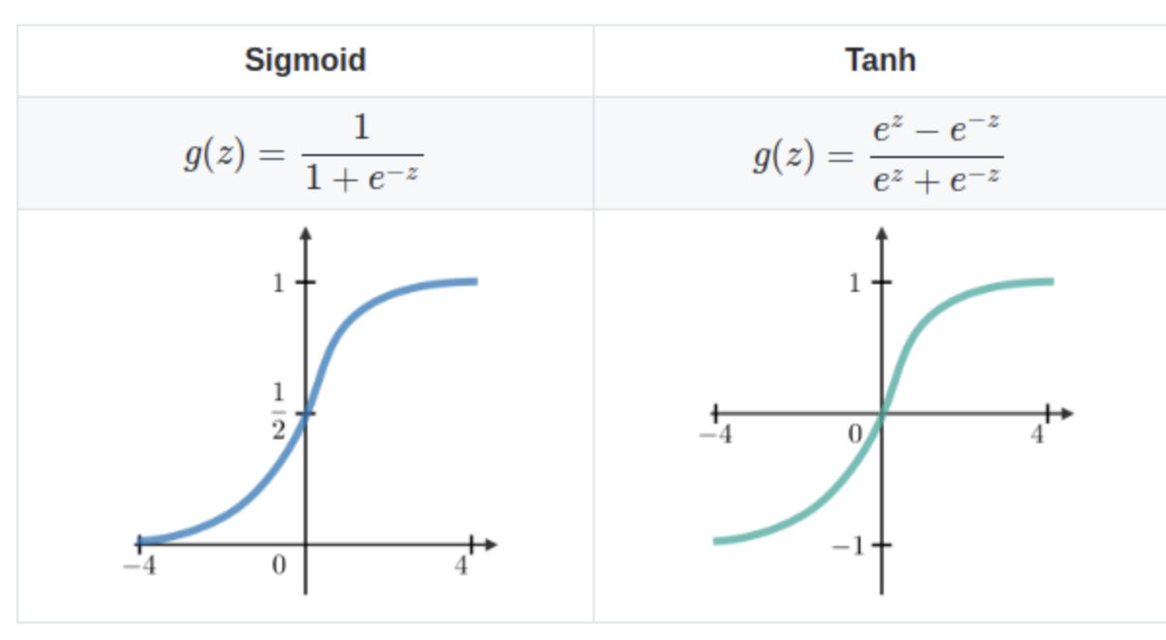

Slide 3
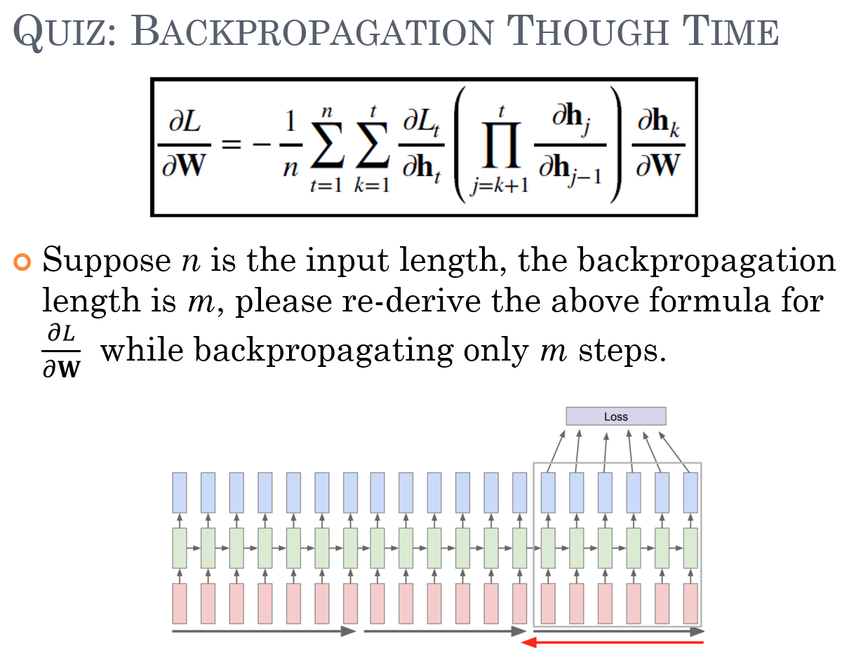


Slide 4
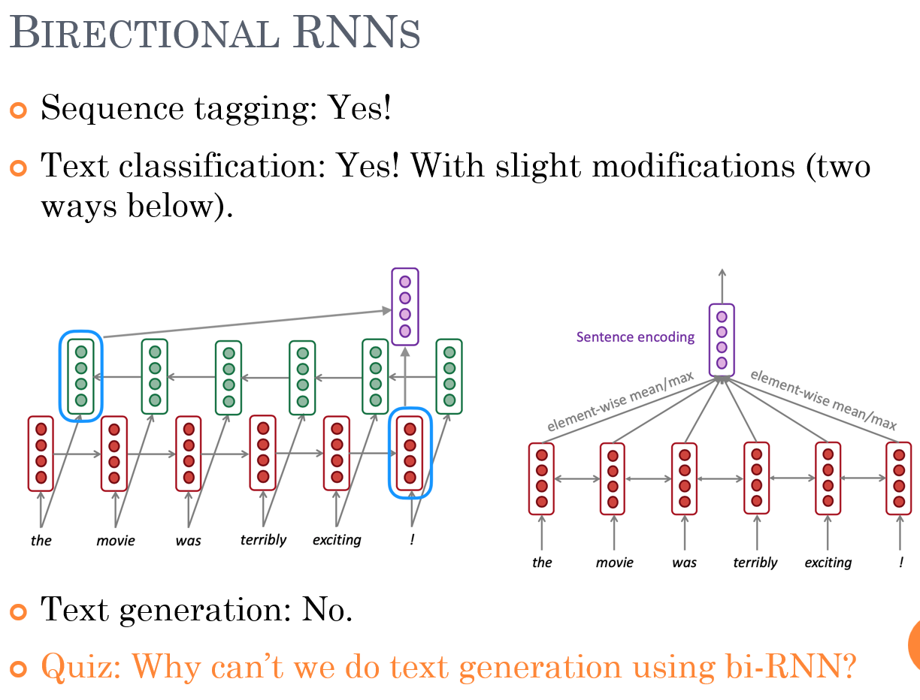

Slide 5







Slide 6


Slide 7
Thank You

