Slide 1
Tutorial-7
TA Sinong

Slide 2
Quiz-6

Slide 3
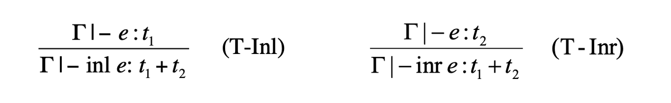
1. What is the problem with T-Inl and T-Inr?

Slide 4
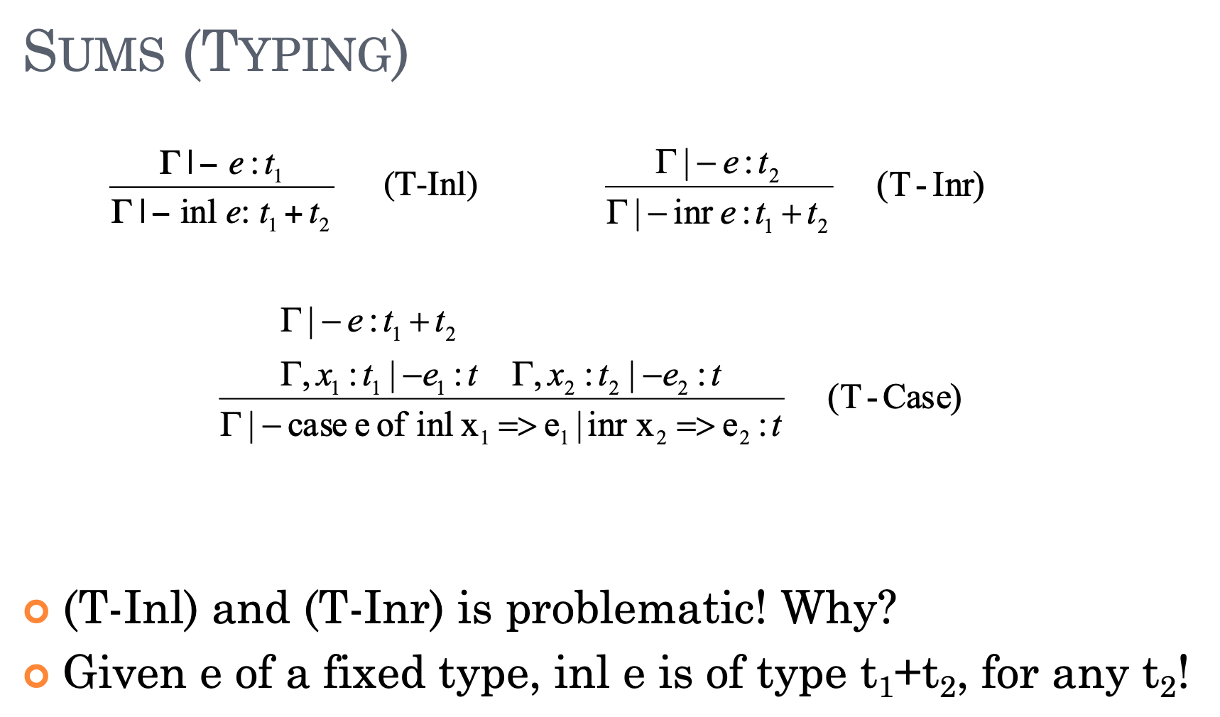
1. What is the problem with T-Inl and T-Inr?
Given e of a fixed type, inl e is of type t₁+t₂, for any t₂!

Slide 5
2. Which is the Evaluation Strategy of fix ?
fix = \f. (\x. f (\y. x x y)) (\x. f (\y. x x y))
Call-by-value
Call-by-name
Normal order
Full beta-reduction

Slide 6
2. Which is the Evaluation Strategy of fix ?
fix = \f. (\x. f (\y. x x y)) (\x. f (\y. x x y))
Call-by-value
Call-by-name
Normal order
Full beta-reduction

Slide 7
3. Write down the evaluation rule of fix

Slide 8
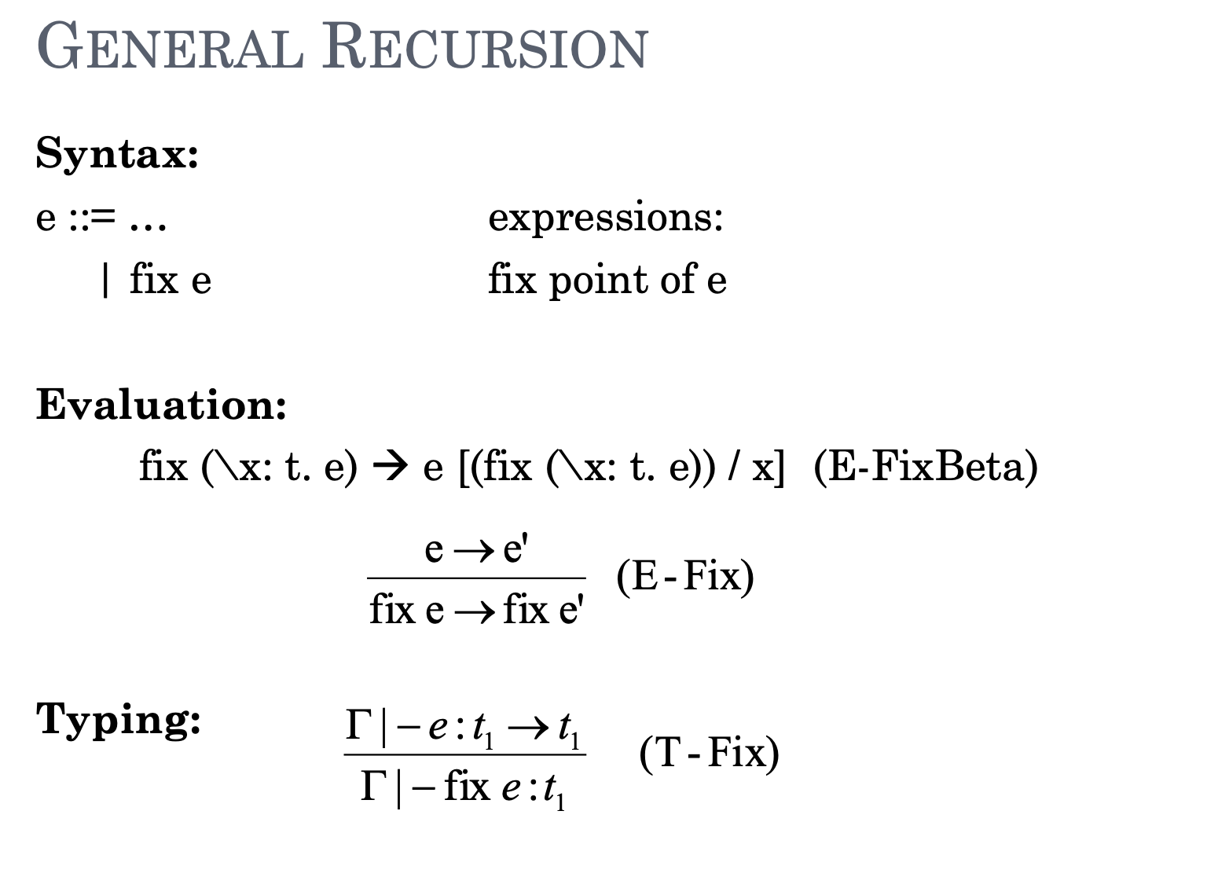
3. Write down the evaluation rule of fix

Slide 9
4. What are the head and tail of list : 1::(2::(3::(4::nil))) ?

Slide 10
4. What are the head and tail of list : 1::(2::(3::(4::nil))) ?
Head: 1
Tail: 2::3::4::nil

Slide 11
5. Which rule is incorrect about list evaluation?

Slide 12
5. Which rule is incorrect about list evaluation?

Slide 13
6. Which one is not a list value according to the definition of list ?
Nil
1::2::3
1::2::3::nil
None of the above

Slide 14
6. Which one is not a list value according to the definition of list ?
Nil
1::2::3
1::2::3::nil
None of the above

Slide 15
Homework-6

Slide 16
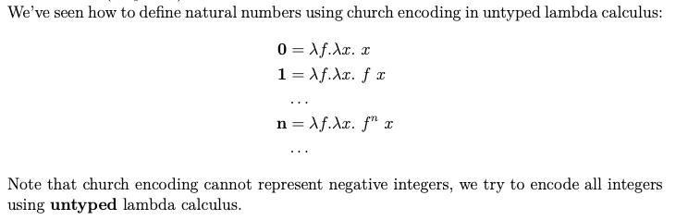
Problem-1

Slide 17

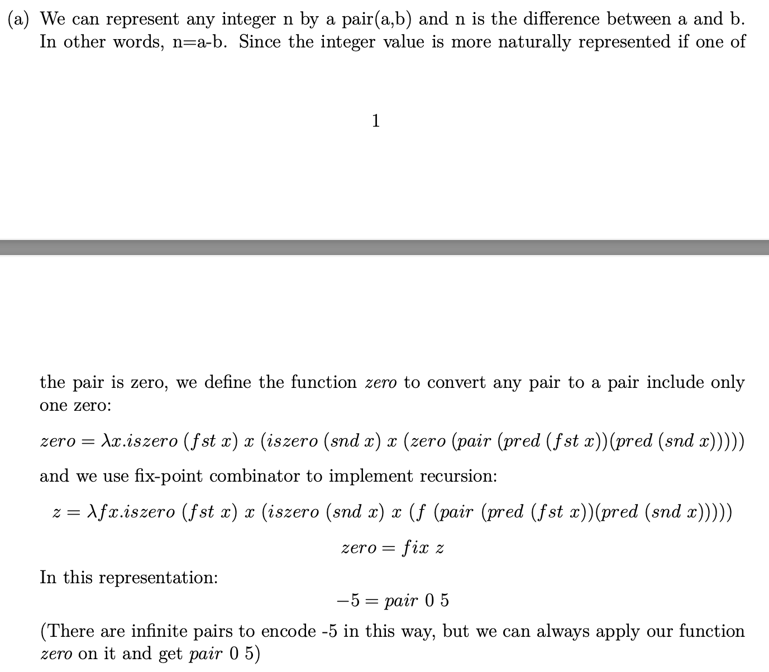
Problem-1

Slide 18
Problem-1

Slide 19
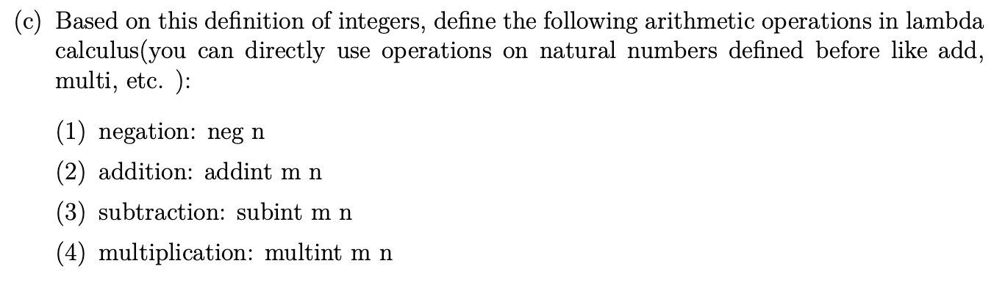
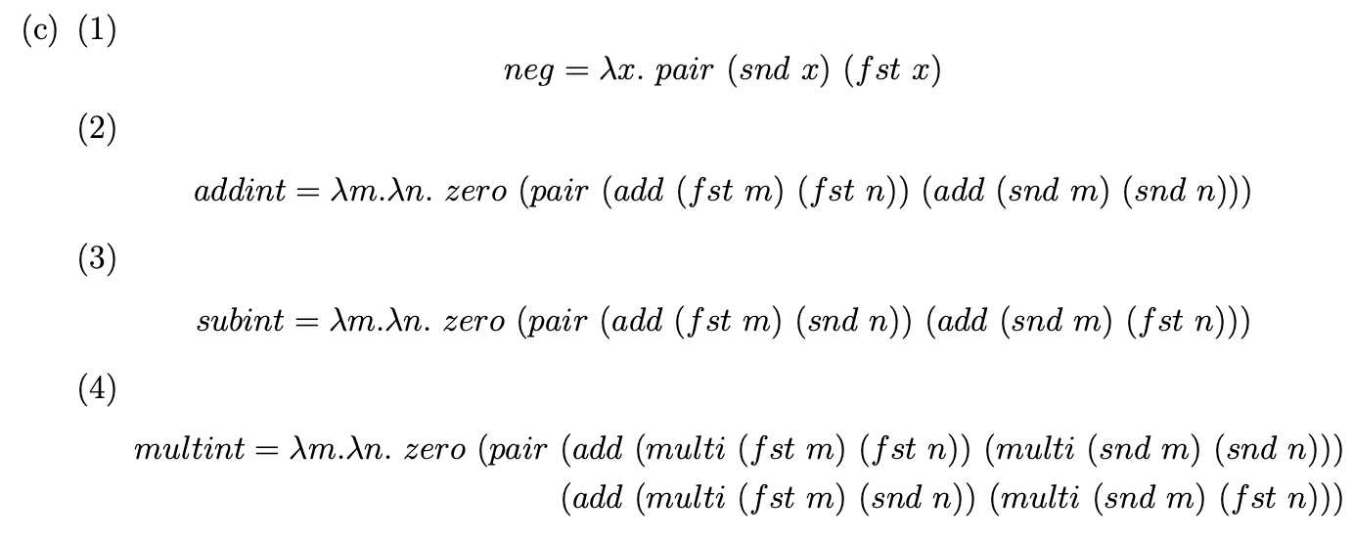
Problem-1

Slide 20
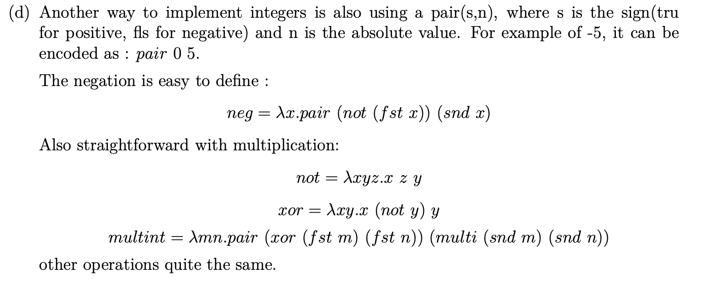
Problem-1

Slide 21
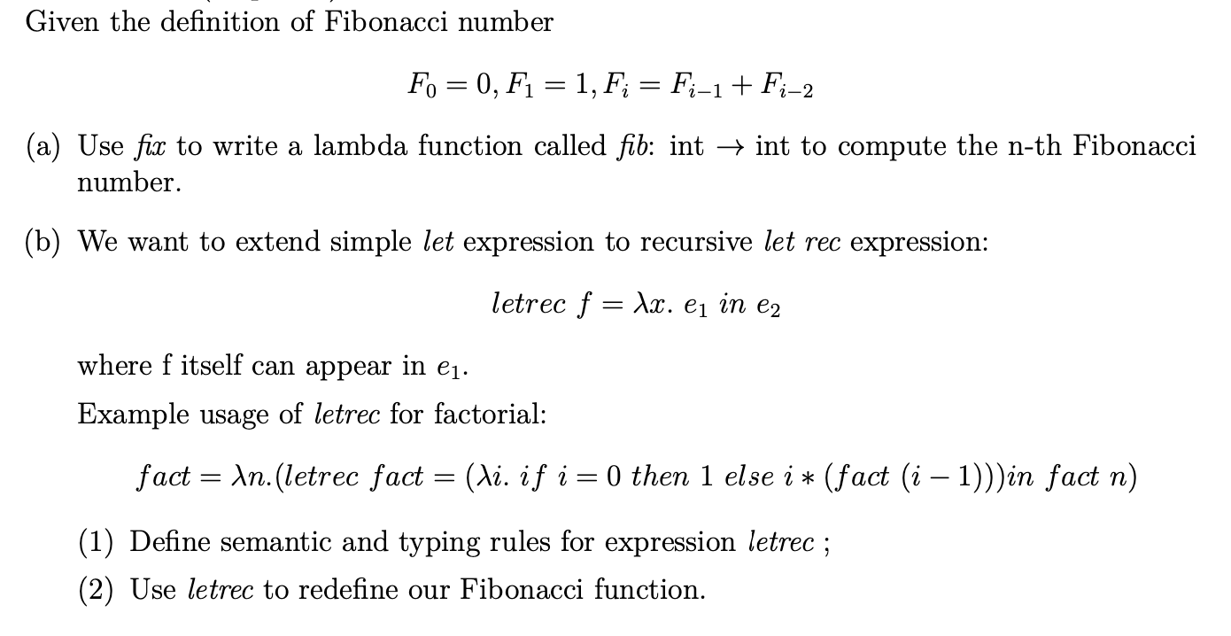
Problem-2

Slide 22
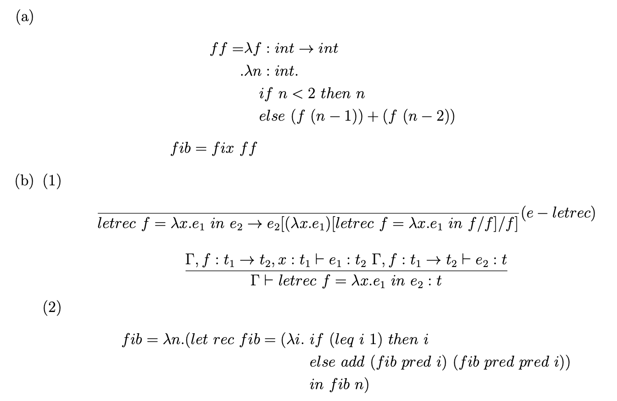
Problem-2

Slide 23
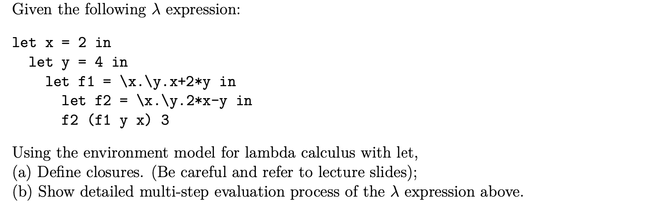
Problem-3

Slide 24
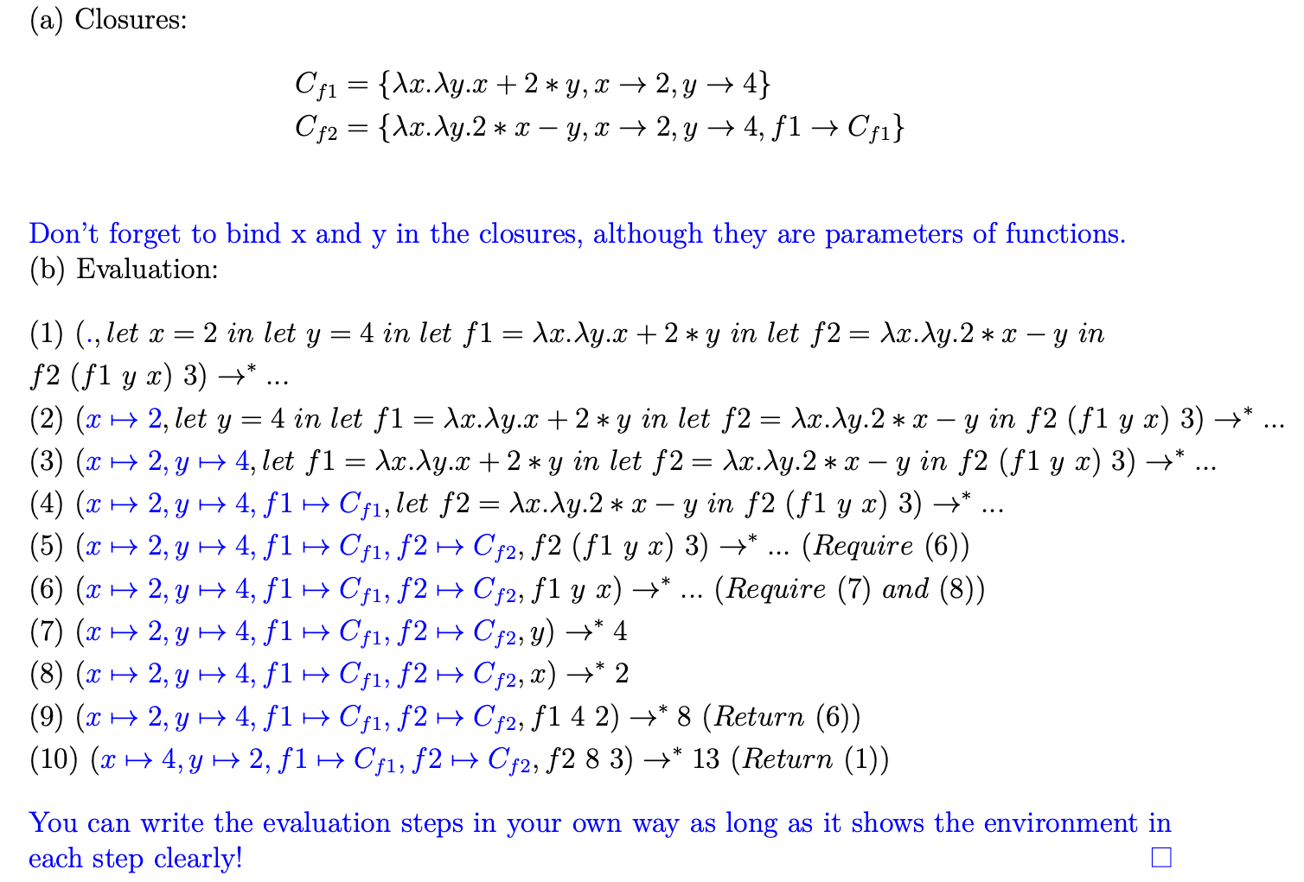
Problem-3

