Slide 1




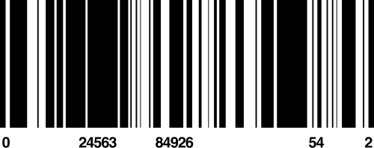
LET’S TRAVEL
AIRLINE RESERVATION SYSTEM
AHMED MOHAMED: 24-101481
LILA MOSTAFA: 24-101455
JANA AHMED: 24-101145
MARIAM MAHMOUD: 24-101348
AHMED HESHAM: 24-101531
KENZY ELBOROLLOSY: 24-101524

Slide 2
CONTRIBUTION
AHMED MOHAMED:
GUI/BRIDGE
LILA MOSTAFA:
USER CLASS/SYSTEM MANAGER CLASS/UML
JANA AHMED:
ADMIN CLASS/UML
MARIAM MAHMOUD:
PASSENGER CLASS/PRESENTATION
AHMED HESHAM:
FILE HANDLING/MAIN/AUTHSYSTEM
KENZY ELBOROLLOSY:
FLIGHT/LUGGAGES/TICKET/SUPERADMIN
USERFACTORY/DEBUGGING/MAIN/TESTING/
COMMENTS

Slide 3
PROJECT OVERVIEW
THE AIRLINE RESERVATION SYSTEM IS A CONSOLE-BASED OBJECT-ORIENTED DATA MANAGEMENT SYSTEM DEVELOPED IN C++.
WHAT DOES IT DO
WHO USES IT
DATA PRESISTENCE
A fully console-based airline reservation platform where passengers can register, log in, browse flights, book seats, manage luggage, and cancel tickets
Three user roles: Passenger, Admin, and SuperAdmin — each with distinct permissions and a dedicated menu.
All data is saved to and loaded from CSV files
via FileManager, so the system state survives program restarts.

Slide 4
PROJECT OBJECTIVES
OBJECTIVES
  BUILD A REAL-WORLD AIRLINE RESERVATION SYSTEM
  Apply OBJECT-ORIENTED PROGRAMMING CONCEPTS
  USE DESIGN PATTERNS FOR BETTER ARCHITECTURE
  IMPLEMENT FILE HANDLING FOR PERSISTENT DATA
  CREATE MODULAR AND MAINTAINABLE CODE

Slide 5
SYSTEM FUNCTIONALITY
FUNCTIONAL:
  PASSENGER SIGNUP, LOGIN, AND PROFILE
  BROWSE AND SEARCH AVAILABLE FLIGHTS
  BOOK SEATS (ECONOMY / BUSINESS CLASS)
  ADD CABIN & CHECKED LUGGAGE PER TICKET CANCEL INDIVIDUAL TICKETS OR FULL FLIGHTS
  ADMIN: ADD/CANCEL FLIGHTS, EDIT PASSENGERS
  SUPERADMIN: MANAGE ADMINS, FACTORY RESET SAVE & LOAD ALL DATA VIA CSV FILES
NON-FUNCTIONAL:
  ROLE-BASED ACCESS CONTROL
(3 LEVELS)
  PASSWORD PROTECTION FOR ALL ROLES
  MAX 3 LOGIN ATTEMPTS BEFORE LOCKOUT
  SEAT VALIDATION
  CASE-INSENSITIVE SEAT INPUT
  DUPLICATE ID DETECTION ON REGISTRATION
  MEMORY SAFETY (NO DANGLING POINTERS)
  ITERATOR-SAFE TICKET REMOVAL

Slide 6
MAIN CLASSES
USER (ABSTRACT BASE CLASS)
Passenger/Admin
LUGGAGE
HandlES BAGGAGE DETAILS
FLIGHT
ManagES SEATS AND FLIGHT DATa
SYSTEMManagER
CONTROLS THE ENTIRE SYSTEM
SUPERADMIN
MANAGES ADMINS
TICKET
HandlES BOOKING INFORMATION
SYSTEM ARCHITECTURE

Slide 7

POLYMORPHISM
  Virtual functions:
displayInfo() // getType()
  RUNTIME POLYMORPHISM
INHERITANCE
  Passenger and Admin inherit from User
OOP PRINCIPLES
ENCAPSULATION
  Private/protected members
  Access through getters/setters
ABSTRACTION
  User class implemented as abstract class

Slide 8

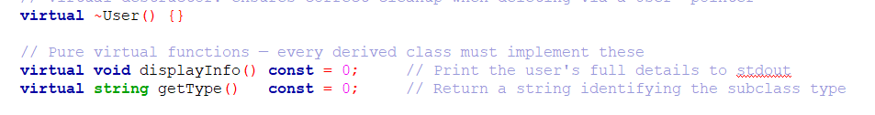
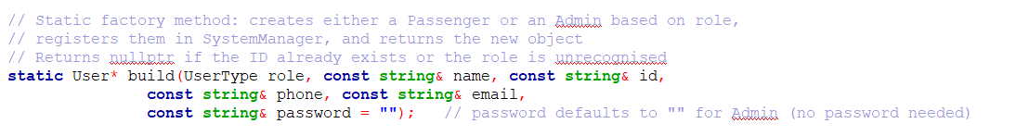

POLYMORPHISM
Virtual functions:
displayInfo() // getType()
ABSTARCTION

Slide 9
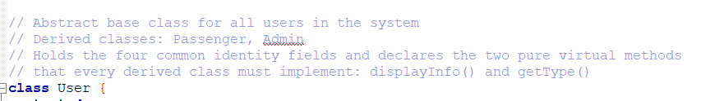
INHERITANCE
Passenger and Admin inherit from User

Slide 10
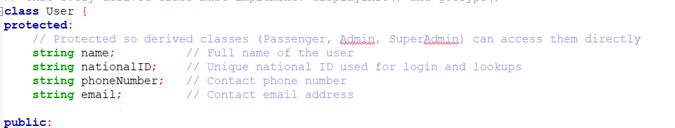
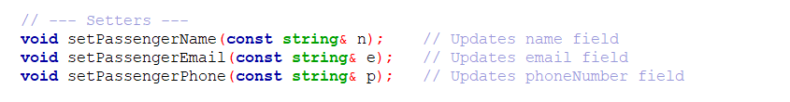
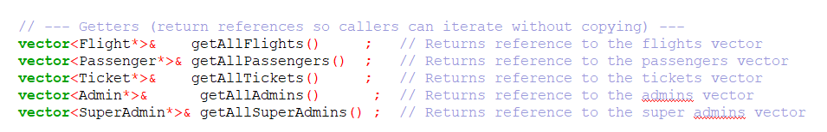
ENCAPSULATION
  Private/protected members
  Access through getters/setters

Slide 11
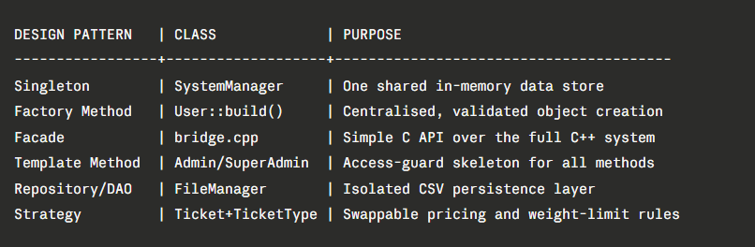
DESIGN PATTERNS
Adaptor

Slide 12
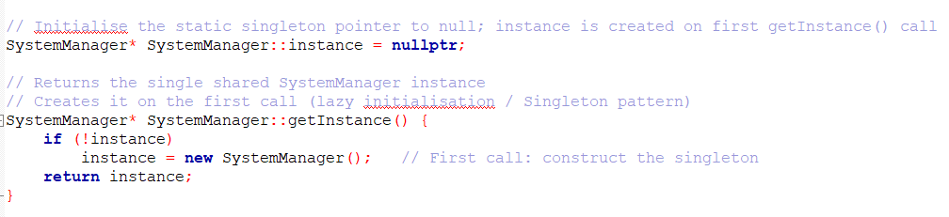
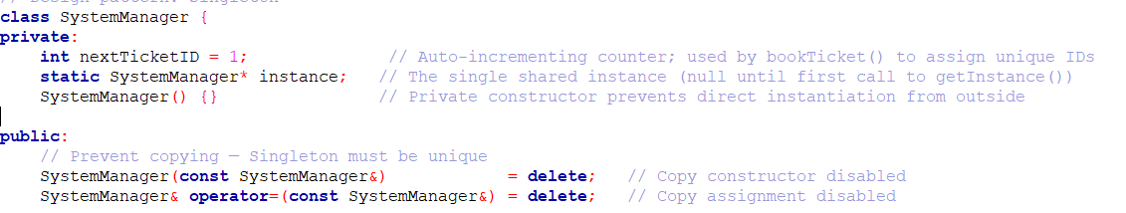
SINGLETON

Slide 13
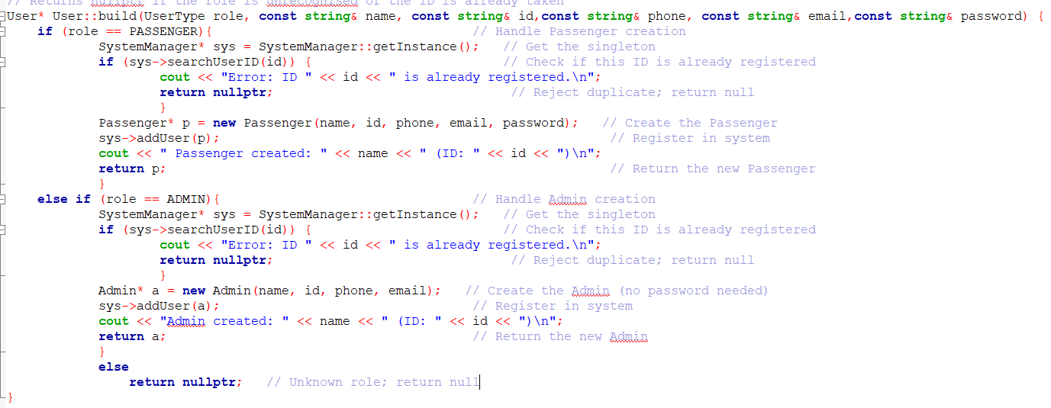
FACTORY

Slide 14
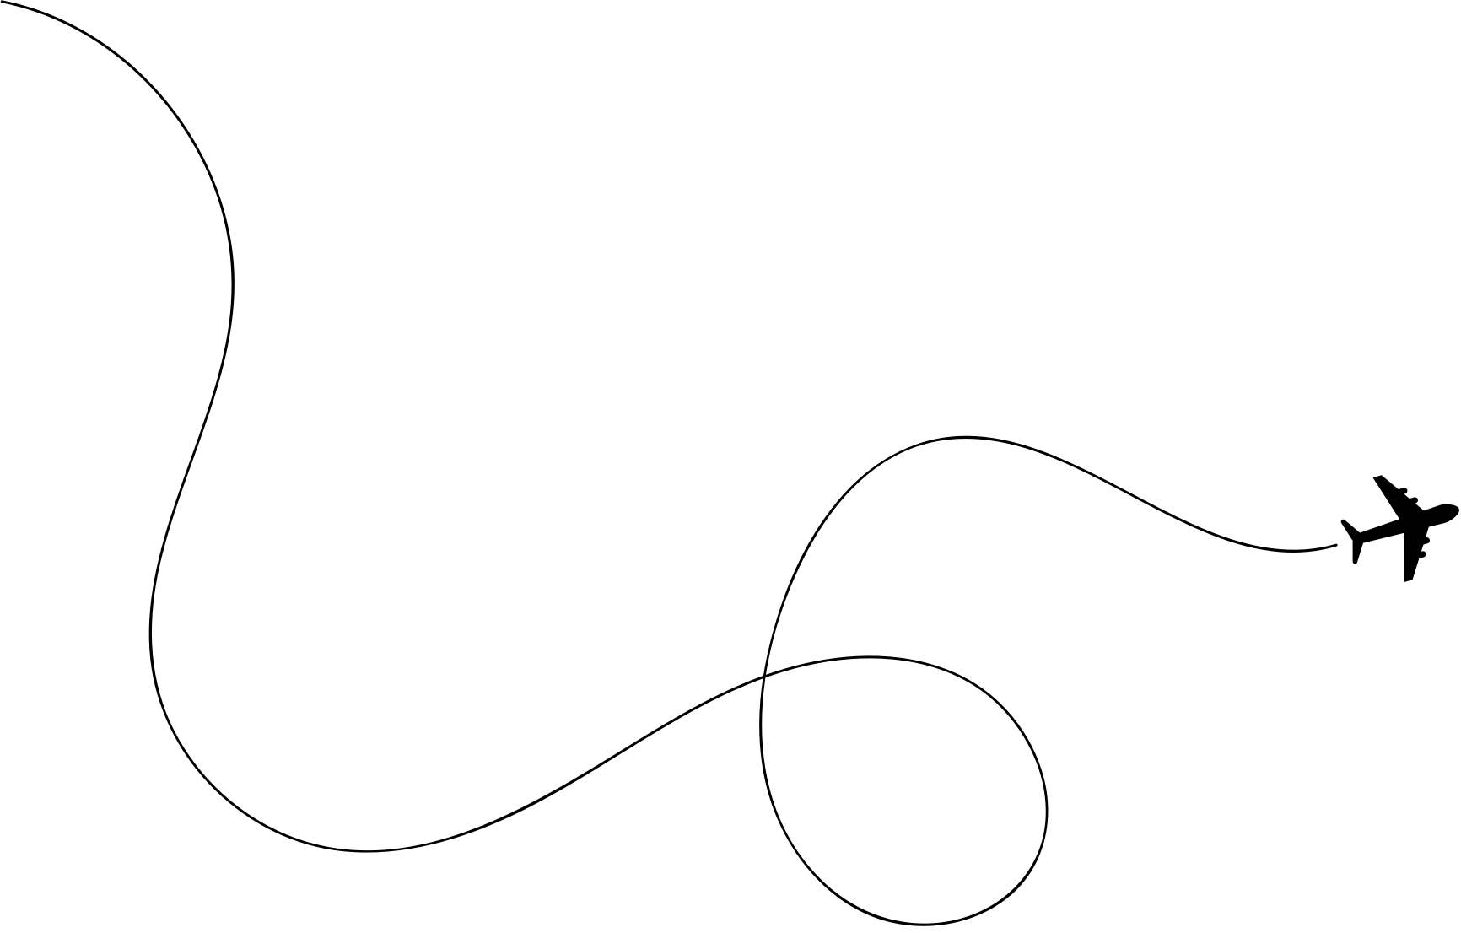
UML

Slide 15
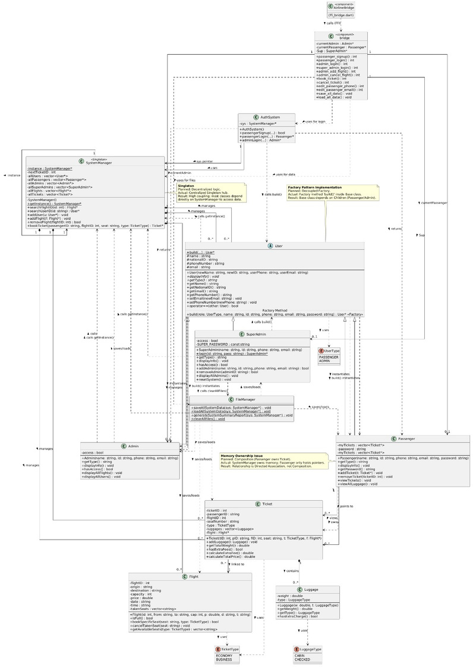

Slide 16
USER

Slide 17
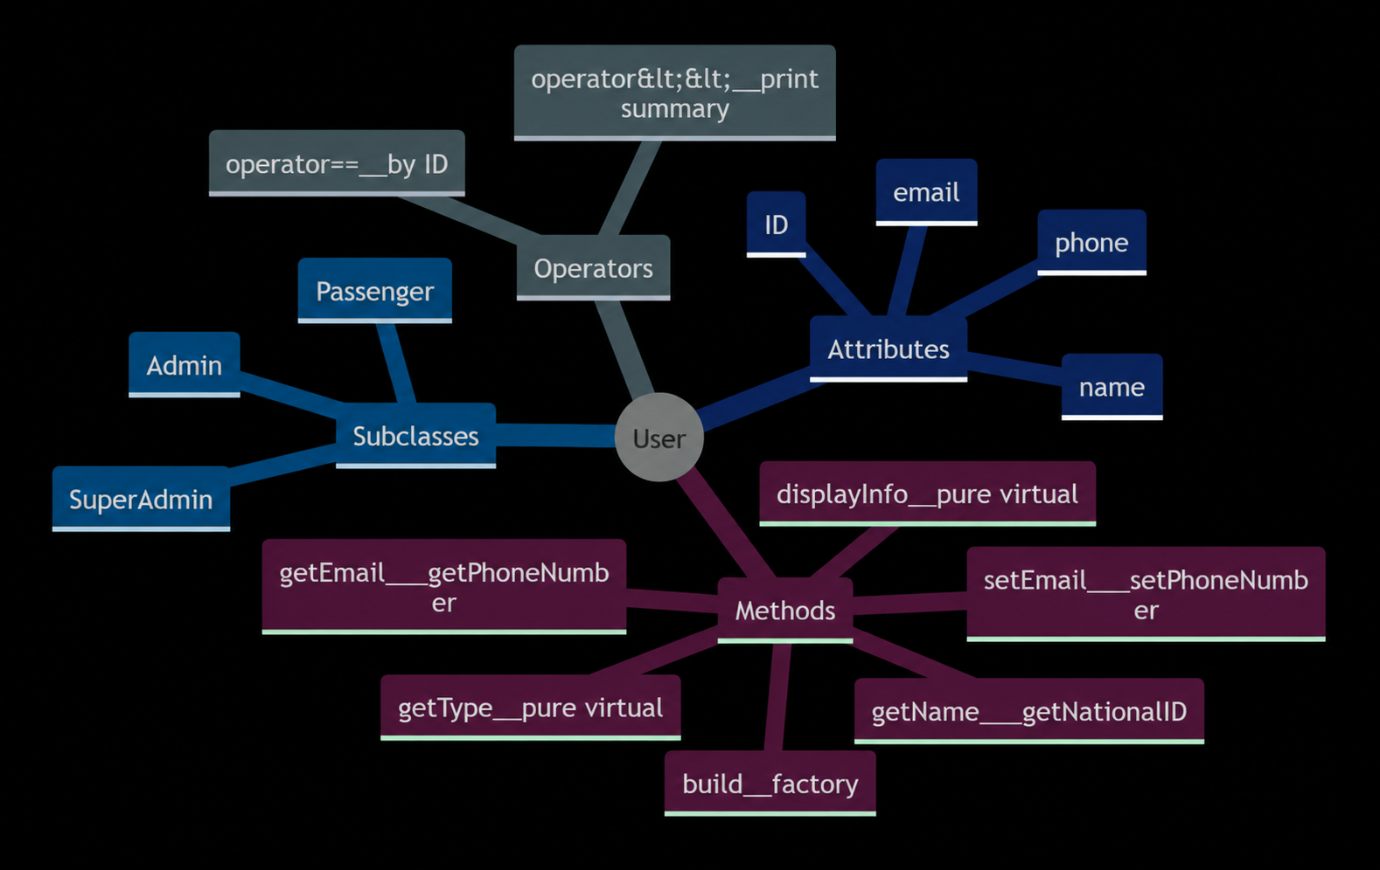

Slide 18
SYSTEM
MANAGER

Slide 19
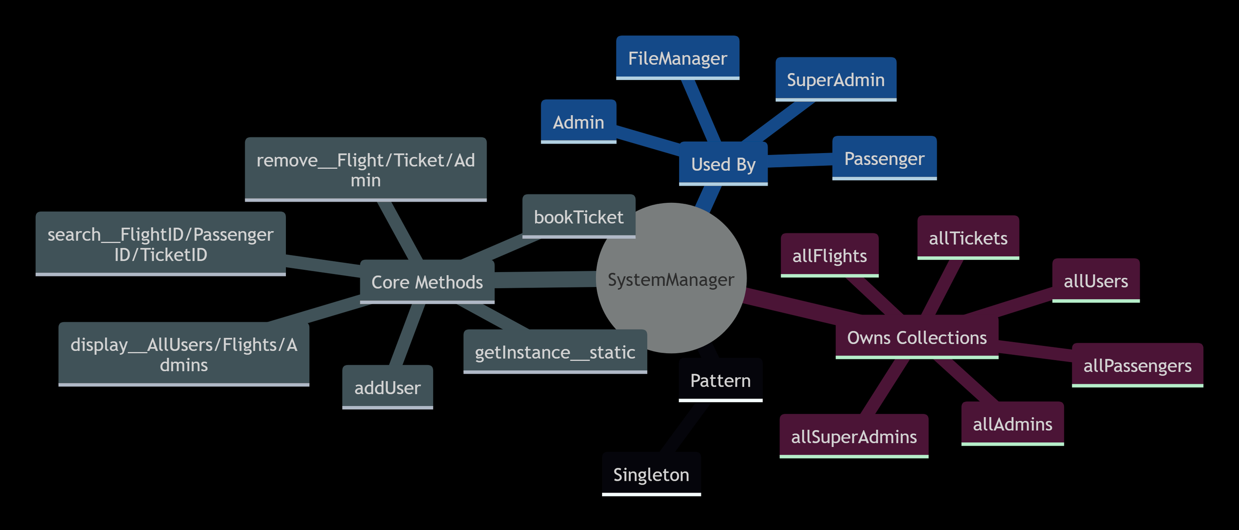

Slide 20
ADMIN

Slide 21
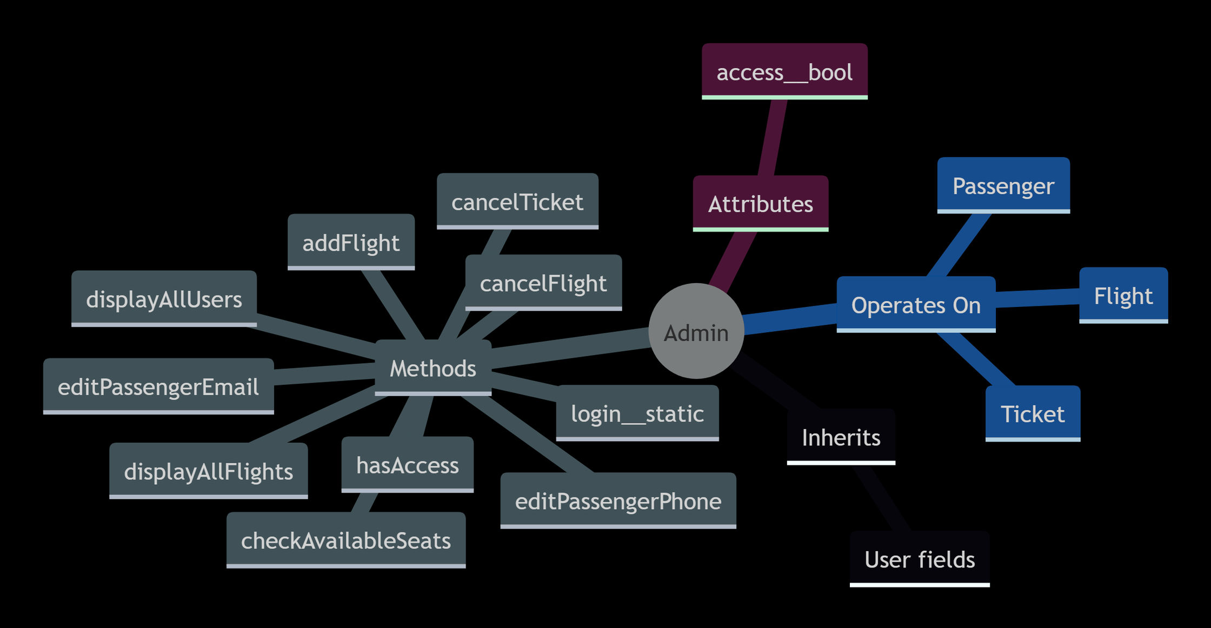

Slide 22
FILE
MANAGER

Slide 23
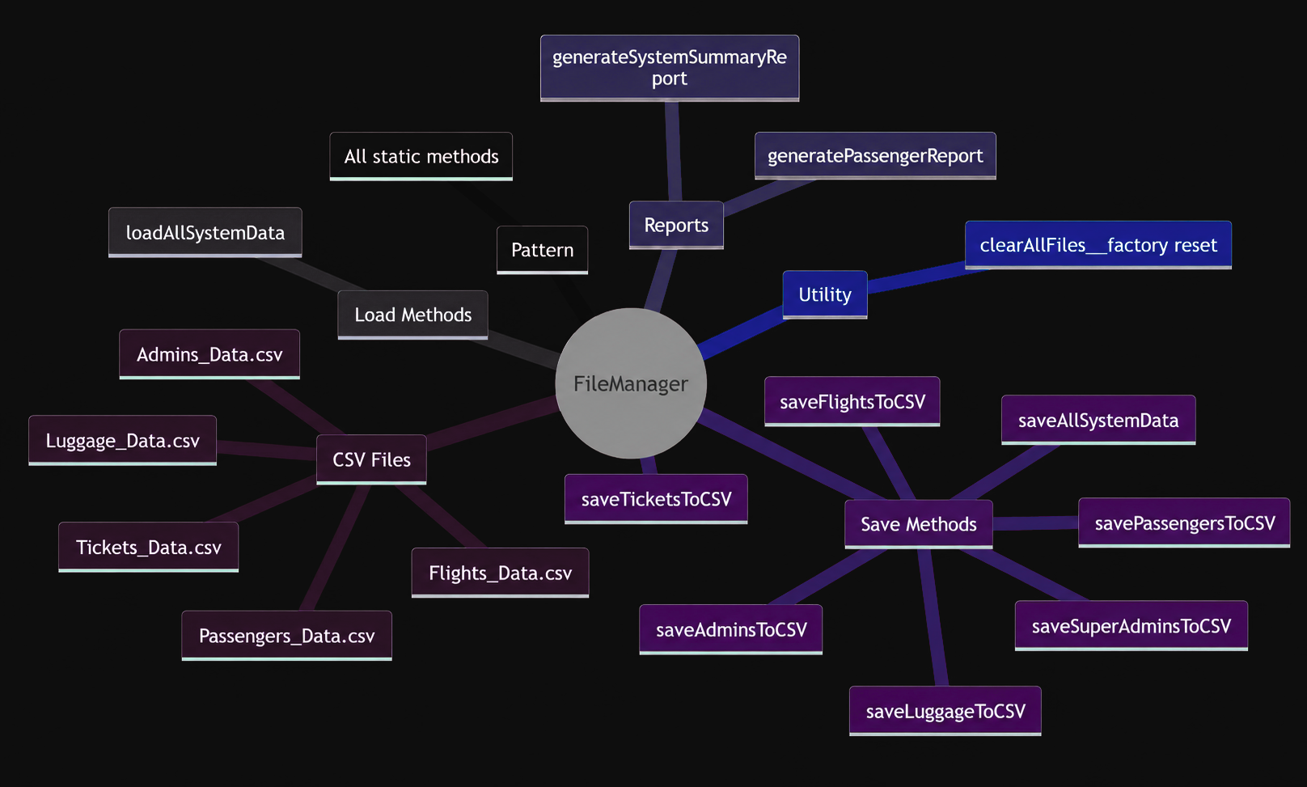

Slide 24
FLIGHT

Slide 25
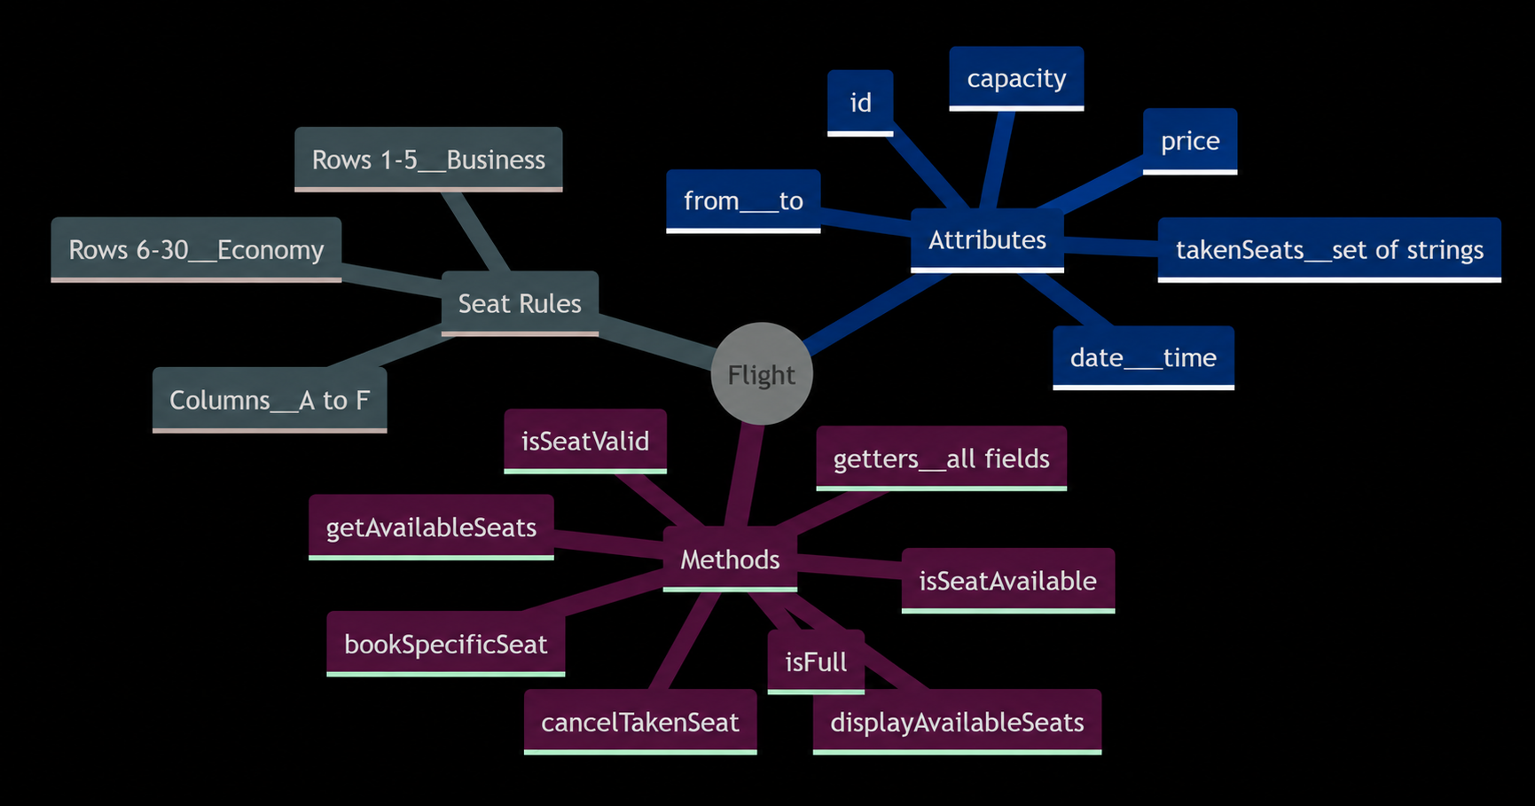

Slide 26
LUGGAGE

Slide 27
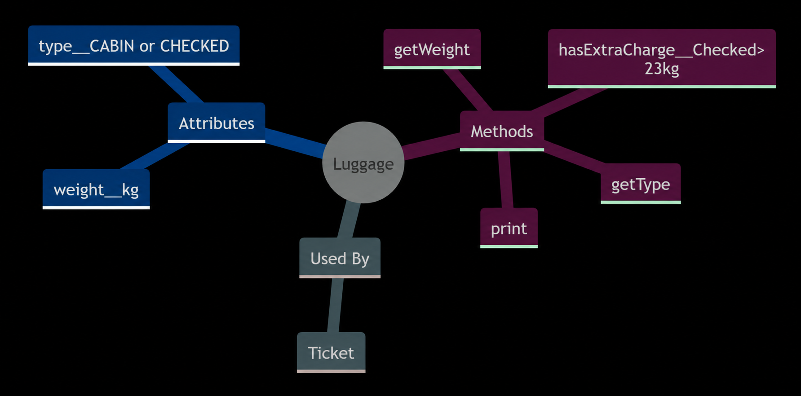

Slide 28
PASSENGER

Slide 29
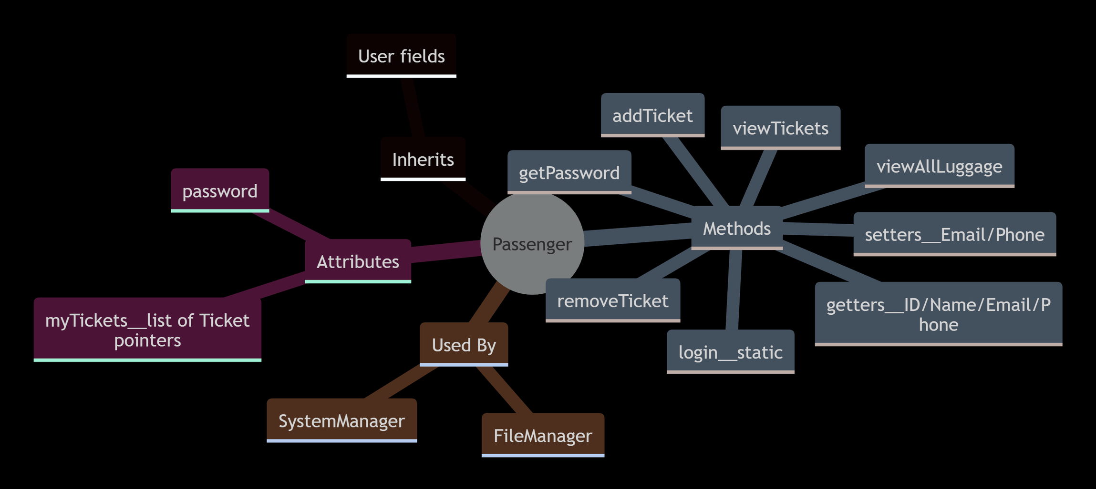

Slide 30
SUPER ADMIN

Slide 31
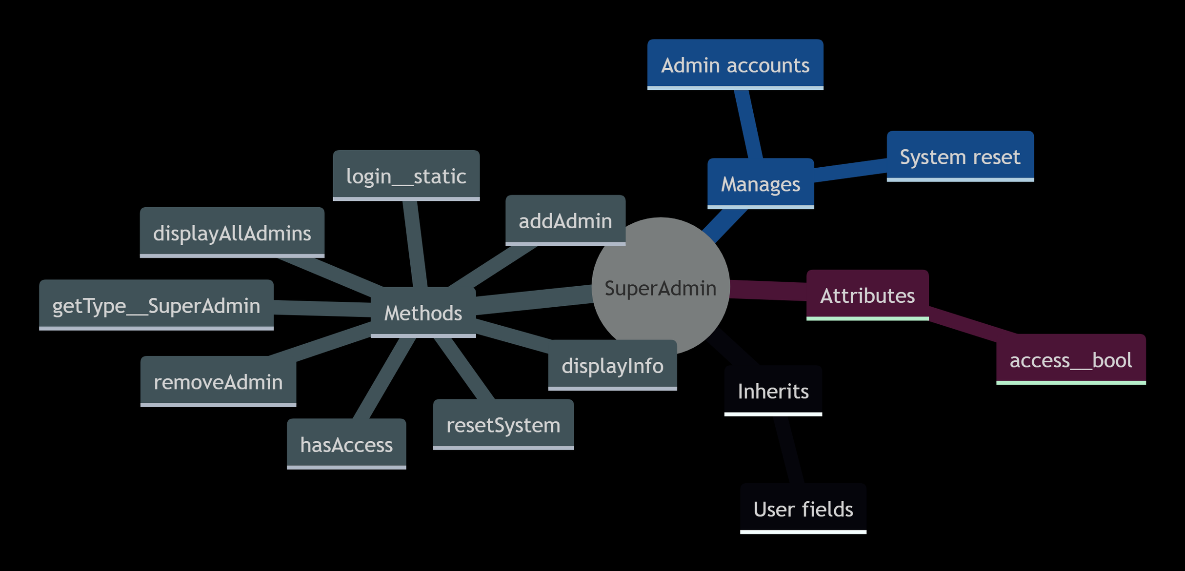

Slide 32
TICKET

Slide 33
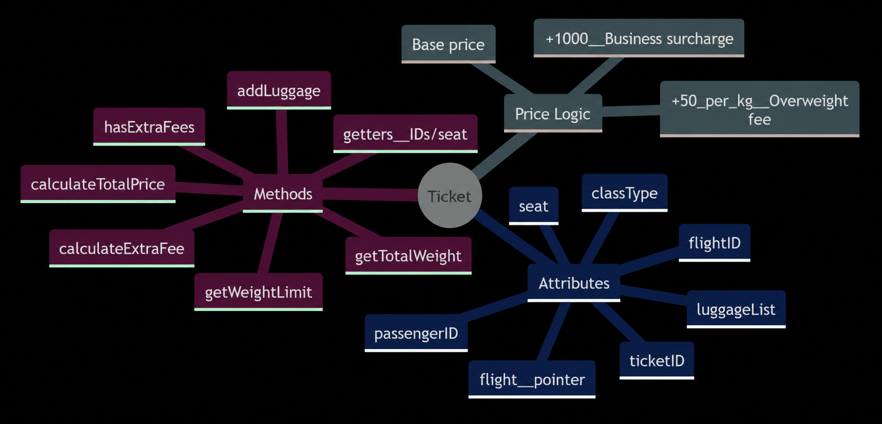

Slide 34
GUI

Slide 35
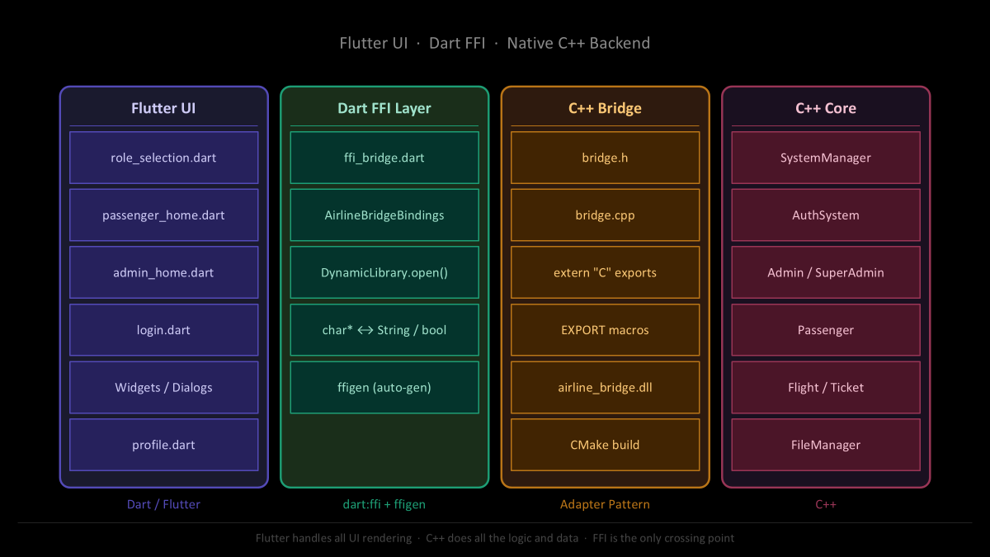

Slide 36
CHALLENGES FACED
MAIN CHALLENGES
  MANAGING RELATIONSHIps BETWEEN CLASSES
  SEAT ALLOCATION LOGIC
  PREVENTING INVALID BOOKINGS
  MAINTAINING CLEAN OOP ARCHITECTURE
  HANDLING MEMORY SAFELY USING POINTERS

Slide 37
BONUS FEATURES
BONUS FEATURES IMPLEMENTED
  GUI
  ERROR HANDLING
  ADMIN AUTHENTICATION
  EXTRA FEATURES

Slide 38
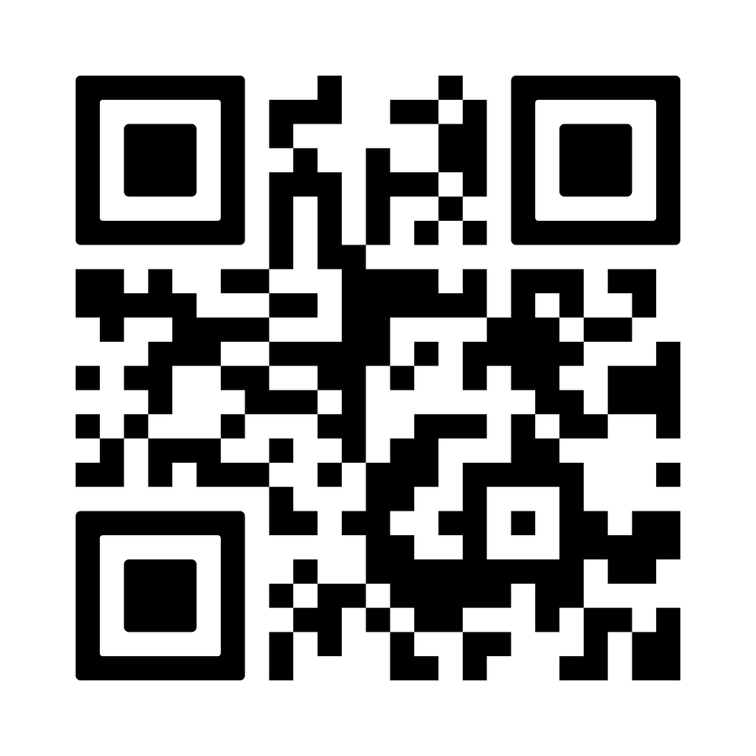
REFERENCES

Slide 39

THANK YOU FOR TRAVELING WITH US

