Slide 1

Talk to a flower to become a part of the Internet
Hello world!
8th August 2016. Pozega

Slide 2
Notes:
Remove and place another with a pon on Keo’s head

Slide 3
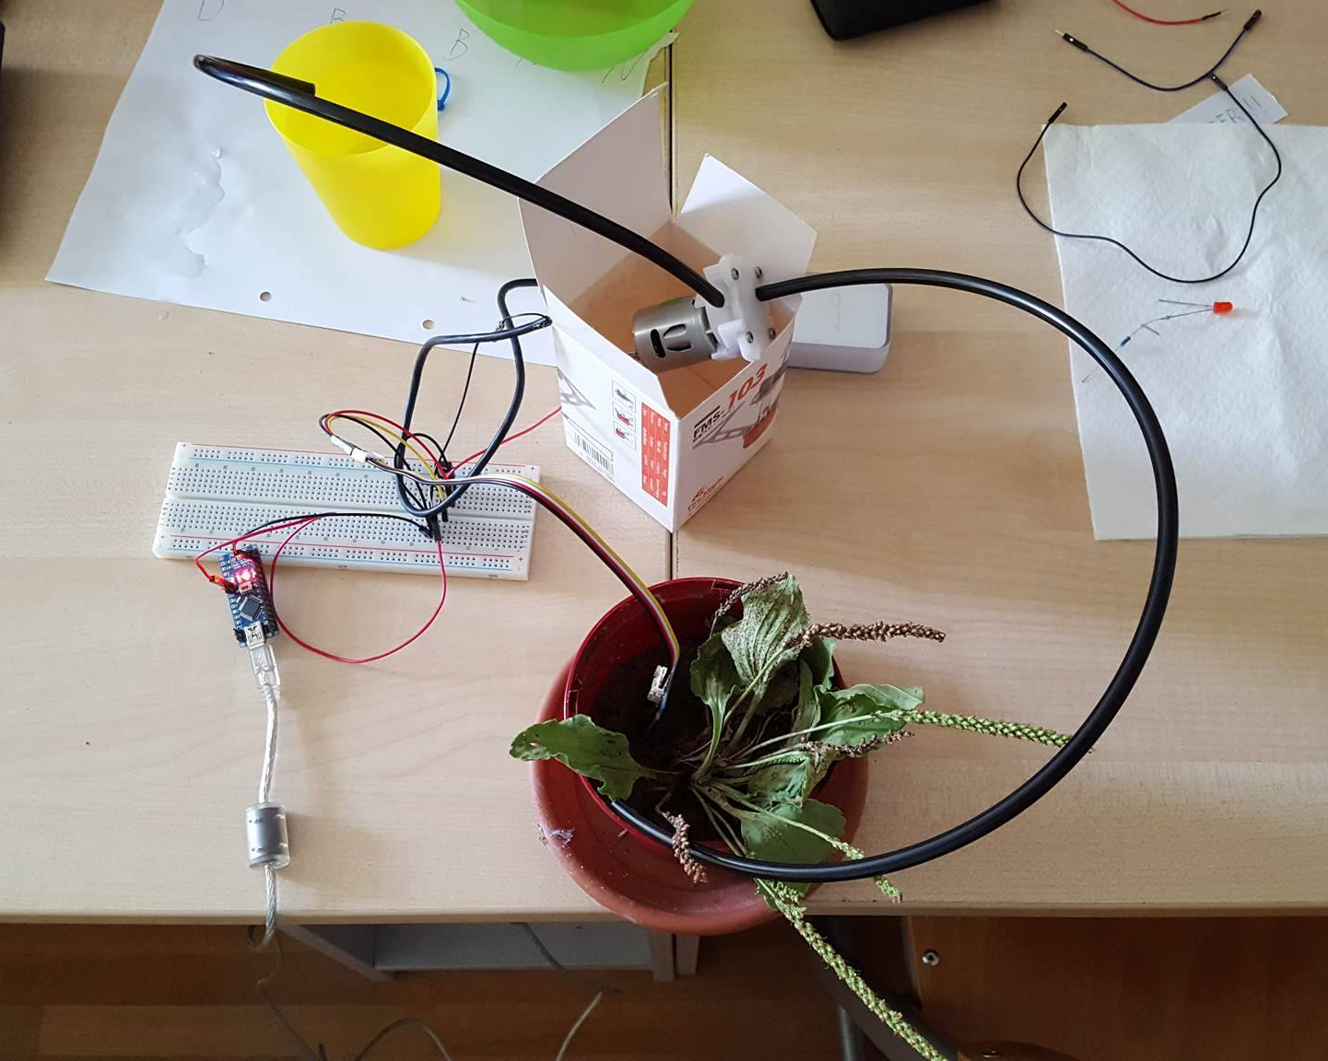
Equipment
Water pump
Arduino
Battery
Moisture sensor

Slide 4
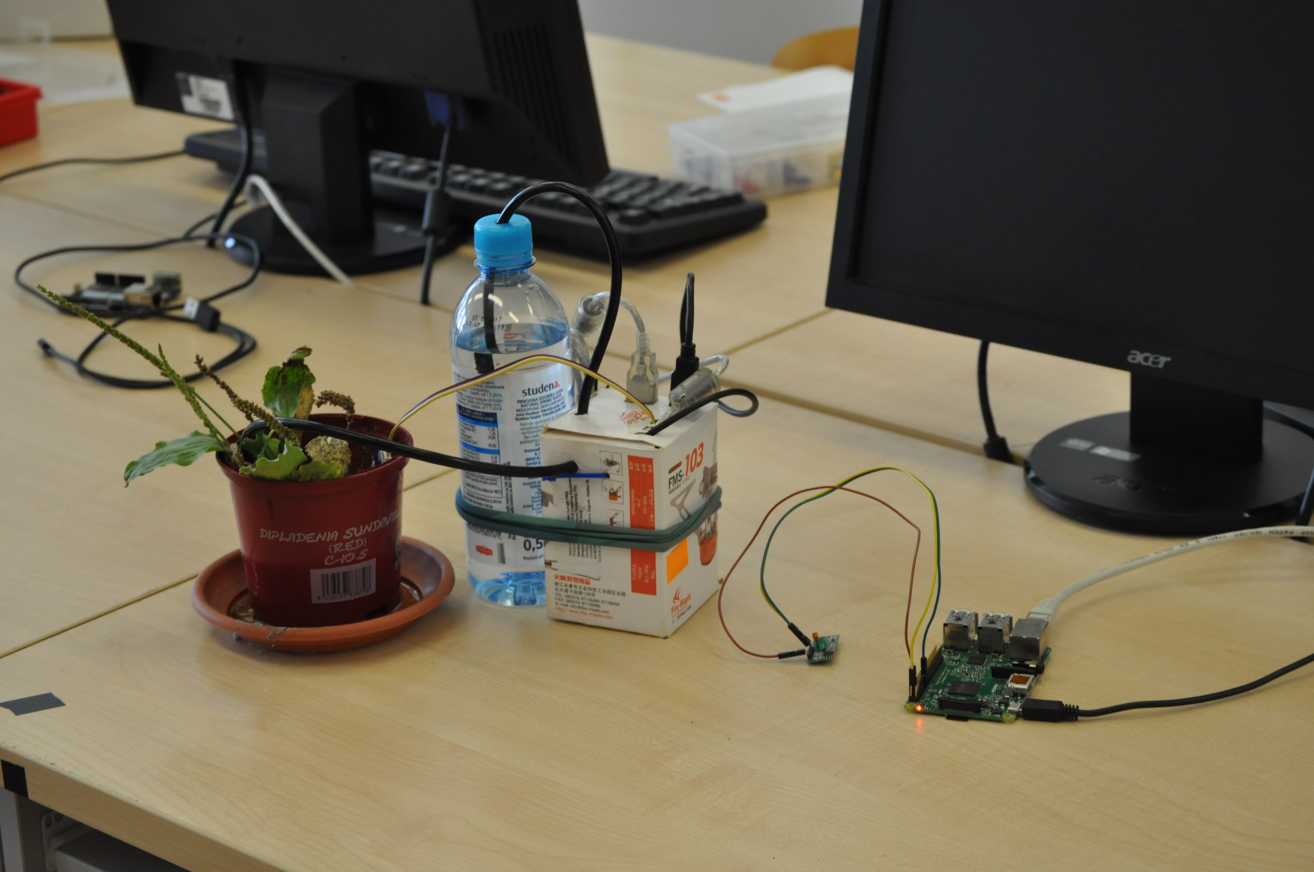
Improved

Slide 5
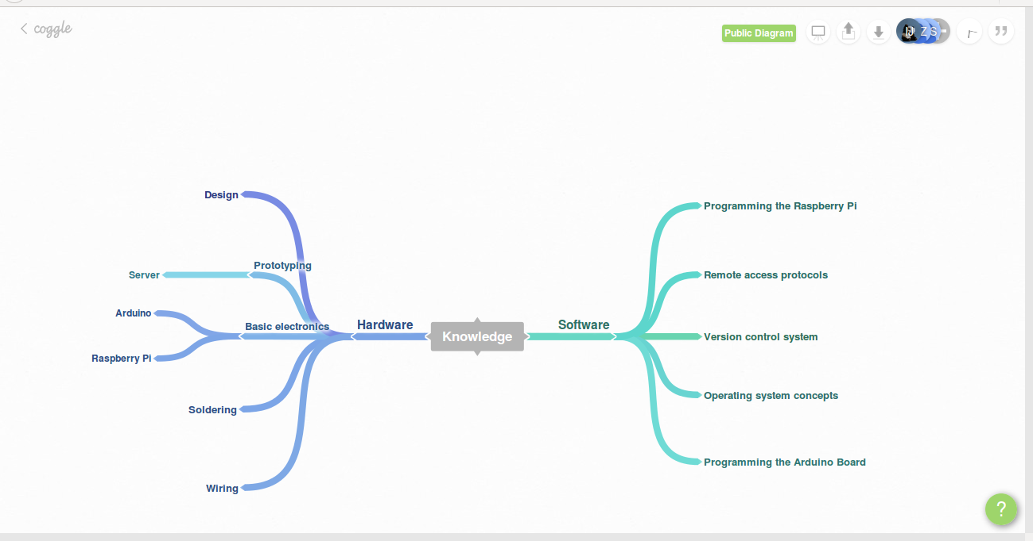
What did we learn?

Slide 6
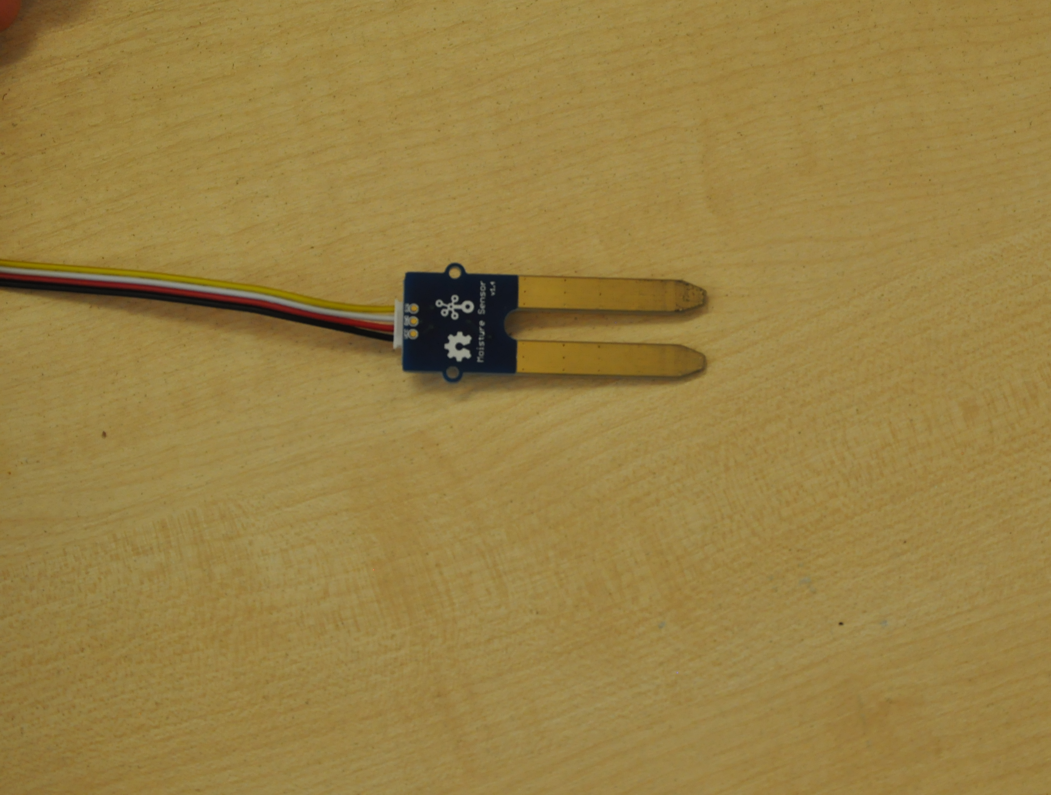
Sensor
Notes:
> what it is
> how does it work

Slide 7
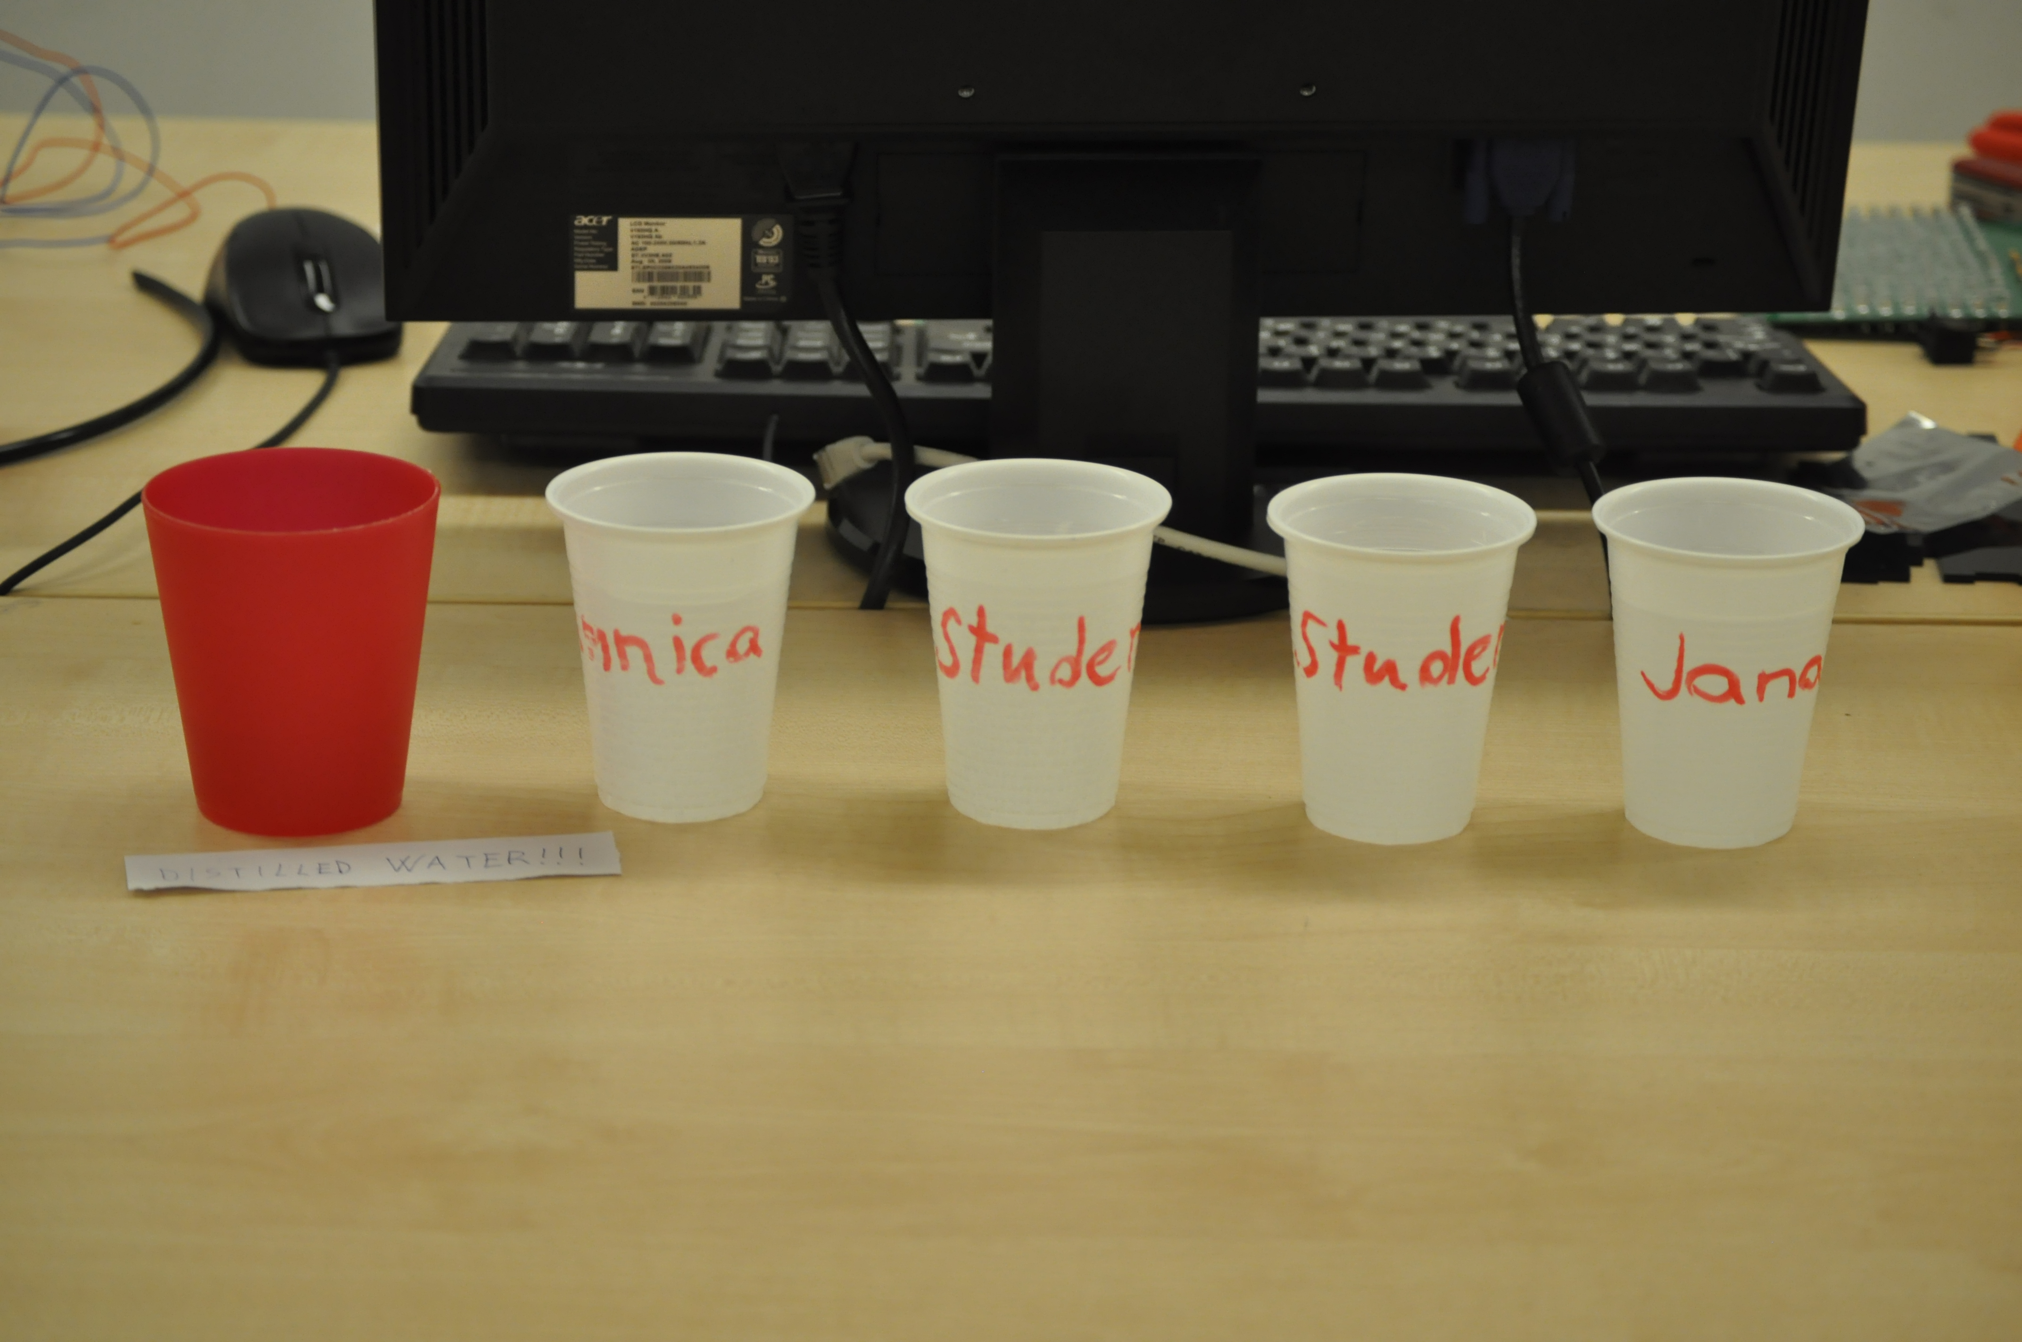
Water testing

Slide 8
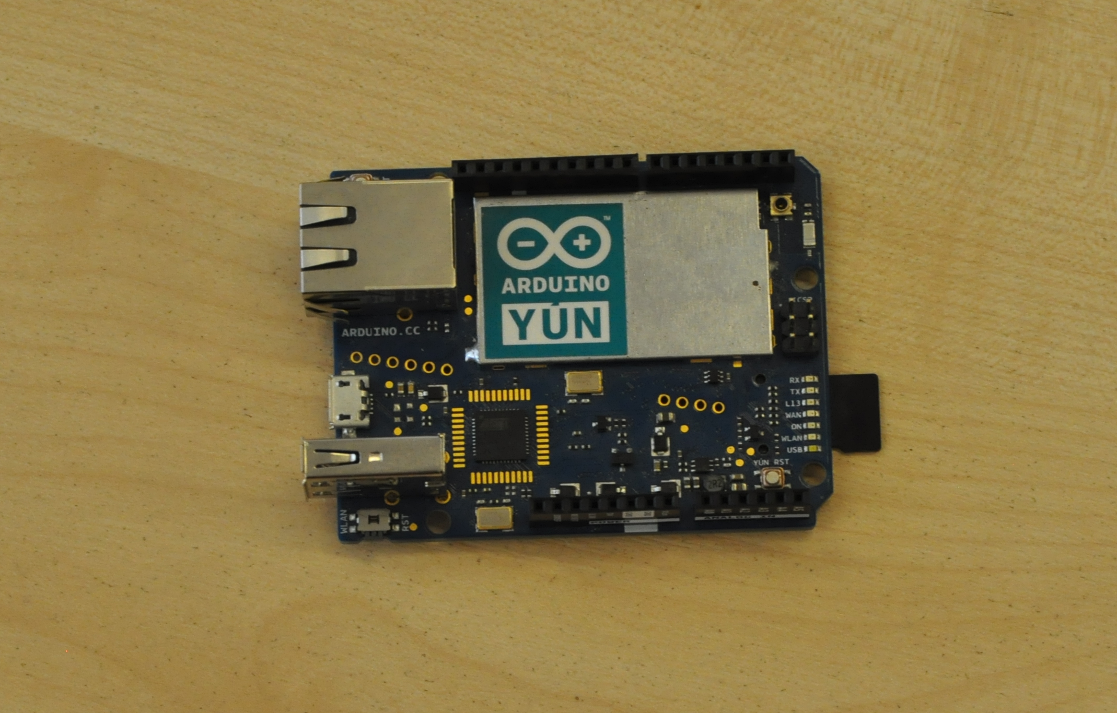
Arduino
Notes:
What it is
How do we get data: analog, digital
Pump > transistor
Circuit > web site for nice drawing

Slide 9
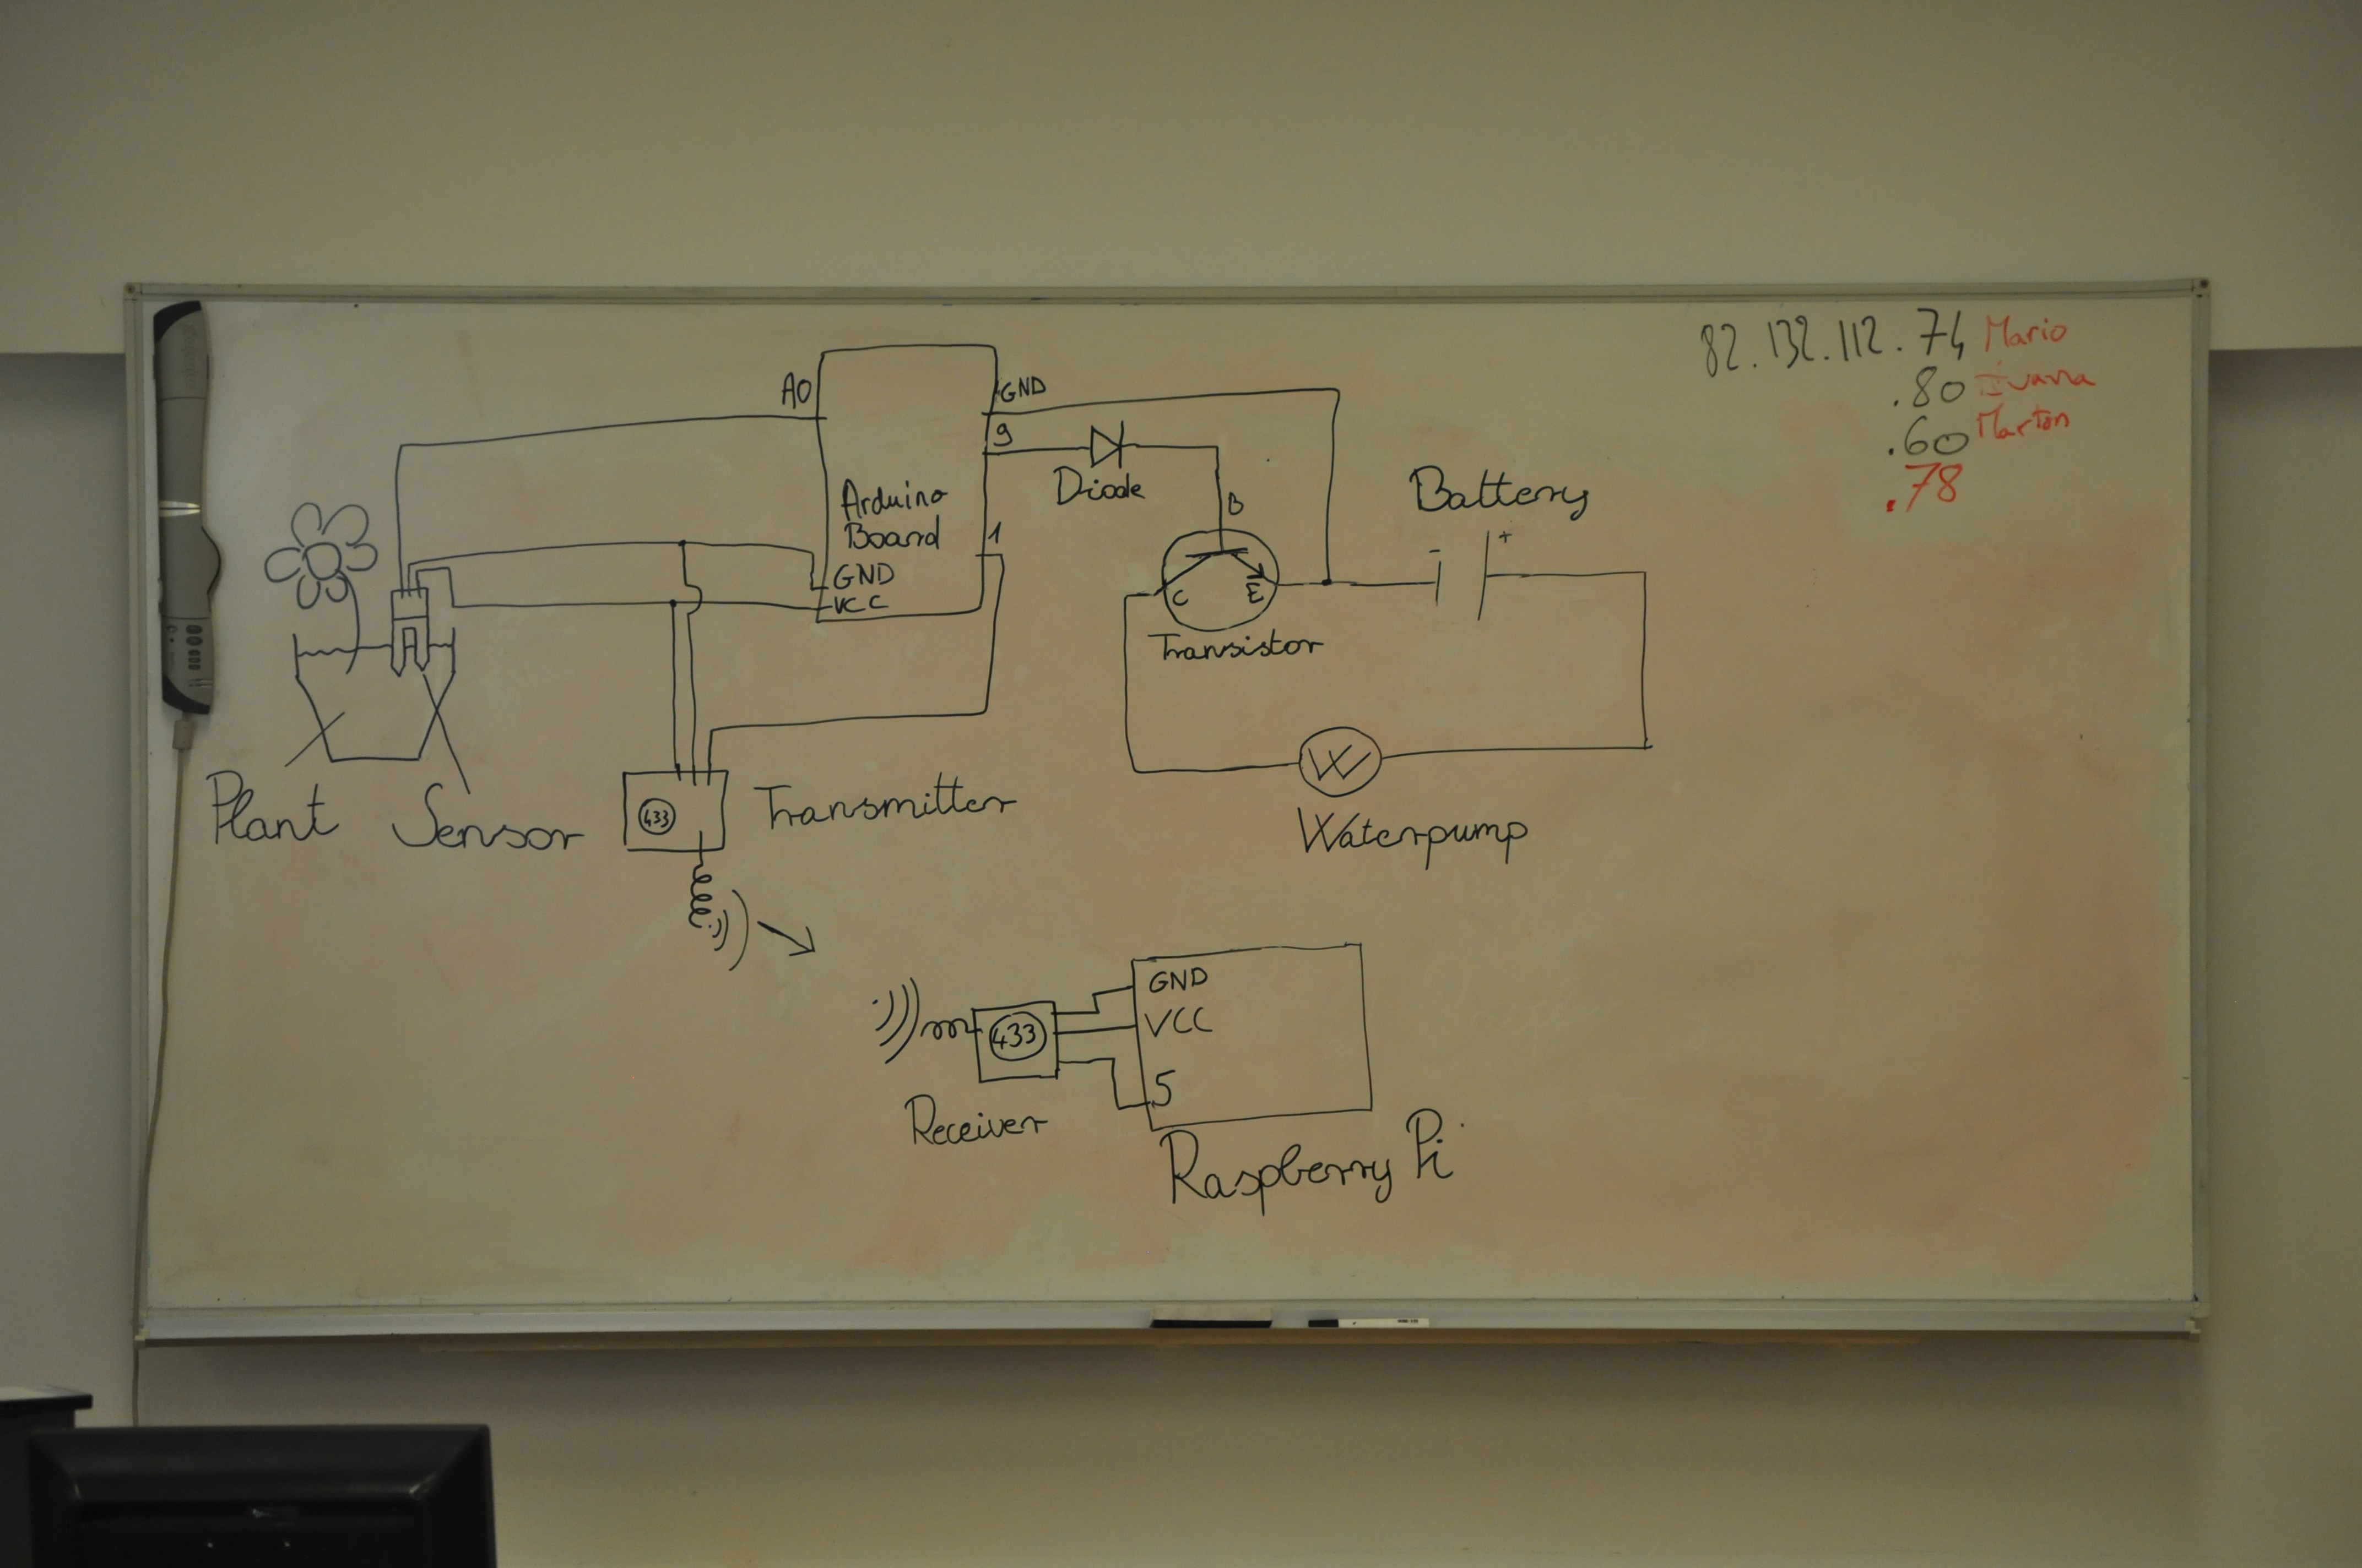
Circuit

Slide 10
Sending data
Amplitude and frequency modulation - analog
On/Off Keying - digital modulation

Slide 11
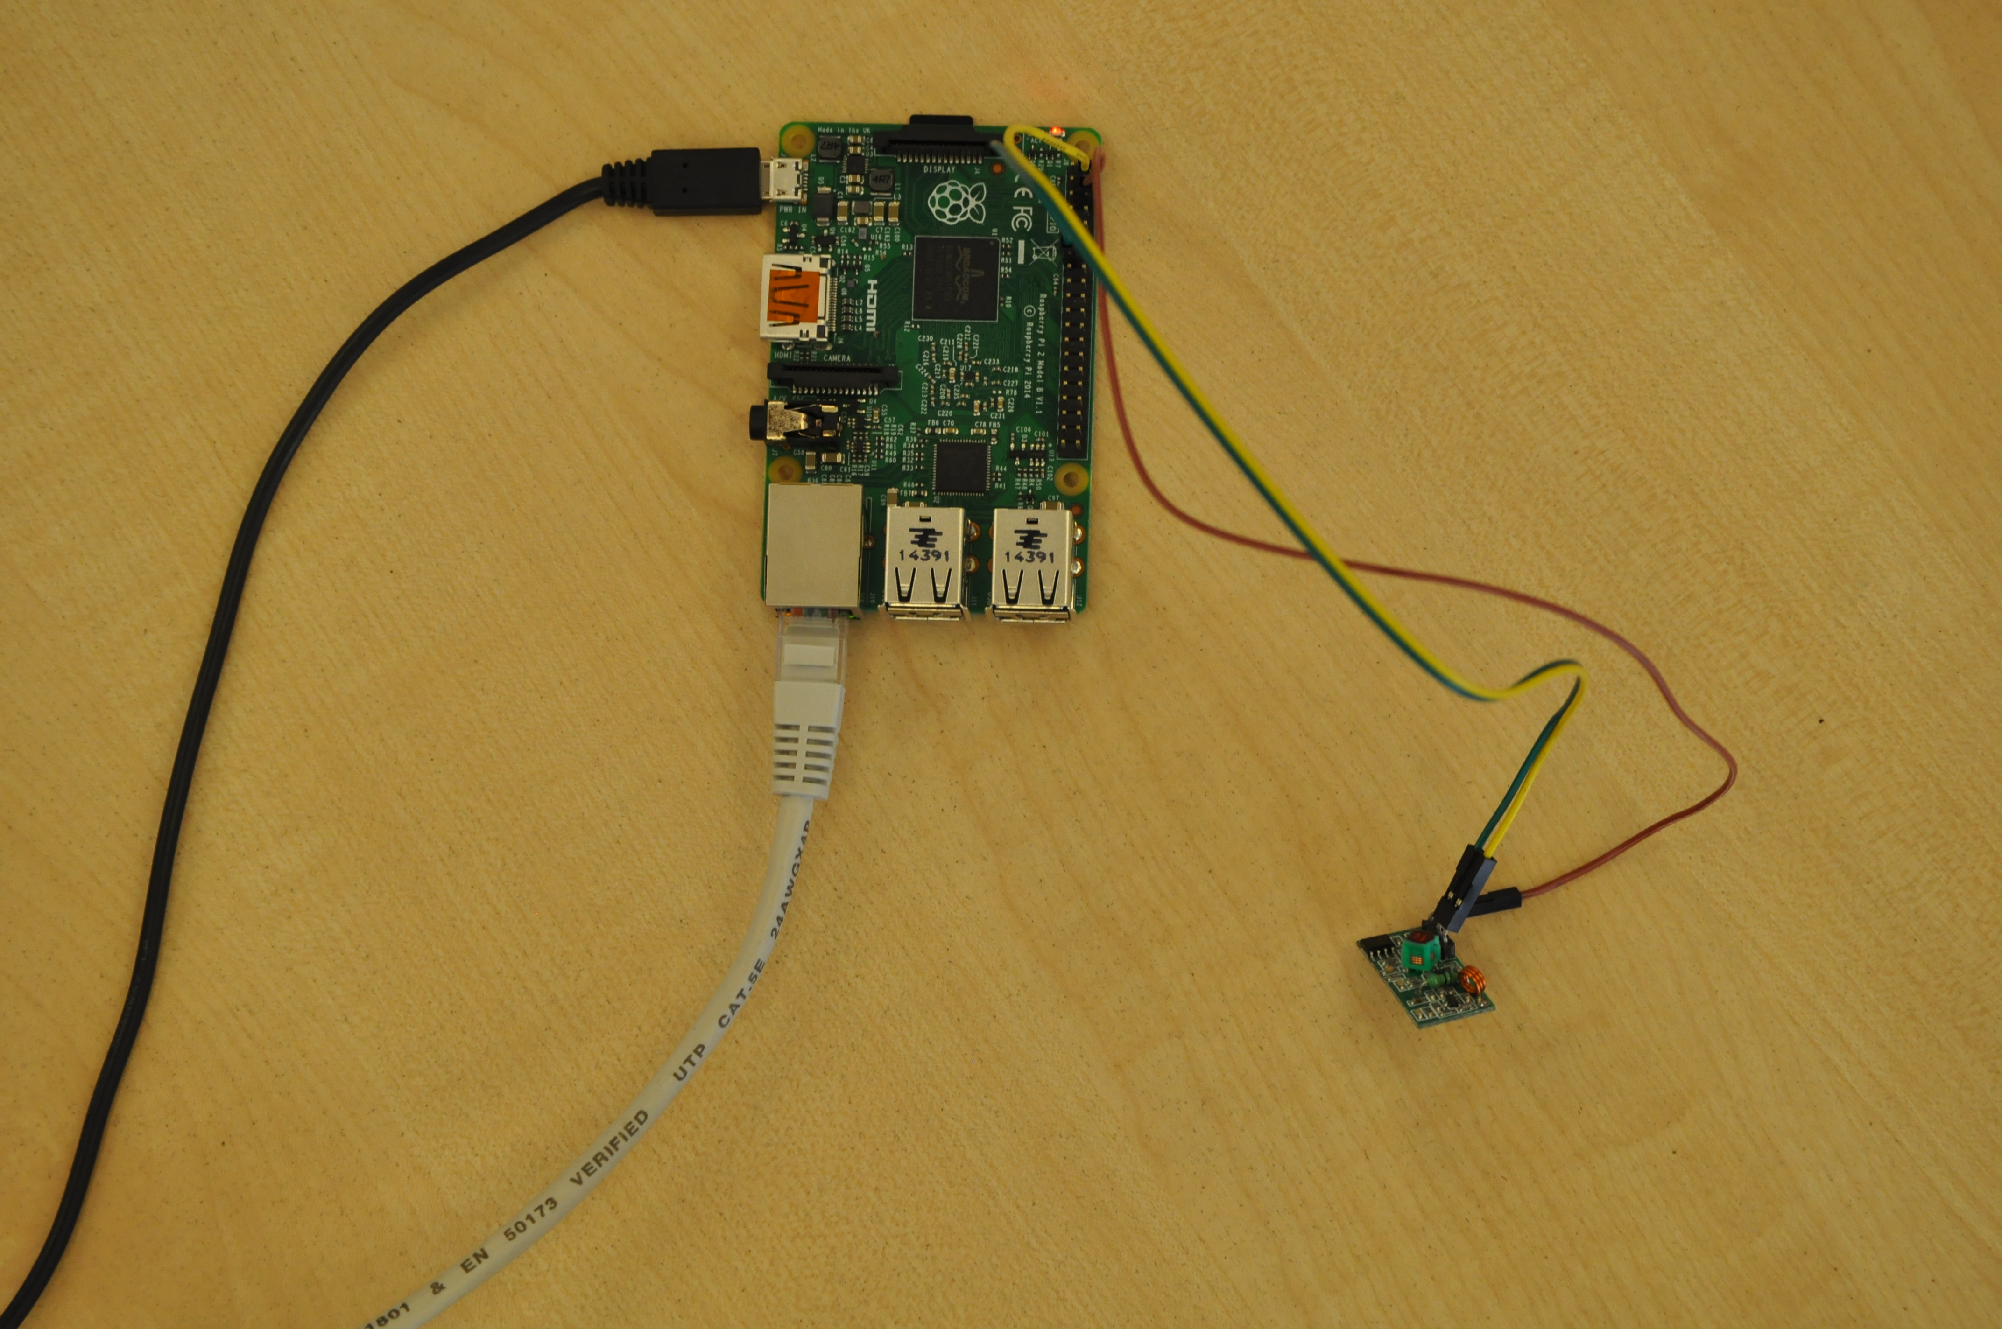

Self-hosting
Raspberry Pi
Notes:
Python > working

Slide 12
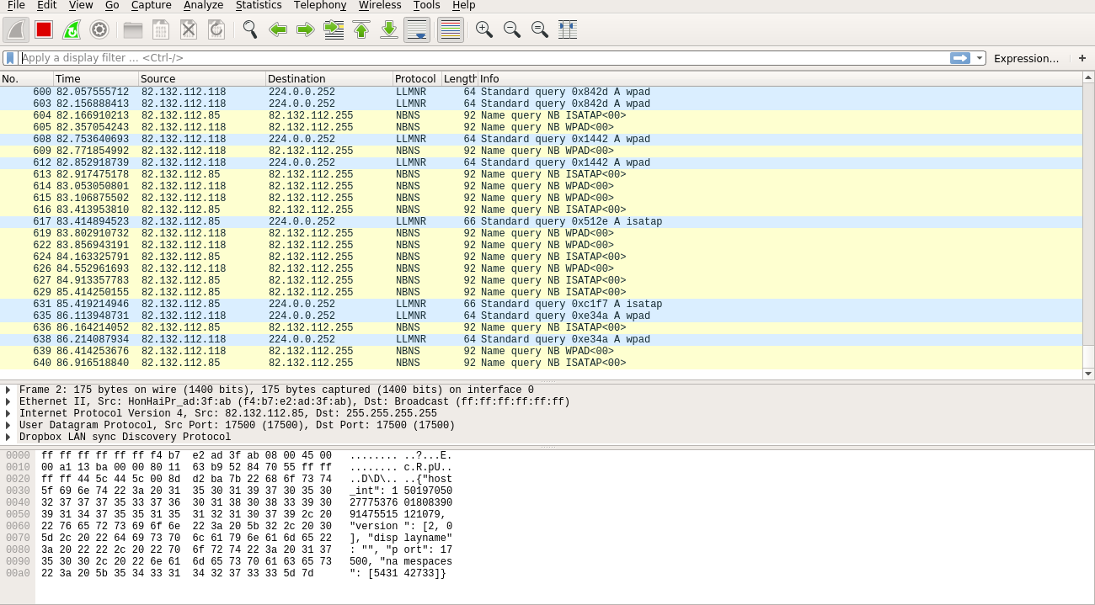
Sniffing
Wireshark
Notes:
HTTP

Slide 13
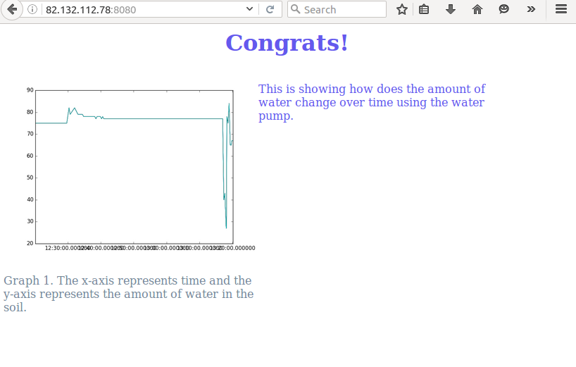
Displaying data
Python
Graph
HTML

Slide 14
Safety - encryption

Slide 15
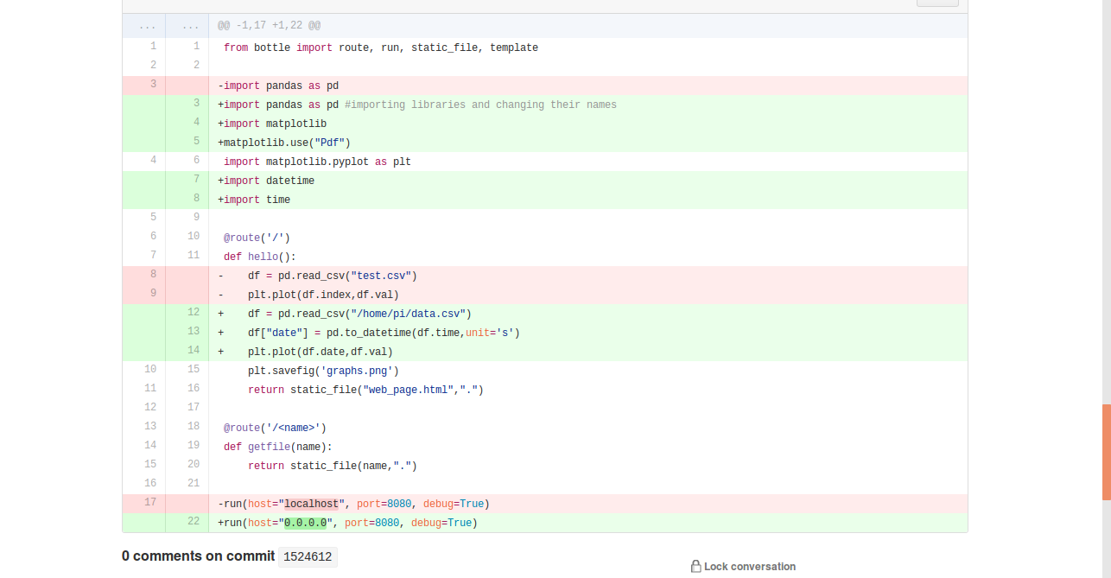


“Reproductible” research

Slide 16
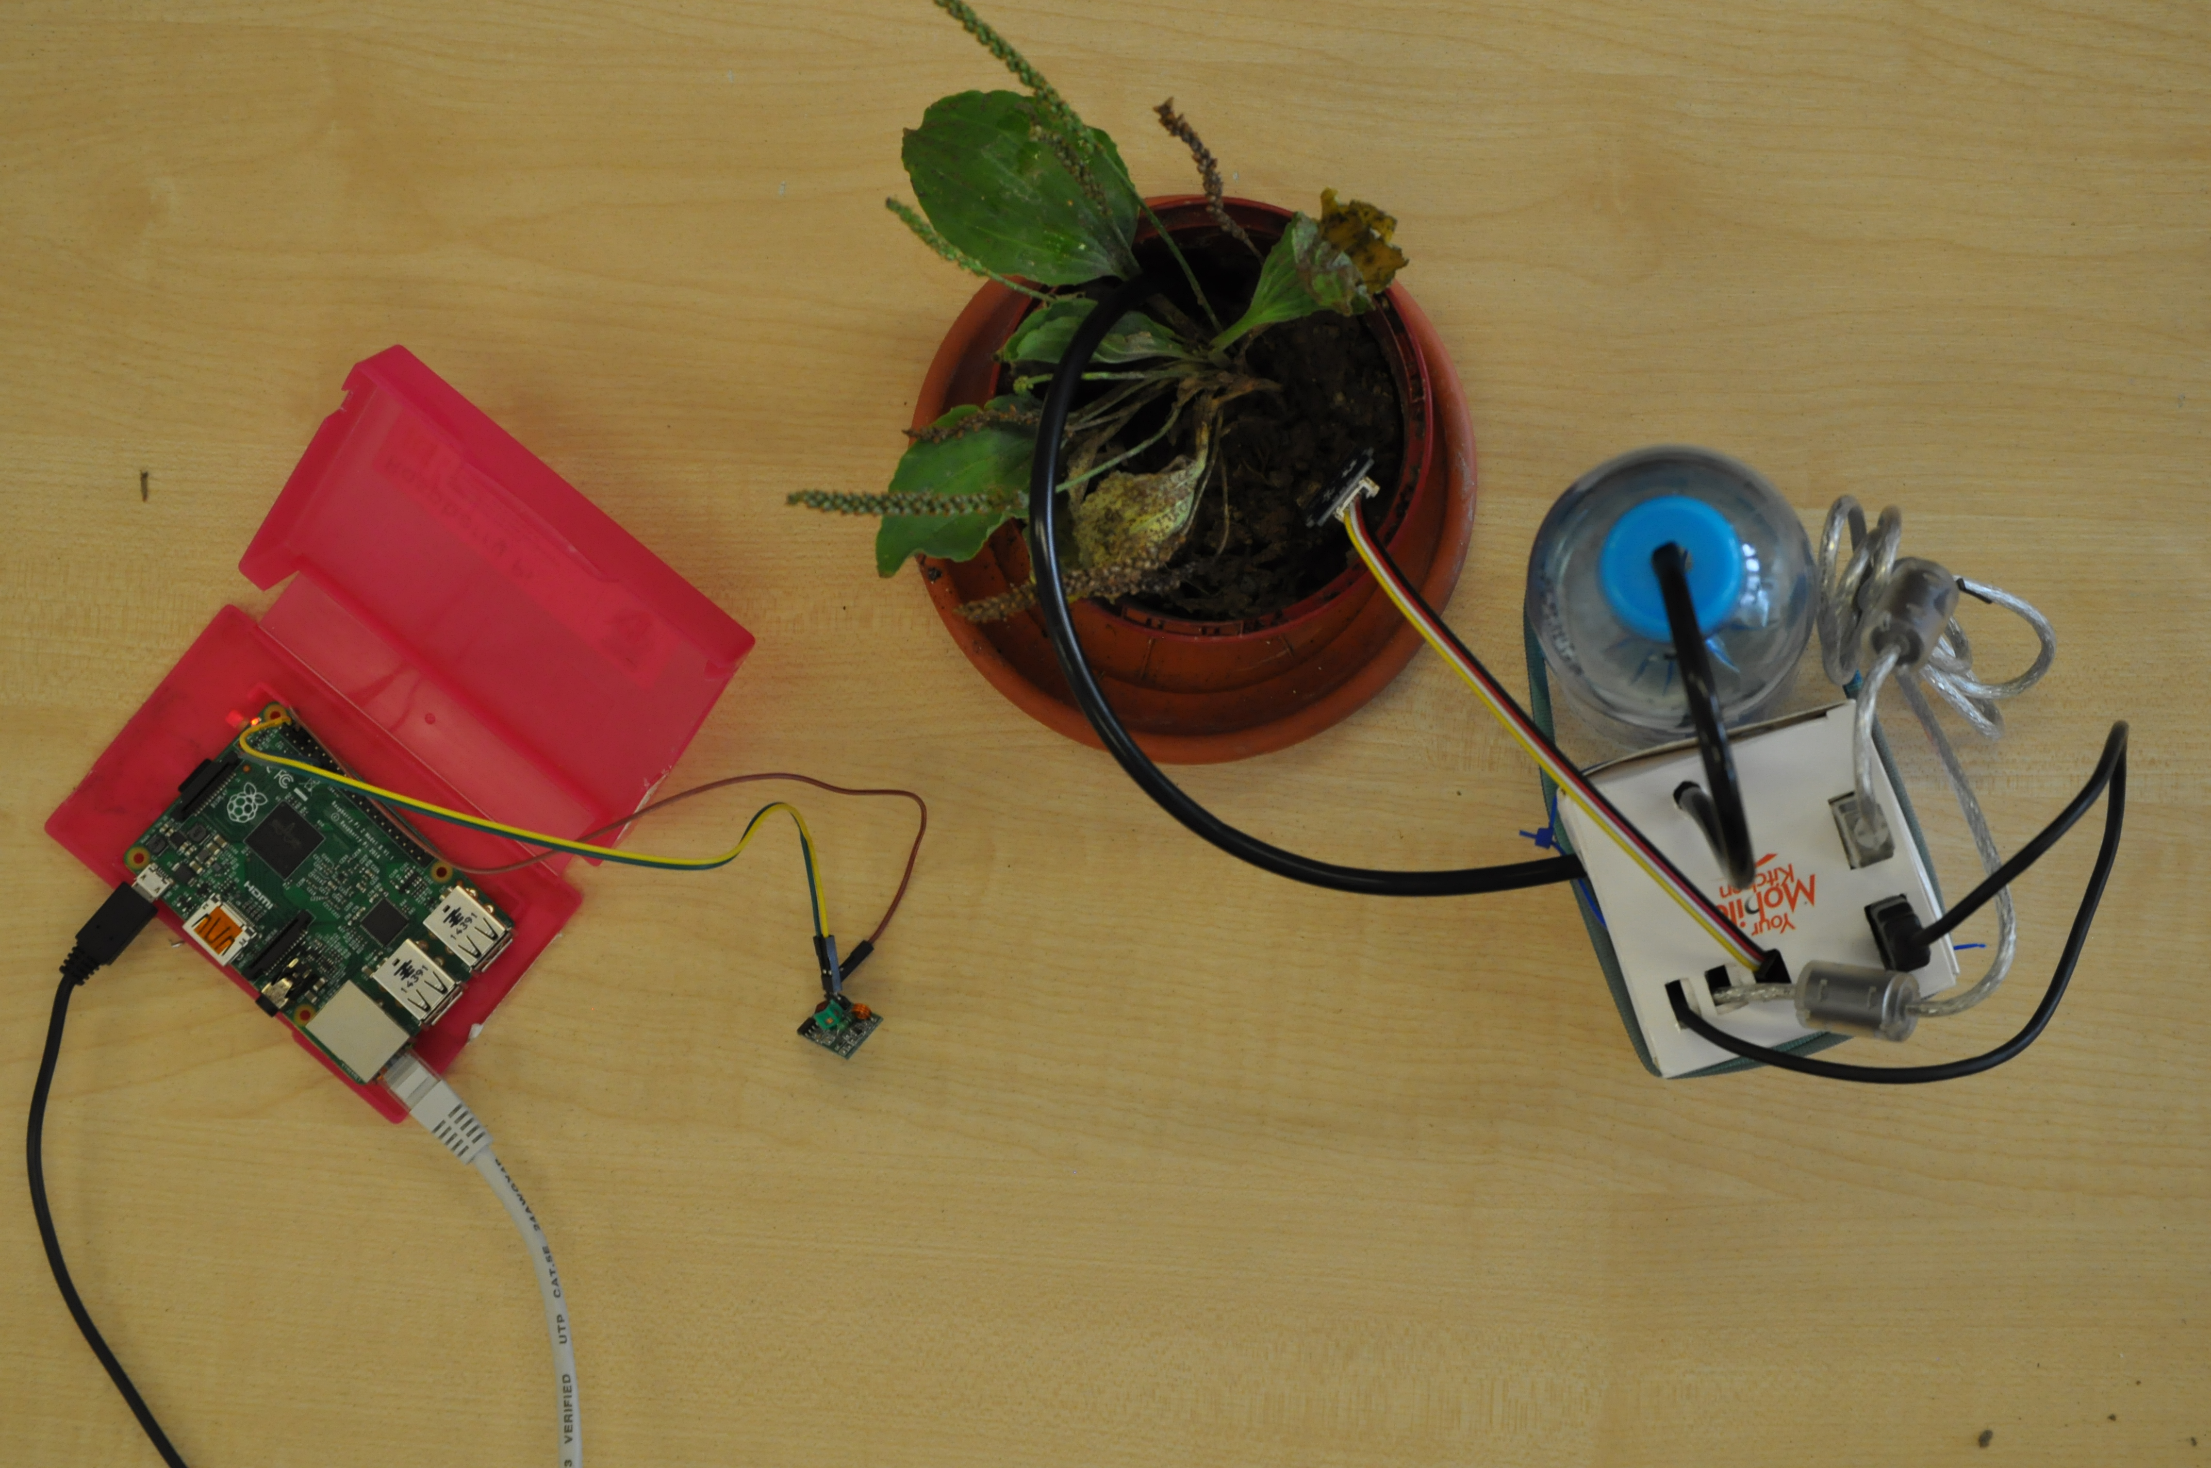
Thank you! Questions?
Notes:
Display a demo with moving graph

