Slide 1
The GNU/Linux System

Slide 2
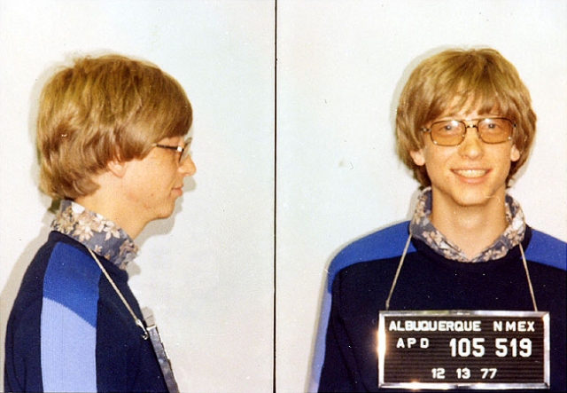


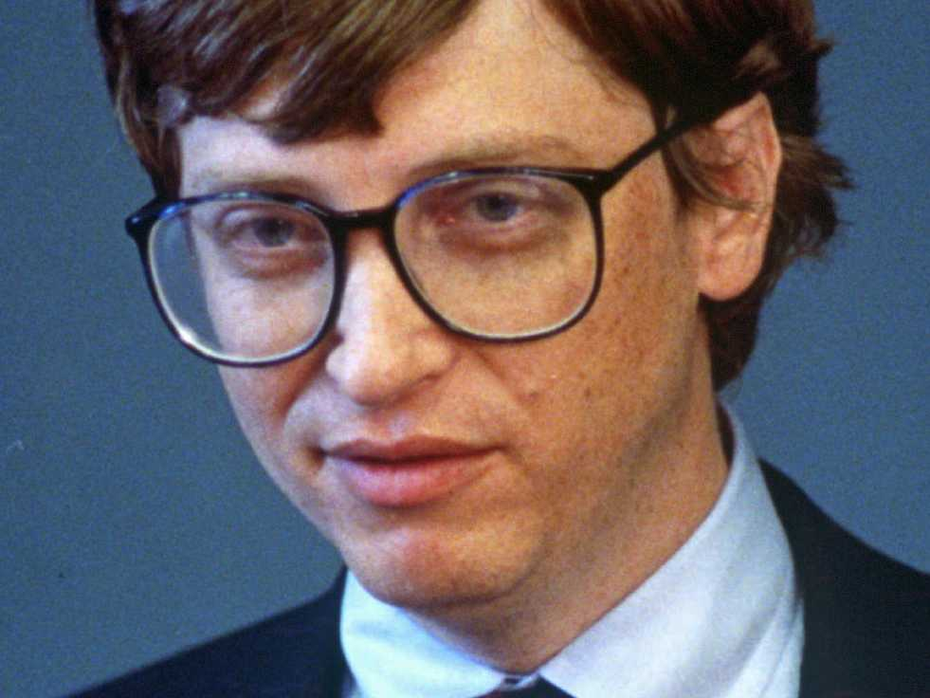
Sharing softwares was the default rule

Slide 3
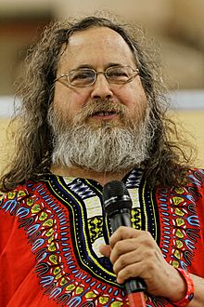
Richard Stallman

Slide 4
4 rules for the Software Freedom
0. Run the program, for any purpose
1. Study the program (Open-source)
2. Redistribute
3. Improve the program and release improvements

Slide 5



The GNU Project
Started in 1984
Replace UNIX

Slide 6
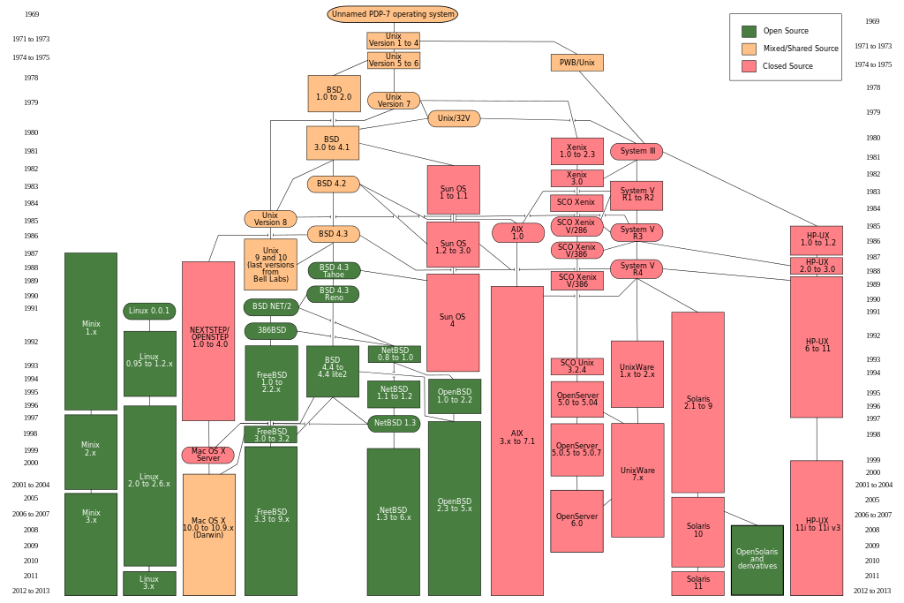

Slide 7
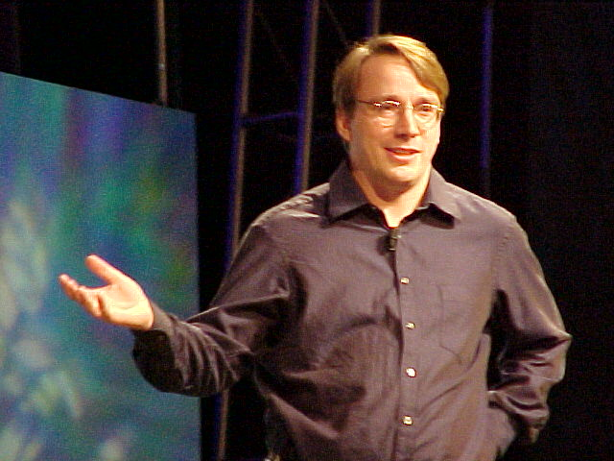
Linus Torvalds

Slide 8
What is a difference between free-software and open-source software ?

