Slide 1

Talk to a flower to become a part of the Internet
Hello world!
Požega, 8th August 2016
Final presentation for S3++ 2016

Slide 2
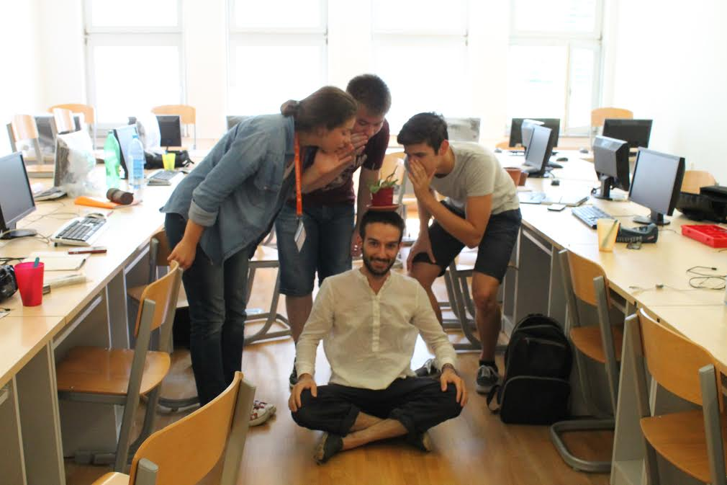
PLANT WHISPERERS
Notes:
Remove and place another with a pon on Keo’s head

Slide 3
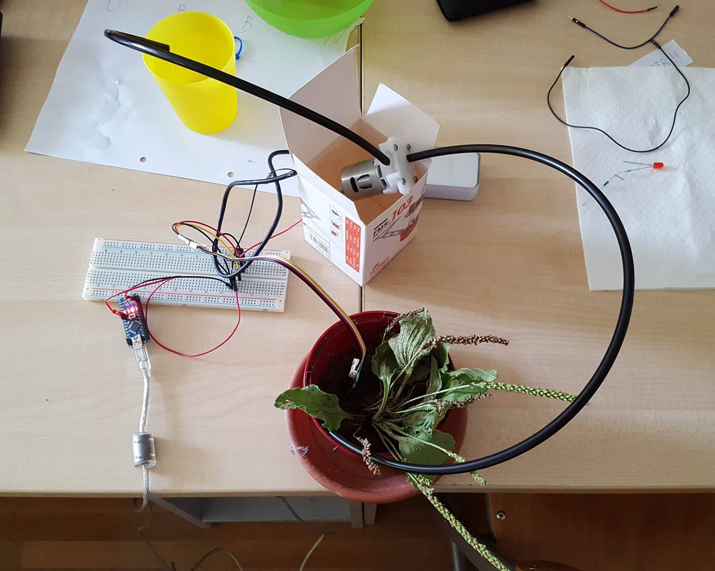
Equipment
Water pump
Arduino
Battery
Moisture sensor

Slide 4
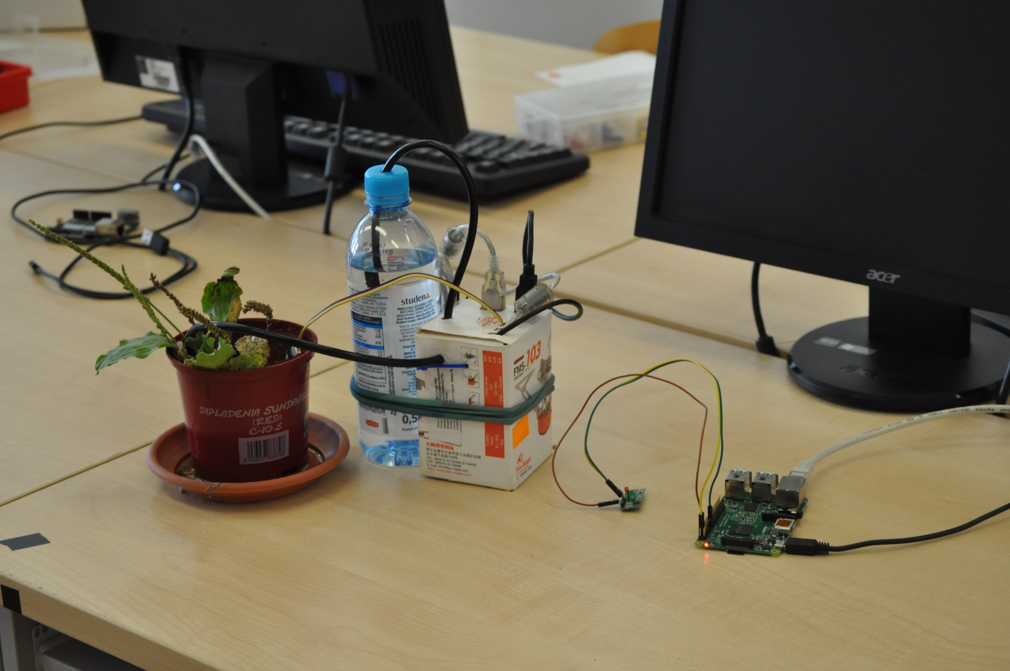
Improved

Slide 5


Software
Operating system concepts
Raspberry Pi
  Programming the Raspberry Pi
  Remote access protocols
  Self-hosting
  Web page design
Arduino
  Programming the Arduino

Slide 6
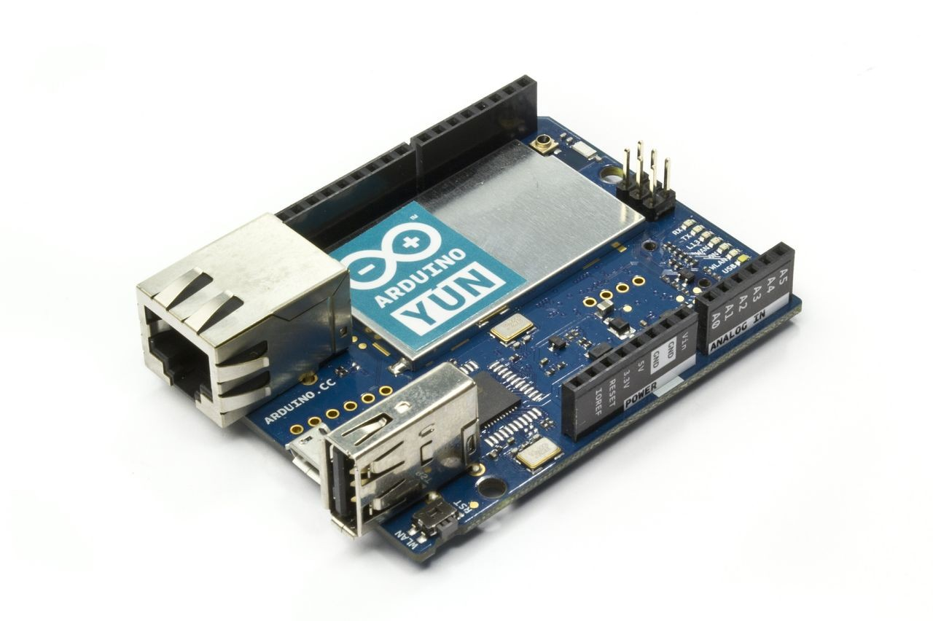
Hardware
Basic electronics
Soldering
Prototyping
Designing

Slide 7
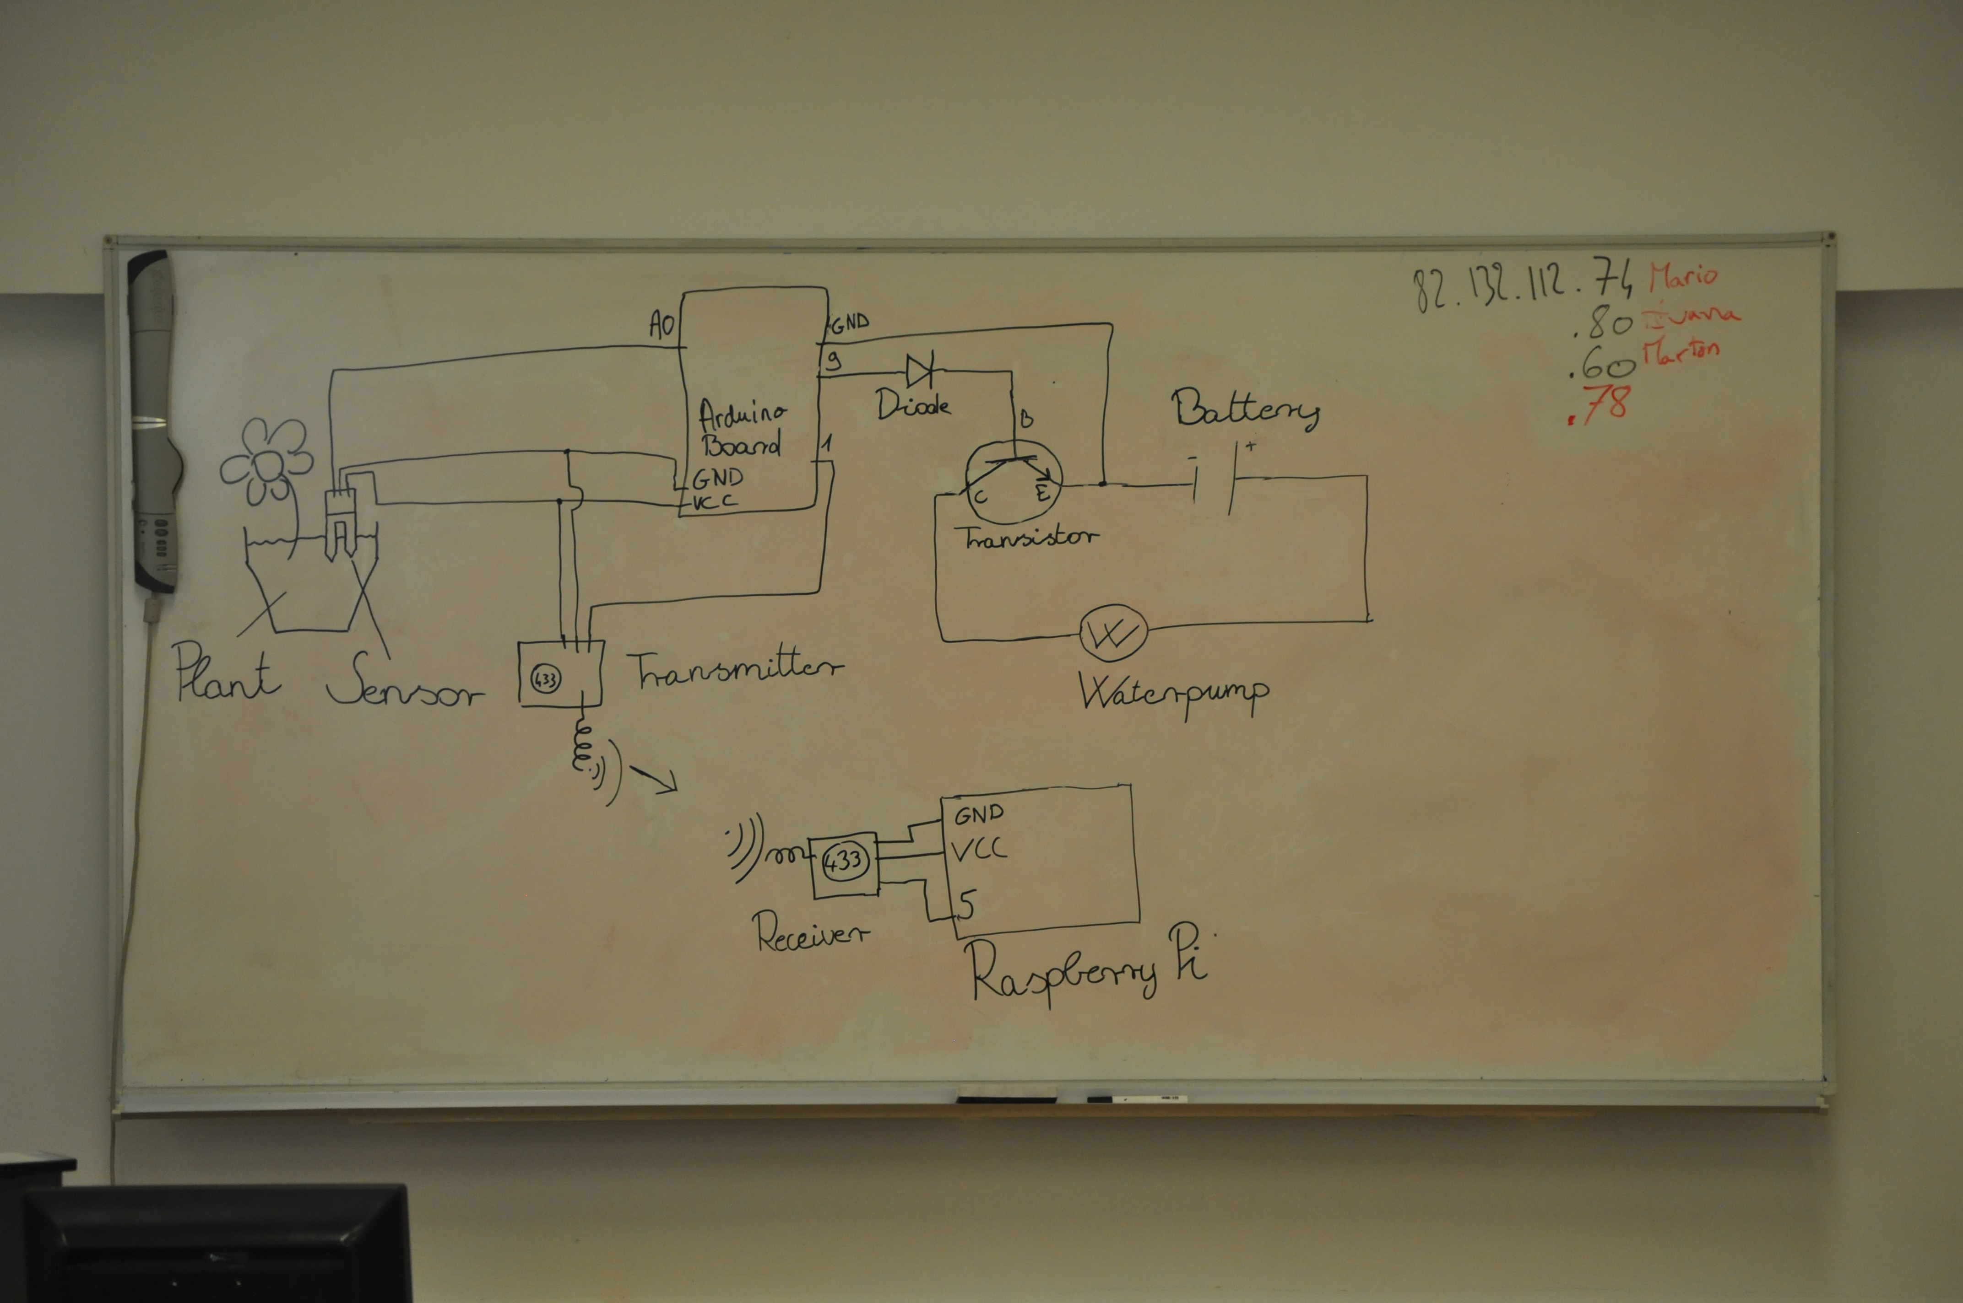
Circuit

Slide 8
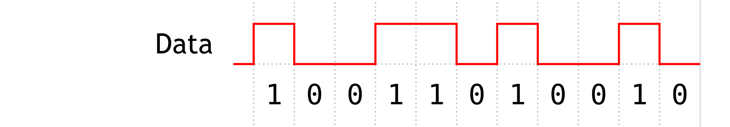
Sending data
Modulation
Analog Digital
On/Off keying
Frequency
Modulation
Amplitude
Modulation

Slide 9
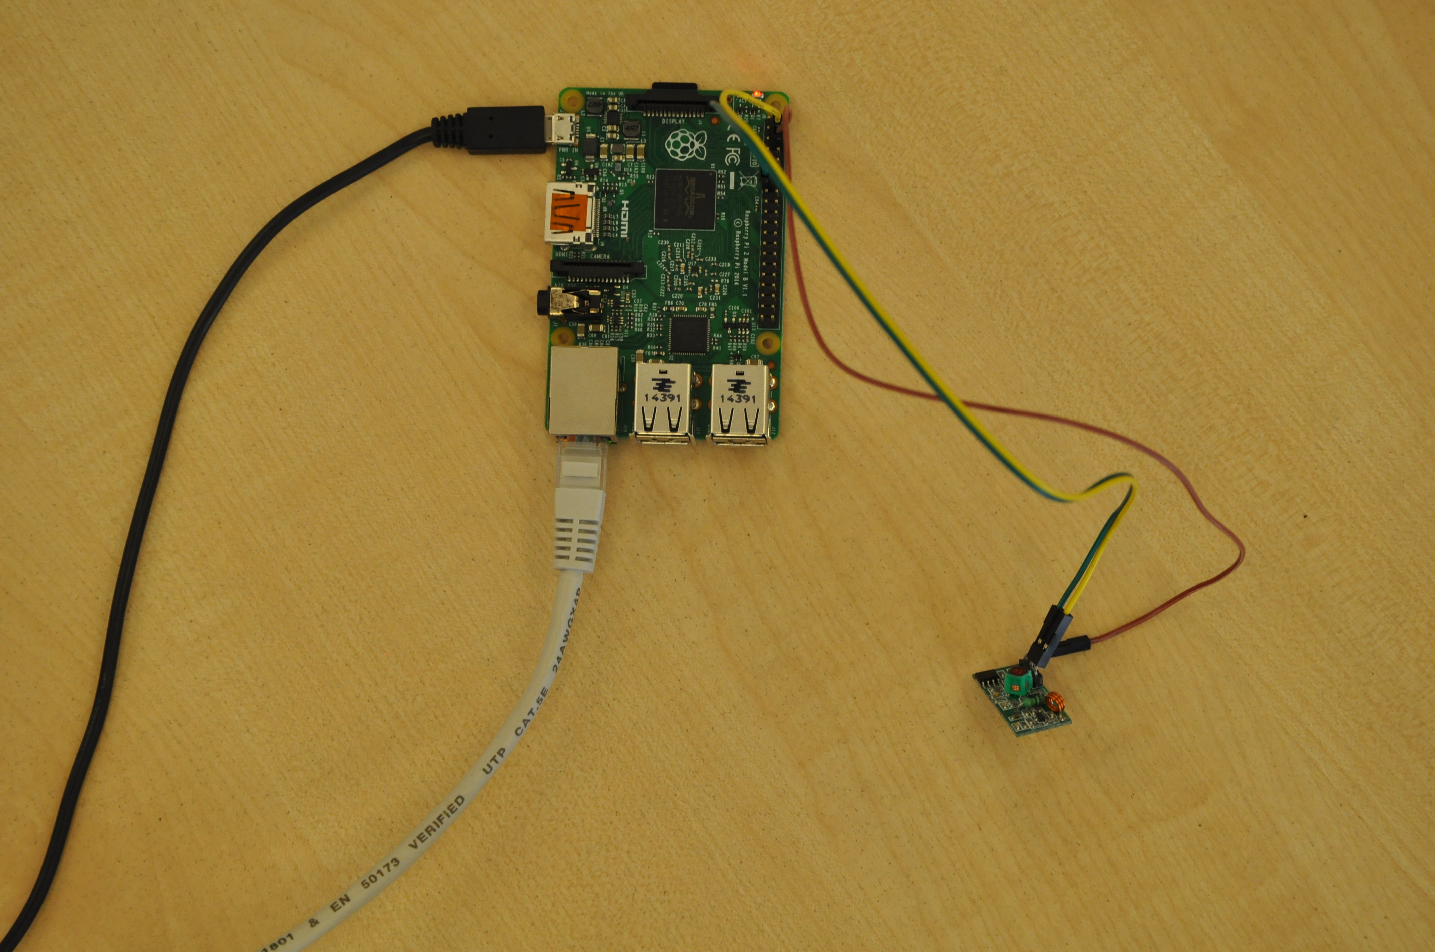

Self-hosting
Raspberry Pi
Notes:
Python > working

Slide 10
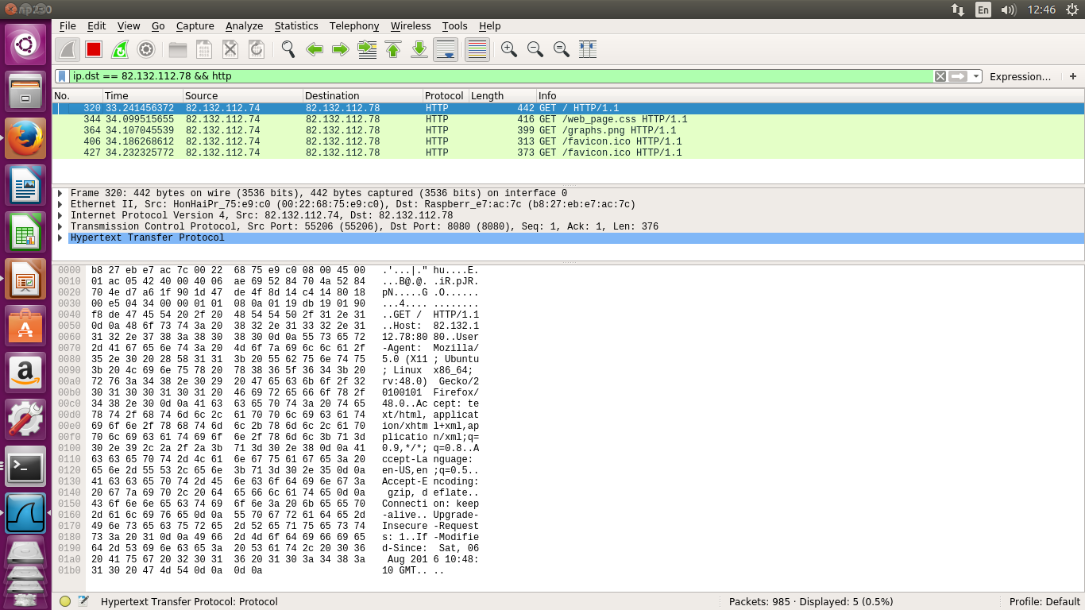
Sniffing
Wireshark
Notes:
HTTP

Slide 11
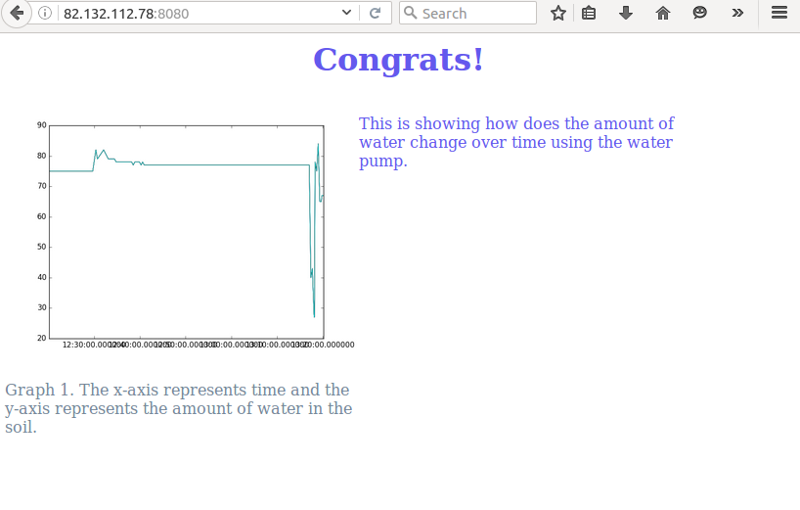
Displaying data
Python
Graph
HTML

Slide 12
Safety - encryption

Slide 13
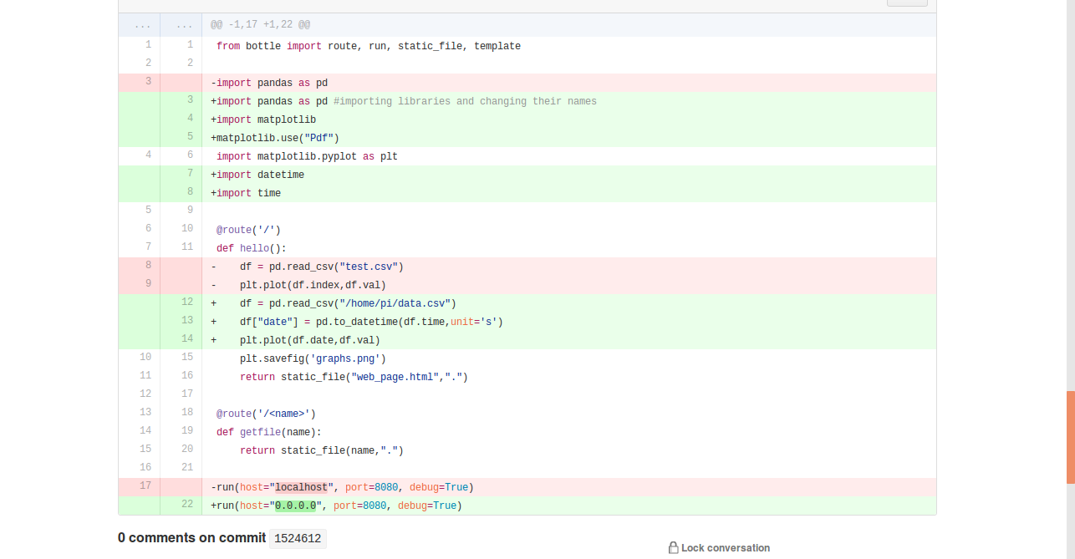


“Reproductible” research

Slide 14
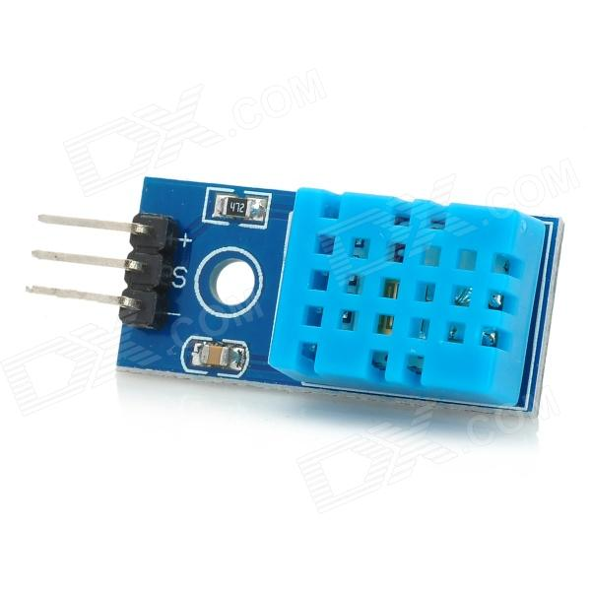
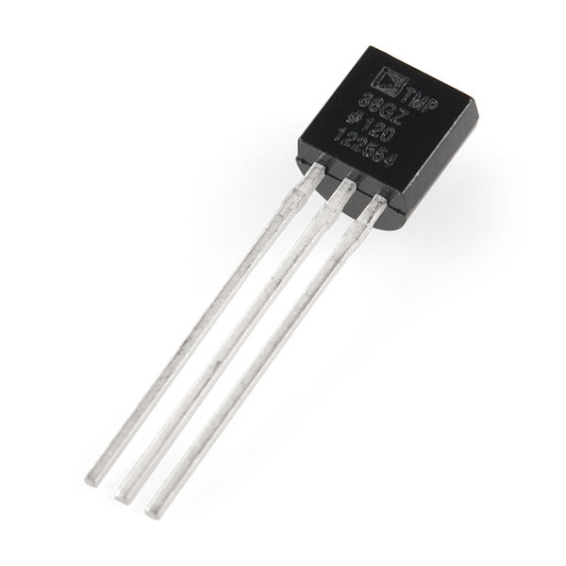
Further plans
Additional sensors
Optimization
User interface

Slide 15
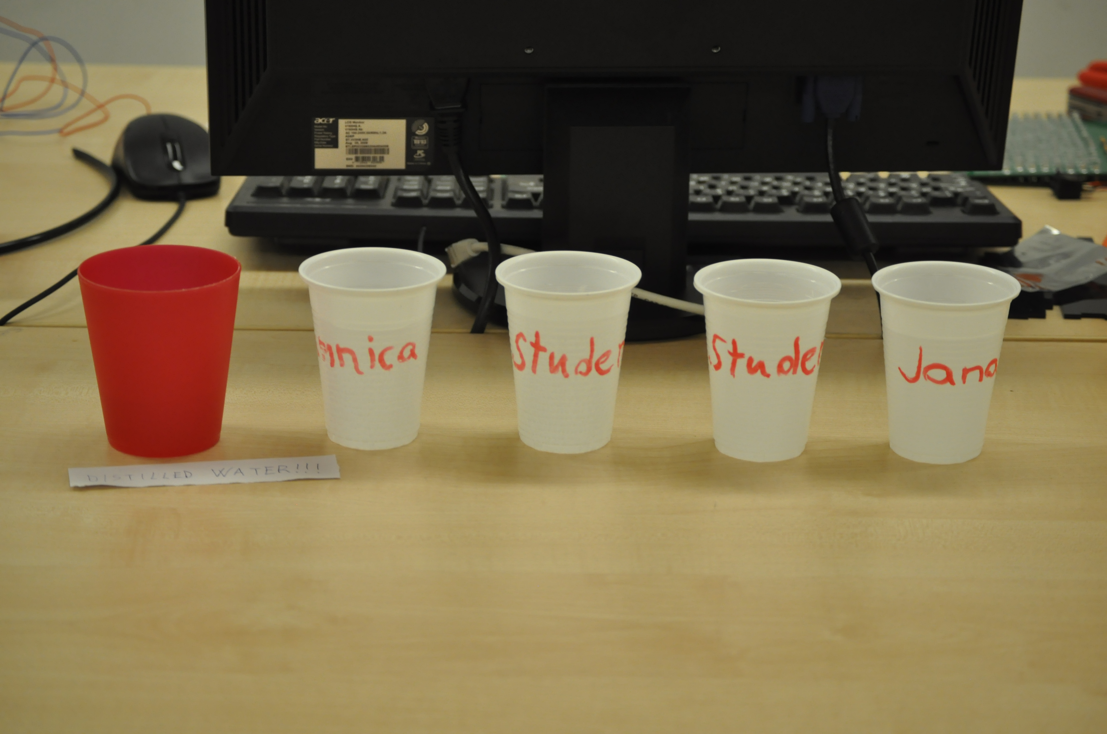
Water testing

Slide 16
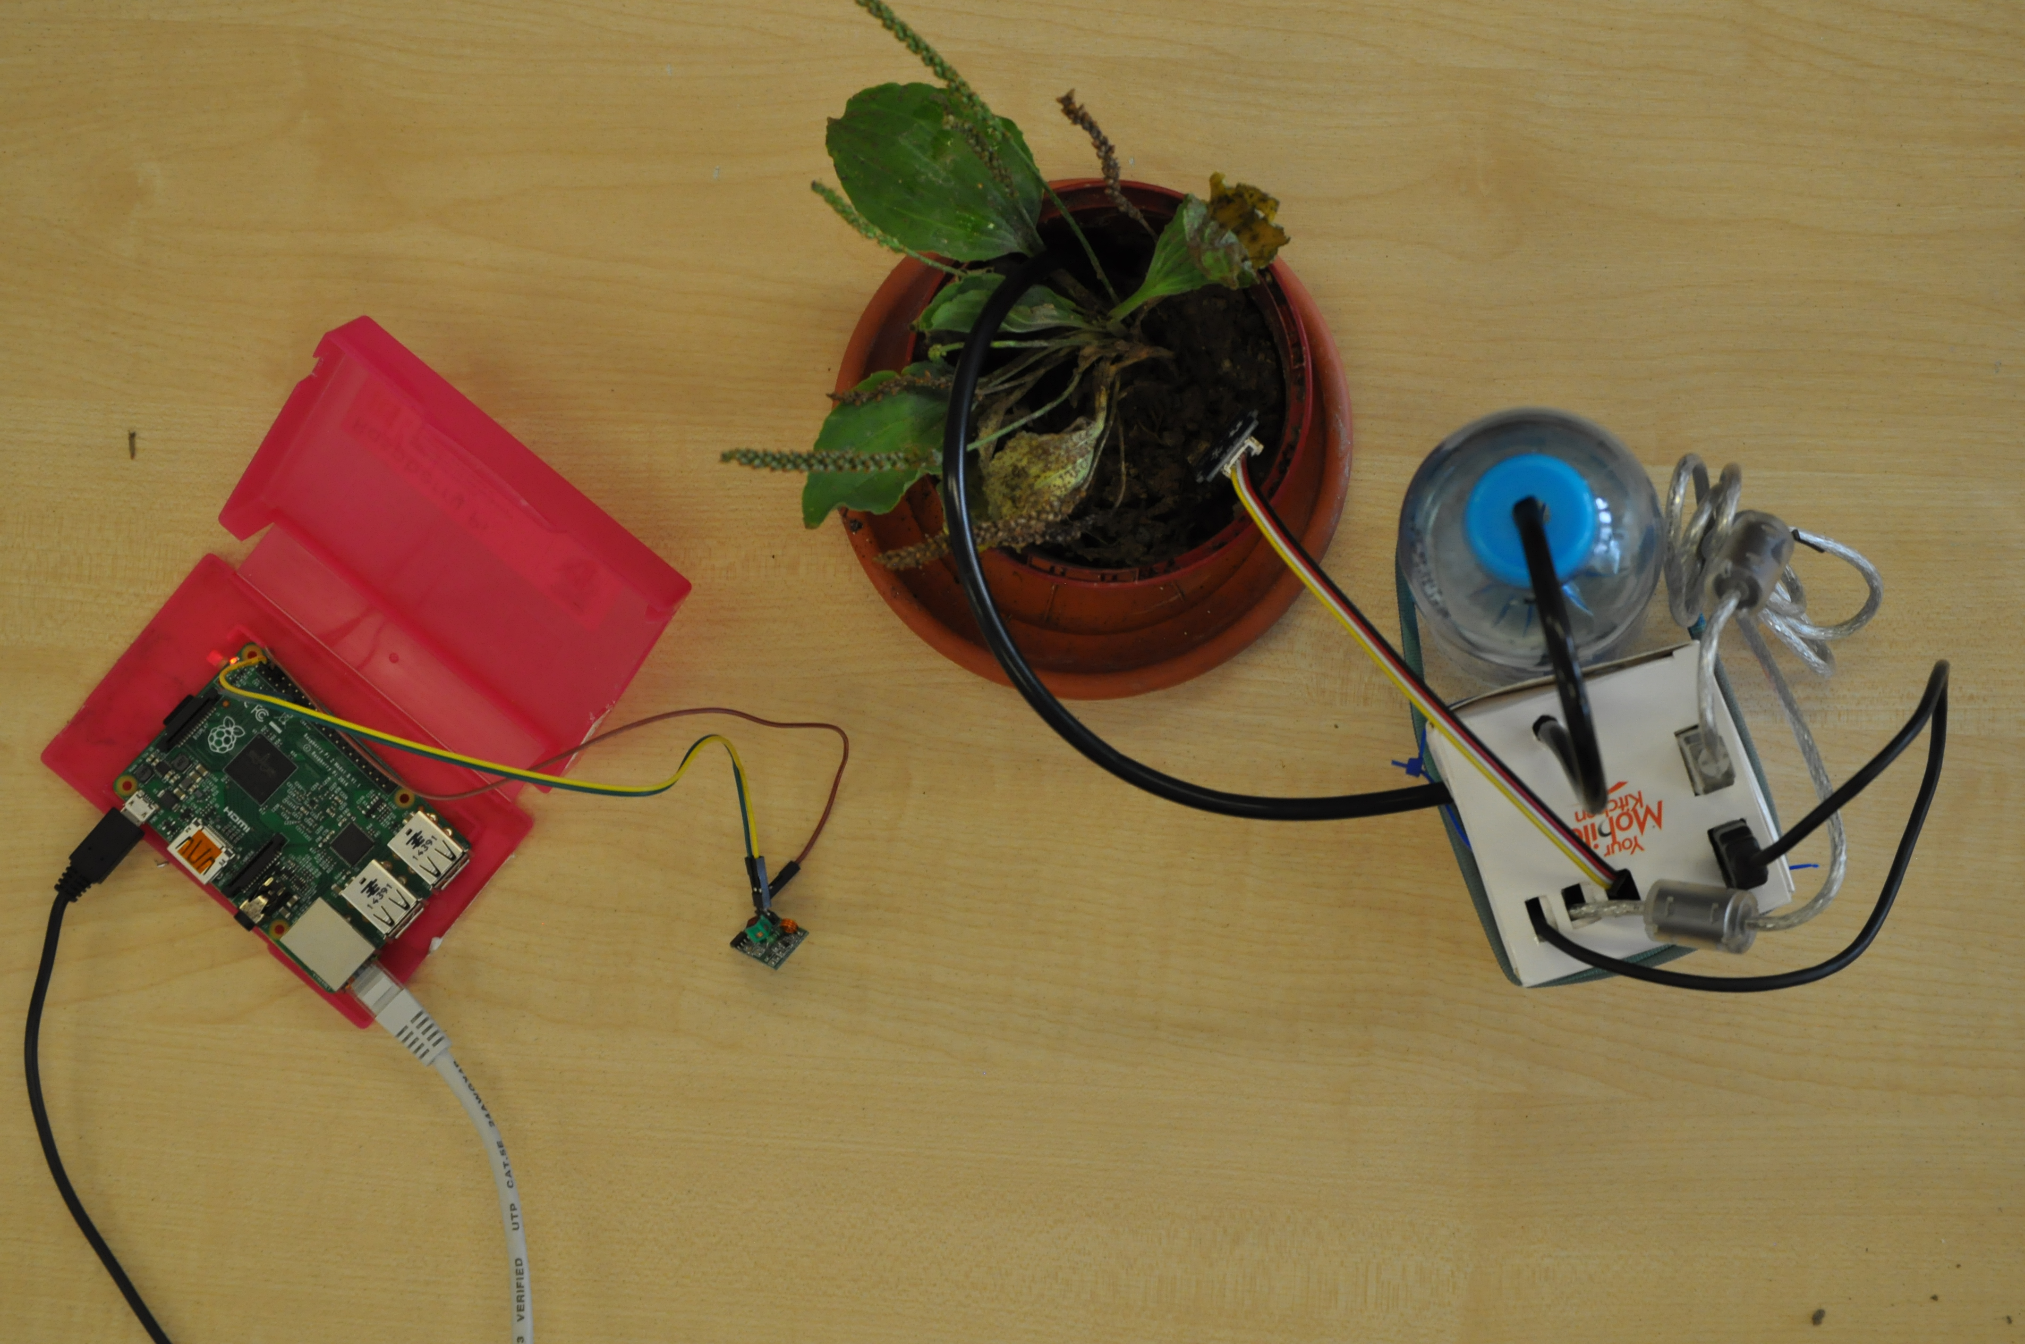
Thank you! Questions?
Notes:
Display a demo with moving graph

